Slide 1
PCMI December Outreach Weekend
9-10 December 2017
Math!

Slide 2
Survivor Time - Morning
URL: go.edc.org/survivor21
What did you notice about the 21-Flags Survivor Game?
Notes:
Pause at 50 seconds.

Slide 3
Games Games Games! What do you notice?
What are your questions?
#12: Losing positions if they differ by 1. Are there any other losing positions?
It was interesting to see at the beginning the different ways folks wrote their work for figuring out the problem.
Notation was a hang-up at first initially, so trying to talk about problems was a challenge. So tasty manipulatives helped.
#8 and #9: the new option changed the winning strategy.
We were able to use modular math when it was just one color. When it went to two colors, we couldn’t do that. How would adding 3 colors change?
We weren’t convinced of the strategy until we modeled the situation. It was fun to work together to come to a common solution. Manipulatives were very helpful.
We did a lot of manipulative use to help with different notation/language until we could establish a common language/notation. We regularly went back to previous problems in light of things we saw in new problems.
We got hung up on #5. Why is it there? Can the first pick be the last pick?
#1-9 is Fibonacci (all numbers are Fibonacci – what’s up with that?).
We spent a lot of time trying to prove things. Especially with #4 (different starting numbers).

Slide 4
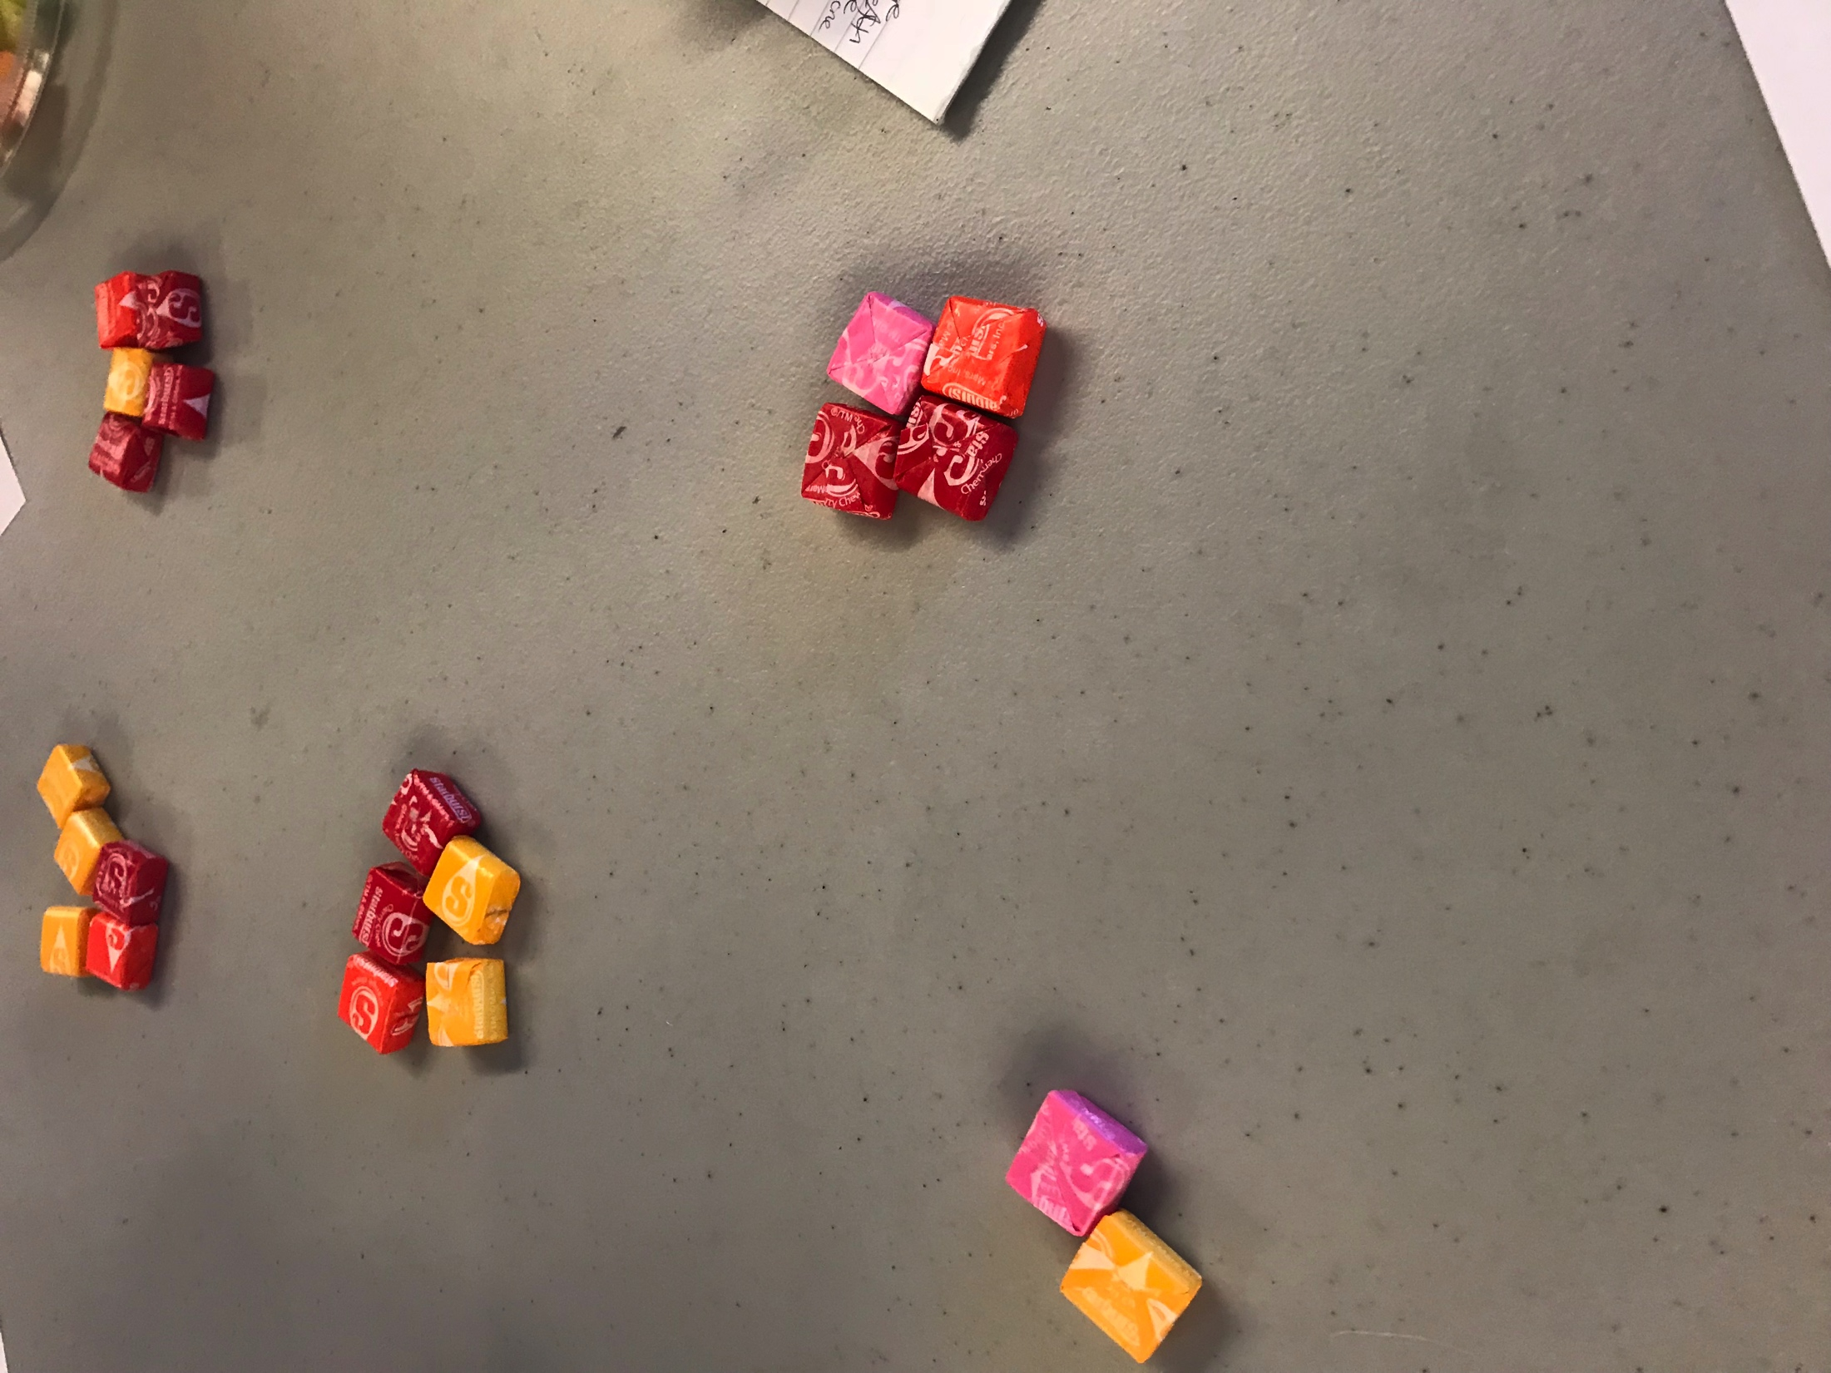
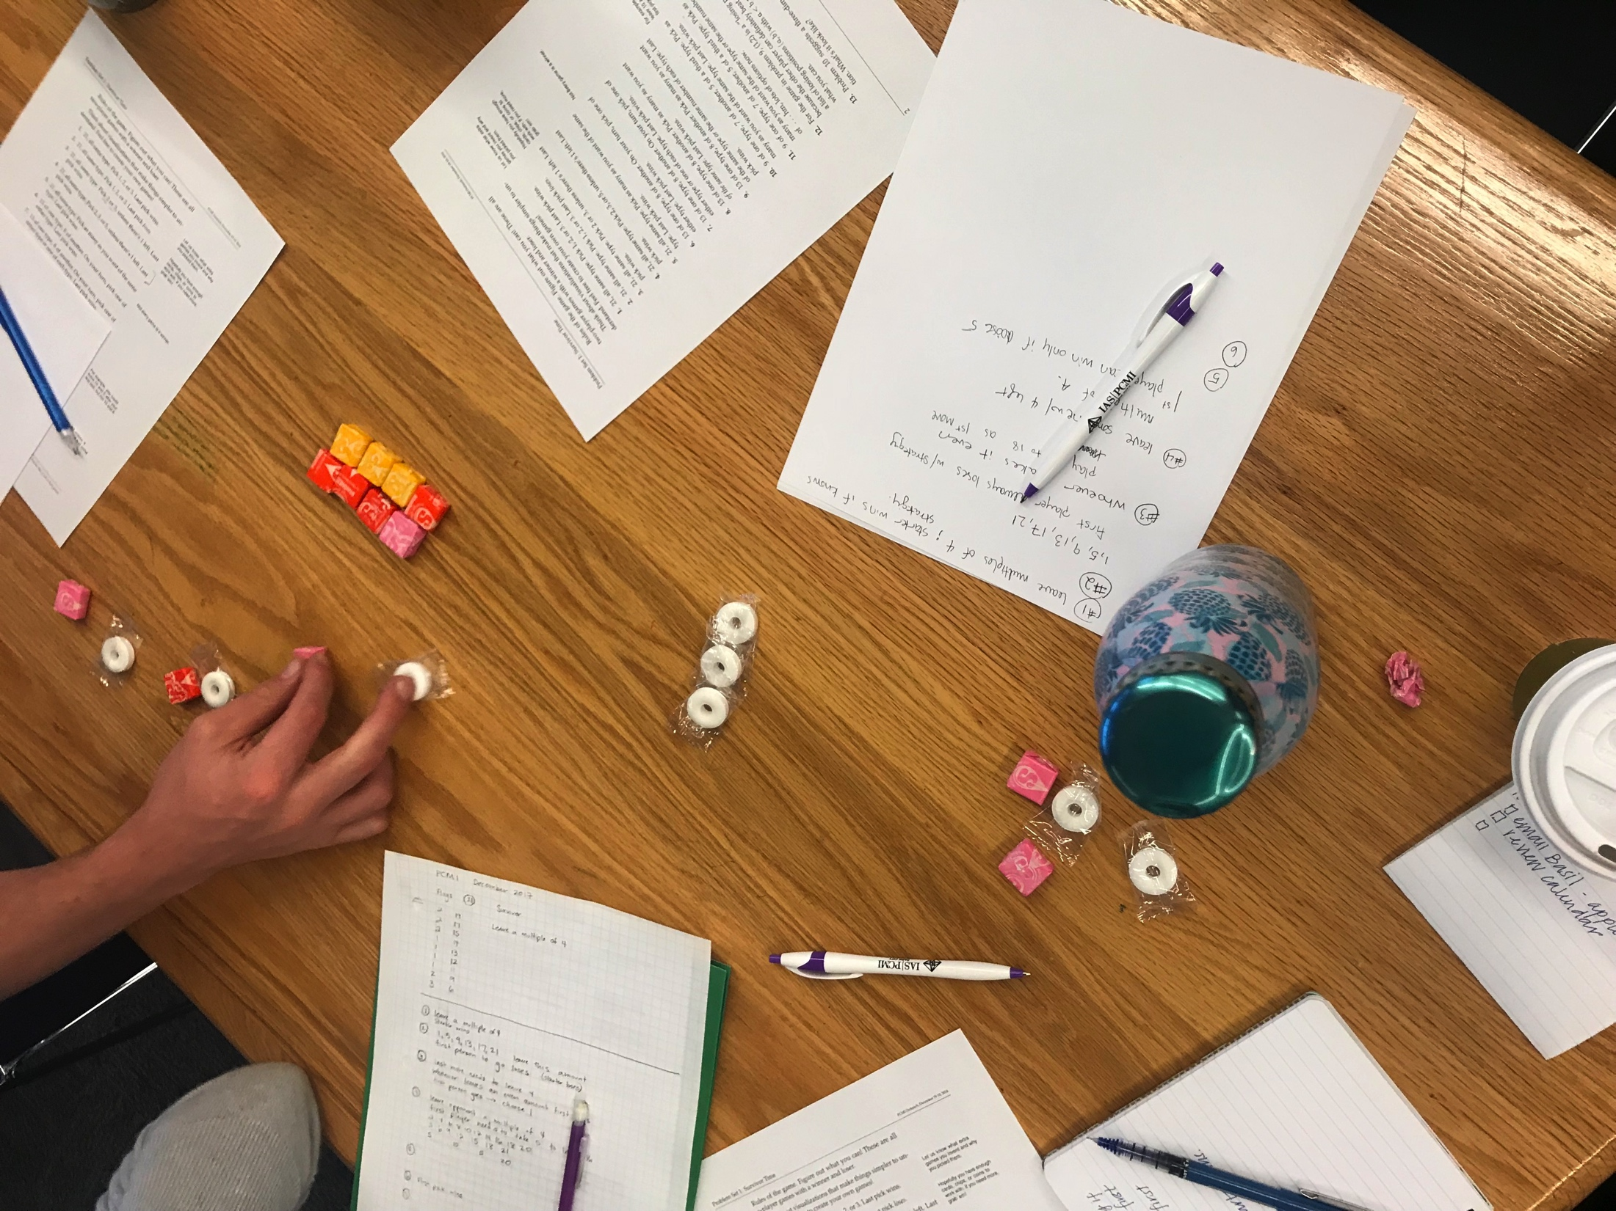
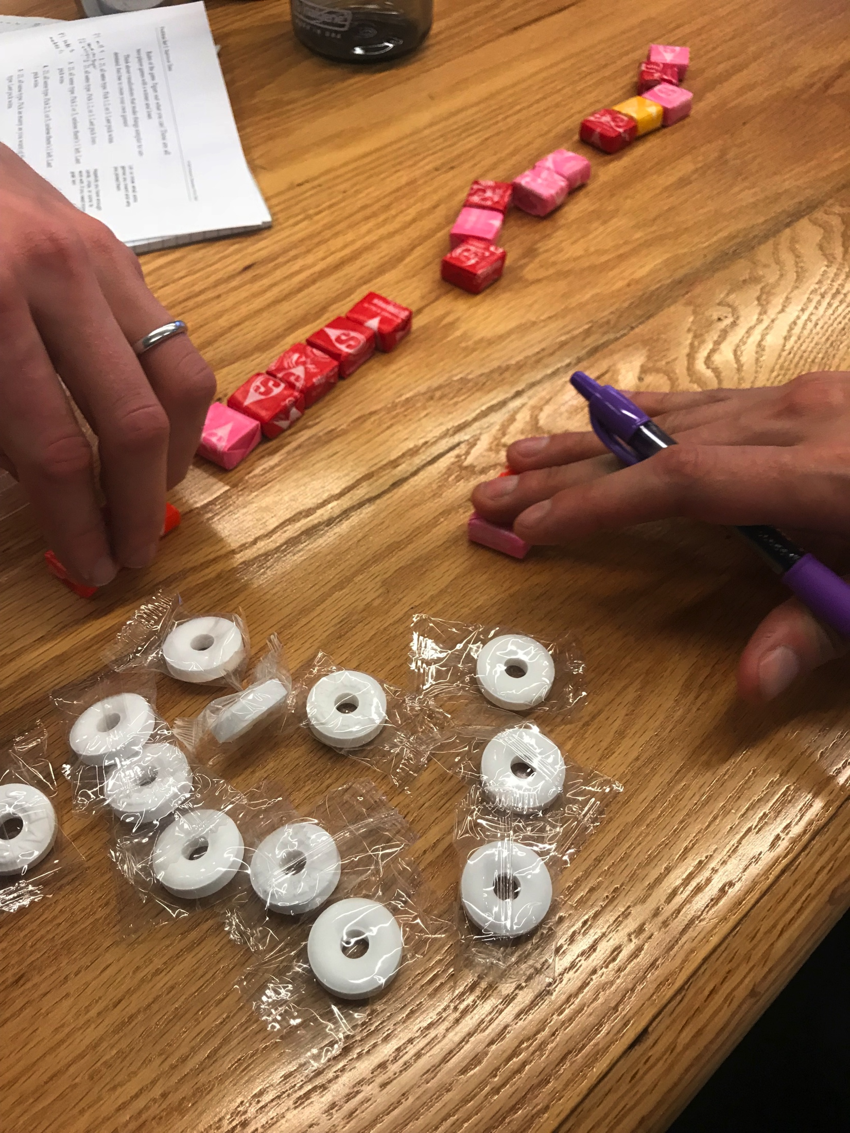
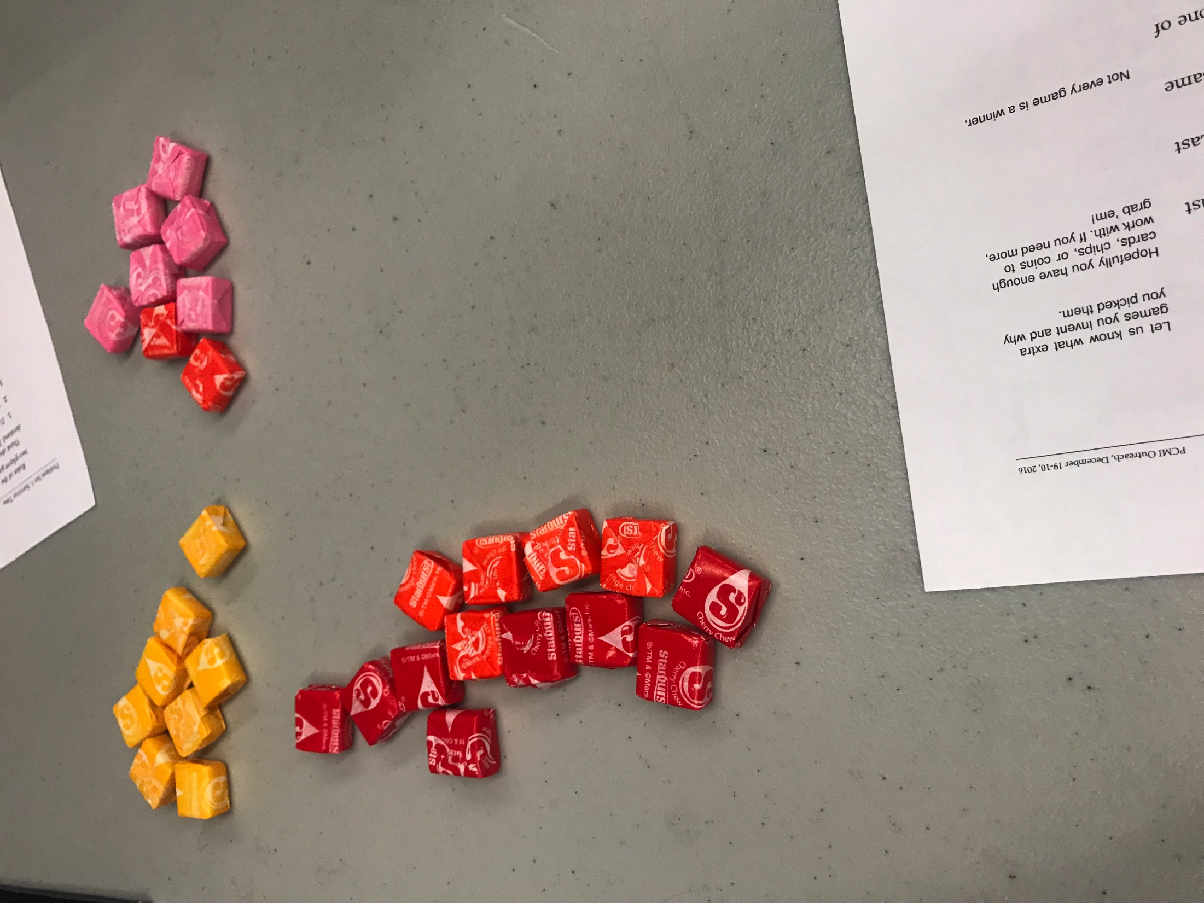
Participant Work

Slide 5
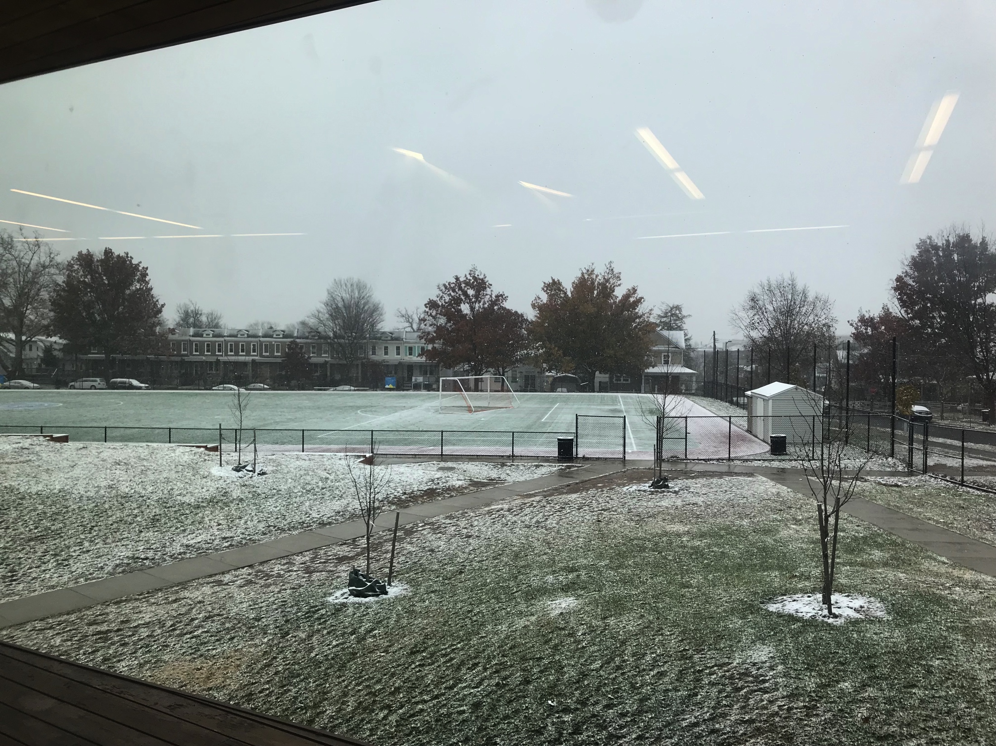
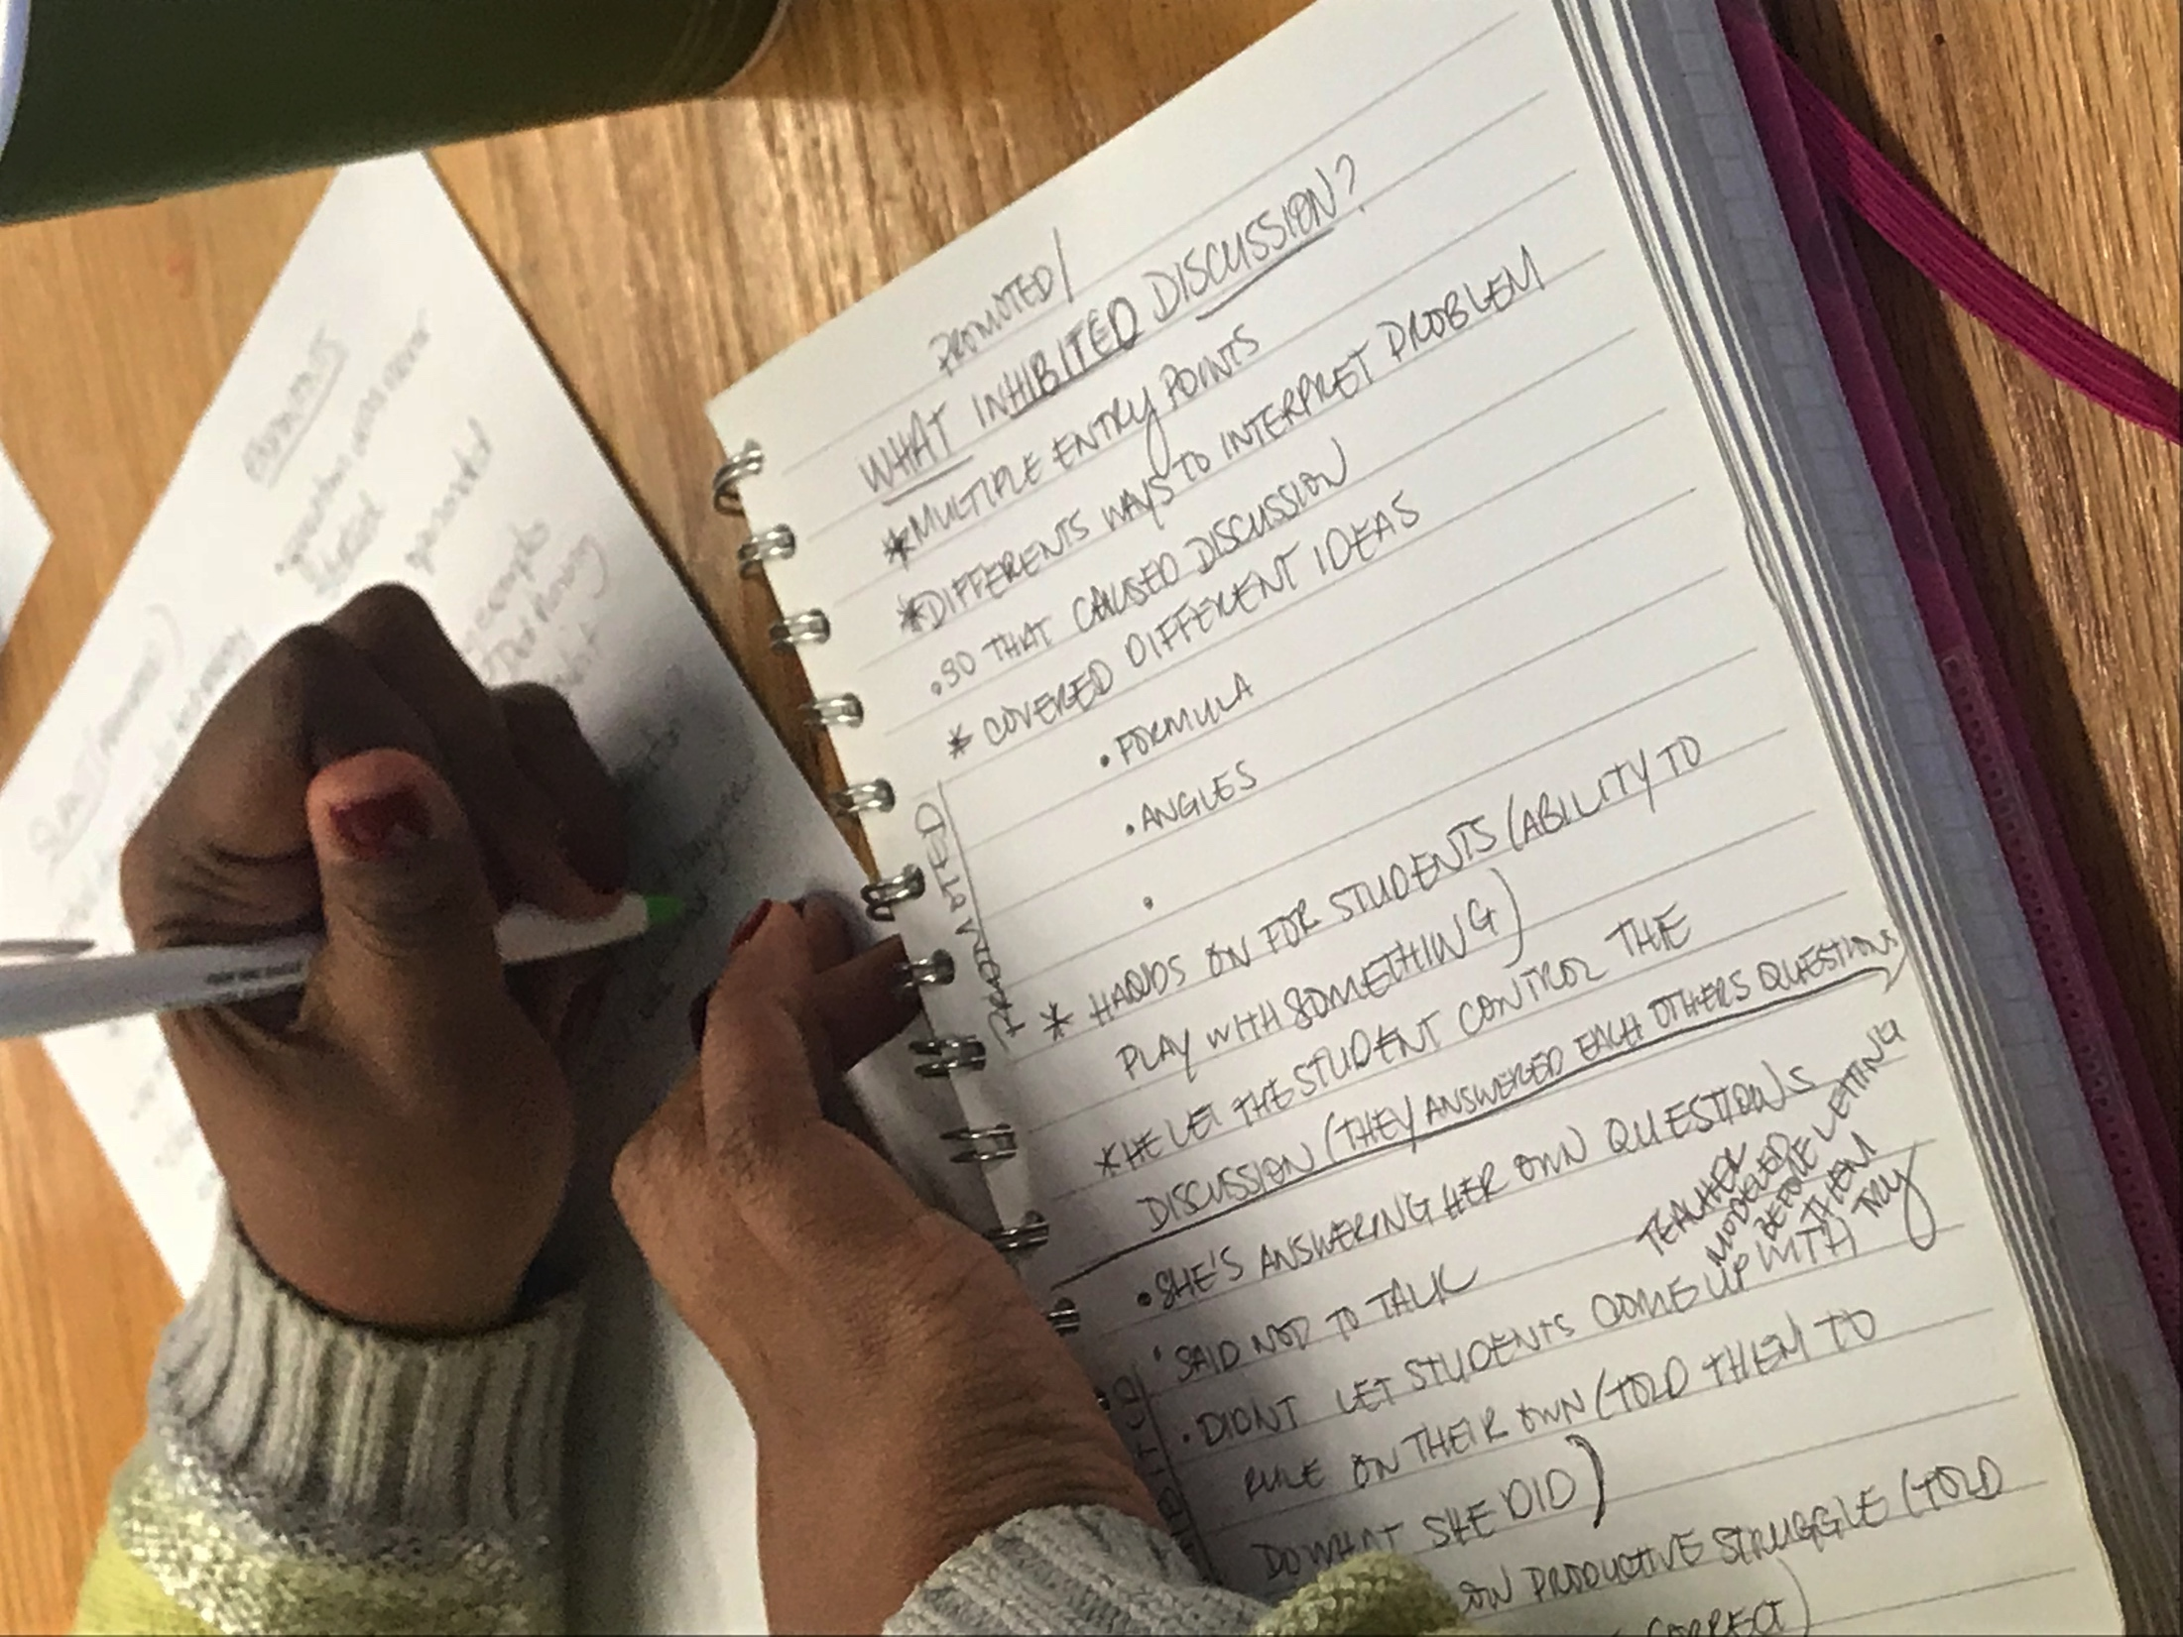
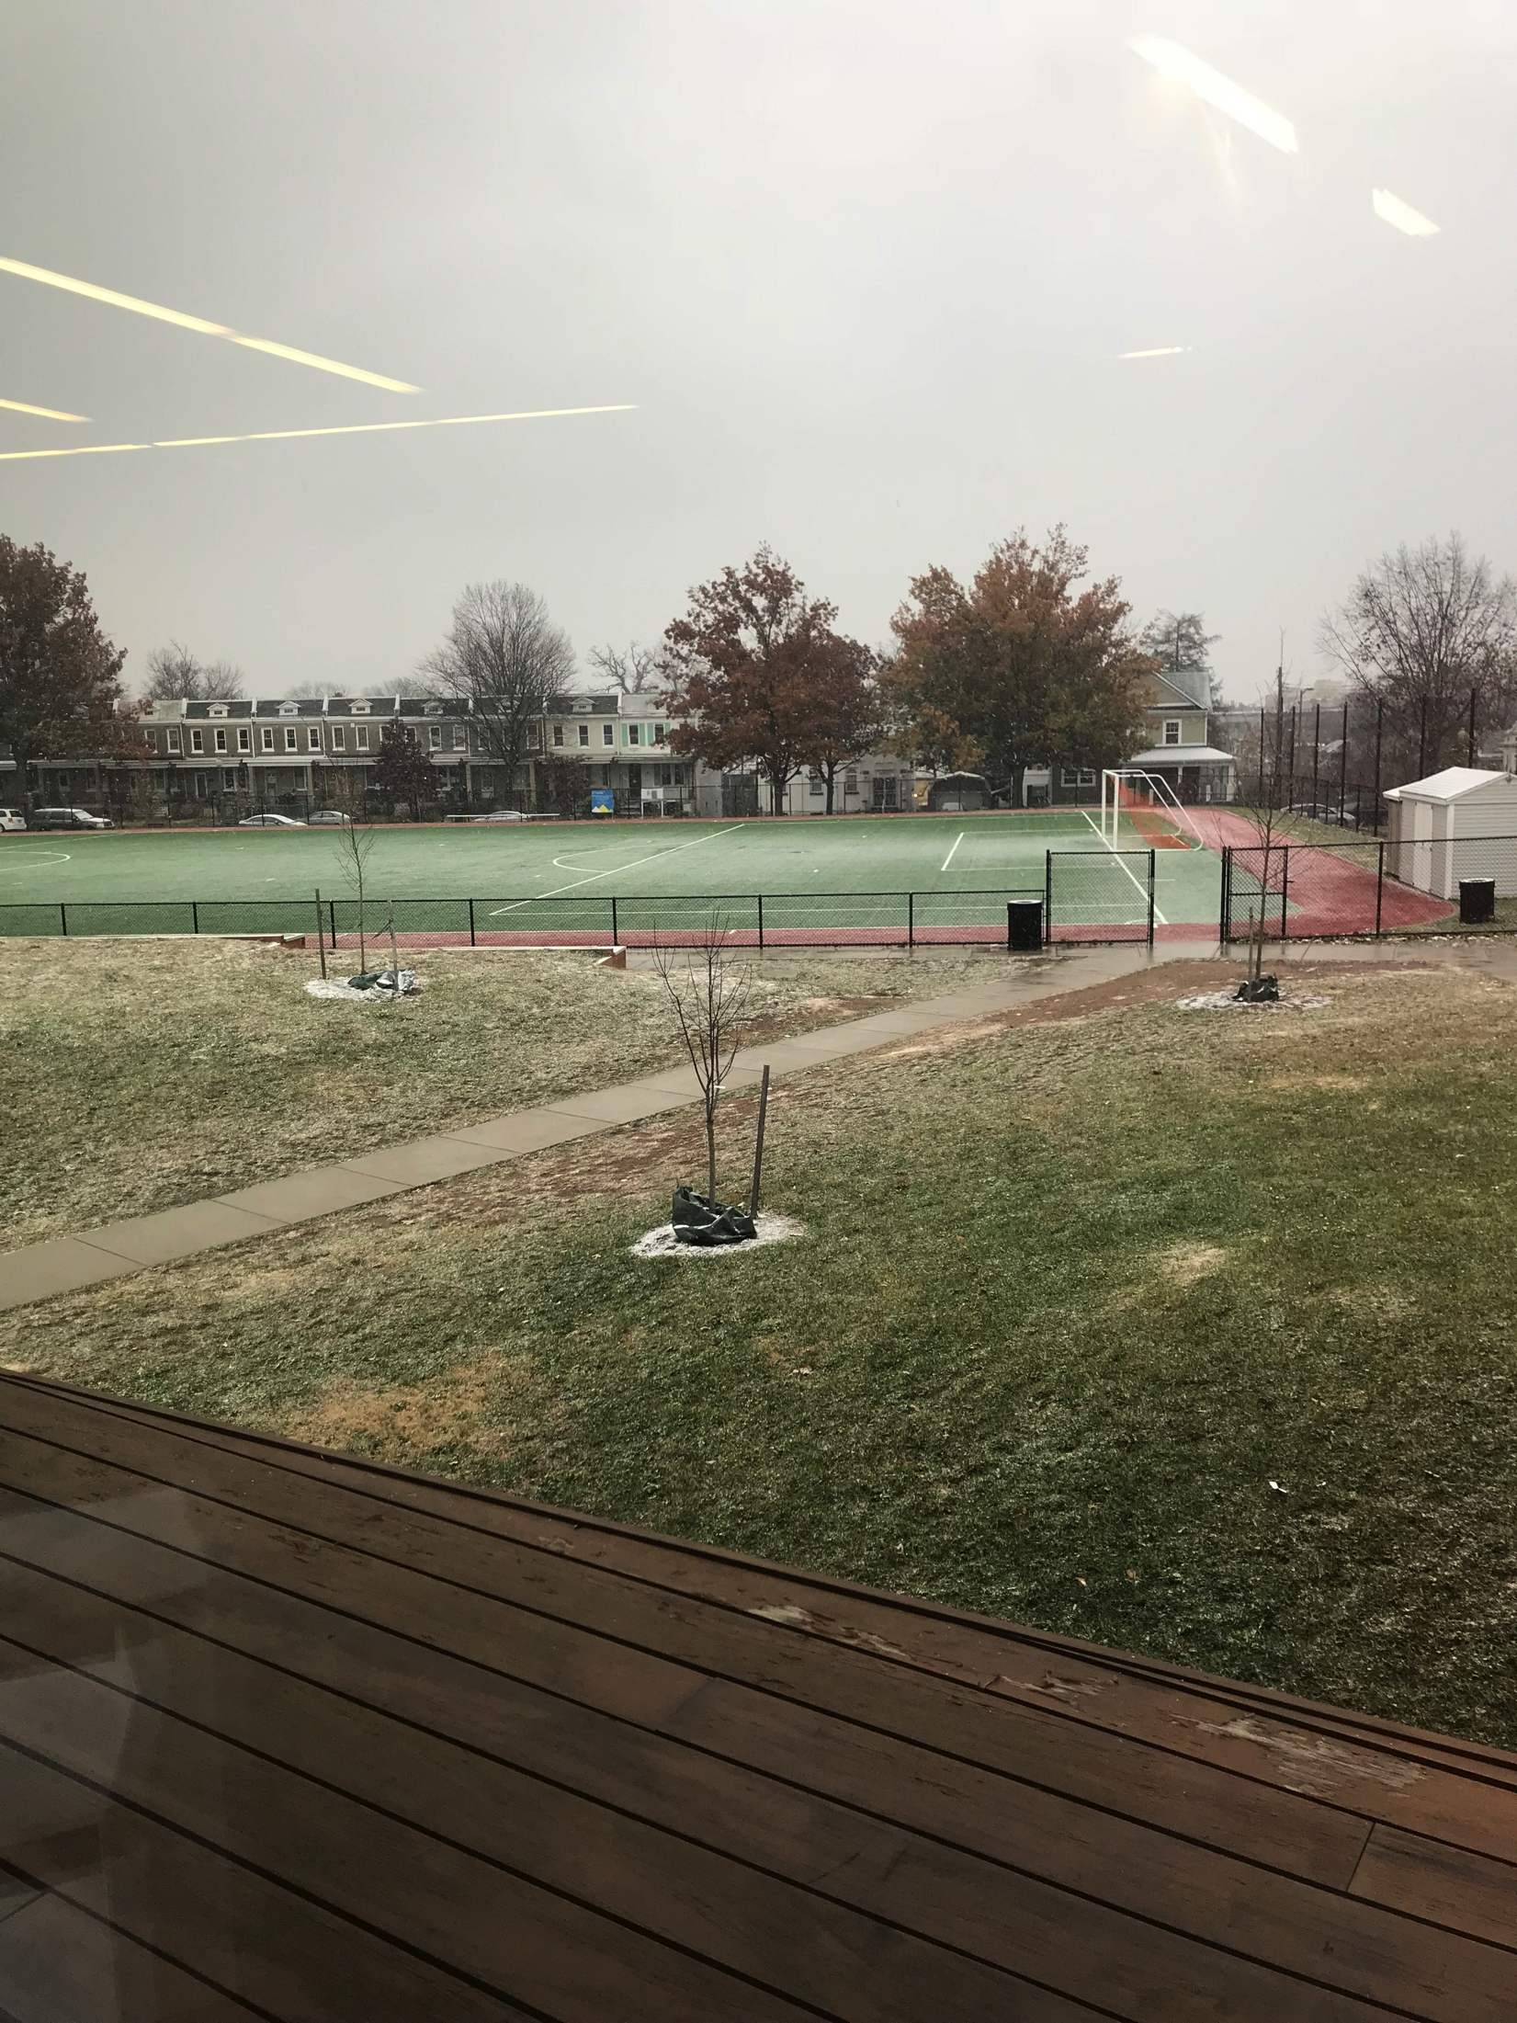
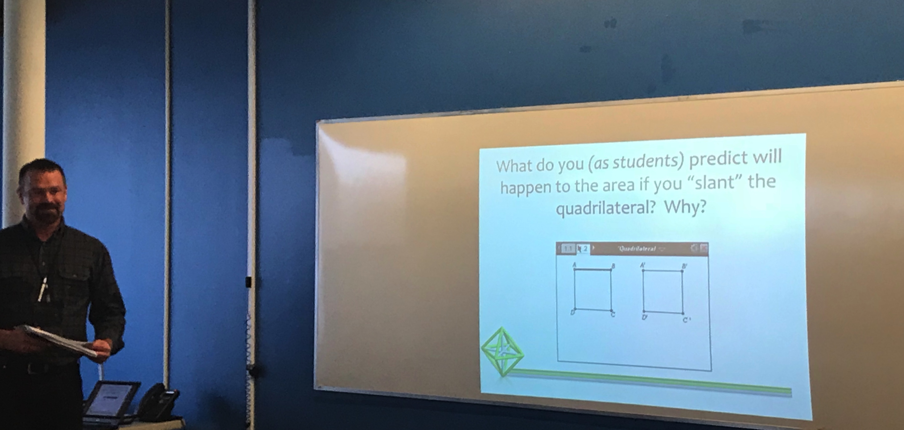
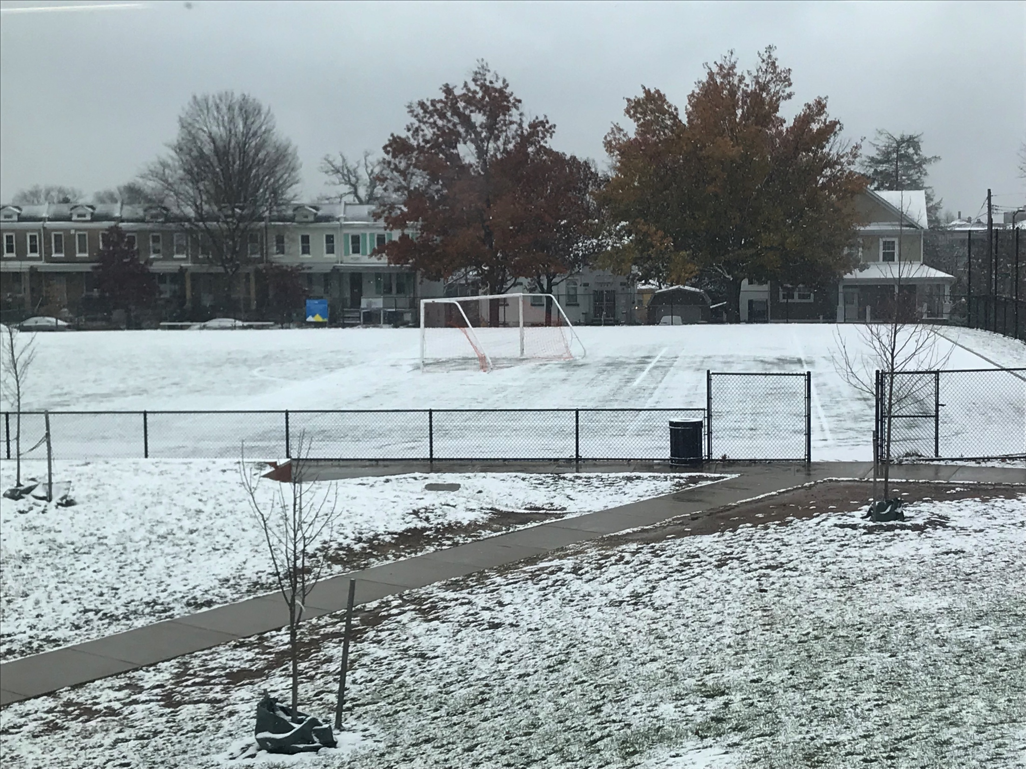
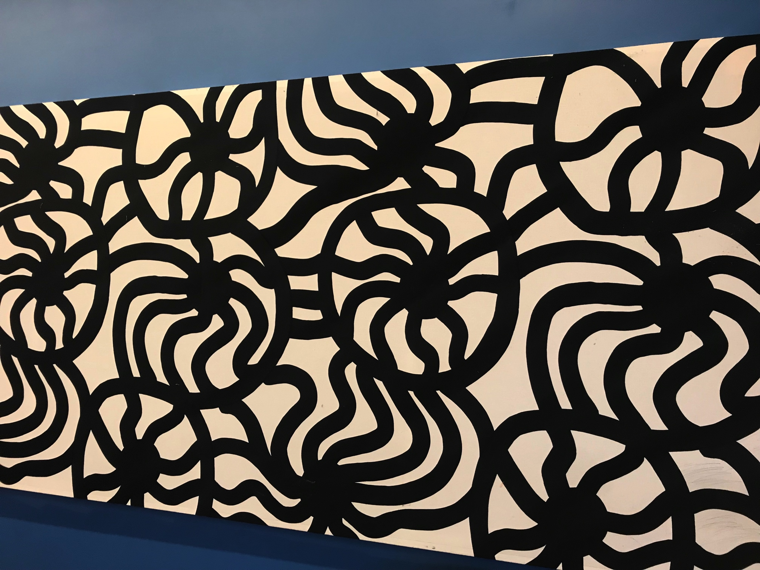

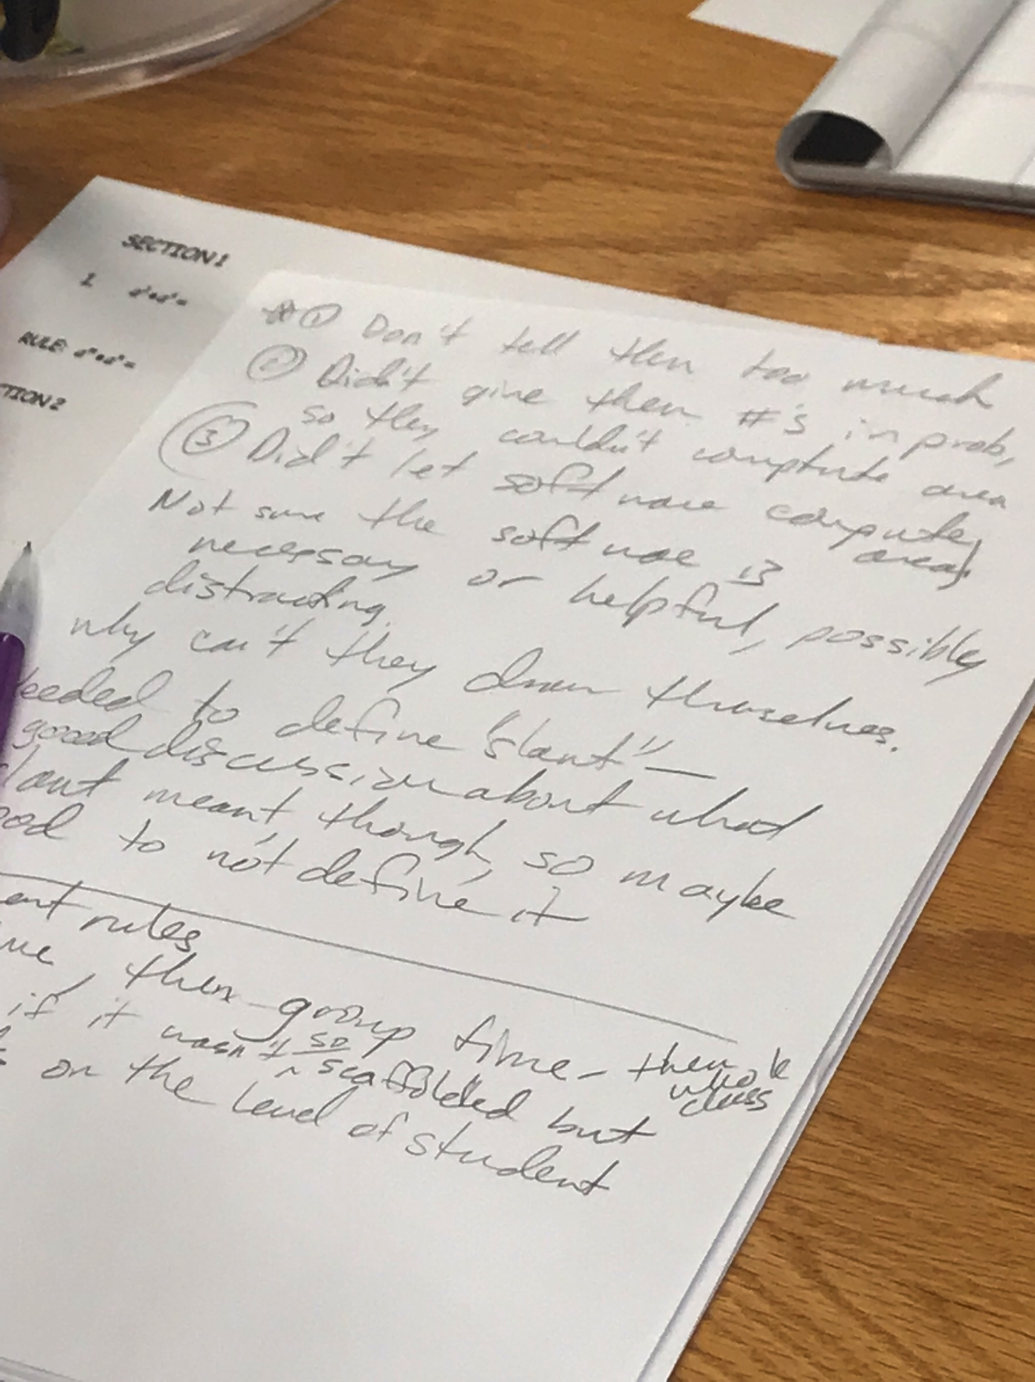
LUNCH TIME!

Slide 6
Survivor Time - Afternoon
What did you notice about the other games? What questions do you have?
#7: No matter what, player 1 will win if they do not pick from the smaller pile.
#10: Similarity to game Nim. You do not want to leave your opponent with a 3-2-1 combination.
We spent a lot of time trying to figure out how to make Player 1 win.
Seems like player 2 is going to win, but we are not yet convinced.
We played around with #9. A general theme, want to create an untenable situation for your opponent.
Listed out lose conditions for #9. Wanted to see if we could generate a formula for losing positions.

Slide 7
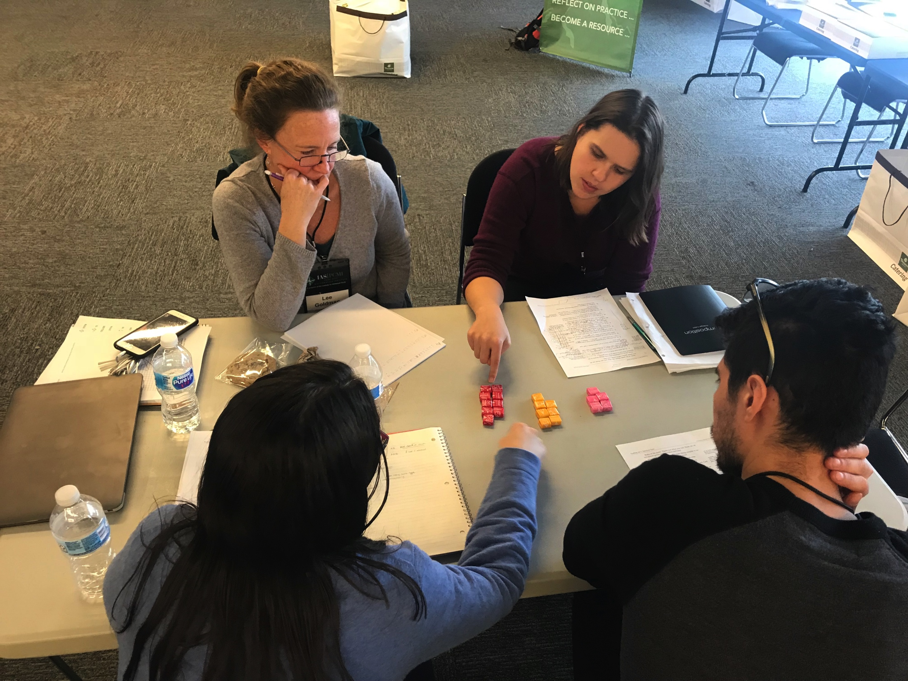
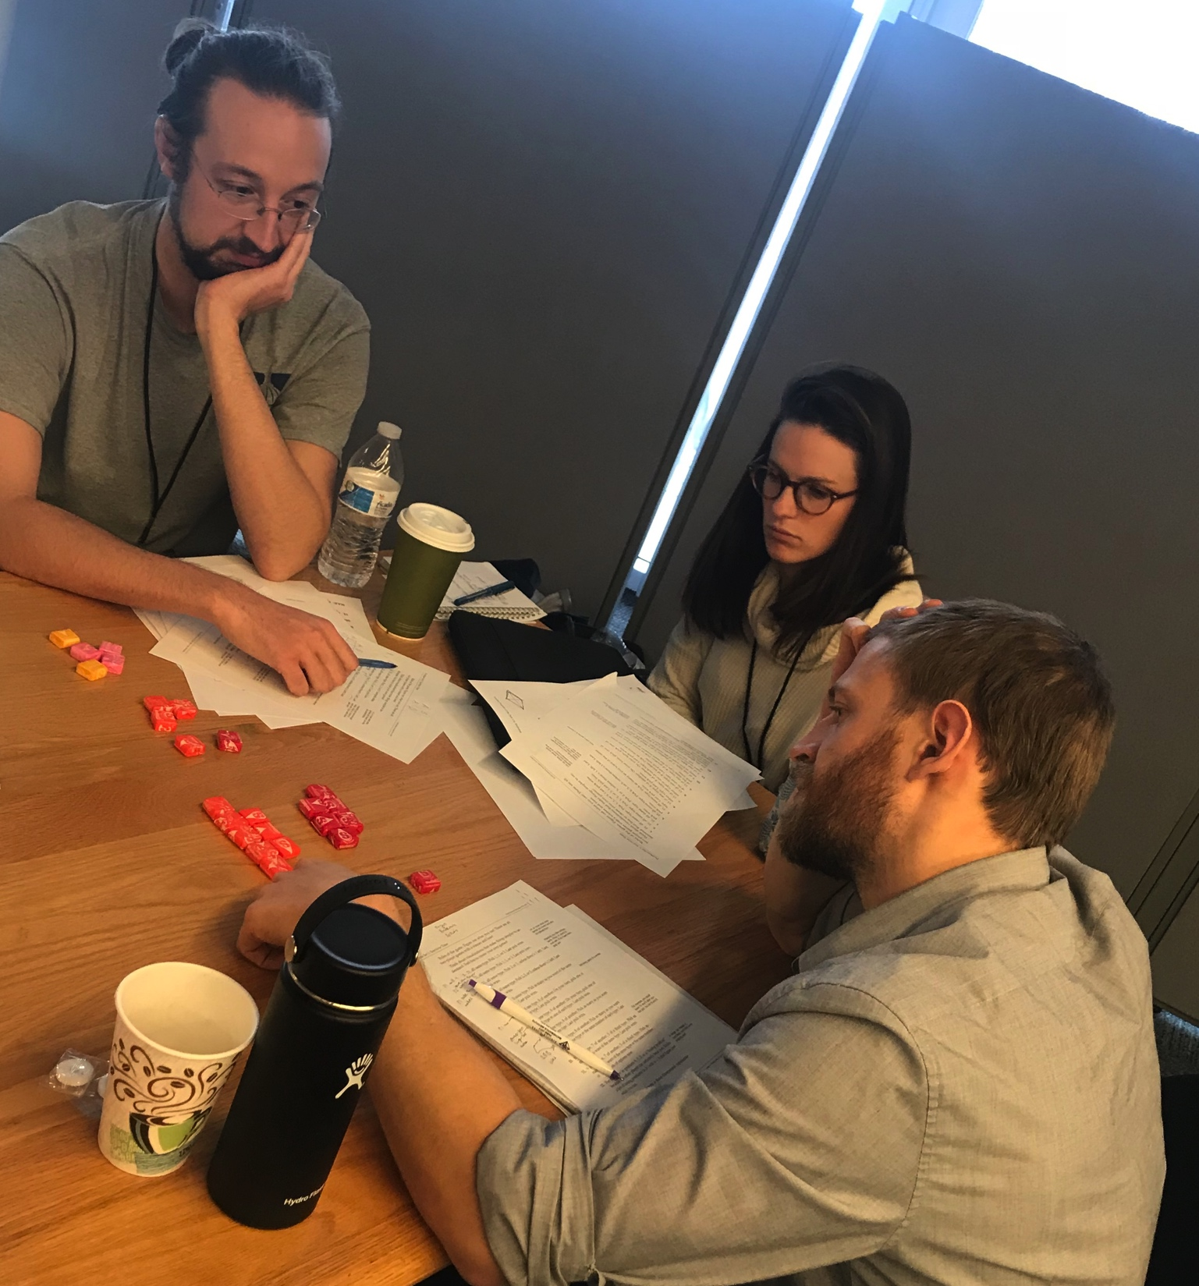

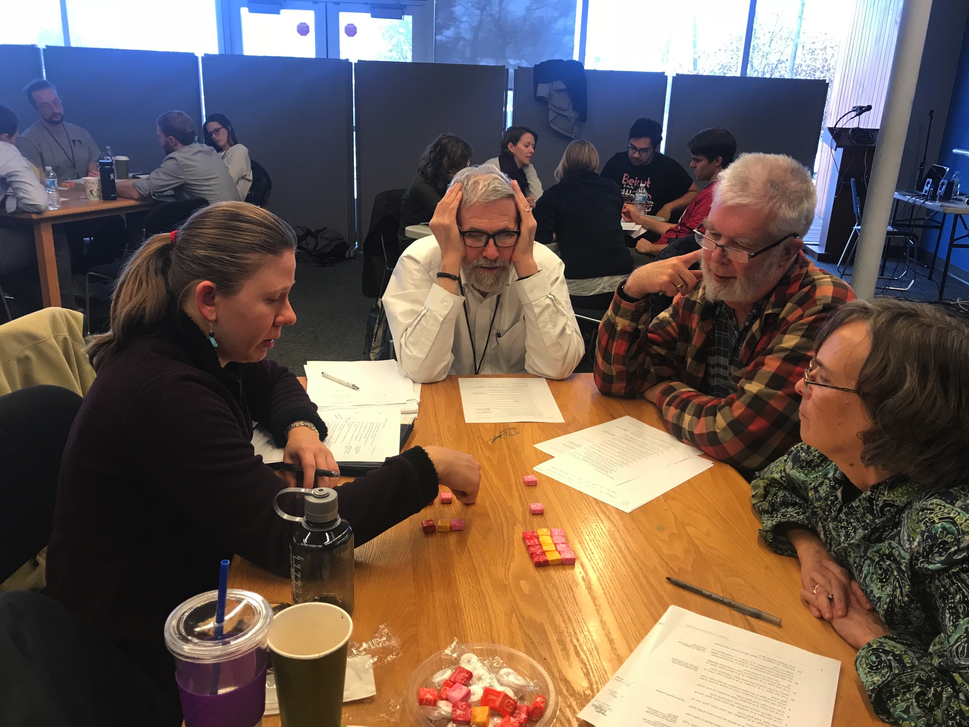
End of Day 1

Slide 8
Chess Time
What do you notice? What questions do you have?
The winner needed to give the loser a combo of evens? (#5 – 3D king).
8 levels up? Is that 8 above the one you are using or a stack of 8? How to relate back to ‘pick from the piles’?
The rook on #5 and connecting to PS1 #10. Did the pile game again. If you’re faced with an equal # in 2 piles you lose. (piles vs type of moves)
3D rook problem: liked piles better than 3D chess. Without revealing anything…we found a solution.
Conversation about language and how a rook moves in 3D. Liked the 3D chess better than the piles. Focused on the idea of having it stacked meant extra moves. Still working… (related to students’ learning experience).
Spent a long time about language with each other. Came up with a system. Tried to define coordinates for the chess board and connect with the piles. Still working…

Slide 9
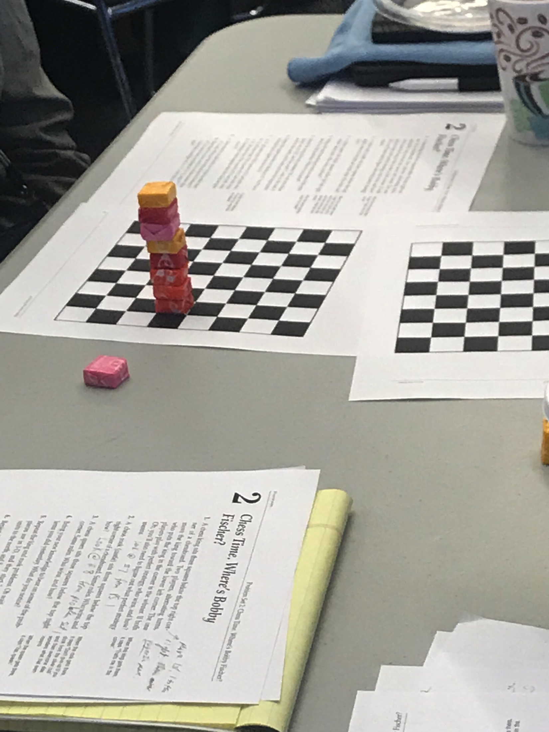
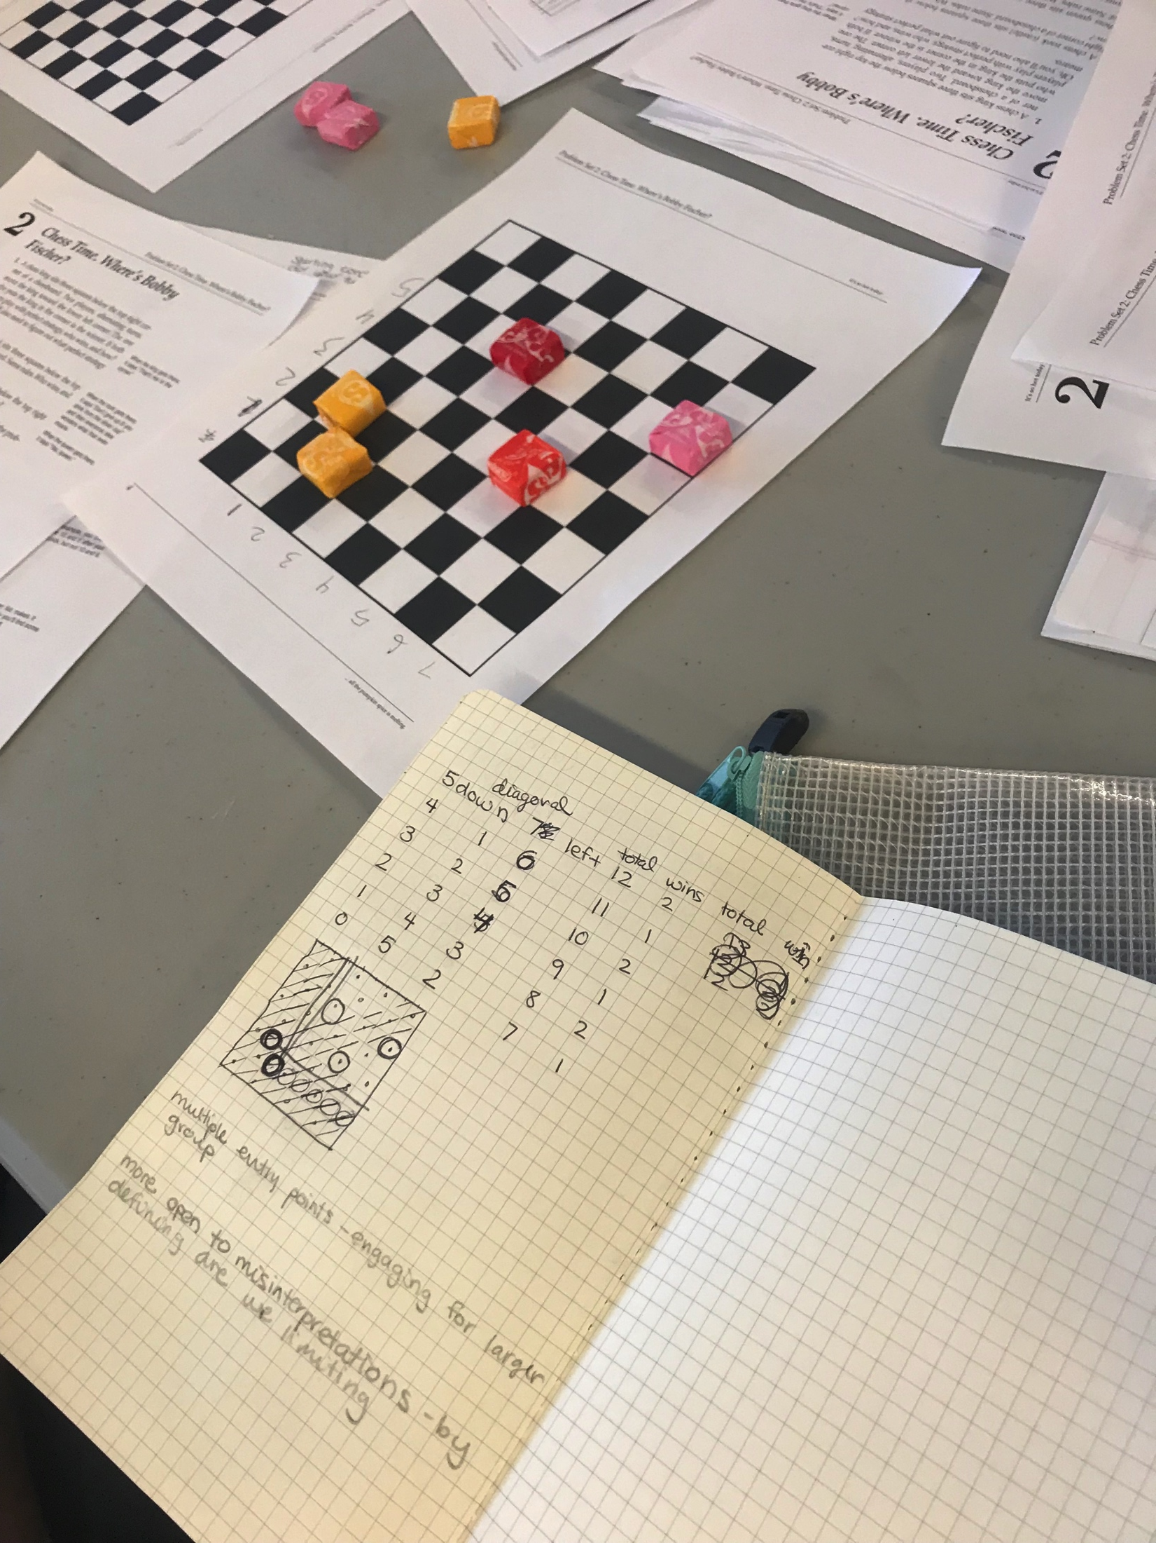
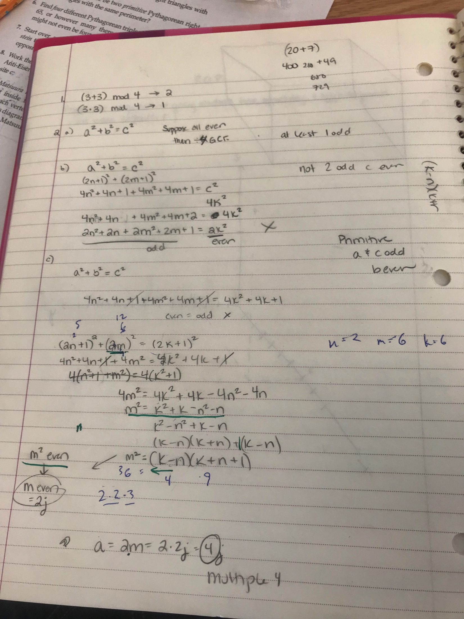
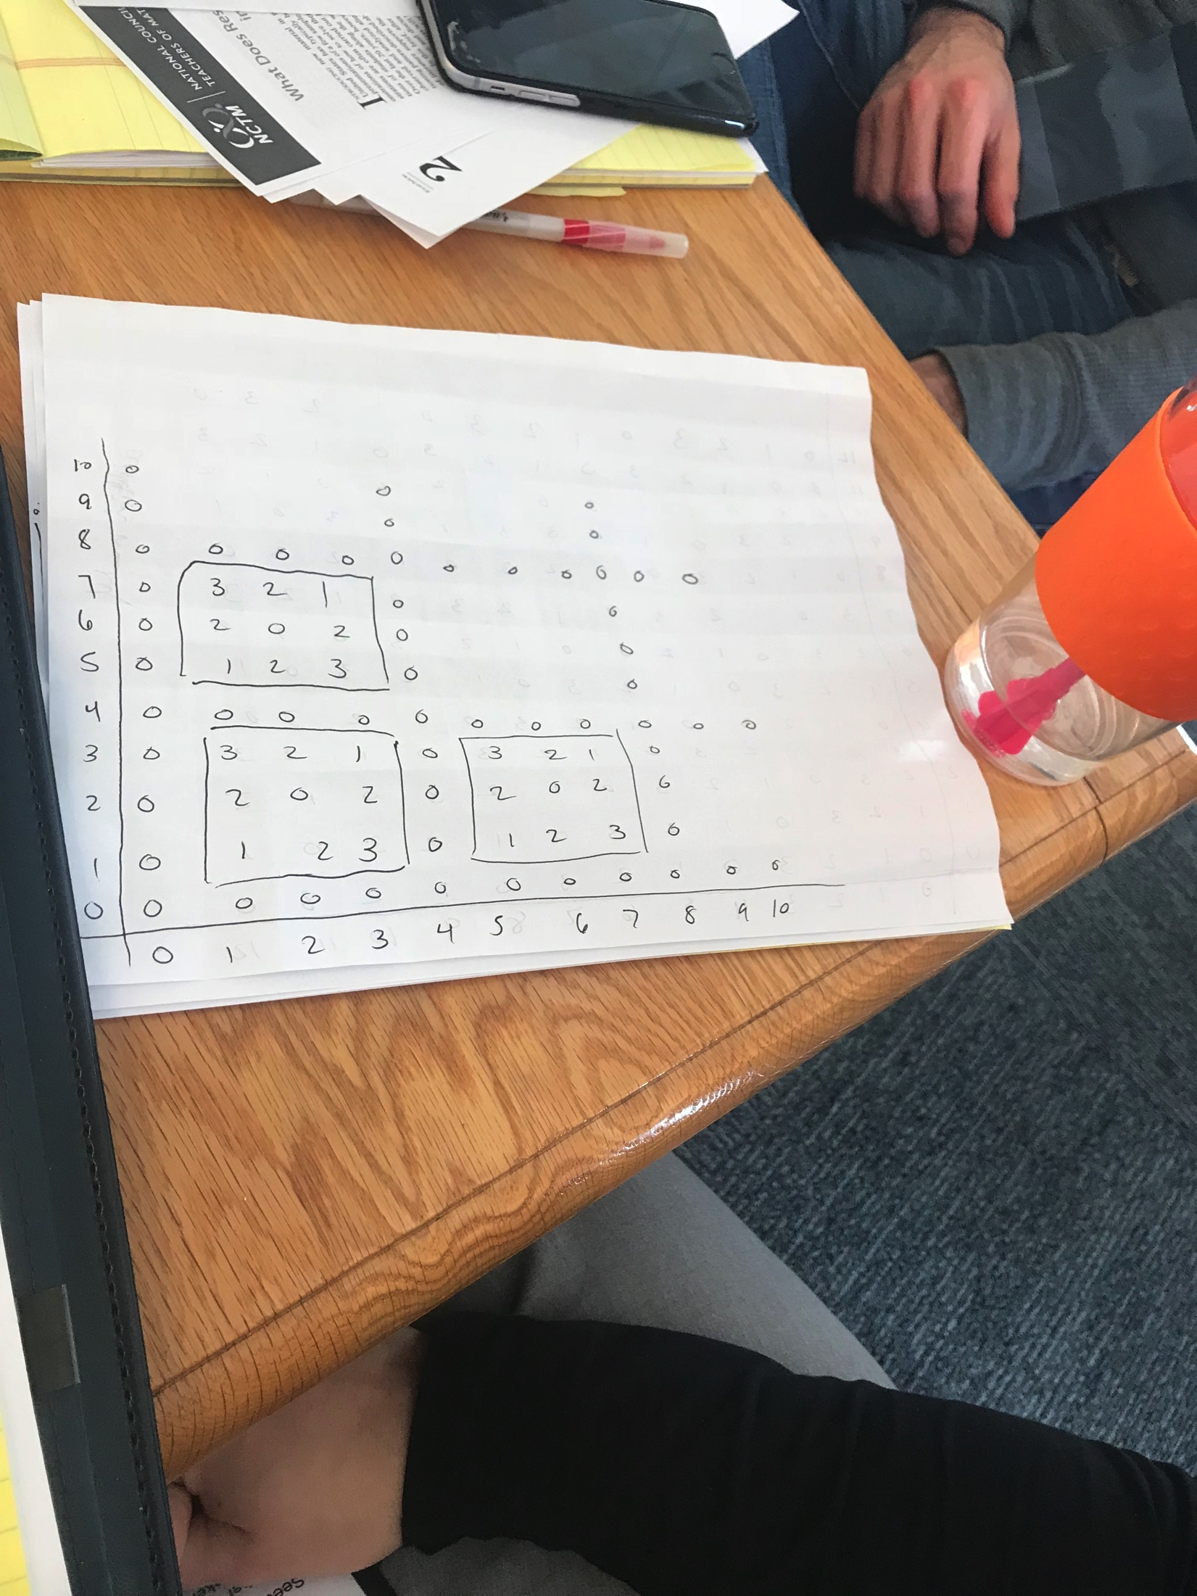
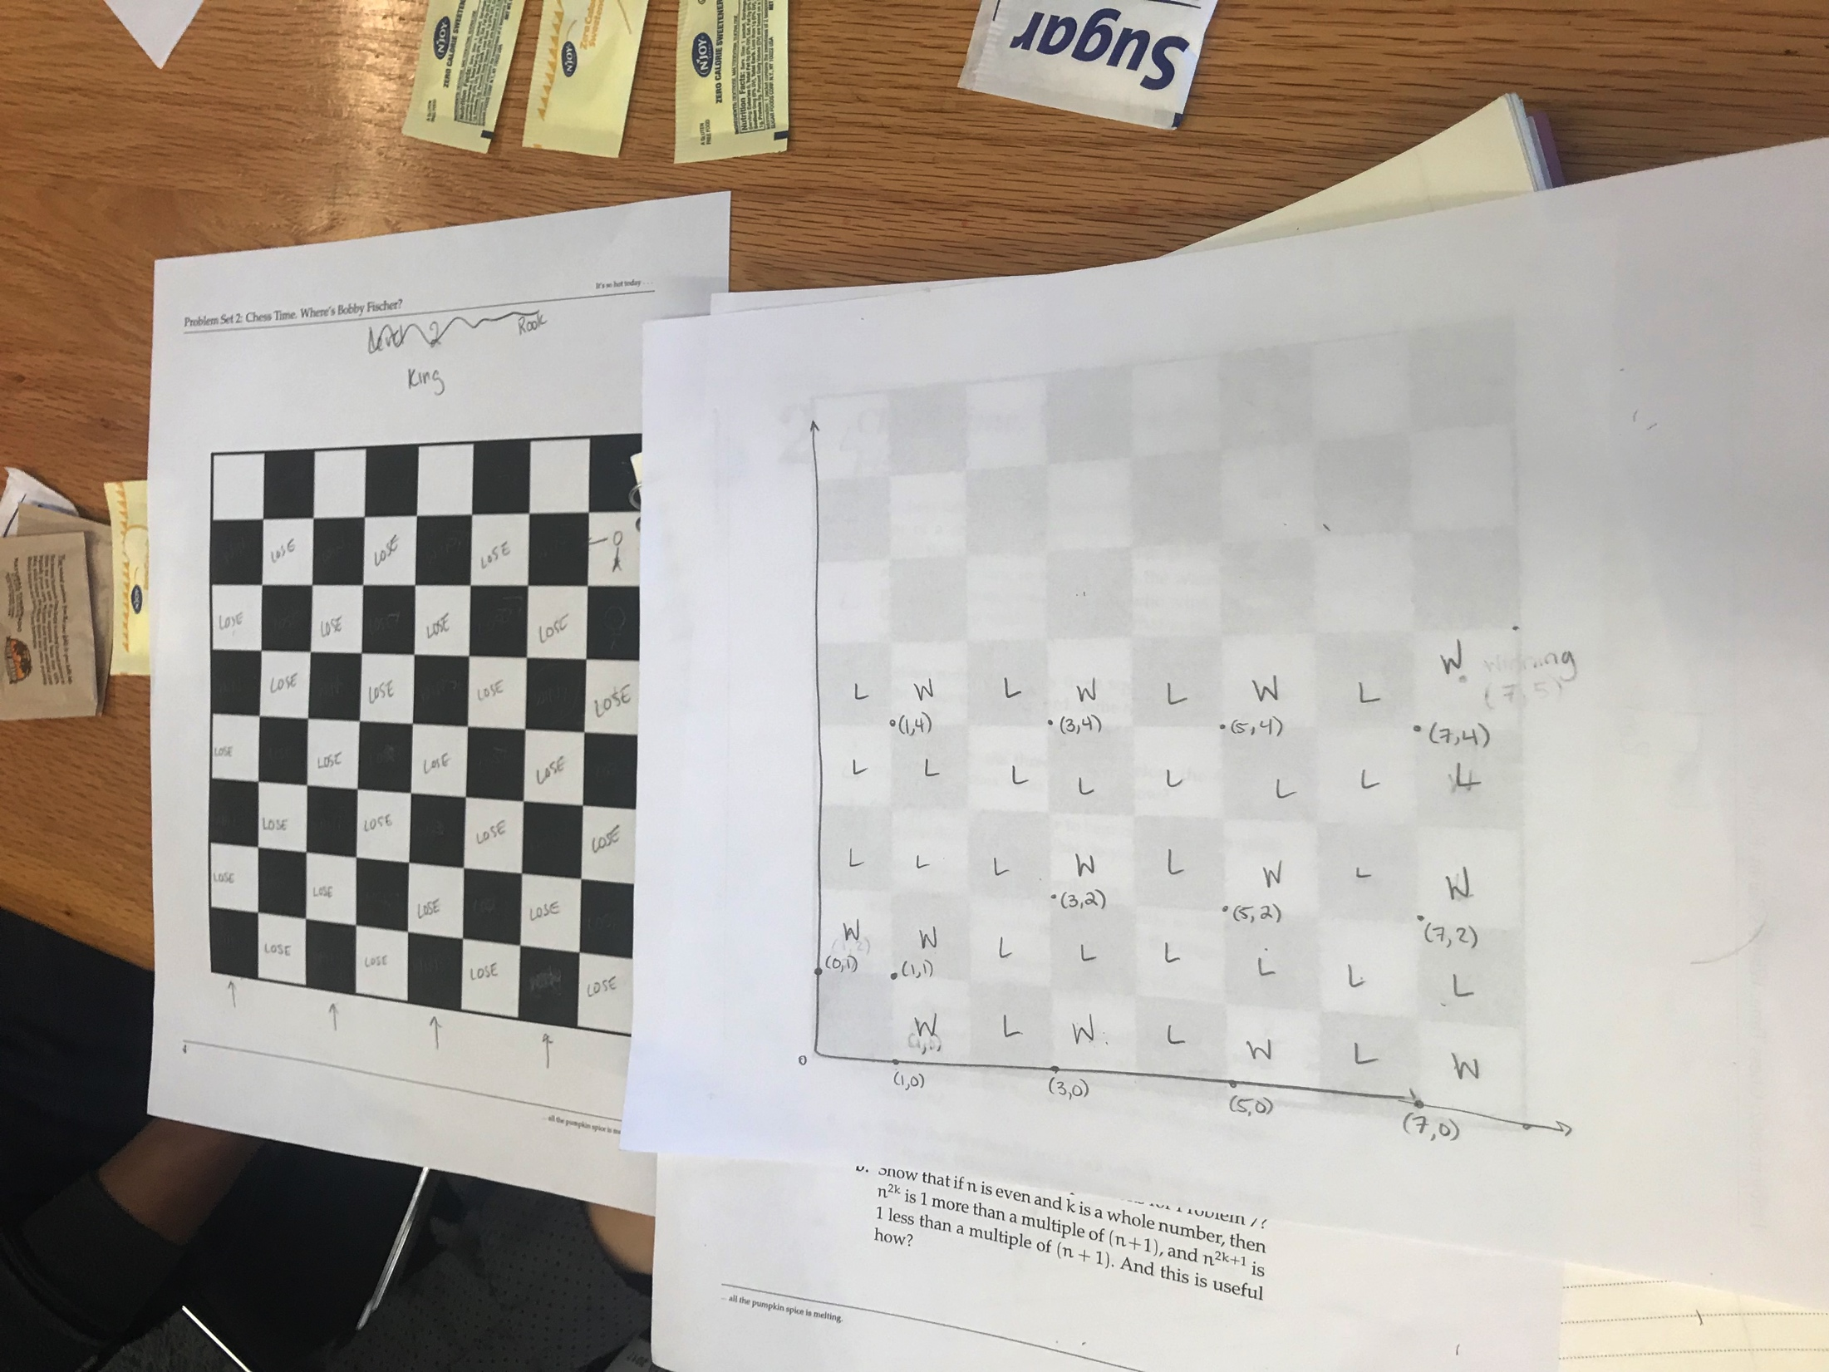
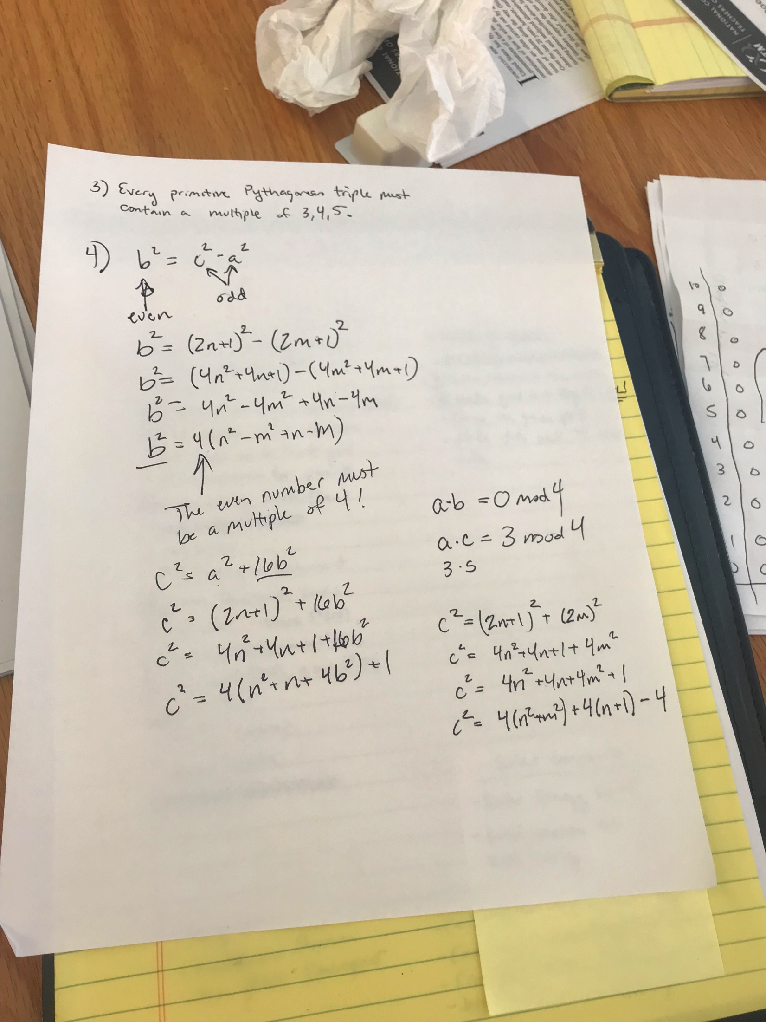
Participant Work

Slide 10
Pythagorean Triples
What do you notice? What questions do you have?
Table B: We proved the fact that every primitive triple has to have a multiple of 3 and a multiple of 5. Not yet 4… (Table A: we did that).
It felt like there was a connection between 2 “base” numbers to generate the triple and (ab)mod4.
We also played around with c-a and c+a and the relationship between those mod4…
Noticed that the 2 larger numbers in a Pythagorean Triple. differed by either 1 (if smallest number odd) or 2 (if smallest even).
We worked on testing a formula for generating PTs. Excel helped with this. Still working….
We feel like we found a way to generate PTs given a certain hypotenuse. Has to do with factoring and finding relative primes. Also generating via choosing 2 odd numbers. (choosing evens just gave us multiples of primitive PTs).
We spent our time finding triples w/ 65 as the hypotenuse. We convinced ourselves that every PT will have a multiple of 3, a multiple of 4, and a multiple of 5 (not all in separate numbers). I wonder in the case where a single number is a multiple of all 3, if the other two numbers are prime?

