Slide 1
PCMI
3 weeks
3 roles
http://projects.ias.edu/pcmi/hstp

Slide 2
Reflecting on Practice: Worthwhile Tasks
Session 1
What makes a worthwhile task?

Slide 3
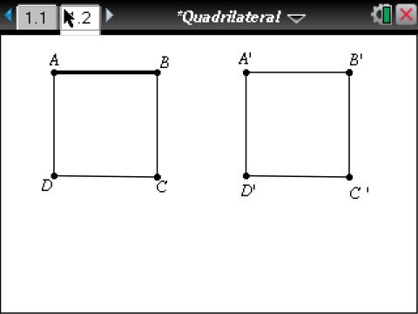
What do you (as students) predict will happen to the area if you “slant” the quadrilateral? Why?
Notes:
What might this look like in classrooms?

Slide 4
Bringing it all together
A sixth grade class studying area of polygons in the fall
As you watch the video, consider :
What about the nature of the task promoted or inhibited discussion?

Slide 5
Video removed for copyright reasons.

Slide 6
Exponents
The teacher’s goal was that students should know and be able to apply the laws of exponents. The video of this task being implemented is from the TIMSS 1999 video study and takes place in an eighth grade algebra classroom in the US. The tasks in which students are engaged are on the worksheet.

Slide 7
Exponents
An eighth grade class beginning the study of the exponent rules
As you watch the video, consider :
What about the nature of the task promoted or inhibited discussion?

Slide 8
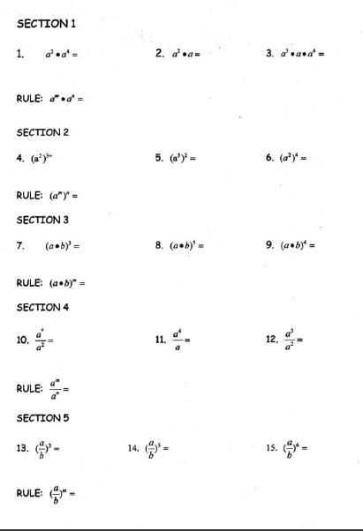
Exponents

Slide 9
http://www.timssvideo.com/videos/mathematics/

Slide 10
By yourself, write down what you noticed about the nature of the exponent task that promoted or inhibited discussion.

Slide 11
At your tables, go around the table round robin with each person offering a thought about difference in the nature of the two tasks with respect to how they promoted or inhibited discussion.
Choose one person at your table to record the ideas as you go.

Slide 12
At your tables, go around the table round robin with each person offering a thought about difference in the nature of the two tasks with respect to how they promoted or inhibited discussion.
What was the big idea from your table?

Slide 13
Tasks have to be justified in terms of the learning aims they serve and can work well only if opportunities for pupils to communicate their evolving understanding are built into the planning. (Black & Wiliam, 1998)

Slide 14
Mathematics Teaching Practices: Effective teachers
Establish mathematics goals to focus learning.
Implement tasks that promote reasoning and problem solving.
Use and connect mathematical representations.
Facilitate meaningful mathematical discourse.
Pose purposeful questions.
Build procedural fluency from conceptual understanding.
Support productive struggle in learning math.
Elicit and use evidence of student thinking.
(NCTM, 2014)

Slide 15
What do we mean when we say a
“meaningful mathematical discourse”?

Slide 16
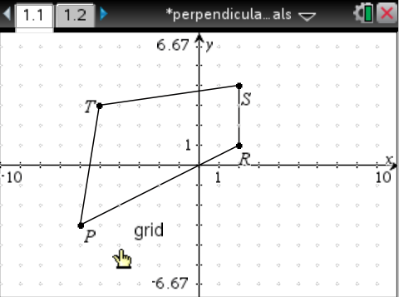
A Quadrilateral
Move vertices R and S to create a quadrilateral whose diagonals are perpendicular to each other.
Related to CCSS Grade 8 Geometry
Notes:
“Do the task on your own” then “share your answer with a partner”.

Slide 17
Student work
With your partner discuss what students might notice and wonder about when looking at these solutions. What mathematical ideas might emerge?

Slide 18
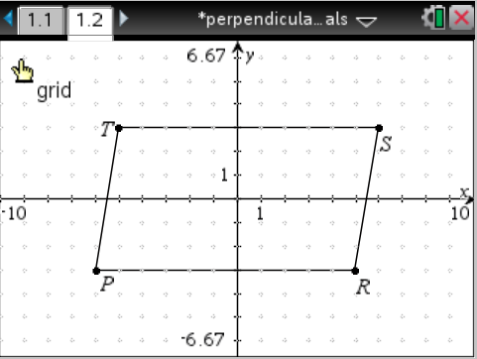
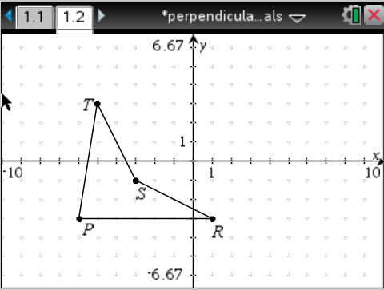
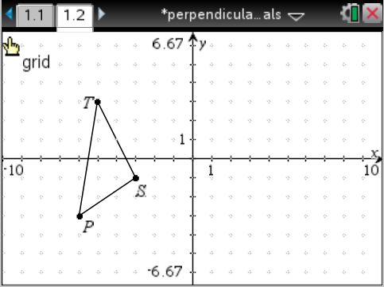
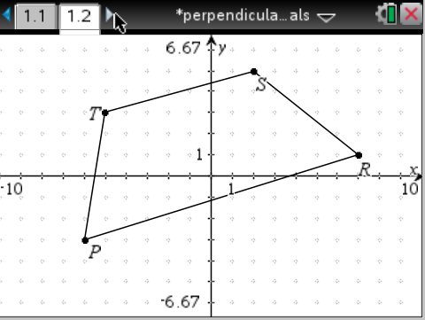
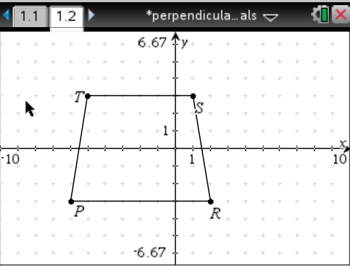
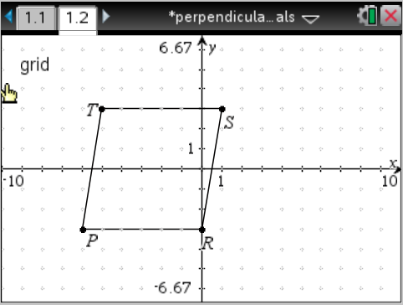
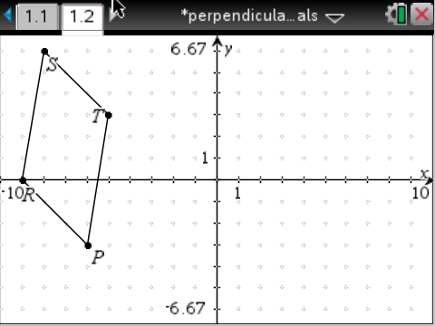
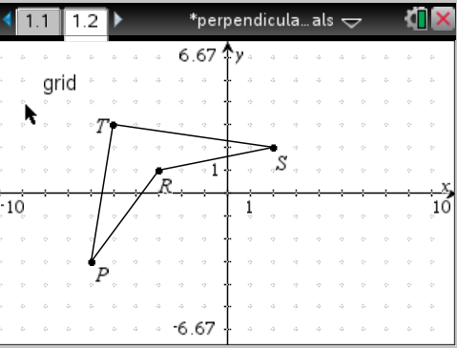
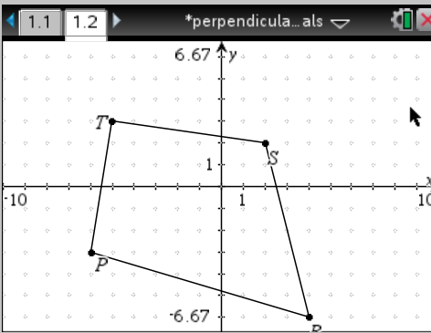

Slide 19
A spaghetti container has a hexagonal base. Which shape will hold the same amount of spaghetti as the original container and be the most economical?
MDE, 2004

Slide 20
Which shape will hold the same amount of spaghetti and be the most economical?
 | Area of base | Surface area | Volume | Ratio of surface area to volume
Cylinder
Rectangular prism
Shape 3
MDE, 2004

Slide 21
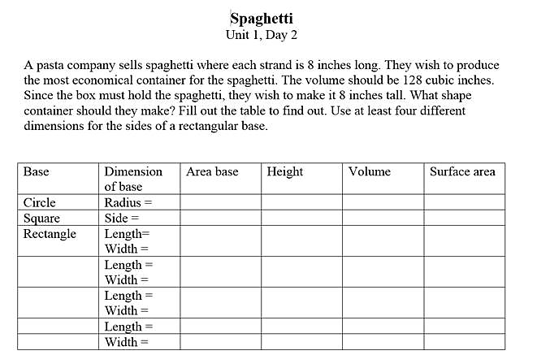

Slide 22
Another important consideration in a worthwhile task is the level of thinking and reasoning required of students, the cognitive demand.
What is different about the nature of this task with respect to cognitive demand than the perpendicular diagonals task?

Slide 23
How did the nature of the tasks we have looked at today engage students in reasoning and sense making and promote or inhibit discussion?

Slide 24
Discussions are important because they surface student thinking, which should inform our next steps as teachers – not to “set them straight” but to work together to negotiate mathematical understanding.
We’ve identified some characteristics of tasks that engage students in productive discussions.

Slide 26
Reference
Black, P. & Wiliam, D. (1998). “Inside the Black Box: Raising Standards Through Classroom Assessment”. Phi Delta Kappan. Oct. pp. 139-148.
Bringing It All Together (2012). Video clip from T-Cubed Common Core State Standards Professional Development Workshop. Brennan, B., Olson J. & the Janus Group. Curriculum Research & Development Group. University of Hawaii at Manoa, Honolulu HI (2009).
Cirillo, M. (2013). What Are Some Strategies for Facilitating Productive Classroom Discussions? NCTM Research Brief. S, DeLeeuw, Series Editor, Reston VA: National Council of Teachers of Mathematics. http://www.nctm.org/news/content.aspx?id=35386

Slide 27
References
National Council of Teachers of Mathematics. (2015). Principles to Action. Reston VA: The Council
Timss video series 1999. US2 Exponents
http://www.timssvideo.com/videos/mathematics/
United States

