Slide 1
Reflecting on Practice: Worthwhile Tasks

Slide 2
Question: If r=2, find the circumference of the circle
A: C=4π

Slide 3
Another question
Question: If r=2, find the circumference of the circle
A: C=4π
Is this a better question?
Will the circumference and the area of a circle ever be the same? Why or why not?

Slide 4
In the figure below, what fraction of the rectangle ABCD is shaded?
A
B
1/6
1/5
1/4
1/3
e) 1/2
D
C
NCES, Grade 8, 1996

Slide 5
In the figure below, what fraction of the rectangle ABCD is shaded?
A
B
1/6 (5%)
1/5 (3%)
1/4 (24%)
1/3* (66%)
e) 1/2 (2%)
D
C
NCES, Grade 8, 1996

Slide 6
Color ¼ of the drawing.
Dekker & Querelle, 2002

Slide 7
Another approach to ¼
(Dekker & Querrelle)

Slide 8
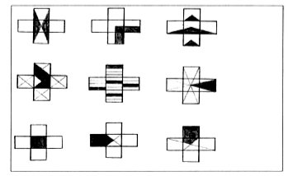
In which is ¼ of the shape shaded?
Dekker & Querelle, 2002

Slide 9
What did you like or not like about this task in terms of promoting discussion and eliciting student understanding?

Slide 10
Tasks should be chosen so that there is an opportunity for error in reasoning or thinking that opens up an opportunity to discuss or explain- not just an error in the next step (for example, lost a negative sign or multiplied incorrectly).

Slide 11
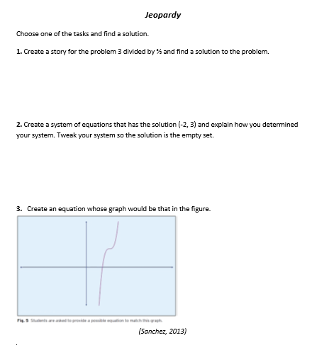

Slide 12
Find a partner who did the same task and discuss your solution with them.

Slide 13
We often call this approach Jeopardy … Give students the answer and ask for the question.
How did Jeopardy promote discussion and elicit student thinking and understanding?

Slide 14
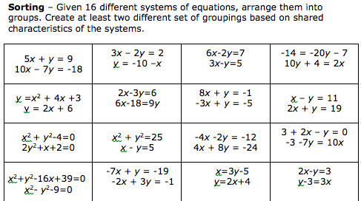

Slide 15
What mathematical ideas emerged during your discussions either with your partner or as a whole table?

Slide 16
How is this approach different from just working through a worksheet?

Slide 17
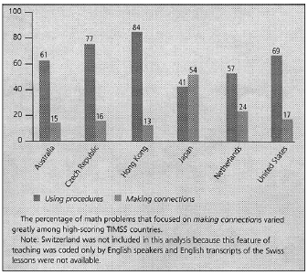
Types of math problems presented
http://bit.ly/hiebert2004
Hiebert & Stigler, 2004

Slide 18
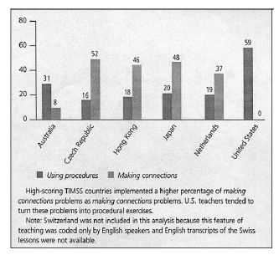
How teachers implemented making connections
math problems
http://bit.ly/hiebert2004
Hiebert & Stigler, 2004

Slide 19
Readings
Hiebert, J., & Stigler, J. (2004). Improving Mathematics Teaching Improving Achievement in Math and Science, 64(5), 12-17.
Sanchez, W. (2013). Open ended questions and the process standards. 107(3). Mathematics Teacher.

Slide 20
Take a few minutes to reflect using the prompts in your journal:
What is one message from this session that you would want to bring back to another teacher? How would you make it meaningful and accessible for them (when they haven’t been here with you)?
On your Exit Card:
What question would you like to raise for us to think about as we move forward?

Slide 21
References
Dekker,T. & Querelle, N. (2002). Great assessment problems (and how to solve them). CATCH project www.fi.uu.nl/catch
Hiebert, J., & Stigler, J. (2004). Improving Mathematics Teaching Improving Achievement in Math and Science, 64(5), 12-17.
National Council of Teachers of Mathematics. (2014). Principles to action: Ensuring mathematical success for all students. Reston VA: The Council
Sanchez, W. (2013). Open ended questions and the process standards. 107(3). Mathematics Teacher.
.

