Slide 1
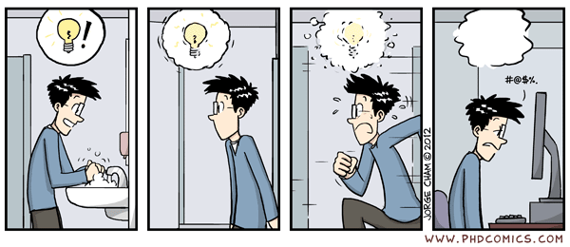
Reflecting on Practice:
Implementing Worthwhile Tasks

Slide 2
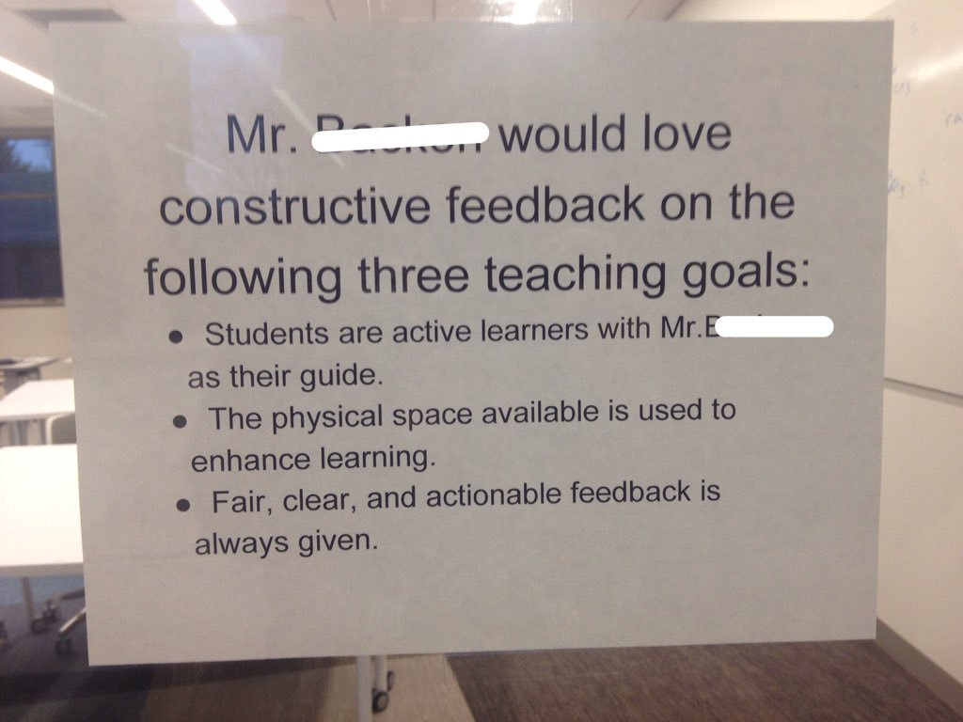
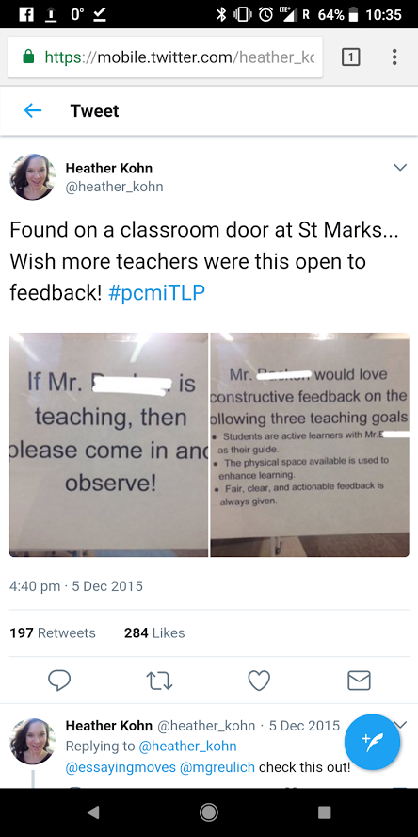
http://robertkaplinsky.com/observeme/

Slide 3
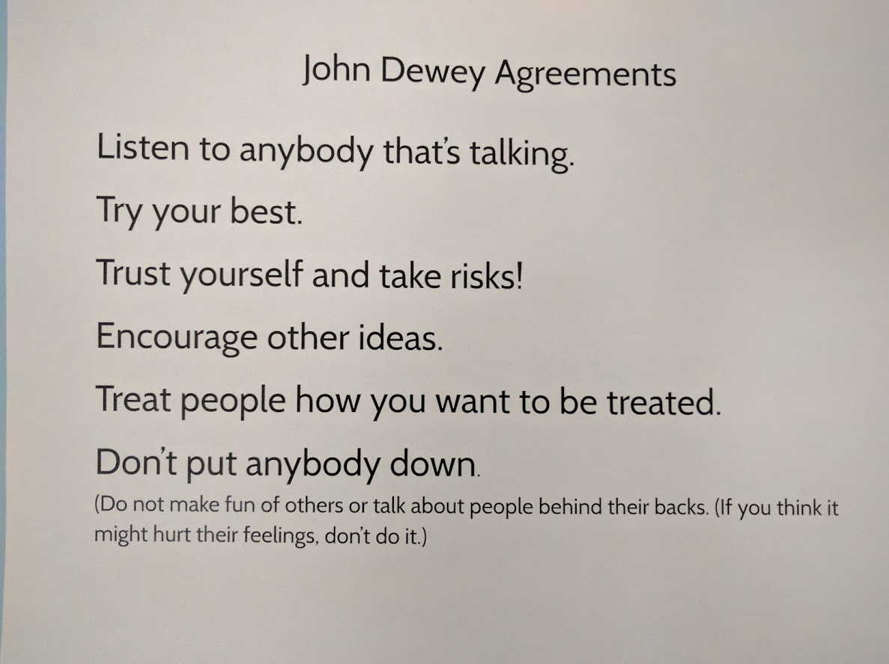
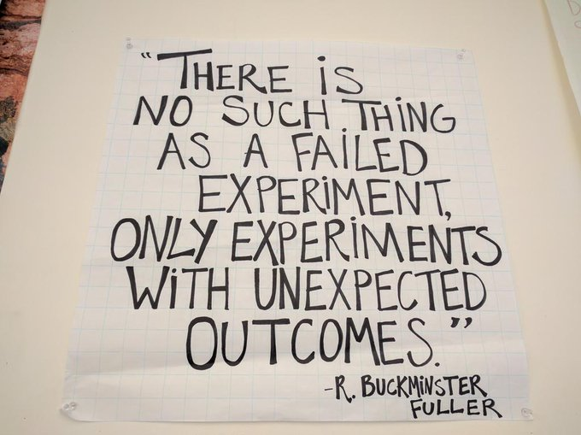

Slide 4
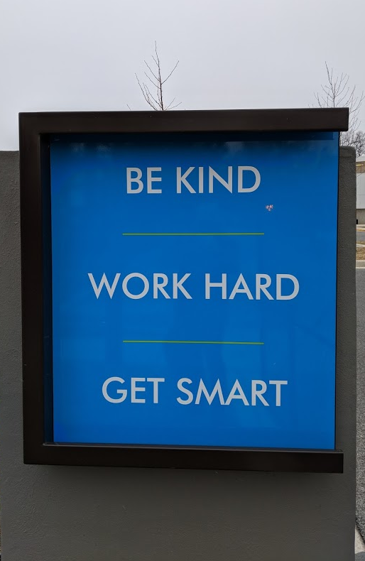
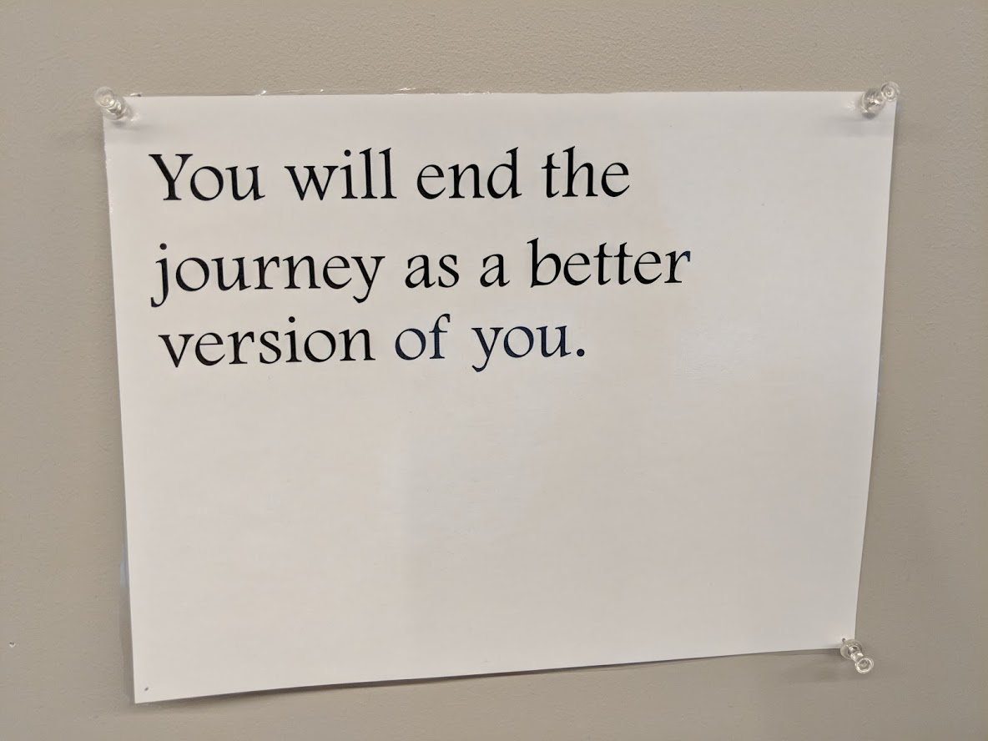

Slide 5
Session 1: What makes a worthwhile mathematical task?
    Opportunity for discussion
    Cognitive demand
Session 2: How do we adapt tasks to make them more meaningful?
    Open-ended tasks
    Dekker & Querrelle – give right/wrong solutions & ask for classification
    Jeopardy – give solution and students pose task
    Grouping mathematical ideas
Session 3: Implementation

Slide 6
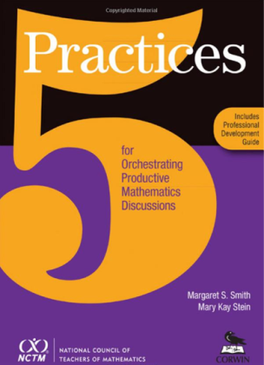
The 5 Practices
Anticipate
Monitor
Select
Sequence
Connect
Smith & Stein, 2011

Slide 7
Becky & Genevieve’s activity
http://projects.ias.edu/pcmi/hstp/sum2016/wg/pldev/lowhigh/
What answers do you expect to see? (Anticipating)
What are students doing? (Monitoring)
What responses are worth discussing? (Selecting)
How will you sequence responses? (Sequencing)
What is the mathematical punchline? (Connecting)
Login: sstp
Password: b@lloon
Smith & Stein, 2011 5 Steps for a Productive Discussion
Notes:
Anticipated: by approach- substitution, graphing, linear combinations
By solution type- whole numbers, rationals, by dividing out a common factor to make easier equivalent system
Observed: Maybe some unique strategies – walk down method; recognize that had a common factor of (x-3) etc.
Sequencing: linear combinations, then substitution, then graphing
Connecting: what are the advantages of each approach? Disadvantages?
Can the strategies work together? Any reason to do more than one?

Slide 8


Slide 9
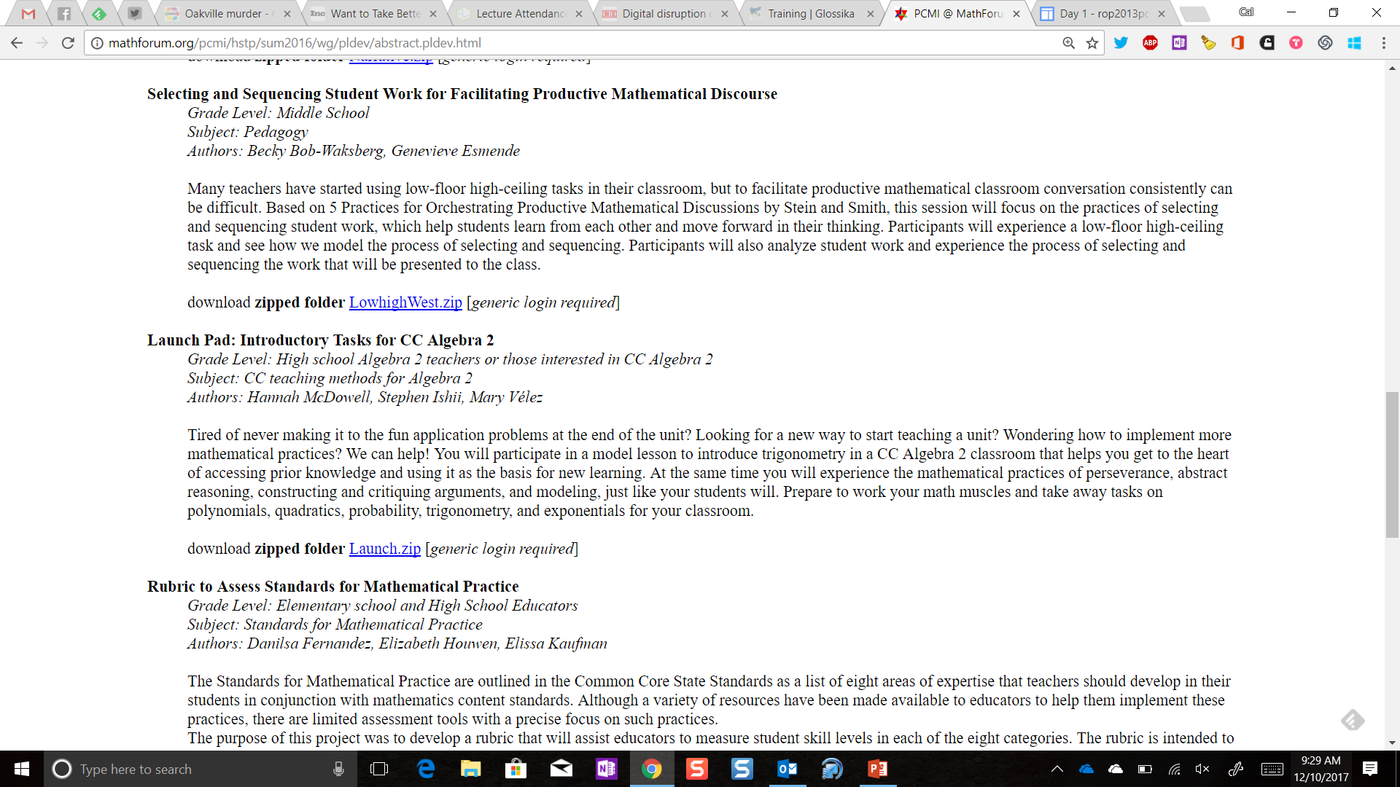

Slide 10
Becky & Genevieve’s activity
http://projects.ias.edu/pcmi/hstp/sum2016/wg/pldev/lowhigh/
What answers do you expect to see? (Anticipating)
What are students doing? (Monitoring)
What responses are worth discussing? (Selecting)
How will you sequence responses? (Sequencing)
What is the mathematical punchline? (Connecting)
Login: sstp
Password: b@lloon
Smith & Stein, 2011 5 Steps for a Productive Discussion
Notes:
Anticipated: by approach- substitution, graphing, linear combinations
By solution type- whole numbers, rationals, by dividing out a common factor to make easier equivalent system
Observed: Maybe some unique strategies – walk down method; recognize that had a common factor of (x-3) etc.
Sequencing: linear combinations, then substitution, then graphing
Connecting: what are the advantages of each approach? Disadvantages?
Can the strategies work together? Any reason to do more than one?

Slide 11
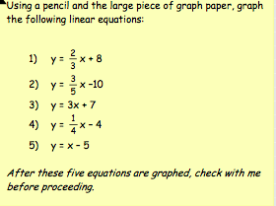
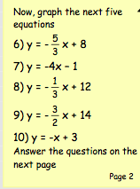
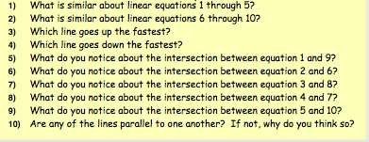
Graphing Linear Equations
(US TIMSS video)
Notes:
This unit is about implementation – that is the process of going from the task to the realization of it in your classroom -- what do we need to think about as we are implementing/preparing to implement tasks in our classrooms.
Today we are going to be looking at a couple of classroom videos. We would ask everyone to be mindful that the teachers in these videos have generously opened their classrooms to us (and whomever else views these videos). While it is acceptable to view their teaching through a critical lens, we also need to be be respectful of them and their practice, and to hold one another accountable to this need.
We are going to look at a section of another video from the TIMSS video series. This eighth grade mathematics lesson focuses on graphing linear equations. It is a review lesson that followed a unit of work on this topic. The lesson is 44 minutes in duration. There are 36 students enrolled in the class. They are working in groups to graph a set of lines with one sheet of graph paper per group.
See power point. (TIMSS 1999 Video Study; timssvideo.com)

Slide 12
Graphing Linear Equations
As you watch, think about:
What things had the teacher done to prepare for the lesson?
What evidence do you see that students are ready or not ready to do the task?
                (US 8th grade TIMSS video)
Notes:
What things had the teacher done to prepare for the lesson?
As you watch, think about the question: What evidence do you see that students are ready or not ready to do the task?
Show Video

Slide 13
We watched the video below from 1:46-5:44
http://timssvideo.com/58

Slide 14
Graphing linear equations
“What things had the teacher done to prepare for the lesson?”
“Were the students ready to do the task? What is your evidence?”
                (http://timssvideo.com/58 US 8th grade TIMSS video)
Notes:
What things had the teacher done to prepare for the lesson?
Quick whole group
Possible responses:
Made a worksheet
Put students in groups
Had the large grid ready for students to graph the lines.
Were the students ready to do the task? What is your evidence? (Round robin at each table)
Facilitator listens and if any table has something that seems important or different, have them share. Otherwise go to the transcript.
Possible responses:
He forgot to tell them why they only had one piece of graph paper.
They didn’t know what to do with fractions.
It was good that he reminded them of the two ways.
He didn’t elicit an example from students to be sure they understood what to do.

Slide 15
TIMMS Graphing Linear Equations
What do students need to know to do this task?
Was there evidence they lacked one or more of these pieces of knowledge?
What questions or other checks could have elicit this evidence?
http://timssvideo.com/58
Notes:
Think about the answers to the questions below in relation to this classroom.
“What do students need to know to do this task? Was there evidence they lacked one or more of these pieces of knowledge? What questions or other checks could have elicited this evidence?”
Discuss your answers at your table.
Facilitator calls on each table for one response.
Possible responses:
What they are supposed to do - they asked for clarification about who was to graph, etc.
What to do to replace a value for x in the equation - someone asked what happened with the number and response was 0 is favorite number; another asked how do you do x and y.
How to do arithmetic with fractions - they asked negative goes in the top, right?.
How to plot points - totally forgot how to do the graph.

Slide 16
It has been one month since Ichiro's mother has entered the hospital. He has decided to say a prayer with his smaller brother at a local temple every morning so that she will be well soon.
There are 18 10-yen coins in Ichiro's wallet and just 22 five-yen coins in his smaller brother's wallet. They have decided every time to take one coin from each of them, and put them in the offertory box, and continue their prayers until either wallet becomes empty. One day after they were done with their prayers, when they looked into each other's wallets, the smaller brother's amount of money was greater than Ichiro’s.
How many days has it been since they started praying?
Notes:
5 min
Now let’s look at a mathematics task. In your folders is a task titled, “Ichiro’s Mother”. Please read the task and work on if for about five minutes, then check with a partner.
Hand out Ichiro’s mother task.

Slide 17
Ichiro’s Mother
What planning/anticipating do you need to do before you would give this to your students?
Notes:
5 min
Whole group discussion:
What planning/anticipating do you need to do before you would give this to your students?
Possible responses:
Prior knowledge of solving equations/inequalities.
May not remember meaning of inequality sign.

Slide 18
Ichiro’s Mother
As you watch, think about the question:
What do you think the teacher planned for in preparing the lesson?
                Japanese 8th grade video
Notes:
7 min
Distribute Ichiro Transcript
Now lets look at a video of students engaged in this task. This eighth grade mathematics lesson from Japan focuses on linear inequalities in one variable. It is the first lesson in a sequence of seven on this topic. The lesson is 52 minutes in duration. There are 34 students in the class.
The teacher reads the task to the class while they follow along. We are joining the class right after he is done reading. The students work individually for about 14 minutes, while the teacher walks around and asks questions such as, is there another way or which way does that represent. We rejoin the video once students begin to share their solutions.
As you watch, think about the question: What do you think the teacher planned for in preparing the lesson?

Slide 19
Ichiro’s Mother
What to you think the teacher planned for in preparing the lesson?
                Japanese 8th grade video
Notes:
20
Short whole group discussion of the first question:
Were you surprised by what you saw?
Possible responses:
Students worked alone without talking to each other.
Teacher monitored what every student was doing and wrote things down.
Students spent a very long time on one problem.
At your tables, talk about the second question: What do you think the teacher planned for?
Possible responses:
Teacher anticipated specific solutions and called on students accordingly.
Teacher was strategic about where he placed solutions on the board.
Manipulatives were ready to use.
Magnetic strips with the method names written on them were ready to post.
The use of the coins and the box were related to the task and were useful in making clear what the task was about.
Facilitator asks each group to share out one idea and records it on chart paper. Then goes around again.
Conclusion: implementing tasks so they work takes planning.
Japan has a rich culture around reflection on teaching practice thatyou might find worth learning more about when you have time. This includes a vocabulary used to discuss teaching from which Cal's favorite Japanese word is drawn - READ SLIDE...

Slide 20
Cal’s favorite Japanese word
Blake Petersen from BYU
  Doing the Sequencing/Connecting from Smith/Stein
Kikan-Shido: “Between Desks Instruction”
A term from Japanese lesson-study, describing the teacher’s walking around the room, predominantly monitoring or guiding student activity – the teacher makes intentional choices to speak or interact with students.

Slide 21
Participation quiz (PCMI, 2011)
High school algebra class working on factoring. They are being graded on how well they work together on the task not on right answers.
You have expectations about the way discussions should happen in your classroom. Do your students know what they are?
As you watch, what norms are being established to encourage discussion?

Slide 22
What explicit norms does the teacher set for student discussion?
What level math talk is going on in the class
What things does the teacher do to promote math talk?

Slide 23
This video is not available for public display outside of PCMI TLP.

Slide 24
Sociomathematical Norms
Talking about the math
Explanations consist of mathematical arguments not simply procedural summaries of the steps taken to solve the problem.
Errors offer opportunities to reconceptualize a problem and explore contradictions and alternative strategies.
Mathematical thinking involves understanding relations among multiple strategies.
Collaborative work involves individual accountability and reaching consensus through mathematical argumentation (Kazemi, 1998).

Slide 25
Norms for students working together
Take turns
Listen to others ideas
Disagree with ideas not people
Be respectful
Helping is not the same as giving answers
Confusion is part of learning
Say your “becauses”
“I can’t do that yet?”

Slide 26
Successful implementation of worthwhile tasks does not just happen by chance

Slide 27
Getting ready
What things do you need to think about when planning to implement a task in your classroom ?
Notes:
What are the things you need to think about when you are planning to implement a task in your classroom?
Write individually for several minutes and then we are going to share in a round robin with the whole class.
Facilitators make a list of the responses on chart paper or for posting; use to compare when read Horn homework.
Possible responses:
Student misconceptions.
What examples to use.
How students are going to work (logistics).
How to record work/thinking.
What answers right/wrong/interesting will students give.
How to assess progress.
Hinge points.
Prerequisite knowledge.

Slide 28
References
Graphing Linear Equations Video: US1
  http://timssvideo.com/videos/mathematics/United%20States
Solving Inequalities Video: JP3 http://timssvideo.com/49

