Slide 1
PCMI December Outreach Weekend
24-25 March2018
Math!

Slide 2
Survivor Time
URL: go.edc.org/survivor21
Shared Websites:
Projects.ias.edu/PCMI
Past PCMI problem sets
Illustrative Mathematics
Past TLP Summer Sessions: http://projects.ias.edu/pcmi/hstp/previous.html
Notes:
Pause at 50 seconds.

Slide 3
Games Games Games! What do you notice? Wonder? What are your questions?
Higher numbers, you have to completely work out all the possibilities to see if it breaks down to an earlier smaller case (e.g. Move X is equivalent to Y in the earlier game).
A lot of our methods involved matching or reacting to the other person to make groups of 4 or 8.
I wonder if there is some sort of probability equation that would help me solve this? Looking at diagonals (drawing 1 color and then 2 of one color then 3 of one color, etc. set up in a diagonal to eliminate the choices and get down to last 3 – 2 of one color and 1 of another) - referencing problem 9.

Slide 4
Games Games Games! What do you notice? Wonder? What are your questions?
We noticed that in #7 you want to leave the other person with an even number when the colors switch from 2 to 1. What is the critical move to make when the transition occurs from 2 colors to 1 color.
Could this be similar to a permutation equation?

Slide 5
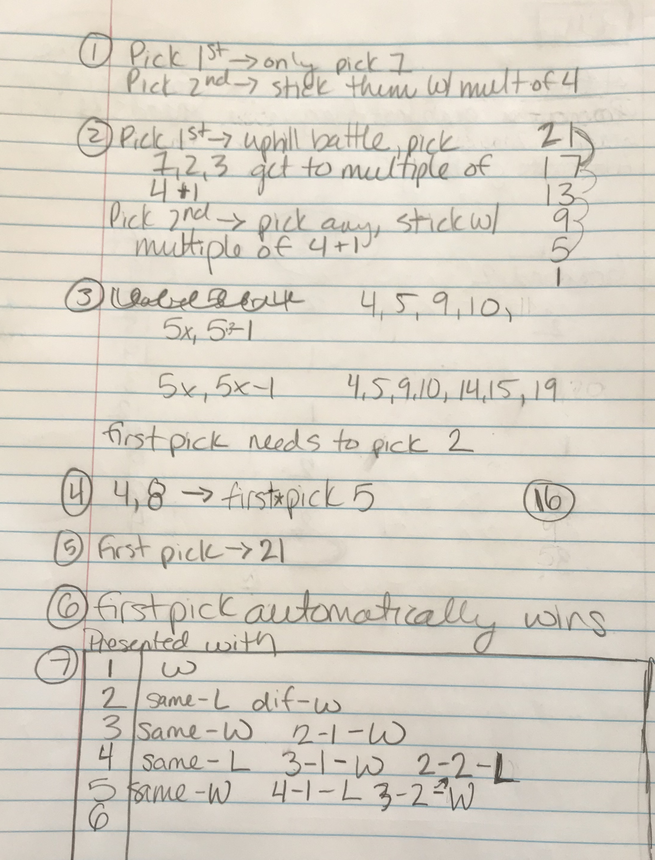
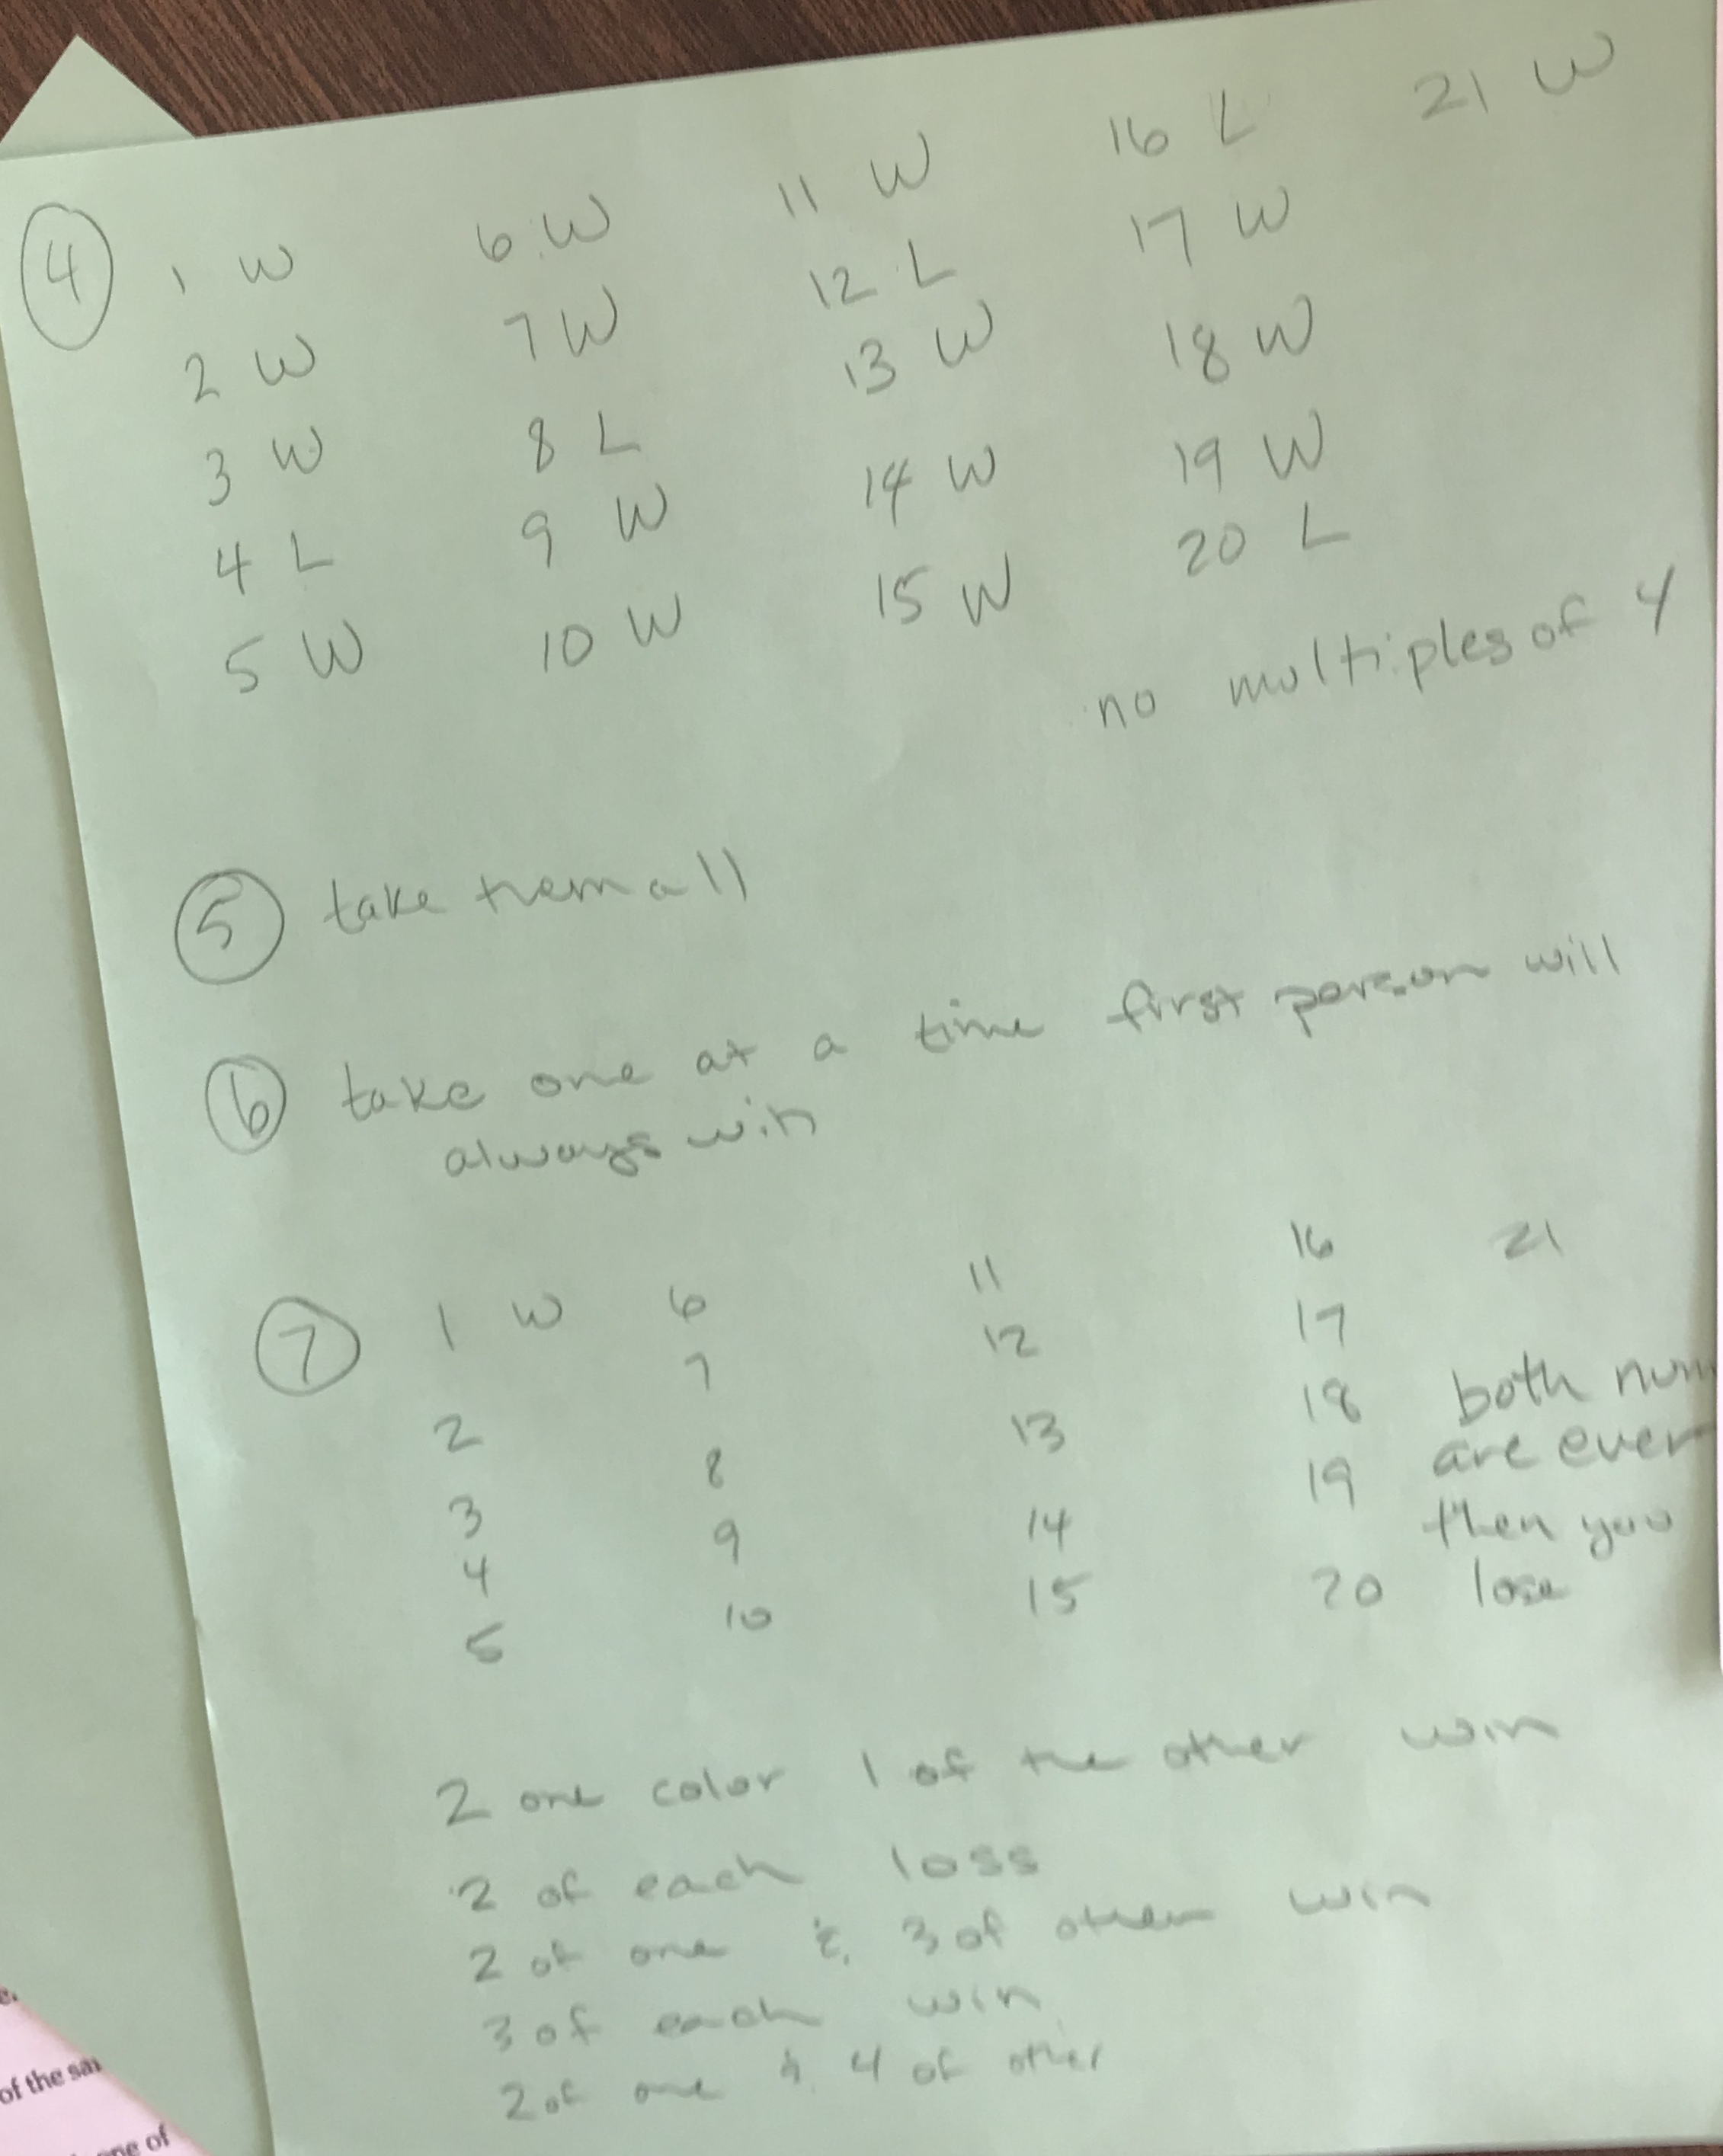
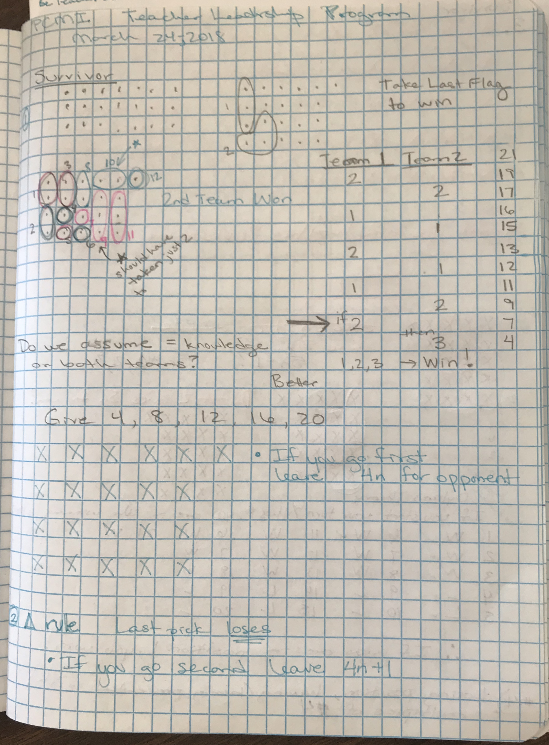
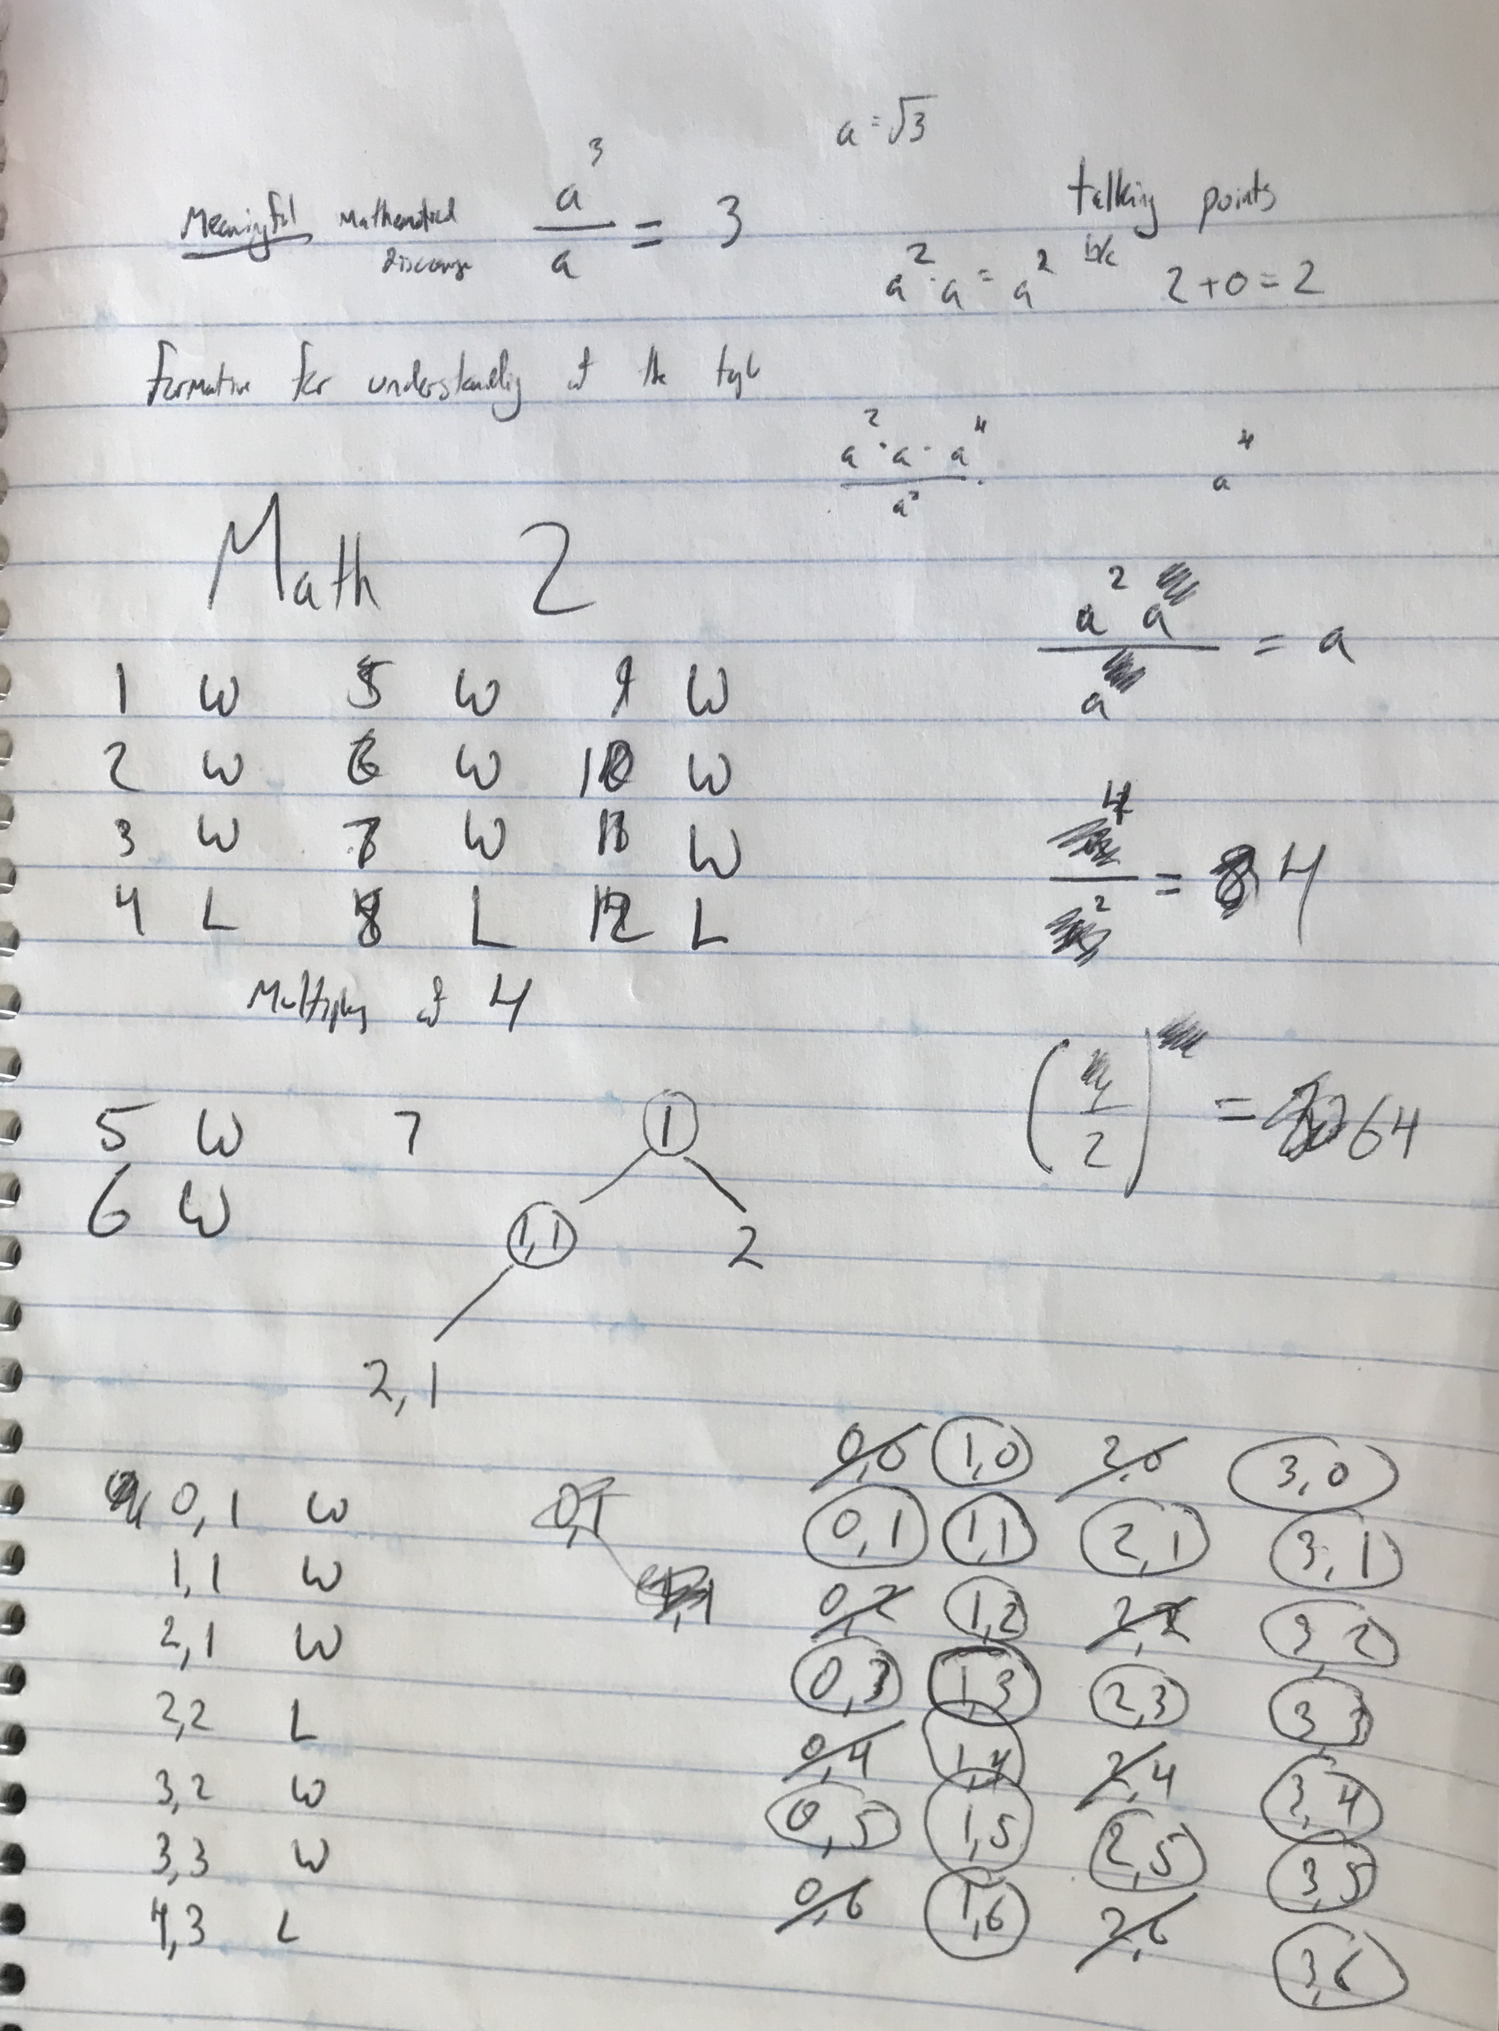
Participant Work

Slide 6
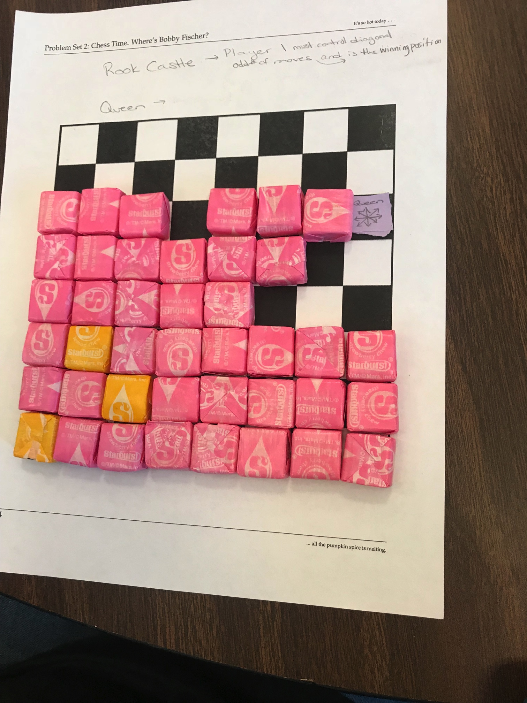
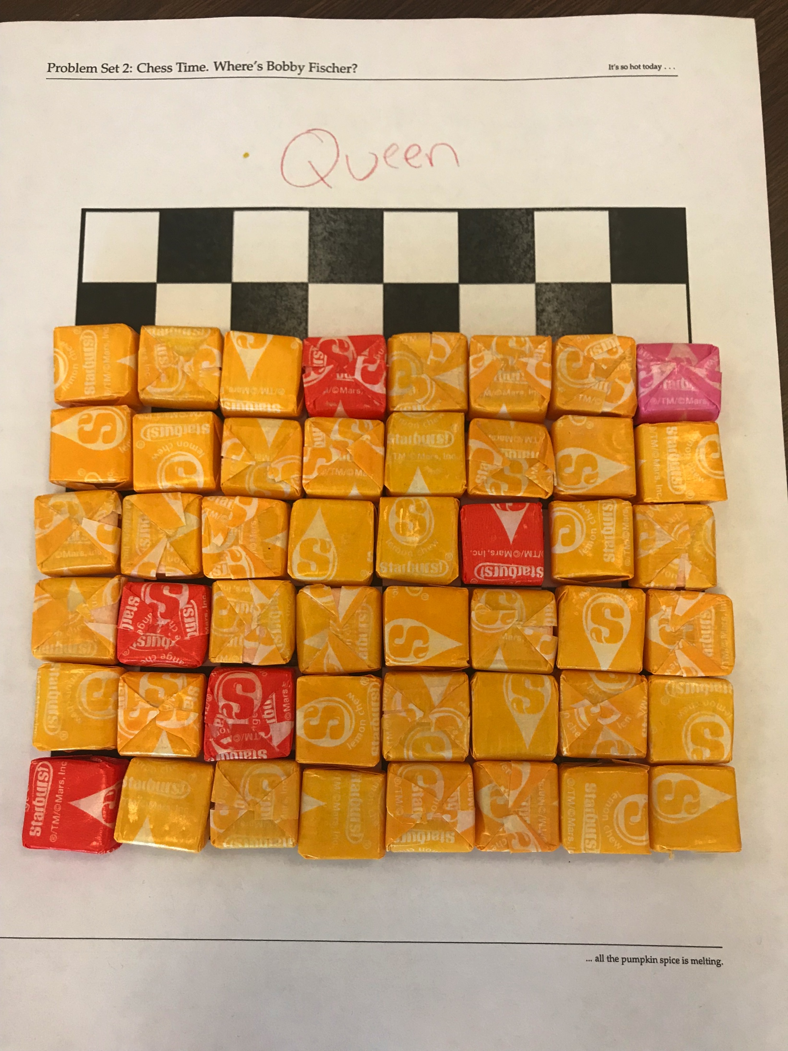
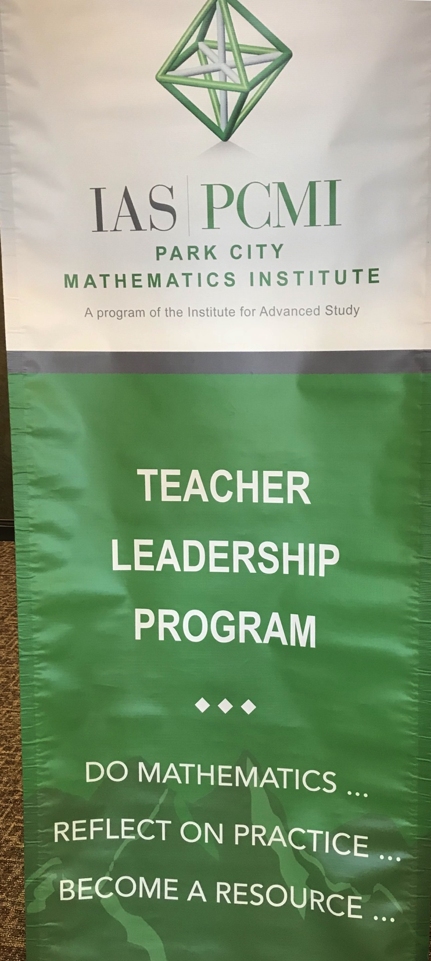
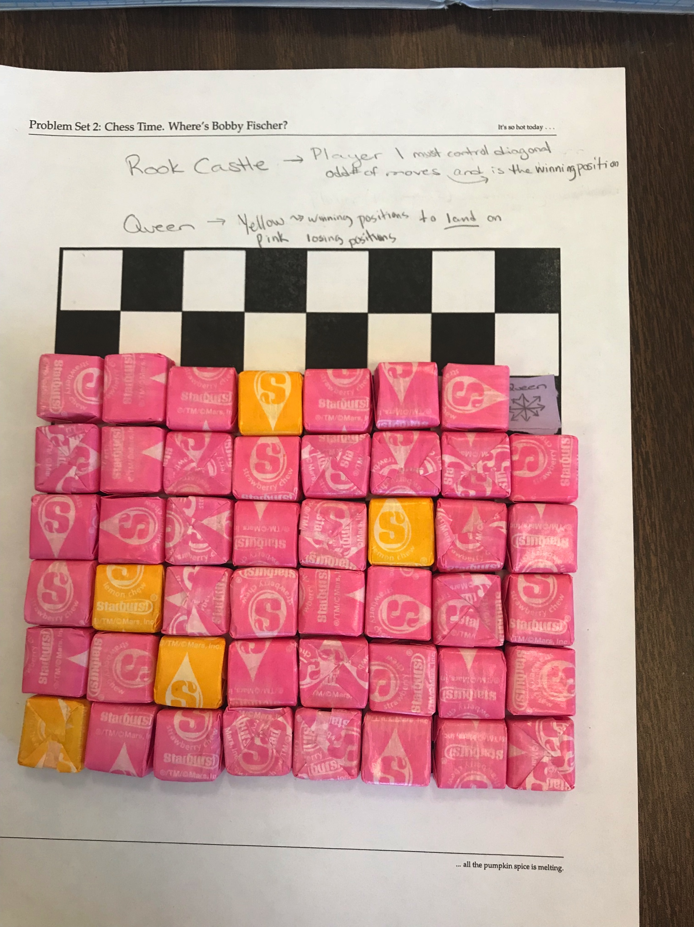
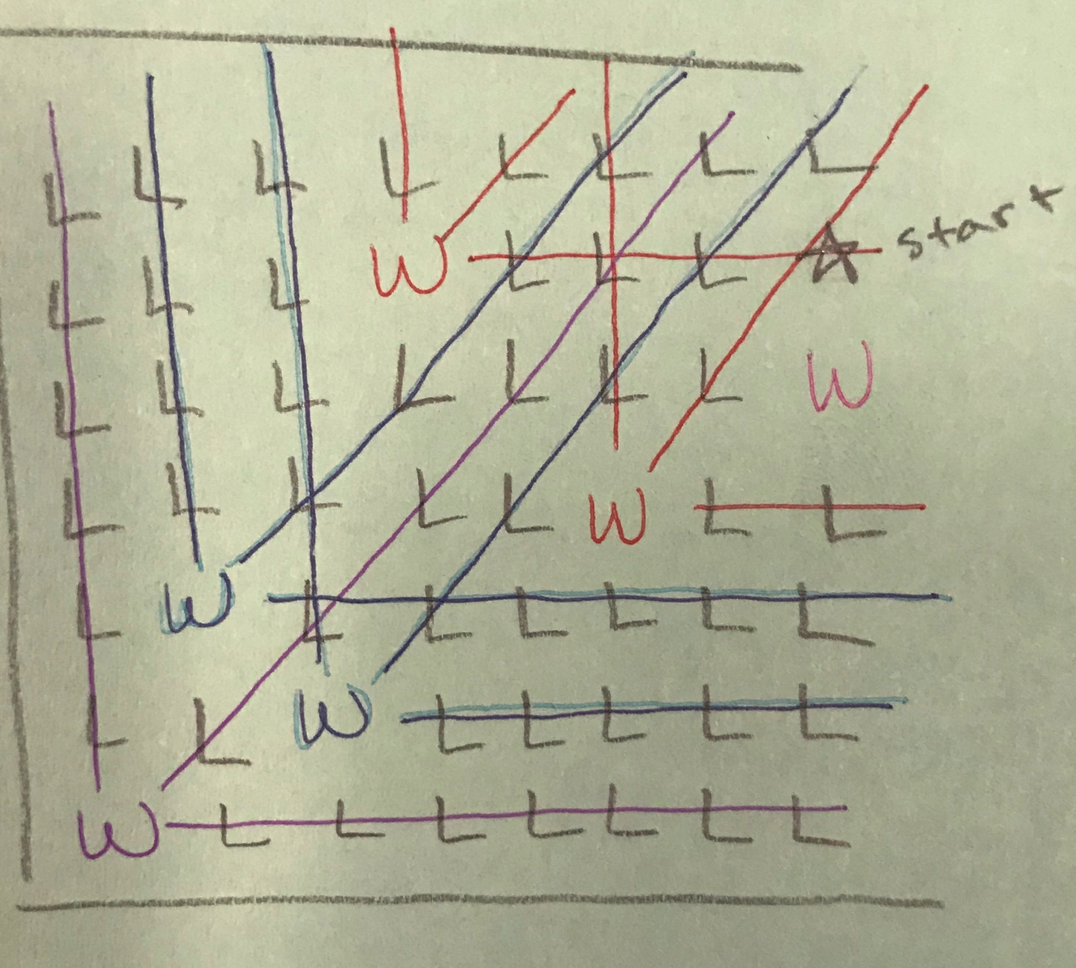
Participant Work

Slide 7
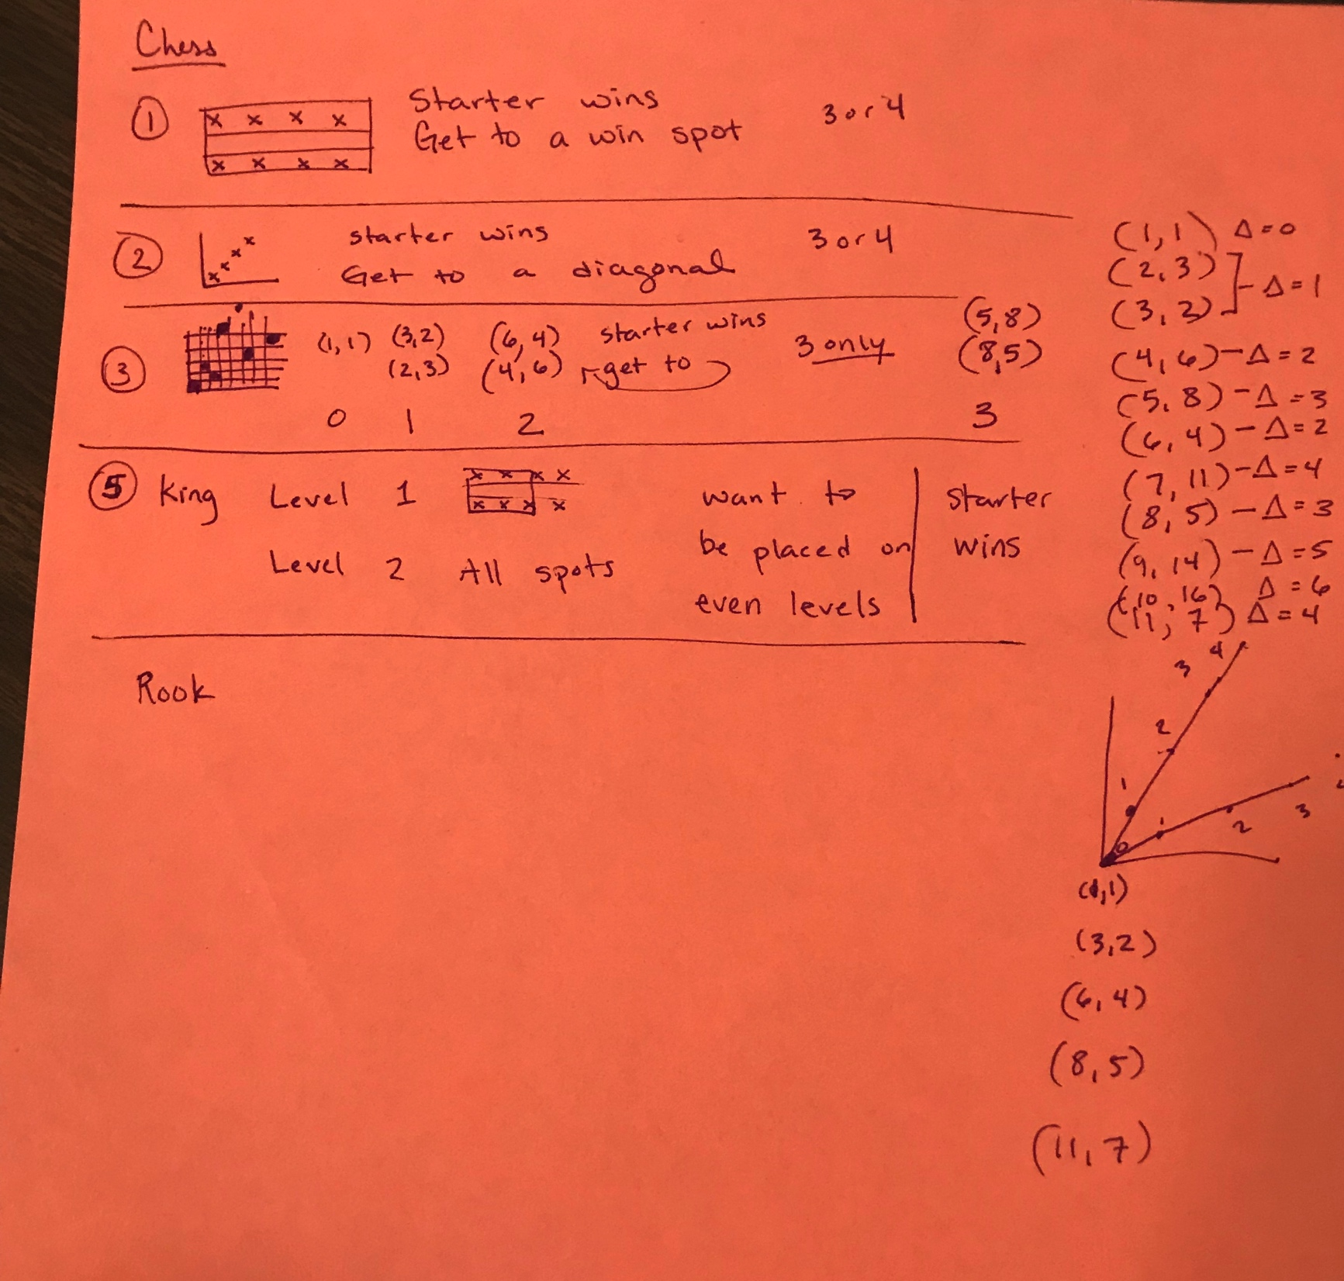
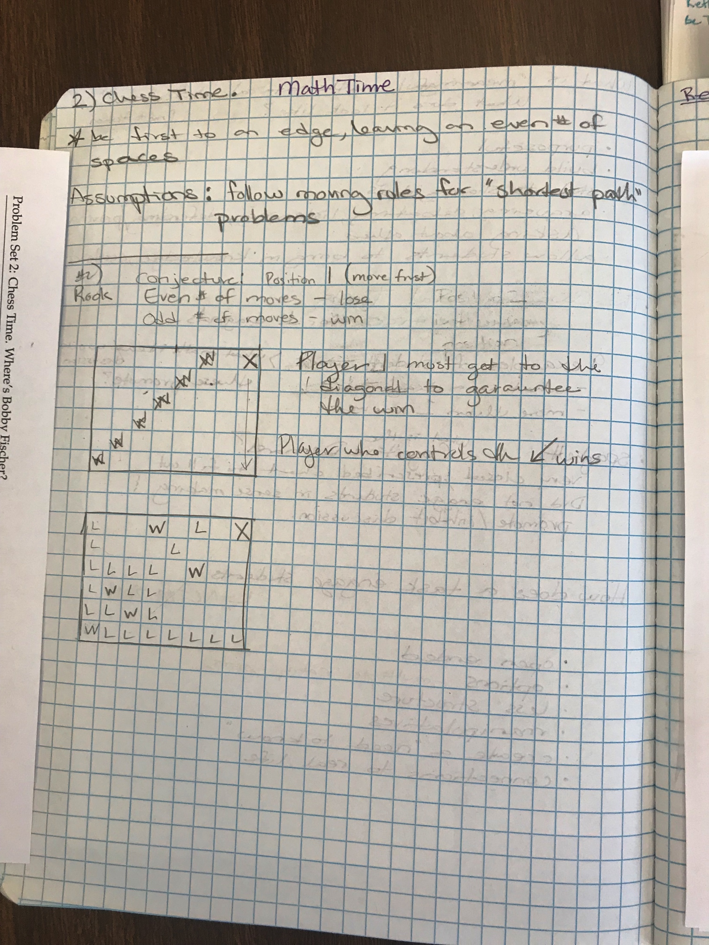
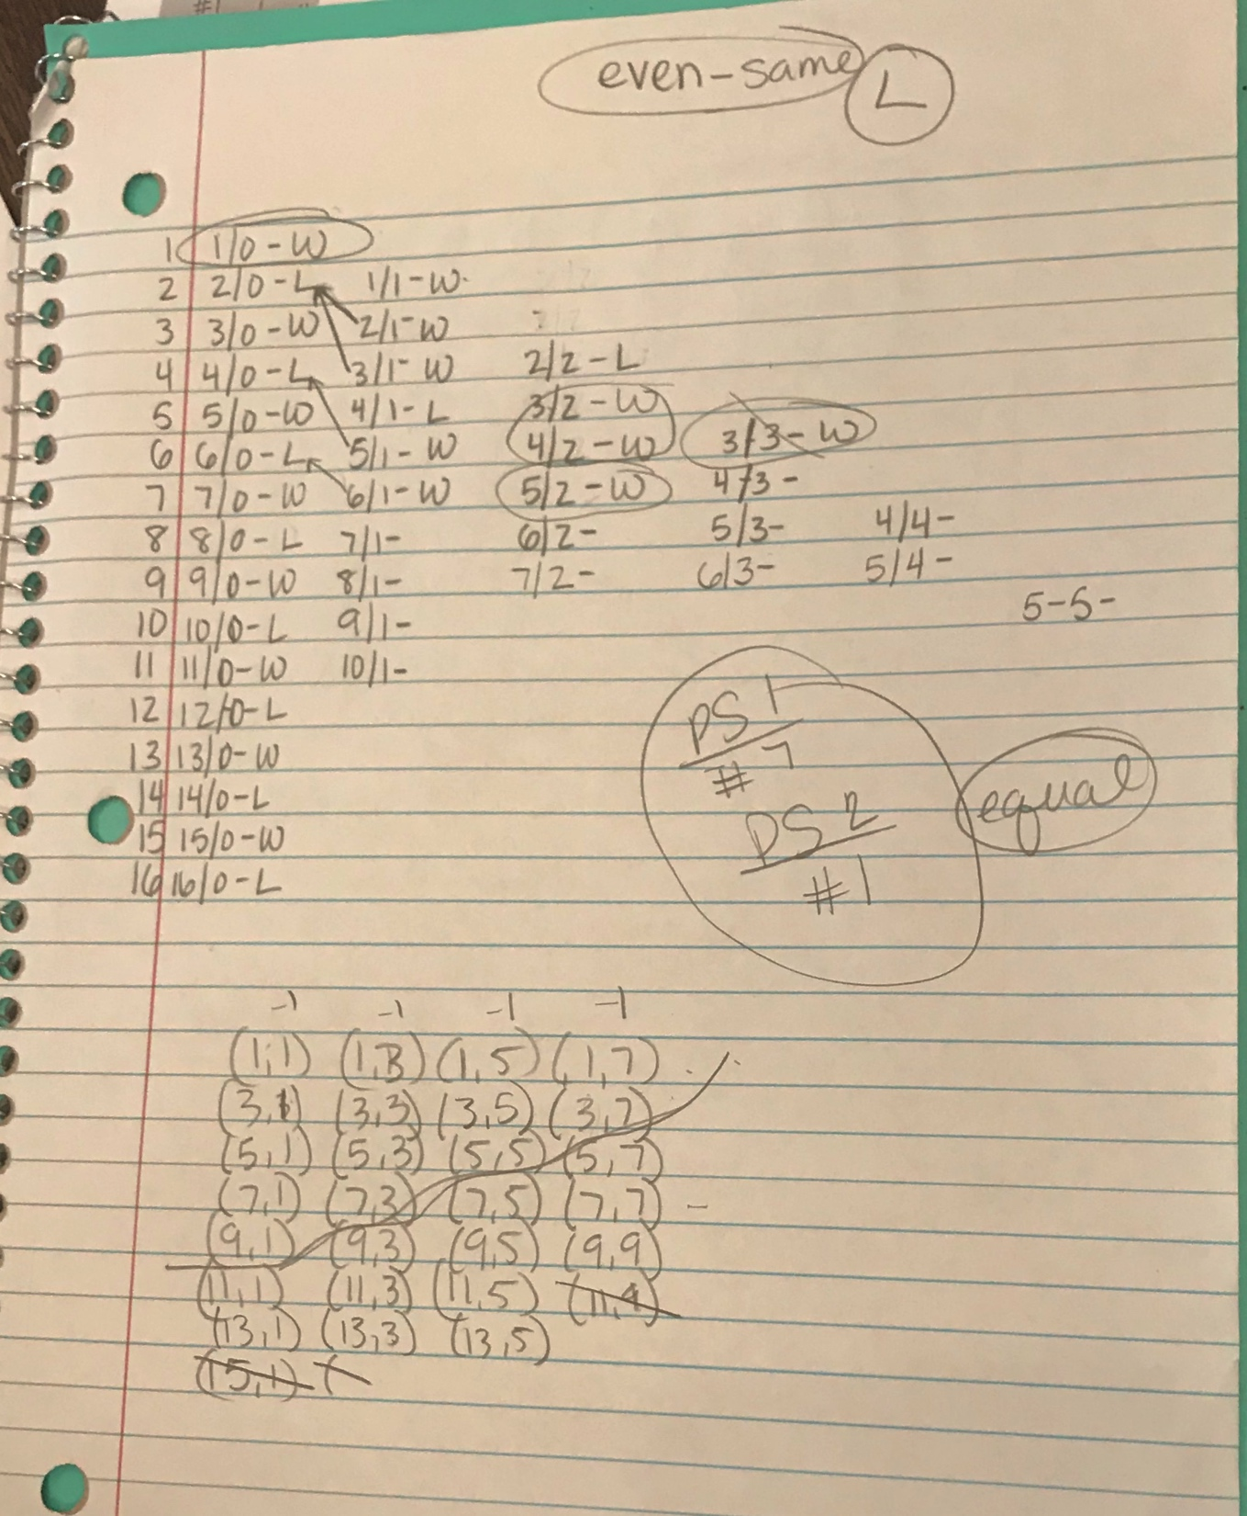
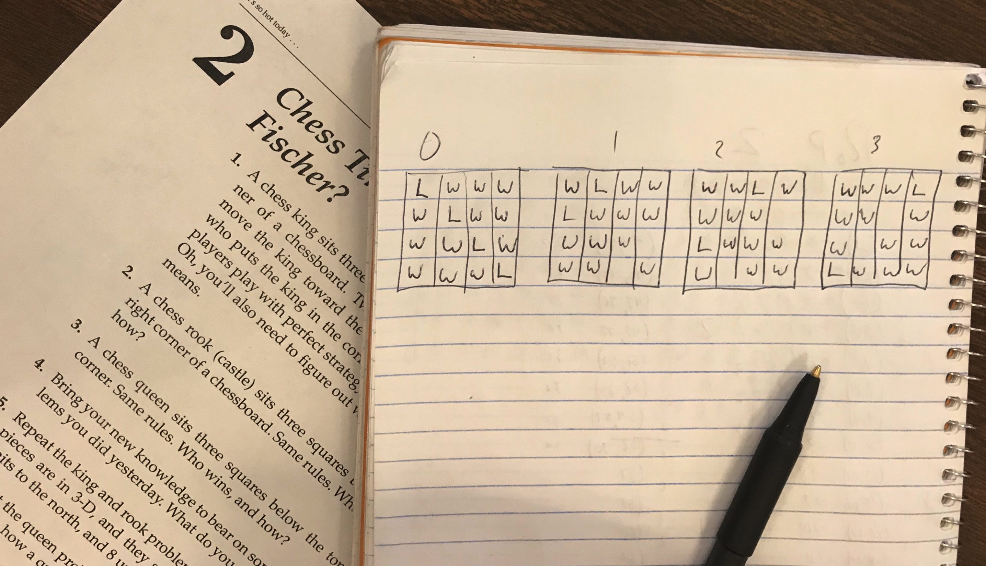
Participant Work

Slide 8
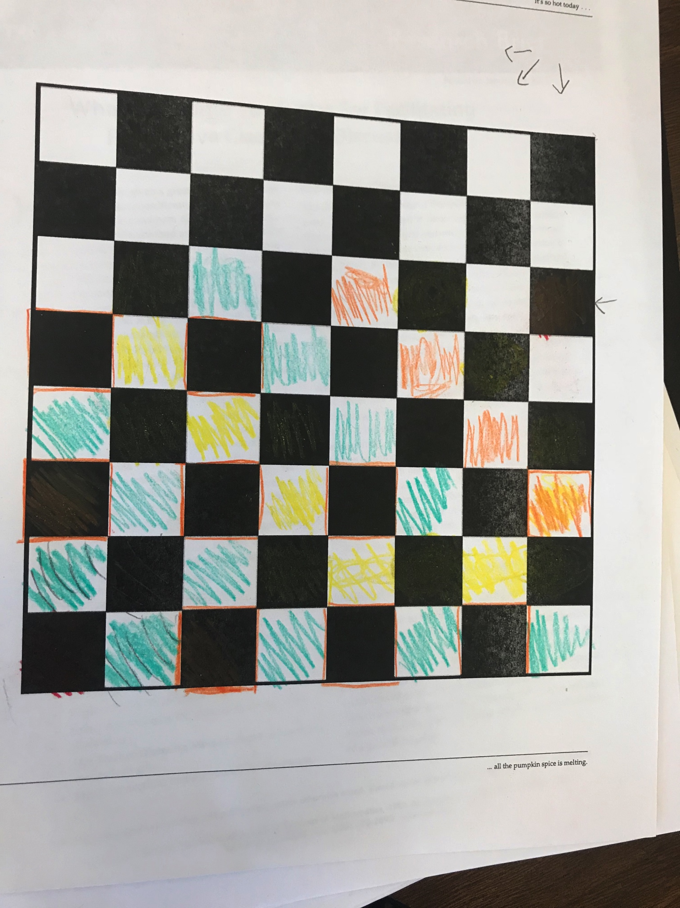
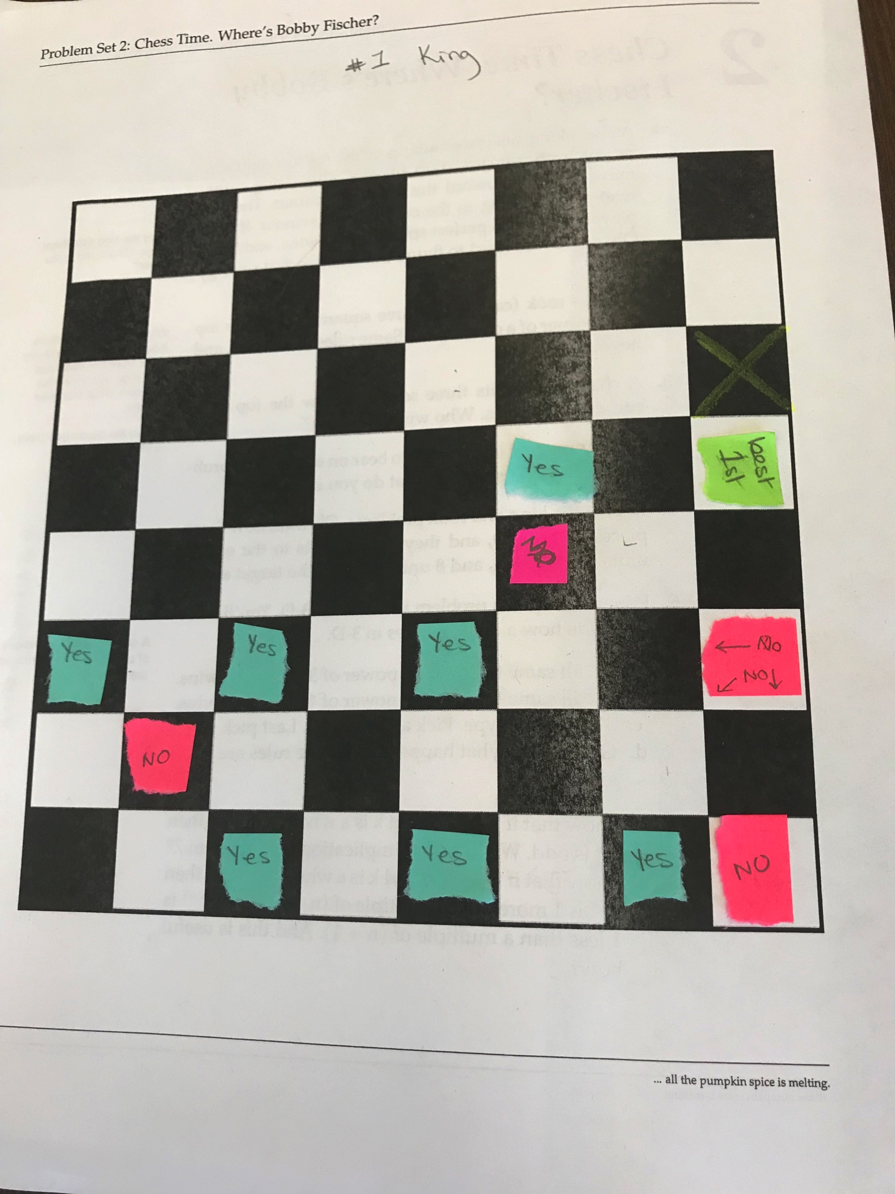

Participant Work

Slide 9



Denver Participants

Slide 10
Chess Time
What do you notice? What questions do you have?
The chess and flag problems were related. The types of flags said went with directions of chess pieces.
Question: Does every chess question have a parallel flag question?
The more freedom a piece had to move, the less choice you had to force a winning move.
The starting position must have something to do with it. Starting on a point (e.g. (8,5)), which are relatively prime must have something to do with it.
Is there a relationship between the starting position and the starting number of flags in each color (when the questions are related)? And what is that relationship?

Slide 11
Pythagorean Triples
I didn’t understand the Eisenstein triples.
There was some relationships with the mod 4s. All the PPT were a combo of 3, 0, and 1. Hypotenuse was always 1 in mod 4.
The multiple of 3, 4, and 5 is in every PPT. (not necessarily distinct numbers).
The hypotenuse cannot be a multiple of 3 or 4. And must be odd.
If the short leg is even, then the other leg has to be odd (and vice versa).
What Becky said…

