Slide 1
PCMI
3 aspect
  For your mathematics
  For your teaching
  For your community
Reflecting on Practice

Slide 2
Reflecting on Practice: Worthwhile Tasks
Session 1
What makes a worthwhile task?

Slide 3
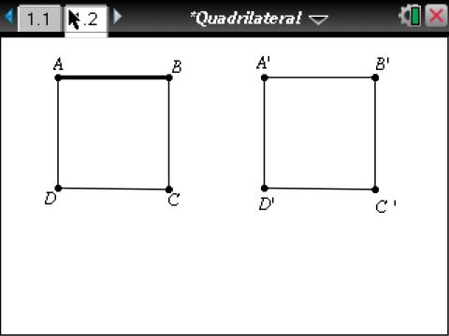
What do you predict will happen to the area if you “slant” the quadrilateral?
Notes:
What might this look like in classrooms?

Slide 4
Bringing it all together
A sixth grade class studying area of polygons in the fall
As you watch the video, consider :
What about the nature of the task promoted or inhibited discussion?

Slide 5
Exponents
The teacher’s goal was that students should know and be able to apply the laws of exponents. The video of this task being implemented is from the TIMSS 1999 video study and takes place in an eighth grade algebra classroom in the US. The tasks in which students are engaged are on the worksheet.

Slide 6
Exponents
An eighth grade class beginning the study of the exponent rules
As you watch the video, consider :
What about the nature of the task promoted or inhibited discussion?

Slide 7
http://www.timssvideo.com/69

Slide 8
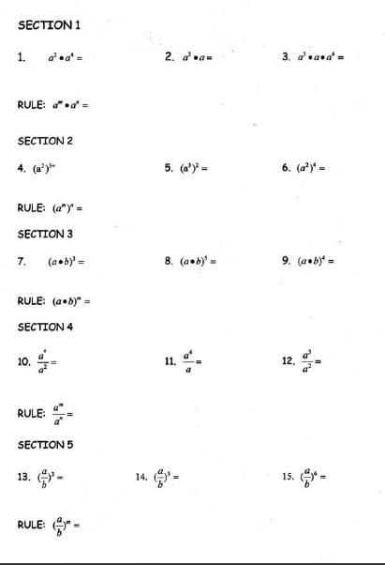
Exponents

Slide 9
At your tables, go around the table round robin with each person offering a thought about difference in the nature of the two tasks with respect to how they promoted or inhibited discussion
Without discussion, continue around the table round robin until no one has new ideas to offer. Then open the table to general thoughts.
Choose one person at your table to record the ideas as you go.

Slide 10
Tasks have to be justified in terms of the learning aims they serve and can work well only if opportunities for pupils to communicate their evolving understanding are built into the planning. (Black & Wiliam, 1998)

Slide 11
Mathematics Teaching Practices: Effective teachers
Establish mathematics goals to focus learning.
Implement tasks that promote reasoning and problem solving.
Use and connect mathematical representations.
Facilitate meaningful mathematical discourse.
Pose purposeful questions.
Build procedural fluency from conceptual understanding.
Support productive struggle in learning math.
Elicit and use evidence of student thinking.
(NCTM, 2014)

Slide 12
What do we mean when we say a “meaningful mathematical discourse”? Lets stop a minute and reflect on why discussions are important.

Slide 13
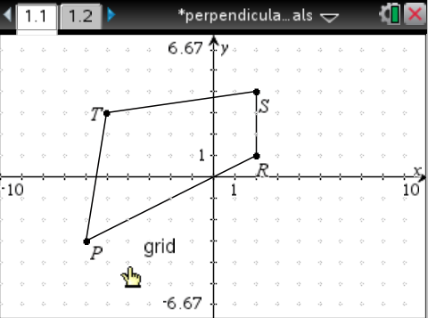
A Quadrilateral
Move vertices R and S to create a quadrilateral whose diagonals are perpendicular to each other.
Related to CCSS Grade 8 Geometry

Slide 14
Student work
With your partner discuss what students might notice and wonder about when looking at these solutions. What mathematical ideas might emerge?

Slide 15
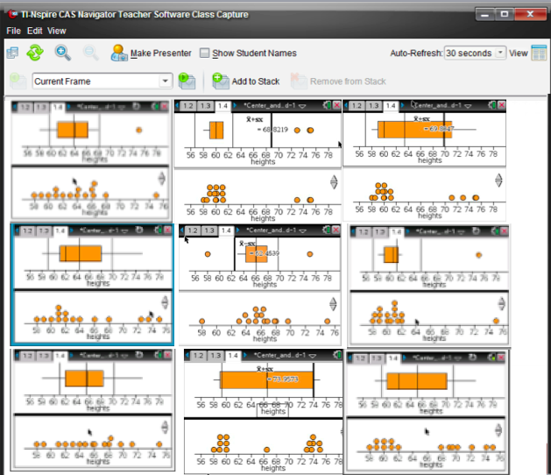
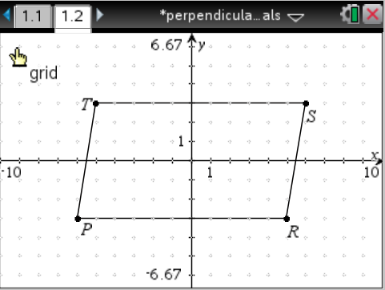
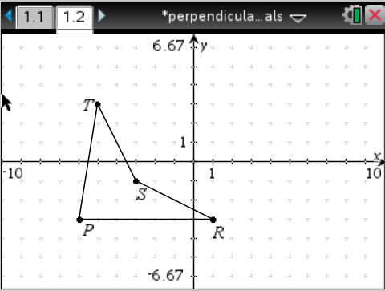
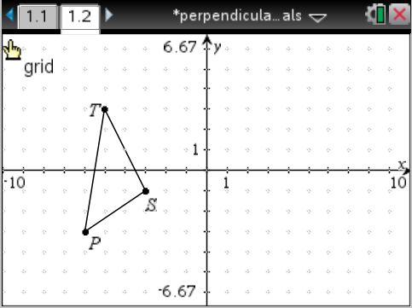
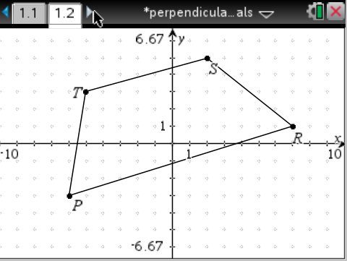
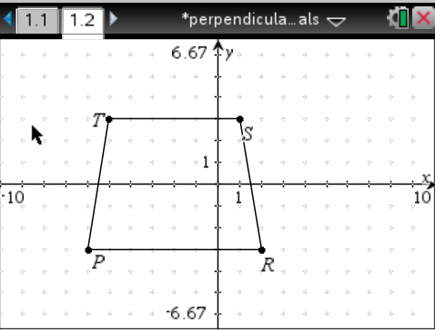
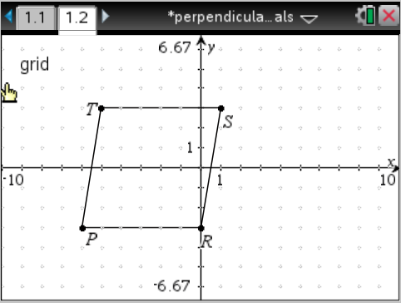
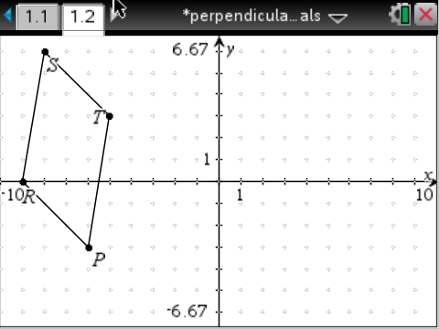
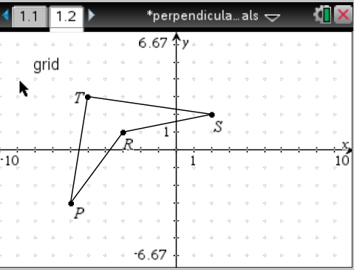
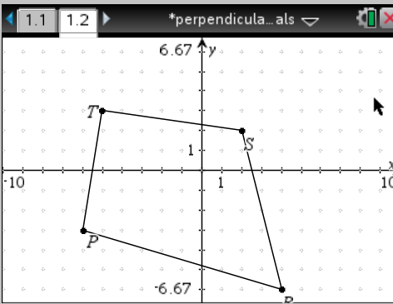

Slide 16
A spaghetti container has a hexagonal base.
Which shape will hold the same amount of spaghetti as the original container and be the most economical?
MDE, 2004

Slide 17
Which shape will hold the same amount of spaghetti and be the most economical?
 | Area of base | Surface area | Volume | Ratio of surface area to volume
Cylinder
Rectangular prism
Shape 3
MDE, 2004

Slide 18
In your table
Another important consideration in a worthwhile task is the level of thinking and reasoning required of students, the cognitive demand. What is different about the nature of this task with respect to cognitive demand than the perpendicular diagonals task?

Slide 19
How did the nature of the tasks we looked at today engage students in reasoning & sense making?

Slide 20
Discussions are important because they surface student thinking, which should inform our next steps as teachers – not to “set them straight” but to work together to negotiate mathematical understanding.

Slide 21
NCTM Research Brief on Productive Discussion
Available online

Slide 22
Reference
Black, P. & Wiliam, D. (1998). “Inside the Black Box: Raising Standards Through Classroom Assessment”. Phi Delta Kappan. Oct. pp. 139-148.
Bringing It All Together (2012). Video clip from T-Cubed Common Core State Standards Professional Development Workshop. Brennan, B., Olson J. & the Janus Group. Curriculum Research & Development Group. University of Hawaii at Manoa, Honolulu HI (2009).
Cirillo, M. (2013). What Are Some Strategies for Facilitating Productive Classroom Discussions? NCTM Research Brief. S, DeLeeuw, Series Editor, Reston VA: National Council of Teachers of Mathematics. http://www.nctm.org/news/content.aspx?id=35386

Slide 23
References
National Council of Teachers of Mathematics. (2015). Principles to Action. Reston VA: The Council
Timss video series 1999. US2 Exponents
http://www.timssvideo.com/videos/mathematics/
United%20States

