Slide 1
Reflecting on Practice: Worthwhile Tasks

Slide 2
Session 2
Where we were
Where we’re going

Slide 3
Question: If r=2, find the circumference of the circle
Answer: C=4π

Slide 4
Another question
Question: If r=2, find the circumference of the circle
Answer: C=4π
Is this a better question?
Will the circumference and the area of a circle ever be the same? Why or why not?

Slide 5
In the figure below, what fraction of the rectangle ABCD is shaded?
A
B
1/6
1/5
1/4
1/3
e) 1/2
D
C
NCES, Grade 8, 1996

Slide 6
In the figure below, what fraction of the rectangle ABCD is shaded?
A
B
1/6 (5%)
1/5 (3%)
1/4 (24%)
1/3* (66%)
e) 1/2 (2%)
D
C
NCES, Grade 8, 1996

Slide 7
Color ¼ of the drawing.
Dekker & Querelle, 2002

Slide 8
Another approach to ¼
(Dekker & Querrelle)

Slide 9
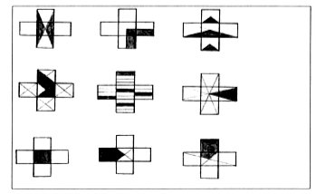
In which is ¼ of the shape shaded?
Dekker & Querelle, 2002

Slide 10
What did you like or not like about this task in terms of promoting discussion and eliciting student understanding?

Slide 11
Tasks should be chosen so that there is an opportunity for error in reasoning or thinking that opens up an opportunity to discuss or explain- not just an error in the next step (lost a negative sign or multiplied incorrectly).

Slide 12
Choose one of the problems and find a solution

Slide 13
Choose one of the problems and find a solution
Share your solution with one or two others that did the same task
Write down a few ways that the task could promote discussion and elicit evidence of student thinking and understanding

Slide 14
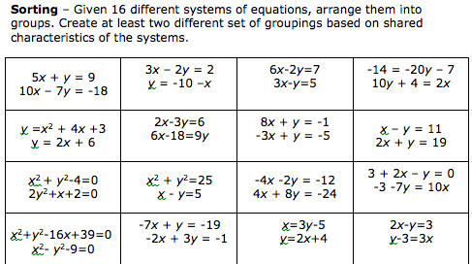
Sort according to some criteria

Slide 15
Solve the system

Slide 16
Tasks should be chosen so that there is an opportunity for error in reasoning or thinking that opens up an opportunity to discuss or explain- not just an error in the next step (lost a negative sign or multiplied incorrectly).

Slide 17
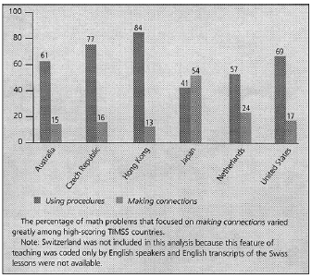
Types of math problems presented
Hiebert & Stigler, 2004

Slide 18
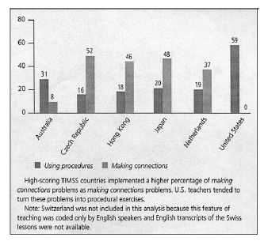
How teachers implemented making connections
math problems
Hiebert & Stigler, 2004

Slide 19
Mathematics Teaching Practices: Effective teachers
Establish mathematics goals to focus learning.
Implement tasks that promote reasoning and problem solving.
Use and connect mathematical representations.
Facilitate meaningful mathematical discourse.
Pose purposeful questions.
Build procedural fluency from conceptual understanding.
Support productive struggle in learning math.
Elicit and use evidence of student thinking.
(NCTM, 2014)

Slide 20
For yourself (write in your journal):
What is one message from this session that you would want to bring back to another teacher? How would you make it meaningful and accessible for them (when they haven’t been here with you)?
To write on index card & hand in:
What question would you like to raise for us to think about as we move forward?
When done ... Be back in the room by 4:25

Slide 21
Readings
Hiebert, J., & Stigler, J. (2004). Improving Mathematics Teaching Improving Achievement in Math and Science, 64(5), 12-17.
Sanchez, W. (2013). Open ended questions and the process standards. 107(3). Mathematics Teacher.

Slide 22
References
Dekker,T. & Querelle, N. (2002). Great assessment problems (and how to solve them). CATCH project www.fi.uu.nl/catch
Hiebert, J., & Stigler, J. (2004). Improving Mathematics Teaching Improving Achievement in Math and Science, 64(5), 12-17.
National Council of Teachers of Mathematics. (2014). Principles to action: Ensuring mathematical success for all students. Reston VA: The Council
Sanchez, W. (2013). Open ended questions and the process standards. 107(3). Mathematics Teacher.
.

