Slide 1
Making Rich Tasks Work: Assessment for Learning in Action
William Thill
PCMI-LA
Scaling the Teaching Curve
Saturday, January 21, 2017

Slide 2
Schedule For the Workshop
Do/ Analyze the math task (Part 1)
Designing (Part II)
Give receive Feedback (Part II)

Slide 3
Goals to take away from this
See how analyzing the mathematics of a task influences how you’ll engineer classroom time with your students.
Use “five non-negotiables” of assessment for learning as a framework to use rich tasks effectively in your classroom

Slide 4
Park City Mathematics Institute/IAS
Teacher Leadership Program
A 3-week residential program for secondary school teachers:
Do meaningful mathematics
Reflect Deeply on effective teaching
Become a Resource for other teachers
To learn more: http://pcmi.ias.edu/program-sstp/
OR
http://mathforum.org/pcmi/

Slide 5
What I don’t plan to do
Give handouts of lessons.
Tell you what will work in your class.
Be an authority

Slide 6


Norms for Participants
Ask, Don’t Tell. Share.
Focus: what can I learn from those next to me? What do I have to offer?
Keep the right Hat on this session:
Student Hat? Teacher Hat?

Slide 7
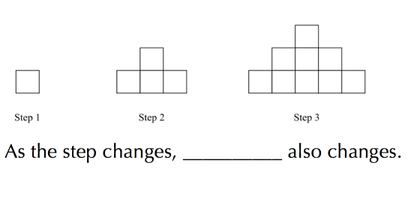
Doing the Math:

Slide 8
Our Task:
Mathematical TOPICS?
Mathematical Practices?

Slide 9
What’s in this task?
Mathematical PRACTICES
Brainstorm.
PS Common Core mathematical practices in your packet.

Slide 10
Using the patterns problem to help students learn
“This is a cool problem.”
“ I will use this in my class.”
Let’s go beyond this. … HOW? With what goal in mind?

Slide 11
Non-negotiables describing
Effective Assessment for Learning
Clarify and share learning intentions and criteria for success with students.
Engineer effective classroom discussions, questions, and learning tasks.
Provide feedback that moves students forward.
Activate students as the owners of their own learning.
Encourage students to be instructional resources for one another.
From
Leahy, et al., Classroom Assessment, Minute by Minute, Day by Day. Educational Leadership : November 2005, Volume 63, Number 3. URL: http://bit.ly/Leahyarticle5nns

Slide 12
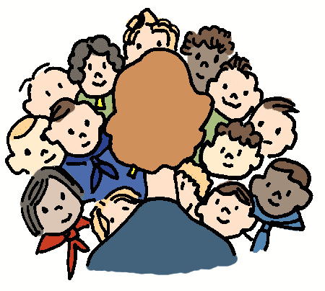
Making it Work:
1. GOALS (many are possible):
  One mathematical content goal, and
  One mathematical practice to design around.
2. CRITERIA FOR (EVIDENCE OF) SUCCESS:
  What does it look like in student work? Possible Errors?
  What does it sound like in student comments? Possible Misconceptions?

Slide 13
The Design
QUESTIONS / CHECKPOINTS:
Plan at one or two questions/checkpoints that will give you good feedback about student progress on your goals. Why will these work?
FEEDBACK to students:
How will students receive feedback about their progress? Who will deliver the feedback? How can it be delivered?

Slide 14

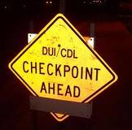

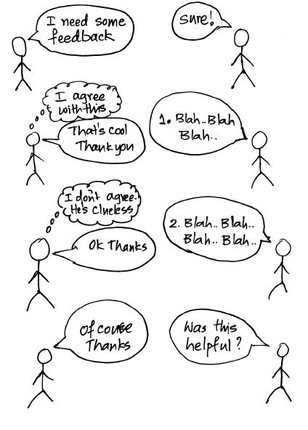
On Poster Paper
Goals
Evidence
Questions / Checks
Feedback

Slide 15
Gallery Walk (Post-its)
Specific Feedback on the LINKAGE between:
Their goals ← → Their Evidence, Questions, Feedback
Then see what your colleagues said about your design work

Slide 16
My Experience with another task
The mathematics I saw in this task
Goals for my students topics and practices
What I looked for in student work
What I learned about student understanding
What I would do differently

Slide 17
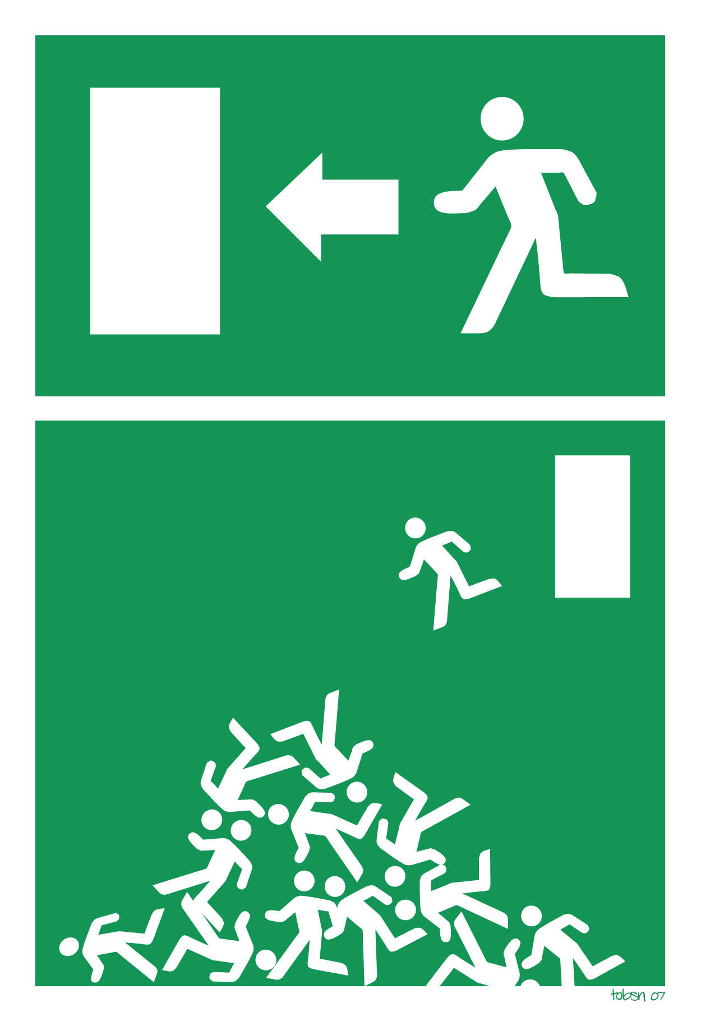
Exit Task
What did you take away from your time thinking about this rich task?

Slide 18
To Learn More:
Leahy, et al., Classroom Assessment, Minute by Minute, Day by Day.
Educational Leadership : November 2005 | Volume 63 | Number 3
URL: http://bit.ly/Leahyarticle5nns

