Slide 1
Reflecting on Practice: Worthwhile Tasks
Session 3
Implementing Tasks: Maintaining Fidelity

Slide 2
In this figure as the step changes, the _____________ also changes
Step 1
Step 2
Step 3
Peterson, 2006

Slide 3
In this figure as the step changes, the _____________ also changes

Slide 4
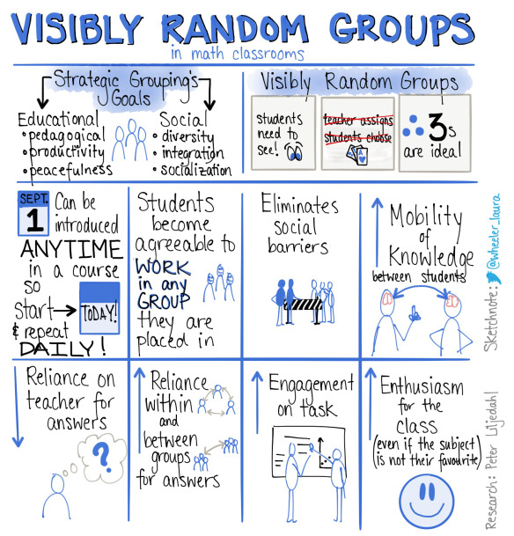
Peter Liljedahl

Slide 5
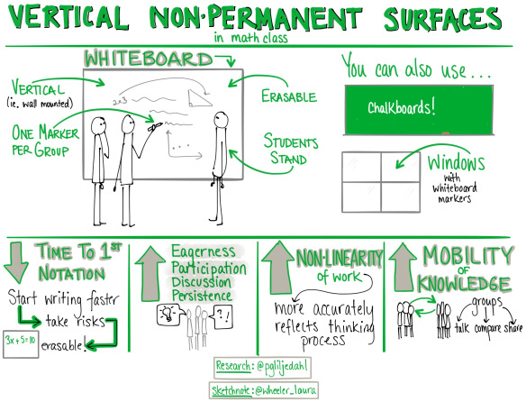
Peter Liljedahl

Slide 6
Investigate
With your trio, pick one of the attributes in our list and investigate how it changes. Make a conjecture and try to prove it. How would a graph, a table, and/or an equation support your conclusion?
(If time, explore a 2nd or 3rd property)

Slide 7
Putting on your Teacher Hat

Slide 8
With your trio, decide what your lesson goal(s) will be
Possible goals:
Distinguish between linear and quadratic relationships
Distinguish between closed form and recursive rules for sequences
Interpret numerical, algebraic and geometric representations of a mathematical concept
Describe a geometric pattern by an algebraic expression
Recognize a quadratic relationship and be able to find a closed form rule for the relationship
Recognize and be able to describe the components of an arithmetic sequence
Explain what rate of change means in different situations

Slide 9
Select and Sequence
As a trio, keeping your learning goal in mind, walk around and select a few examples of work that you would want to have your class discuss.
Sequence the work in the order in which you want the discussion to take place and be ready to defend your choice of sequence for the discussion.
Once you are finished, sit at any table with your trio (move chairs if you need ☺)

Slide 10
Connections
It is important to bring ideas together for students.
What connections would you want students to discuss? How would you help them see those connections?

Slide 11
Possible mathematical connections
Which changes led to linear equations and which lead to quadratic? Is there an explanation?
What were the advantages and disadvantages of different approaches (symbolic vs. tables vs. graphs vs diagrams)?
What is the distinction between patterns and proof? Is this important? Why or why not?
Identify where it was important to “attend to precision”.

Slide 12
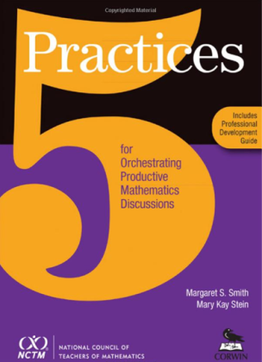
The 5 Practices
Anticipate
Monitor
Select
Sequence
Connect
Smith & Stein, 2011

Slide 13
Consider the task we just looked at and it’s implementation.
As a student, what was useful about this task? What did you like? What didn’t you like?

Slide 14
Consider the task we just looked at and it’s implementation.
As a teacher, what was useful to you? What did you like? What didn’t you like? What would you change? How would you change it?

Slide 15
Reflecting on Practice: Worthwhile Tasks
Session 1 – What Makes a Worthwhile Task
Session 2 – Adapting Tasks to make them Worthwhile
Session 3 – Implementing Tasks: Maintaining Fidelity

Slide 16
References
Horn, I. (2012). Strength in numbers: Collaborative learning in secondary mathematics. Reston VA: National Council of Teachers of Mathematics
Peterson, B. (2006). Linear and quadratic change: A problem from Japan. The Mathematics Teacher, 100(3). Reston VA: National Council of Teachers of Mathematics.
Smith, M., & Stein, M.(2011). 5 practices for orchestrating productive mathematics discussions. Reston VA: National Council of Teachers of Mathematics

