Slide 1
PCMI November Outreach Weekend
12-13 November 2016
Math!

Slide 2
Survivor Time - Morning
What did you notice about the 21-Flags Survivor Game?
Little time given on Survivor. Didn’t notice until end that they were “screwed.”
Grouping pennies was useful.
Multiples of 4 bad. Seems to be true for Game 4 too.
What about the other games? (Specifically games 2-8)
In General: What was the winning strategy at the end? How to win from there… Working backwards.
Looked at different combos by grouping (Game #3) to see what would win. What would wipe the other out?
Used a grid. Looked at 2 variables (coordinate plane?).
Correct language was important for discussing the scenarios – are we talking about leaving team A with X or team B? Be clear.
Looked at groupings and combos that were winning/losing scenarios.

Slide 3
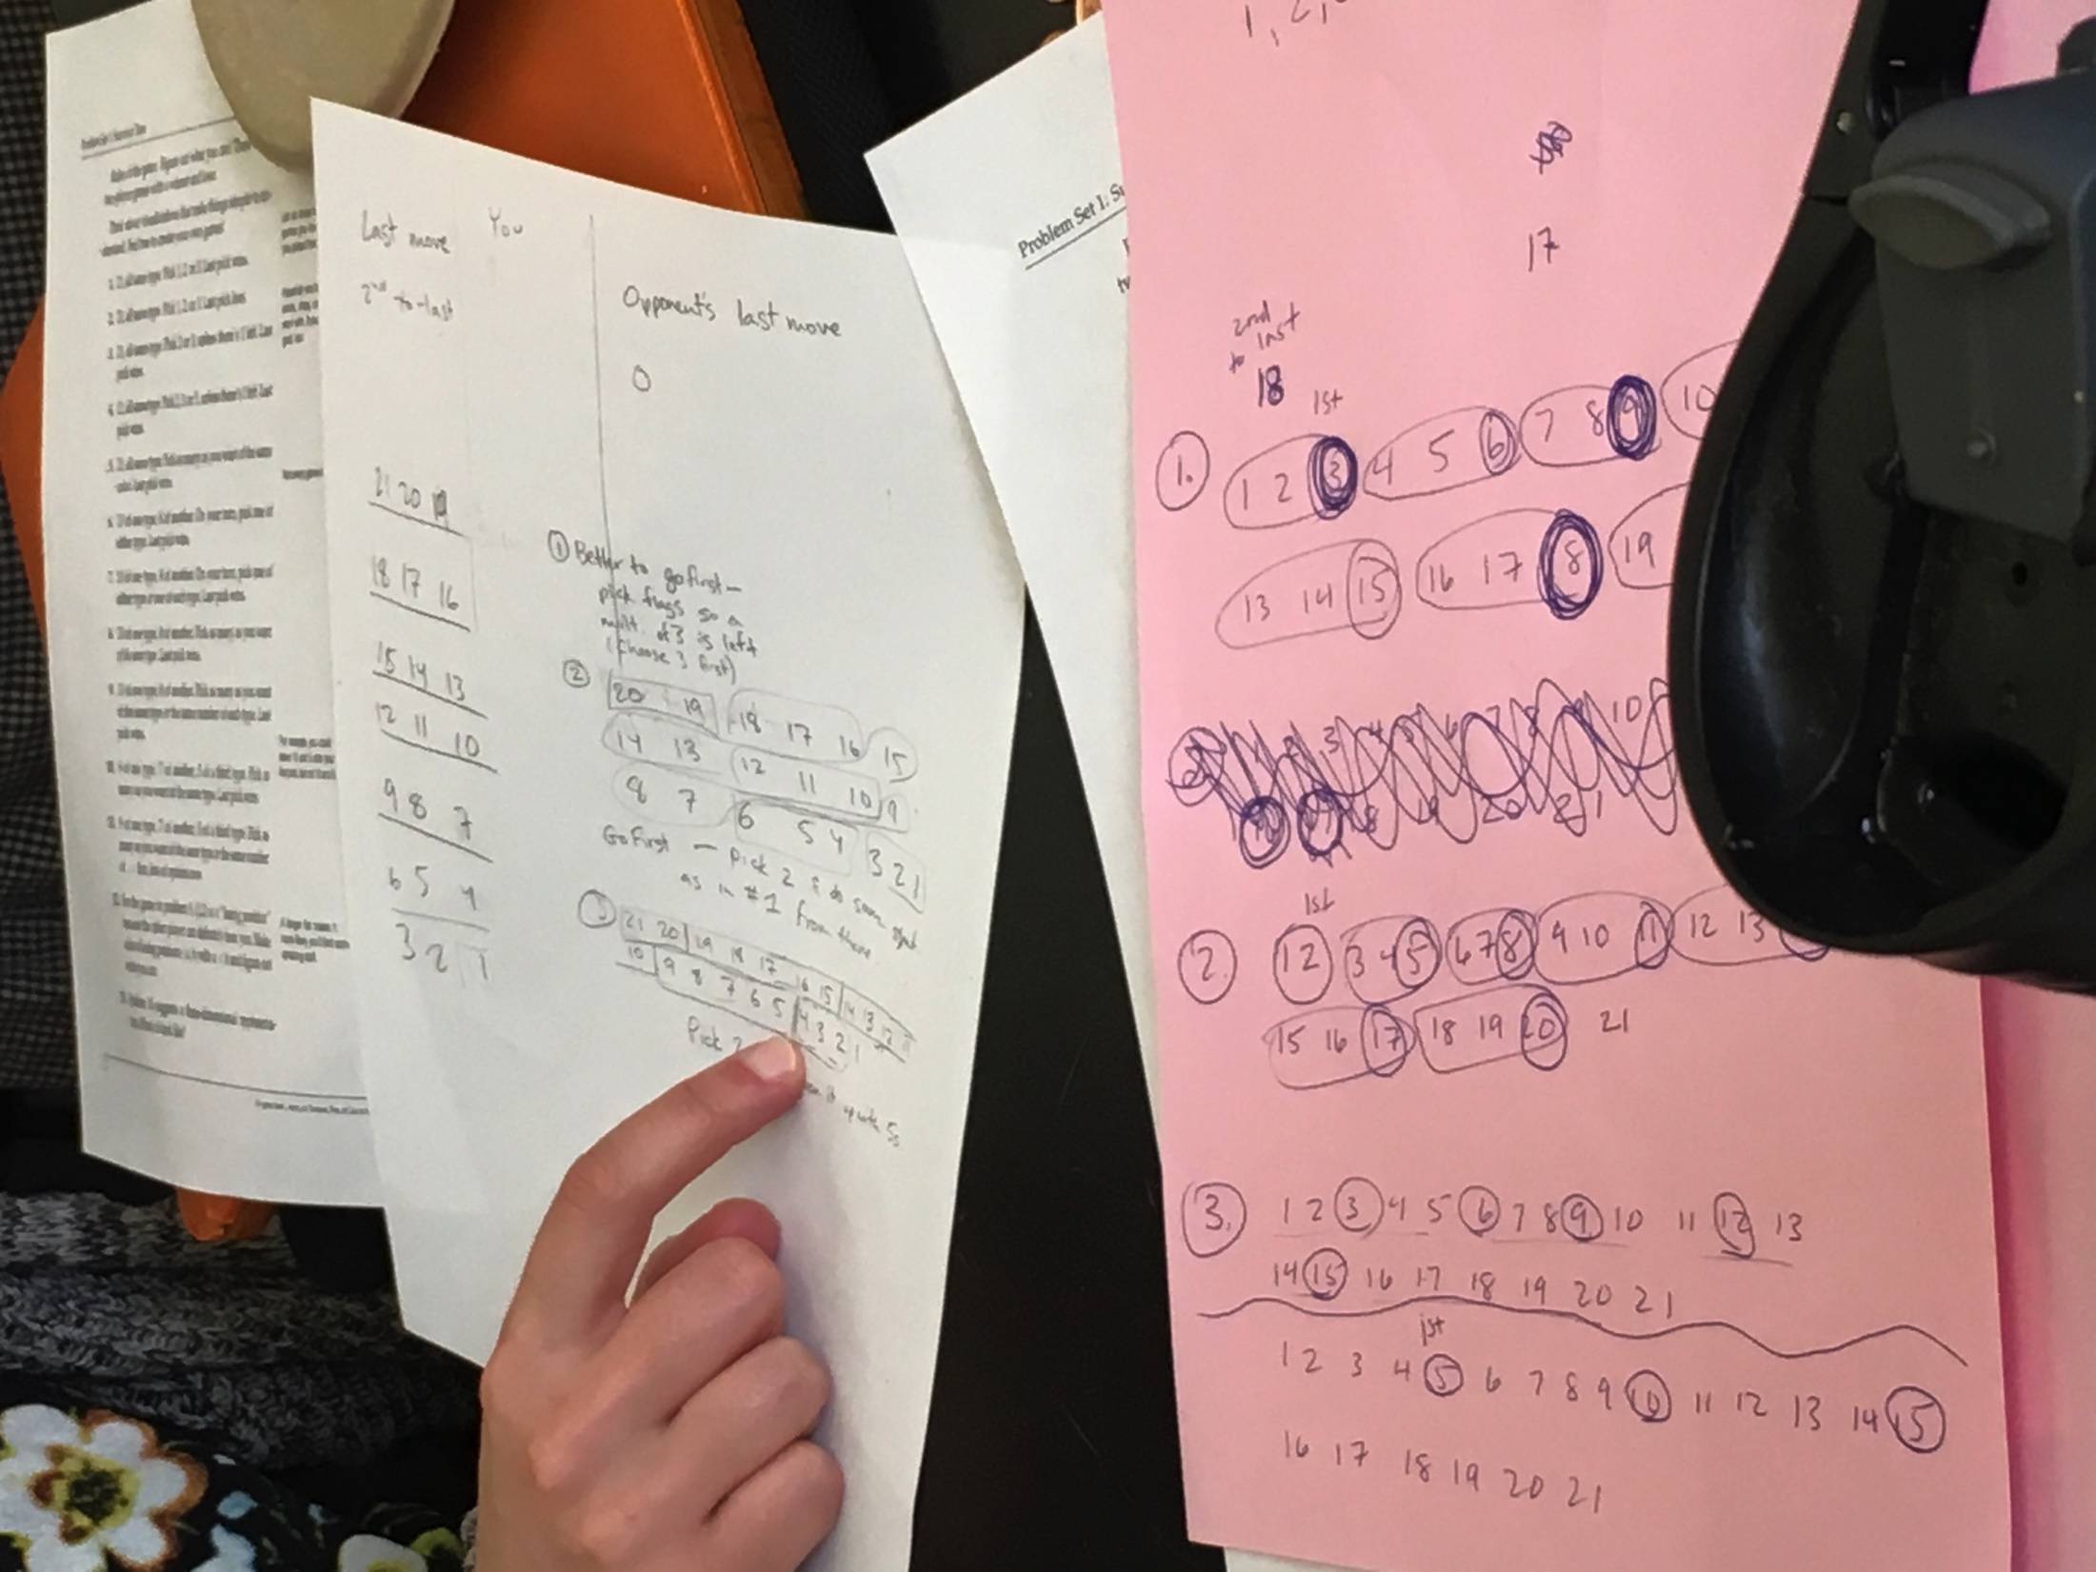
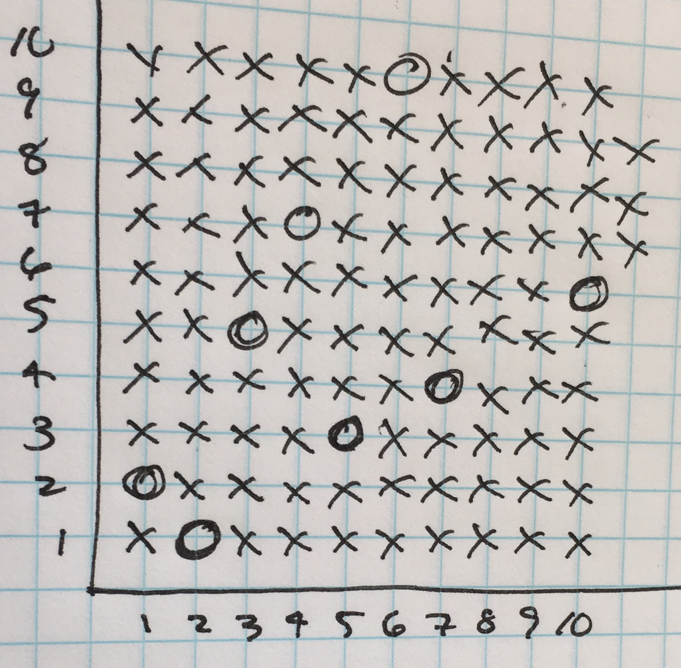
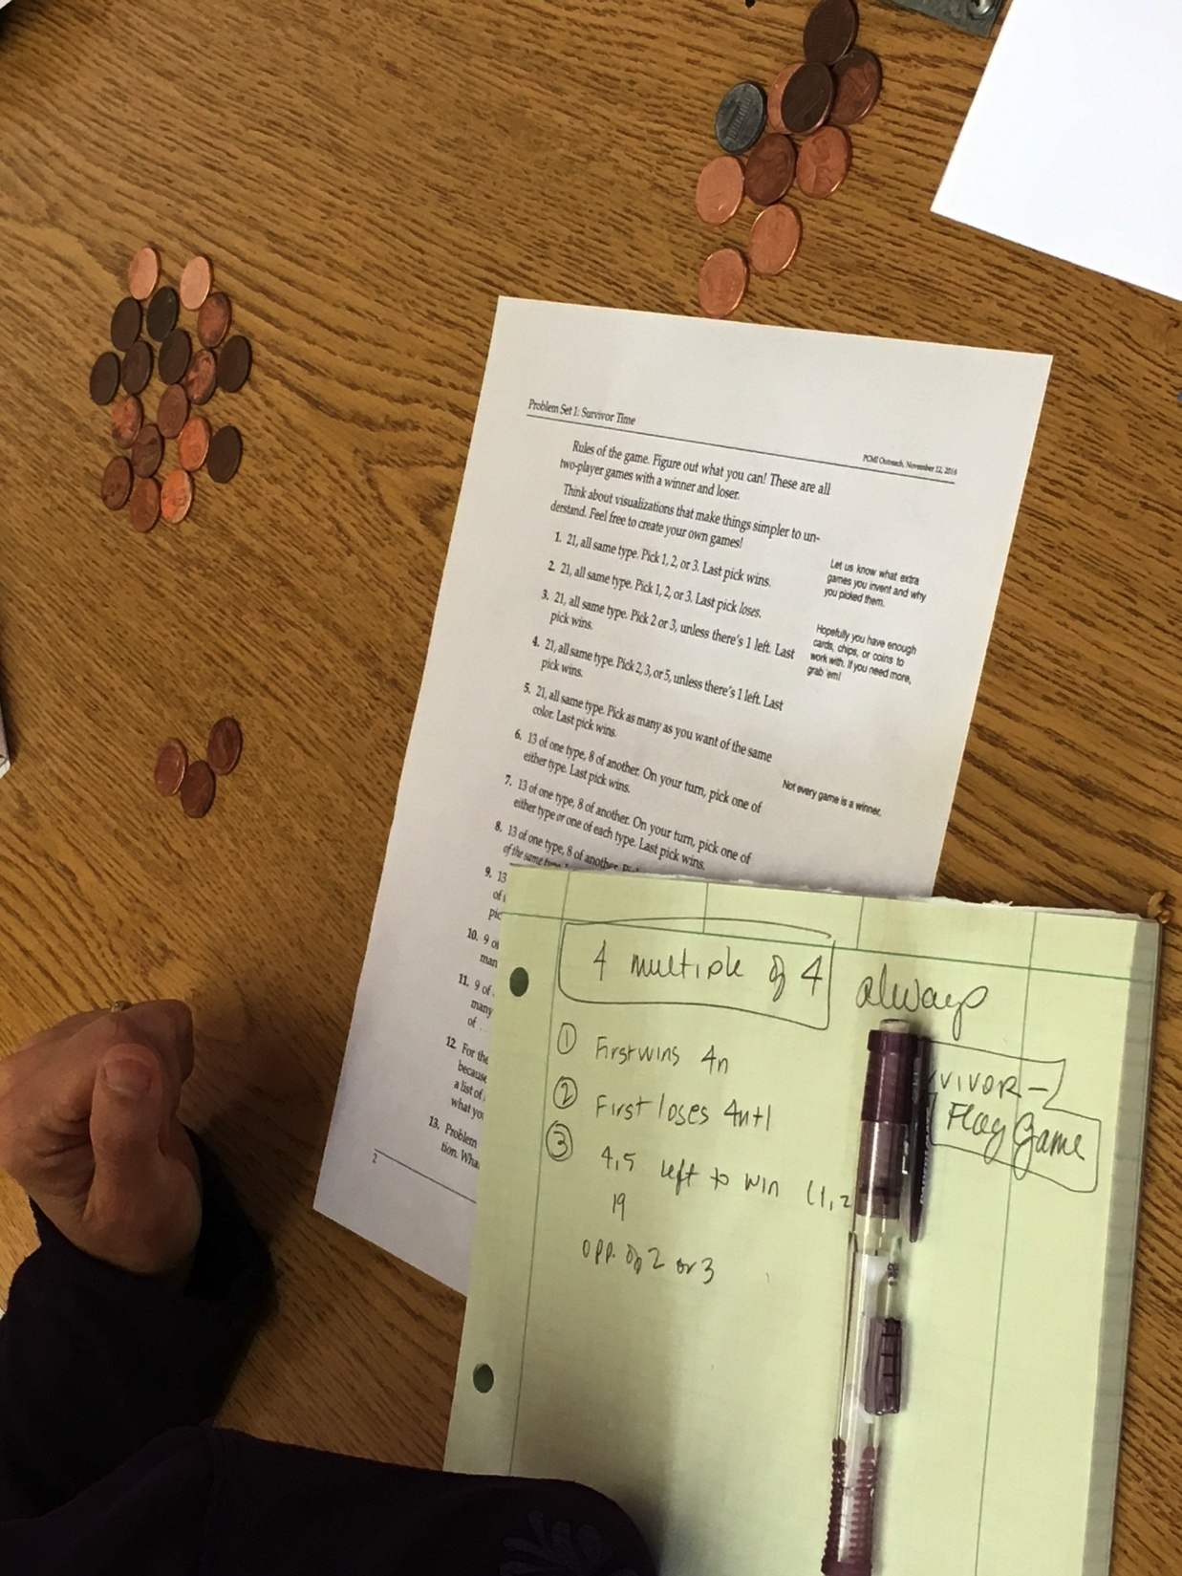
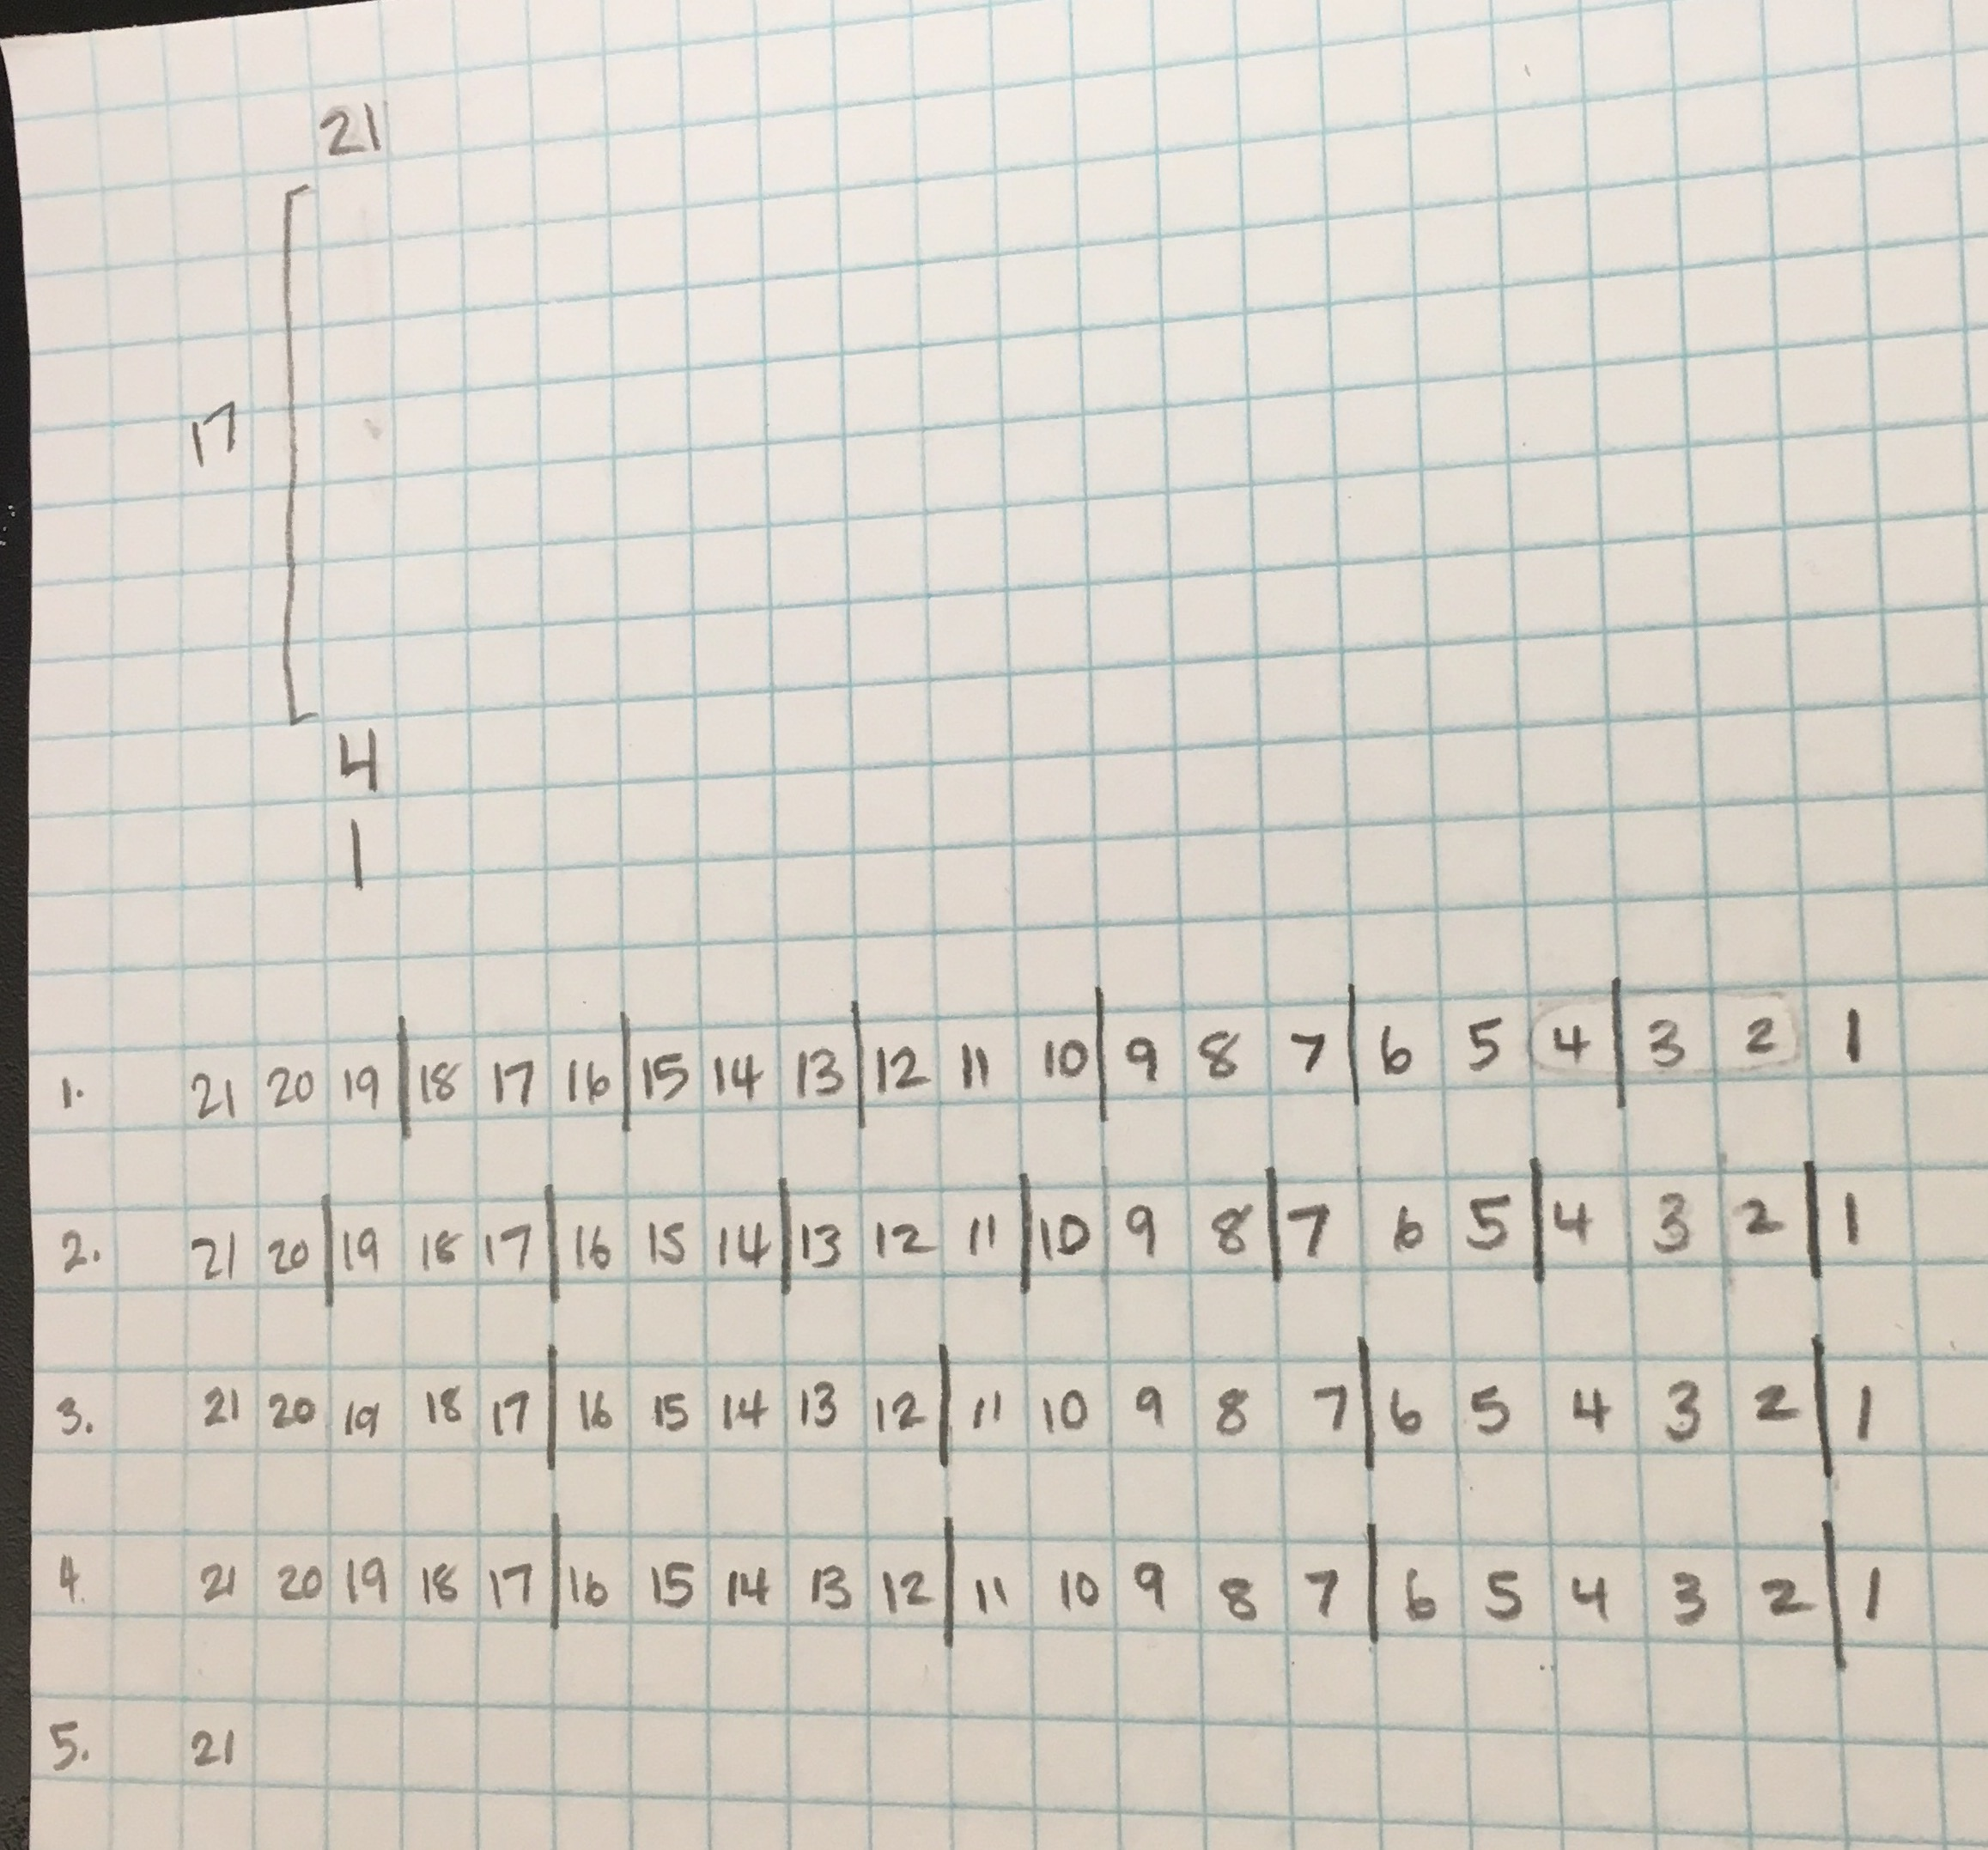
Participant Work

Slide 4
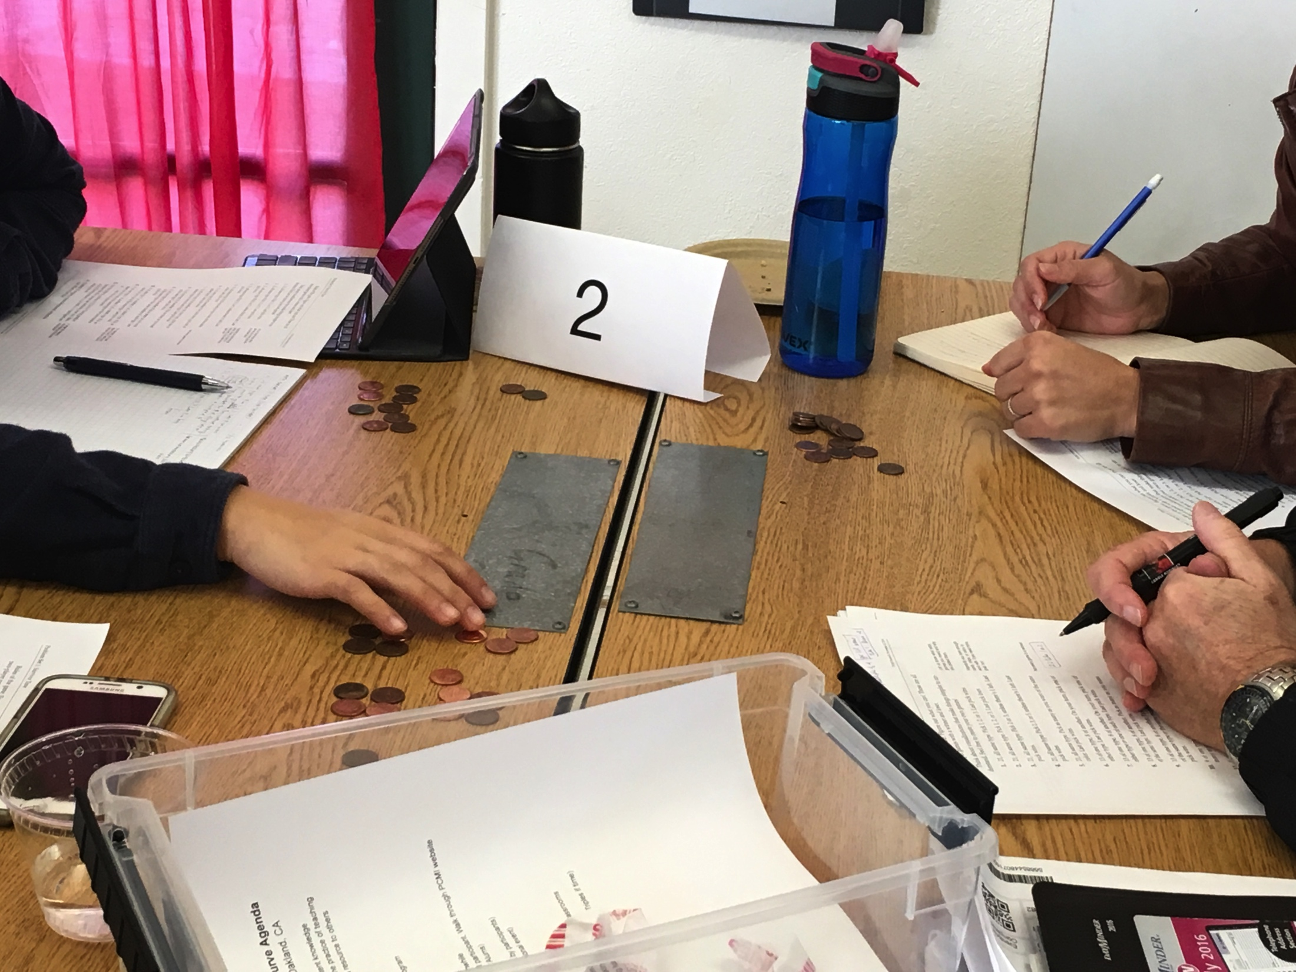
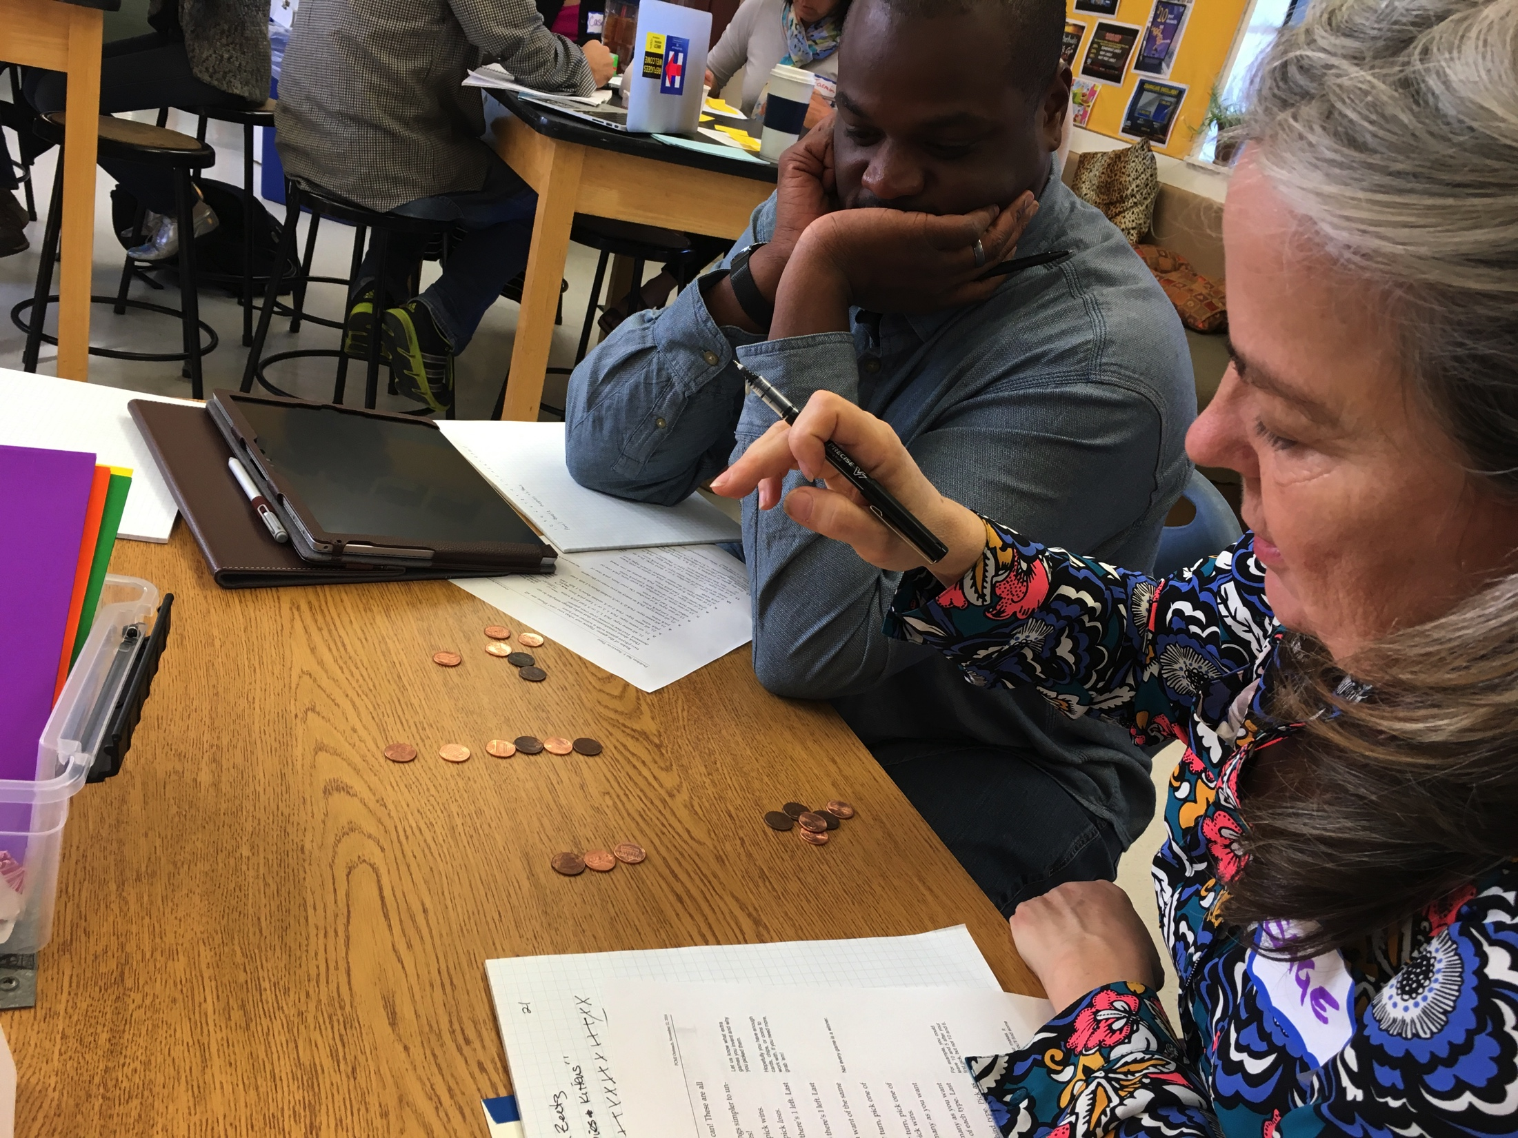
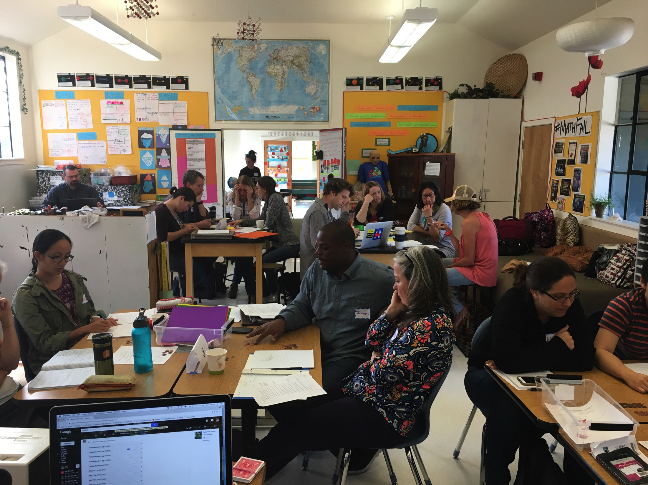
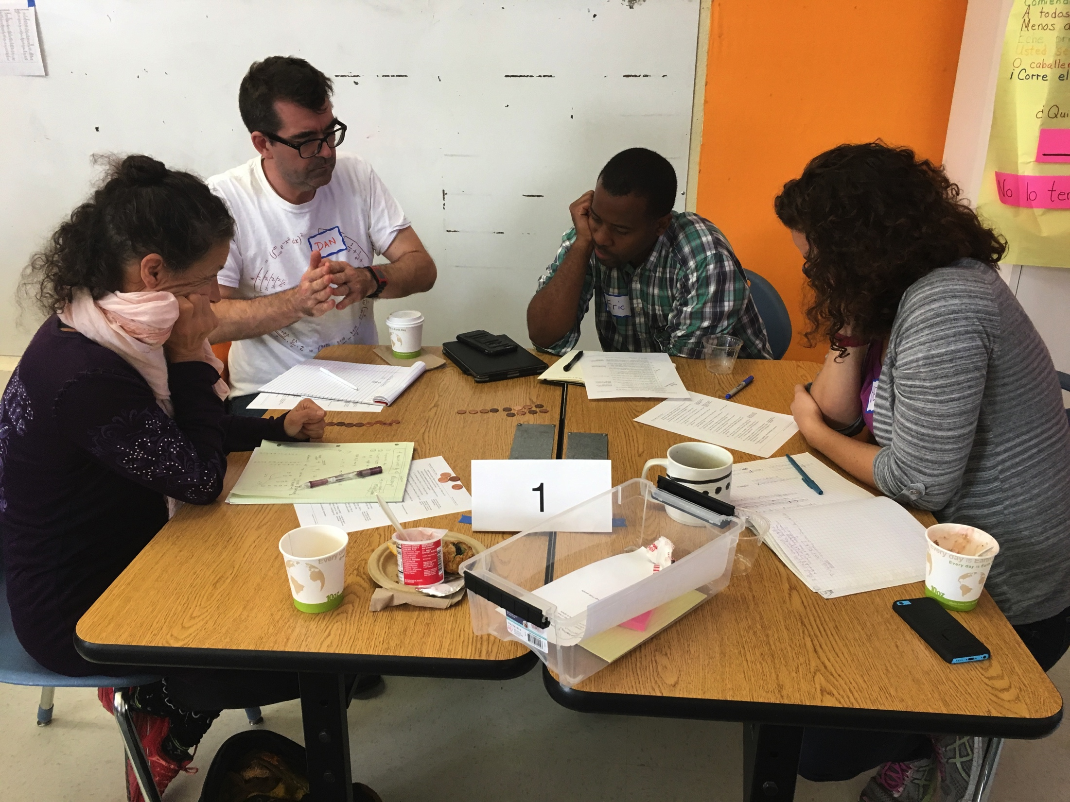
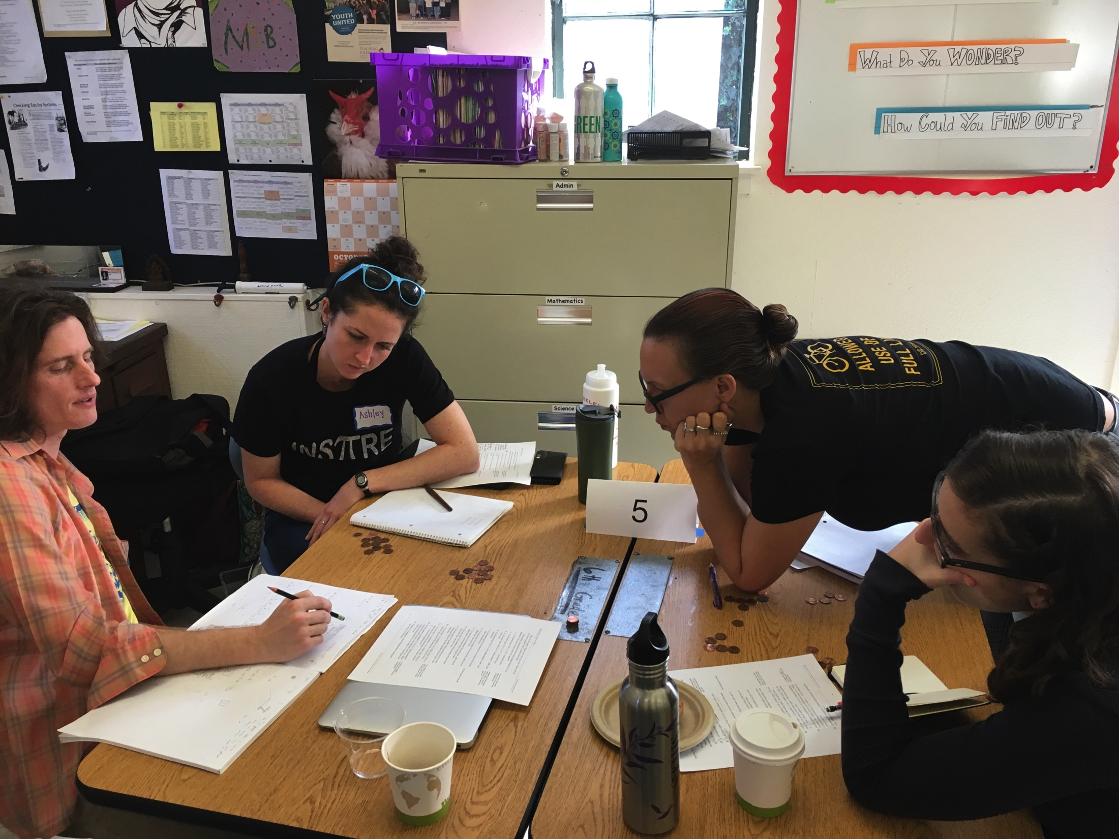
Morning Math!

Slide 5
Survivor Time - Afternoon
What did you notice about the other games?
Game 7: Strategy of maintaining even-even in both piles.
Experimented with the coordinate plane – still working through to see what combos win. Got to the idea of one even number helping (Game 7 as well).
What questions do you have? Wonderings?
Can someone explain how the 3D representation works (For #13).
Seems like there is a favor to being either first or second player. Doesn’t seem to be a game where it doesn’t matter if you go first or second.
Noticed that the beginning game position for #9 was the losing position. And we couldn’t solve #9 until we did #12.
If you leave the piles with 1 more than the other one on #9, then you can win.
Could turn #10 into #8. (strategies of tying other games together)
Is there a significance here with Fibonacci numbers?
#12: Wythoff Sequence?

Slide 6
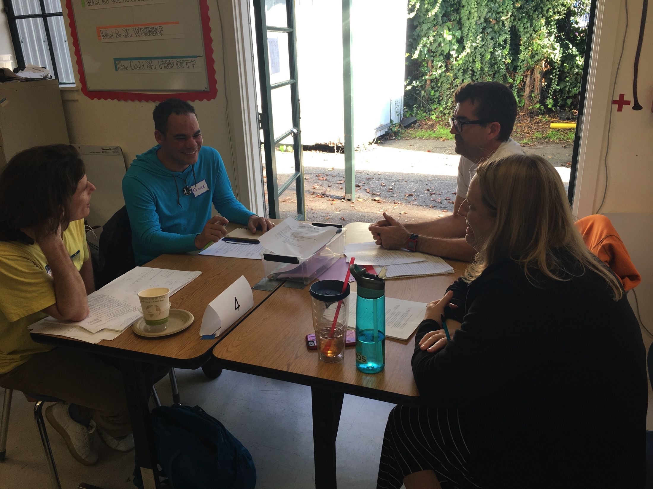
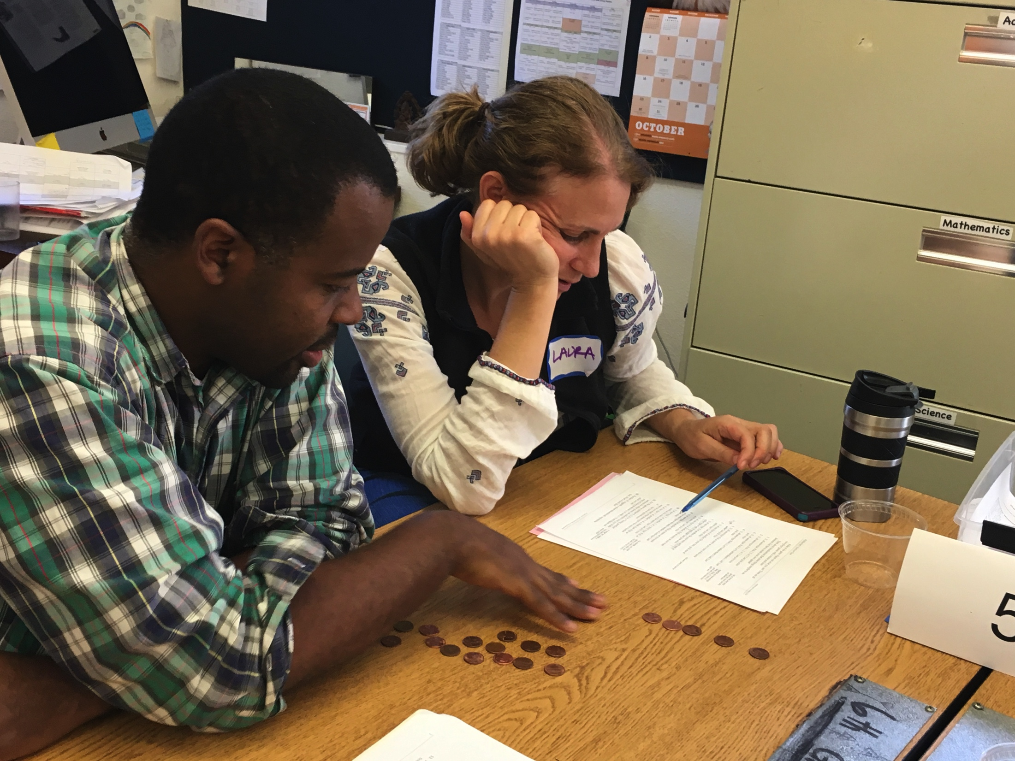
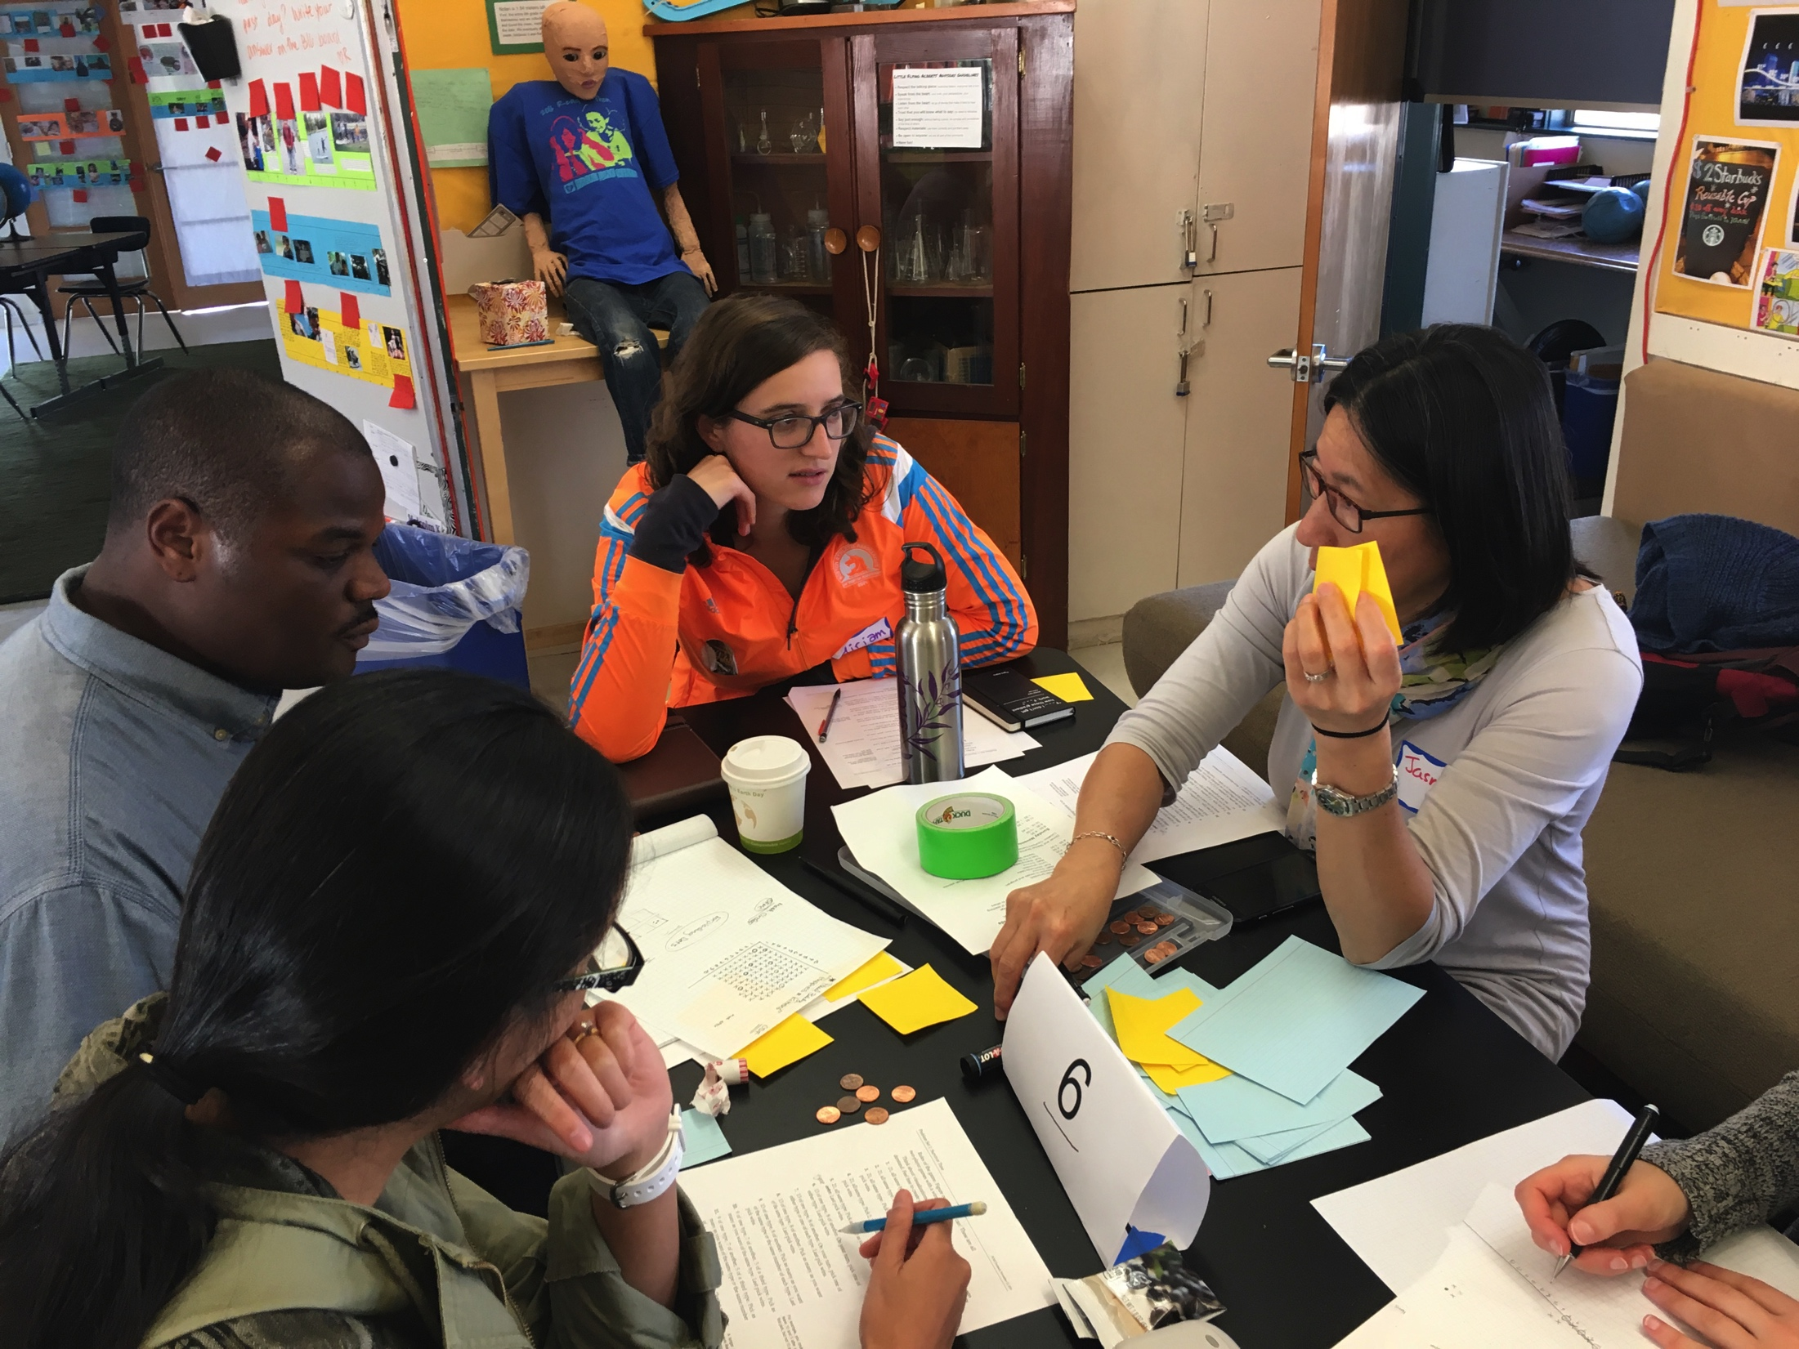
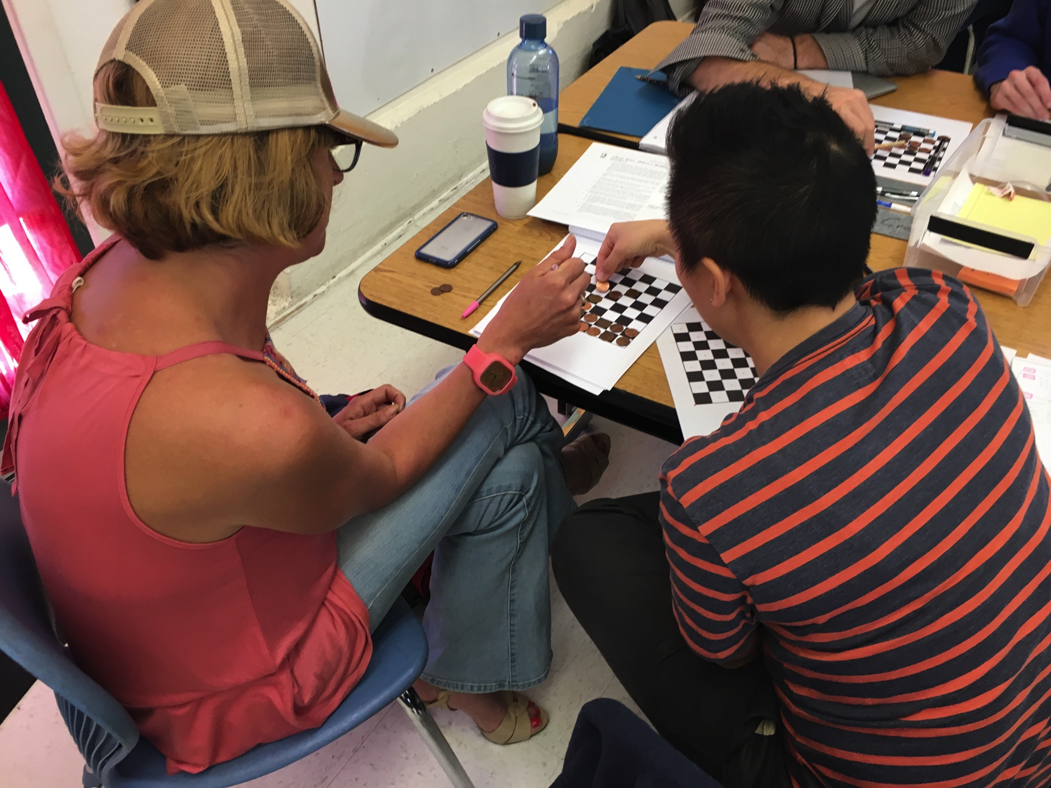
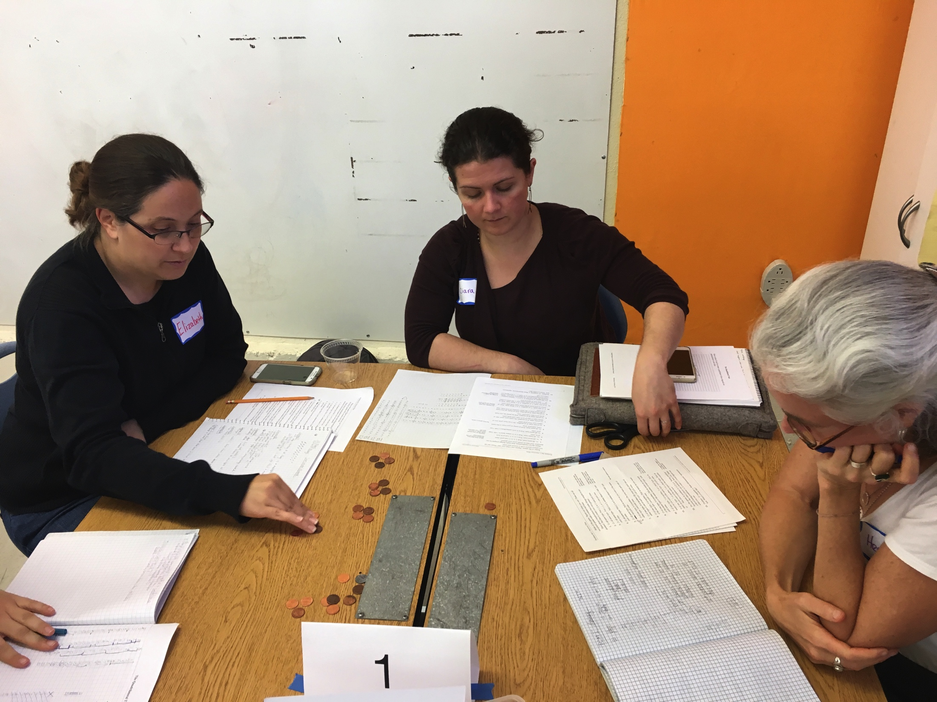
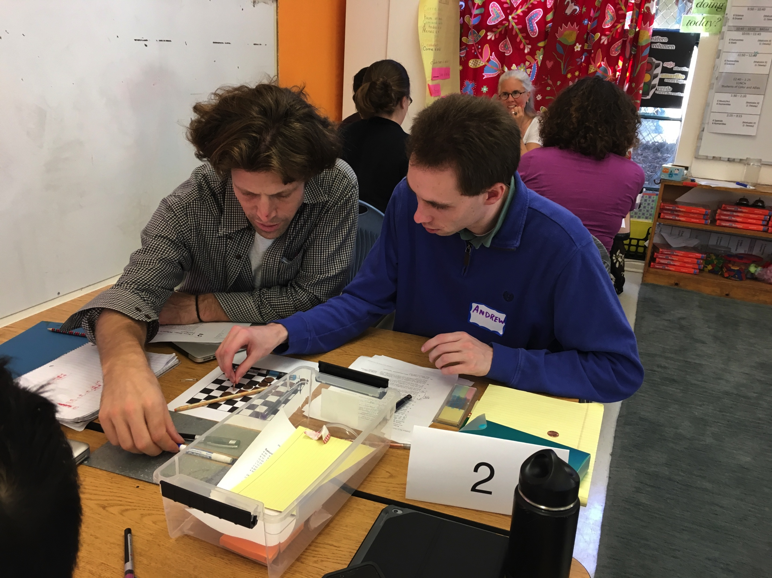
Afternoon Math!

Slide 7
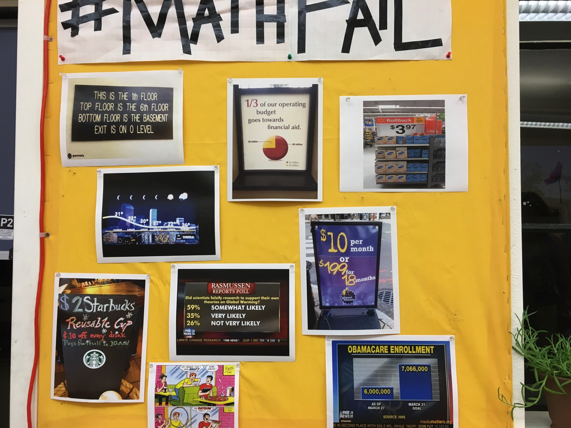
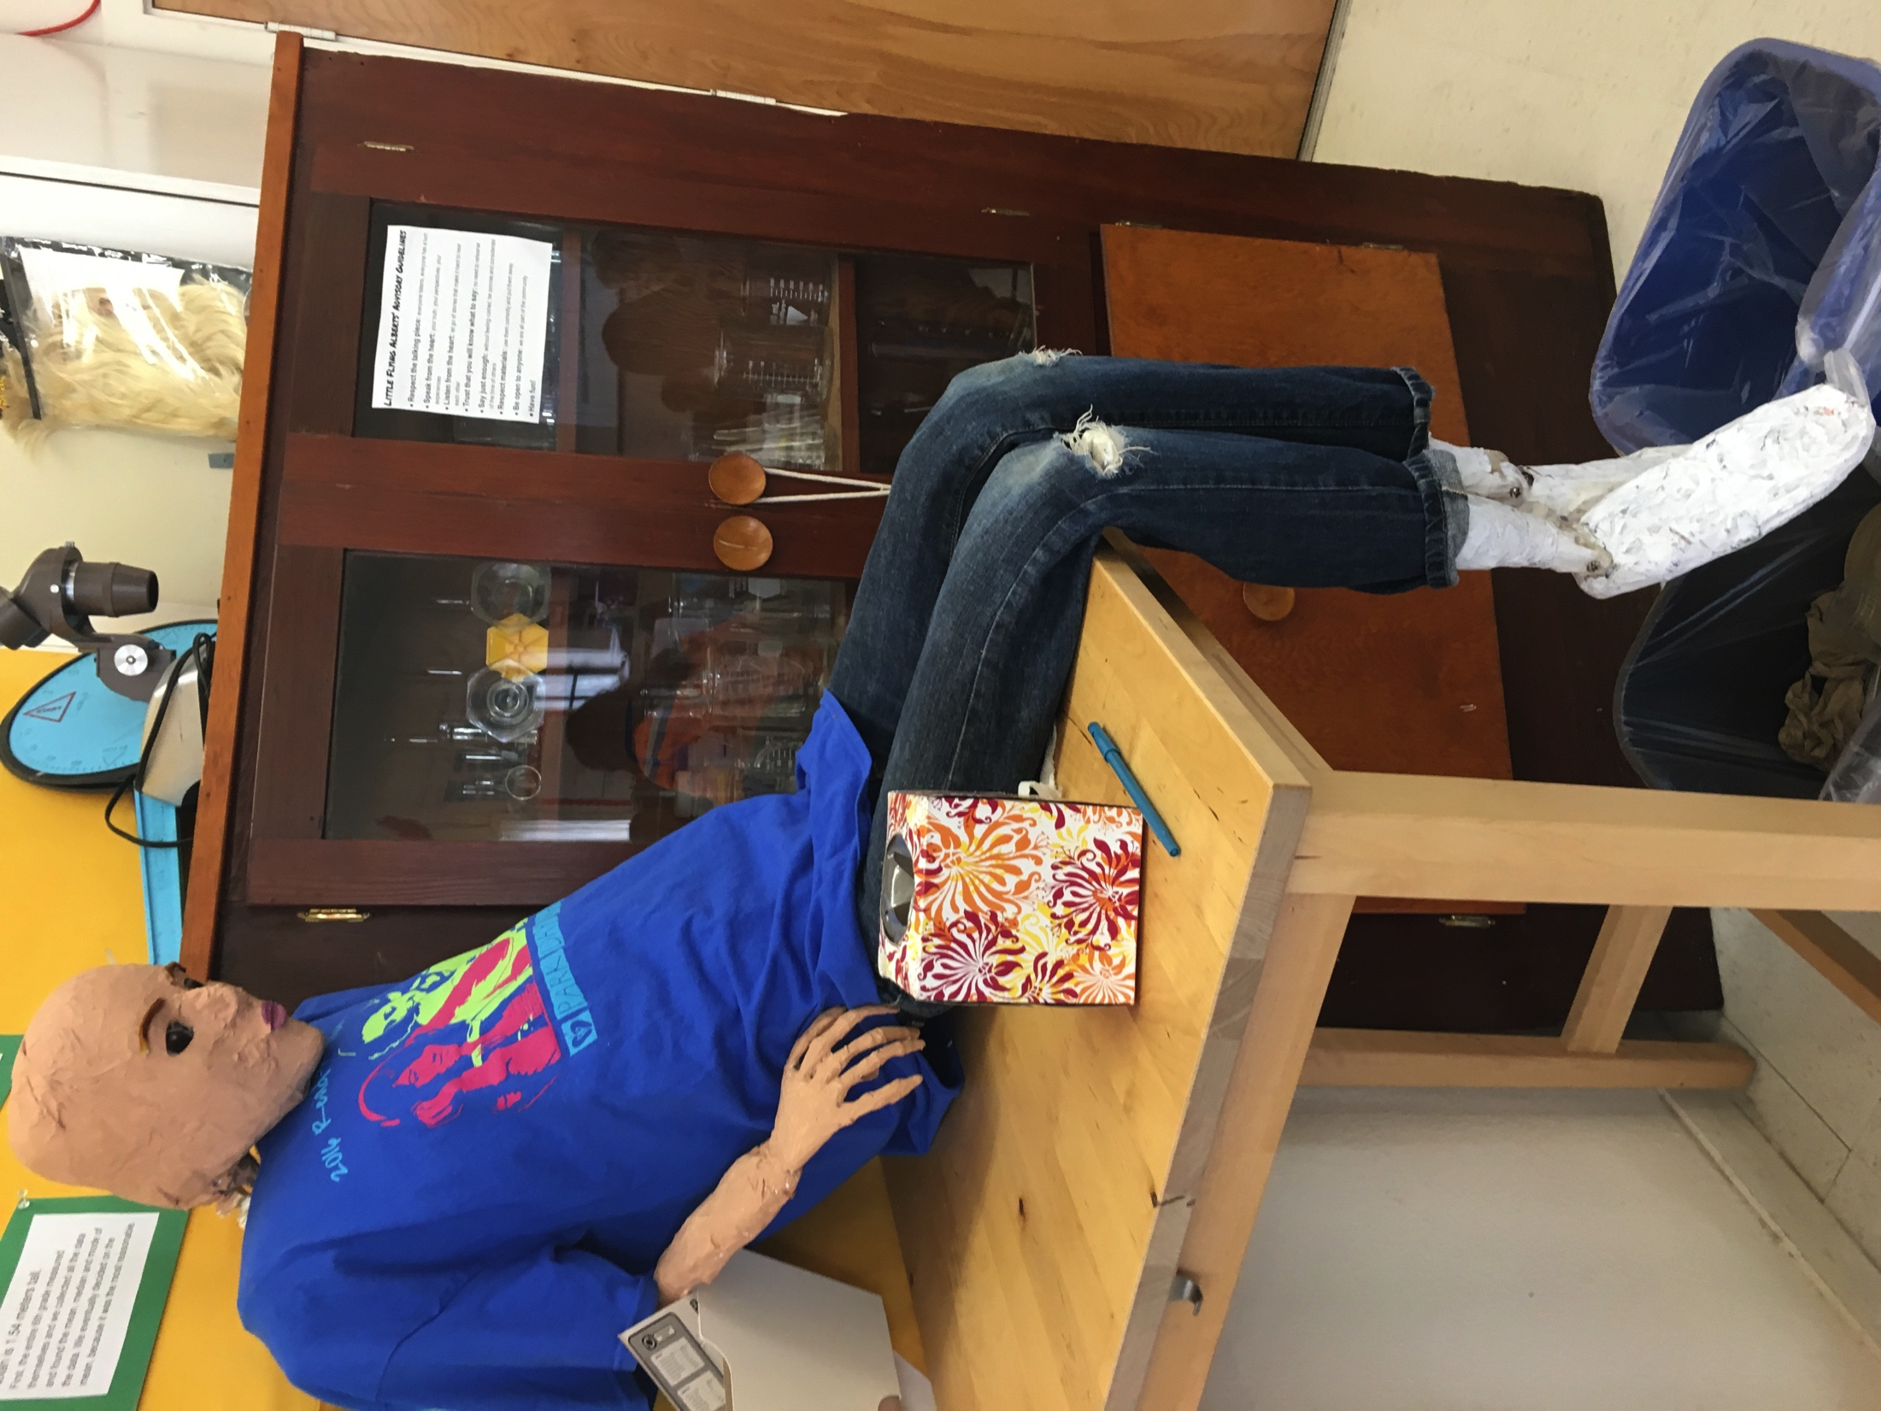
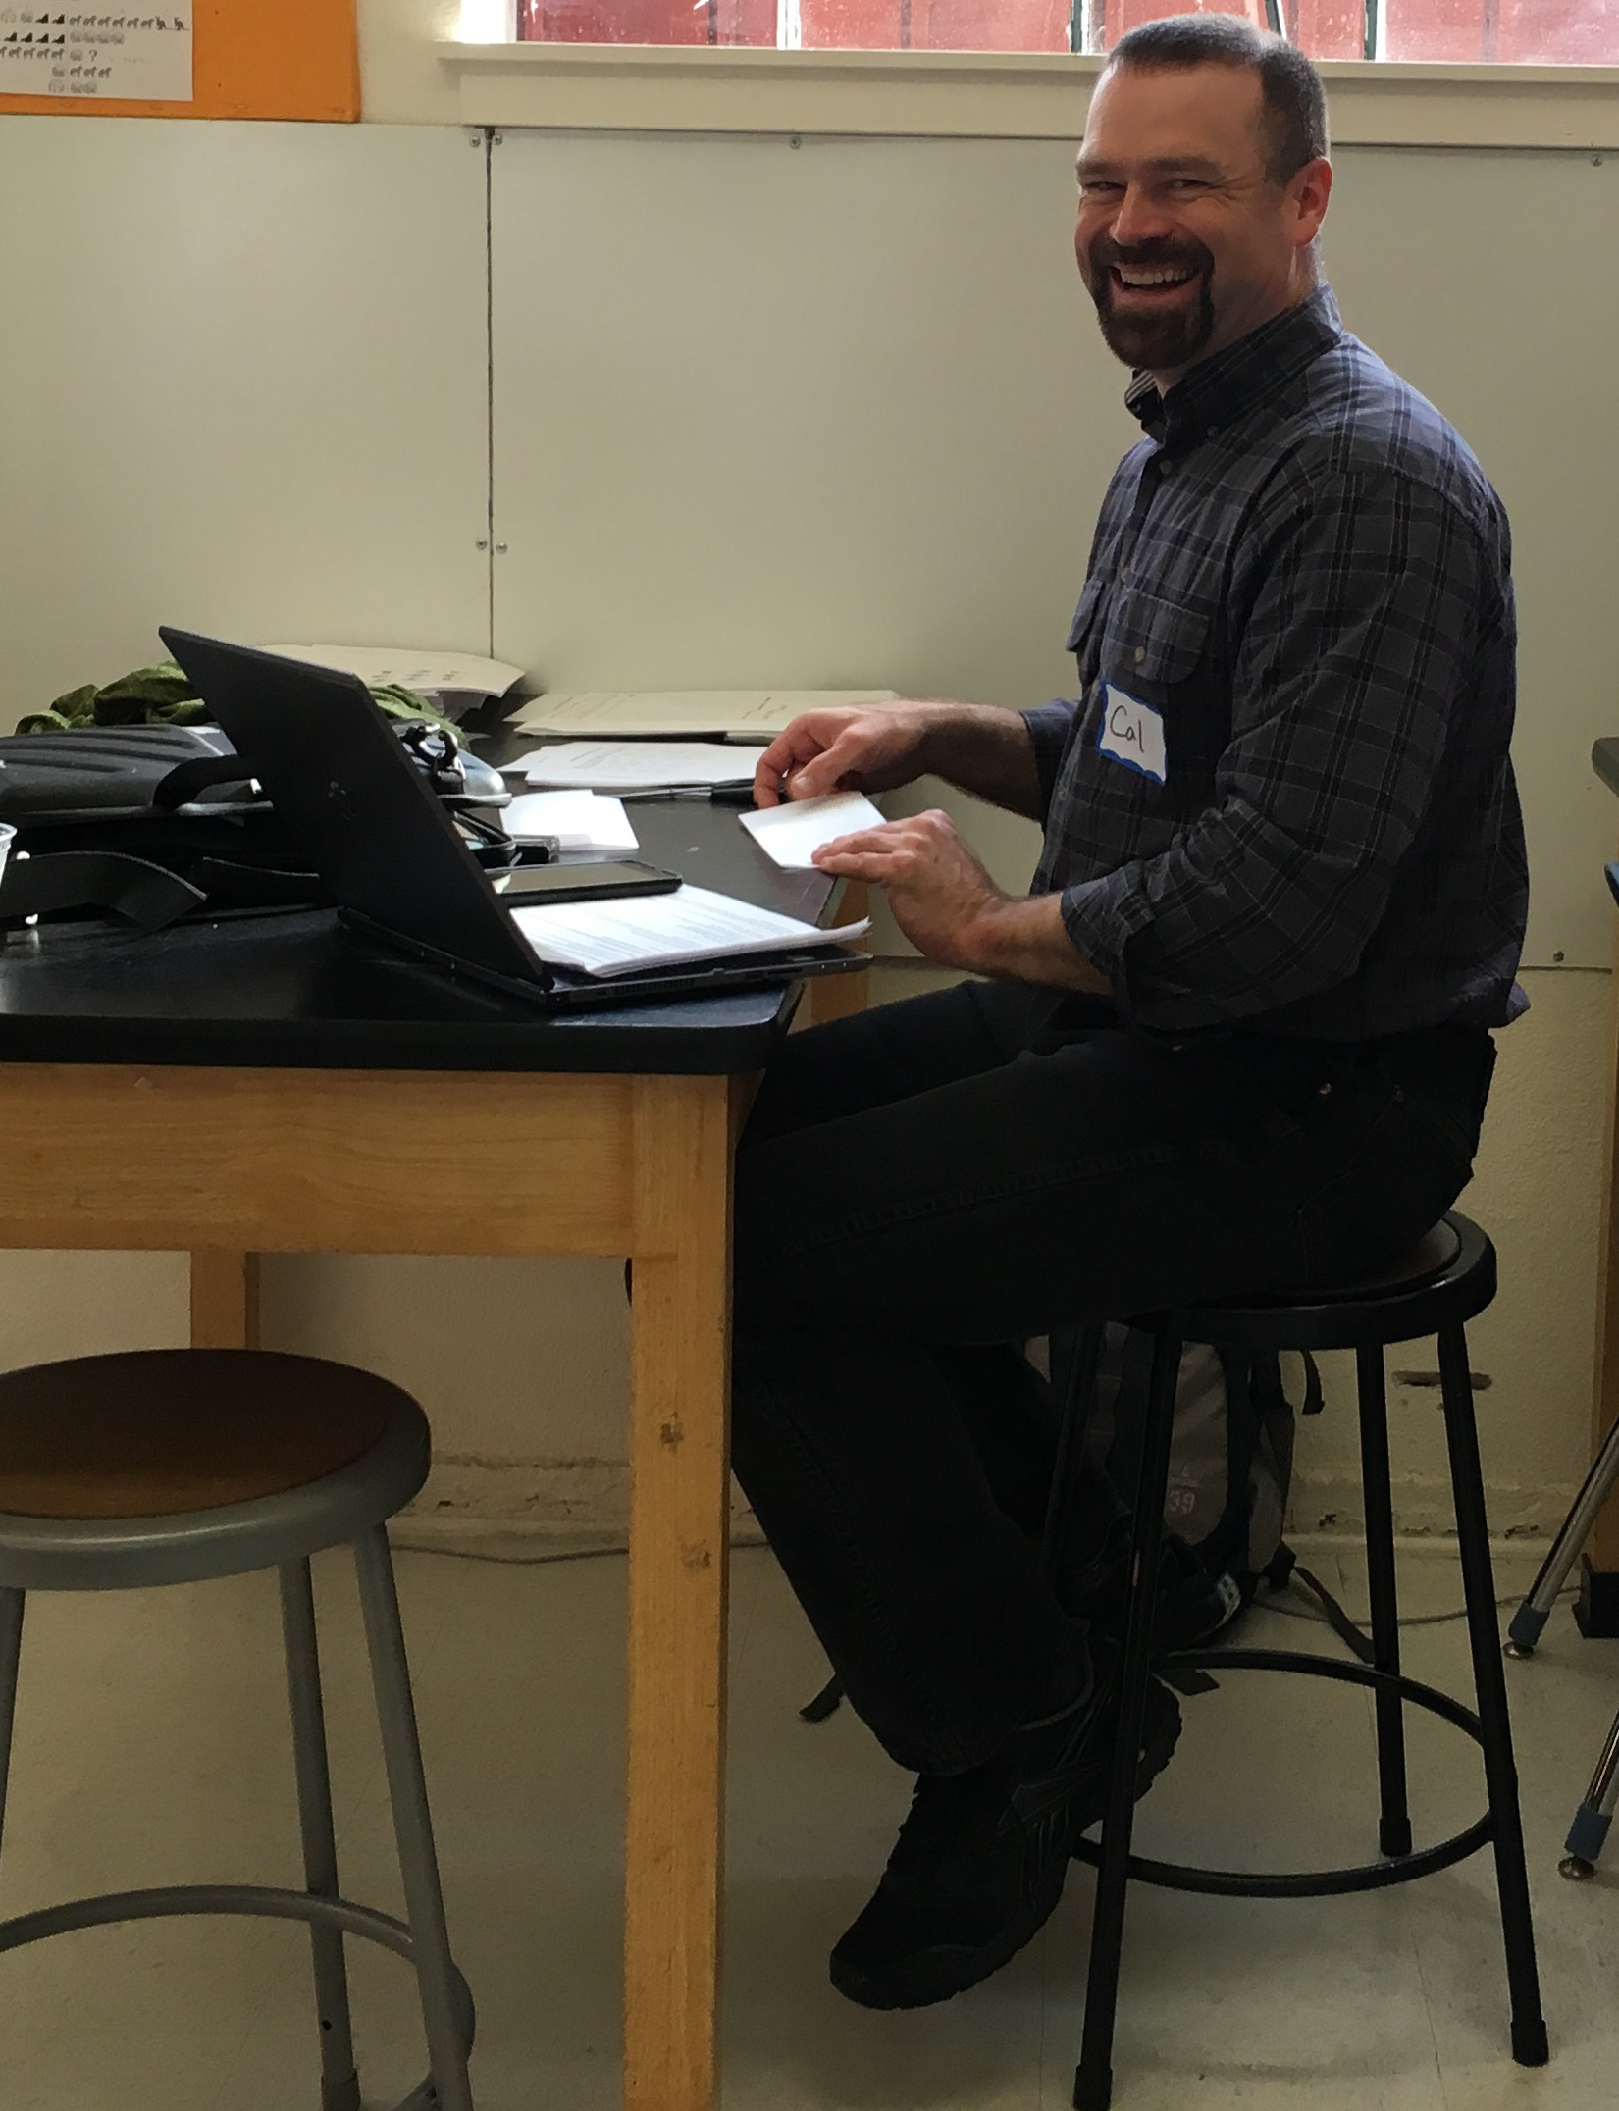
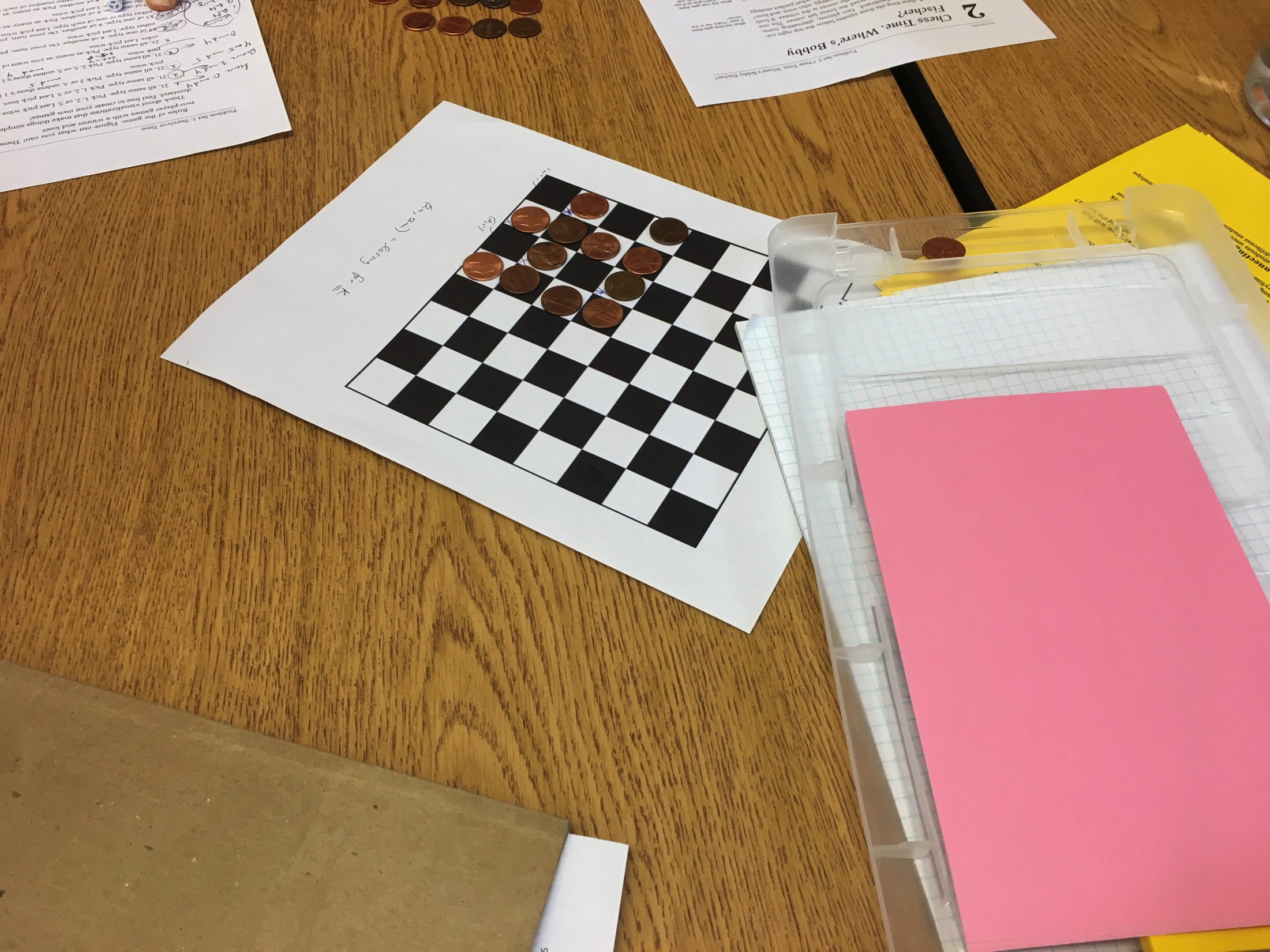
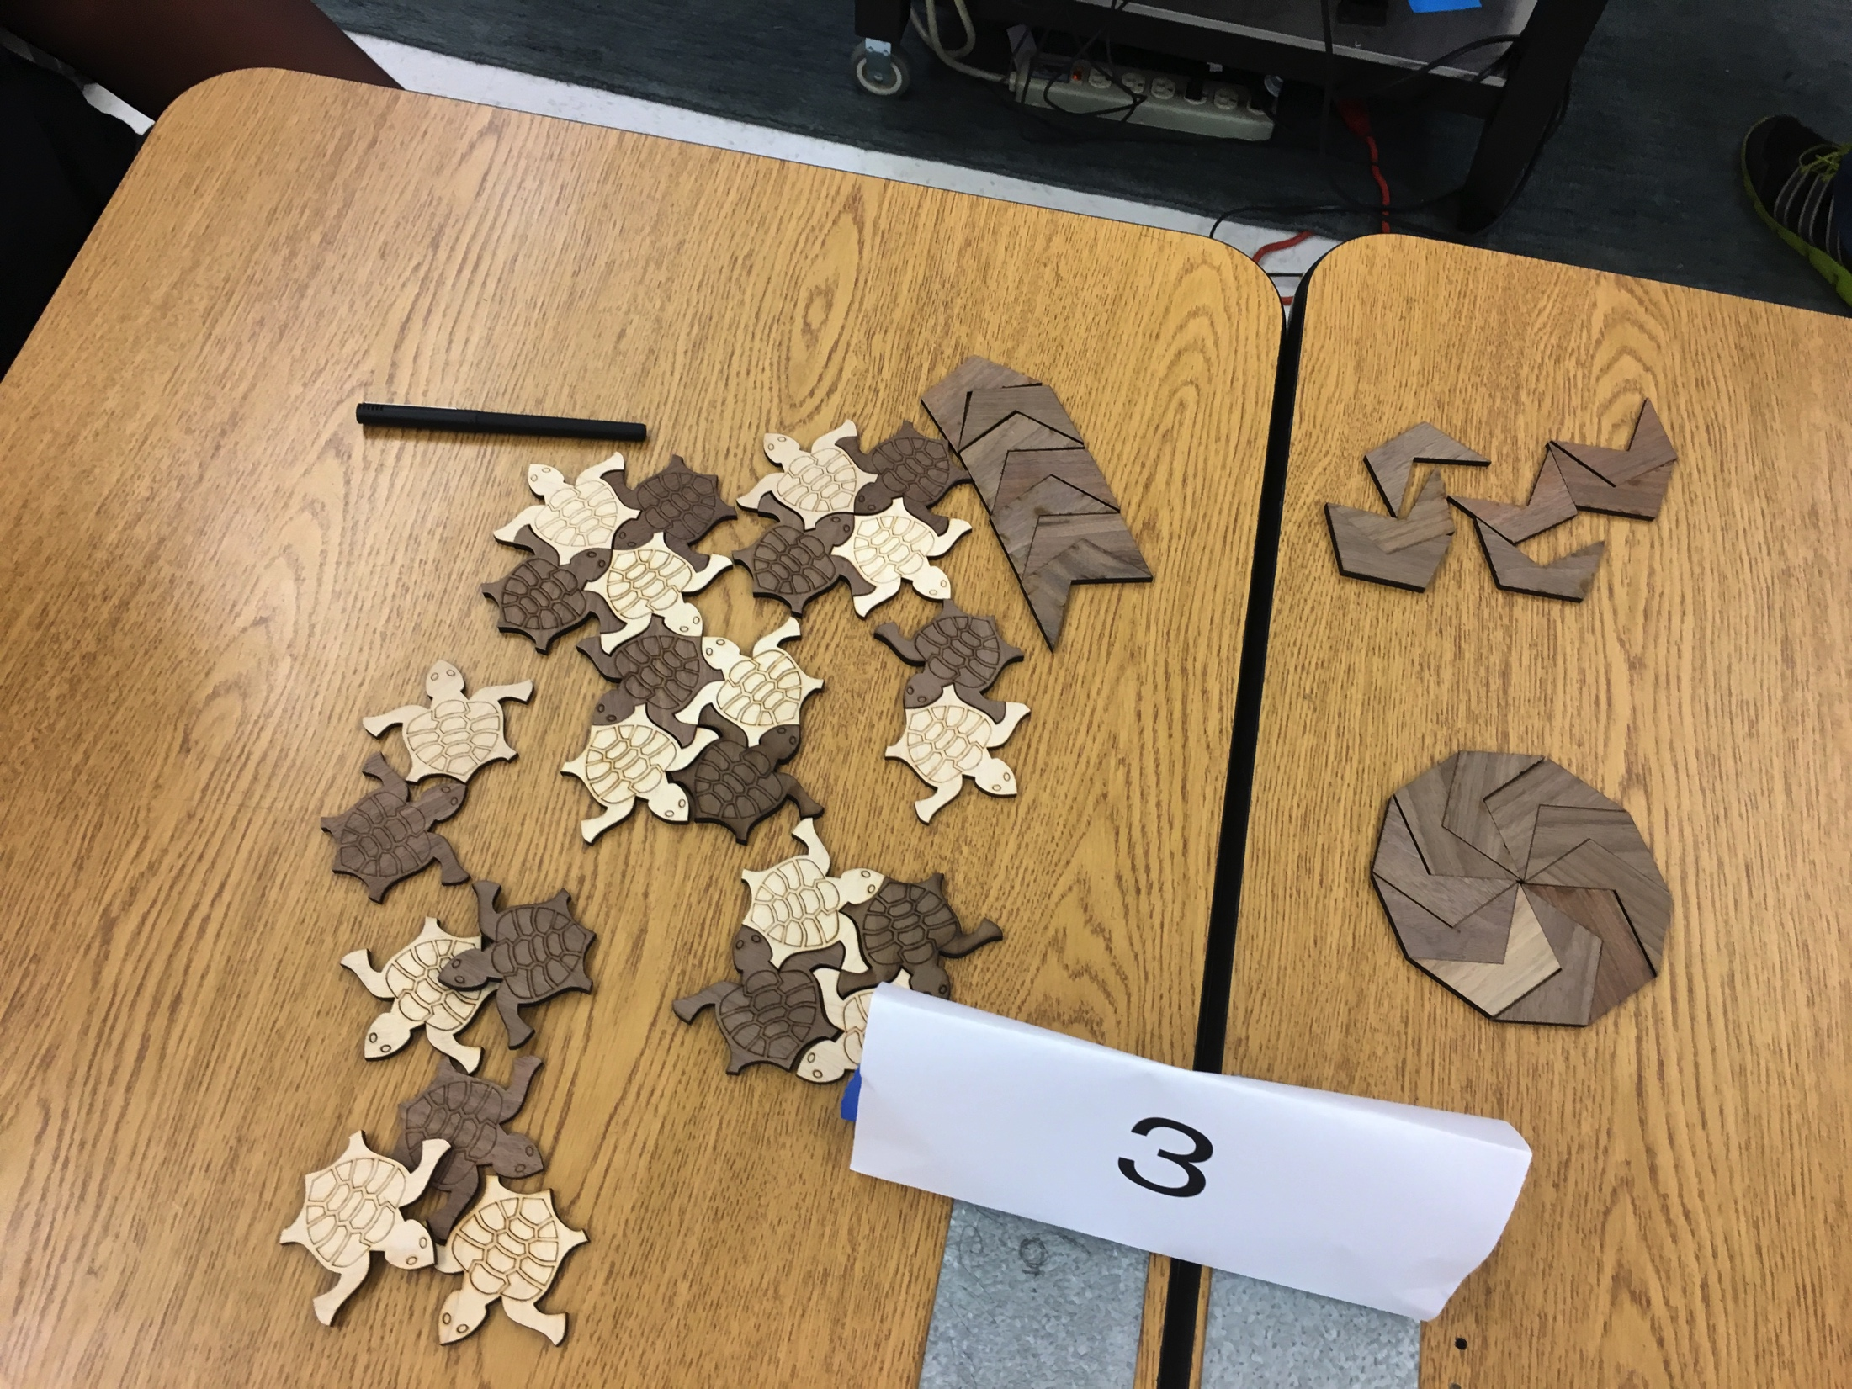
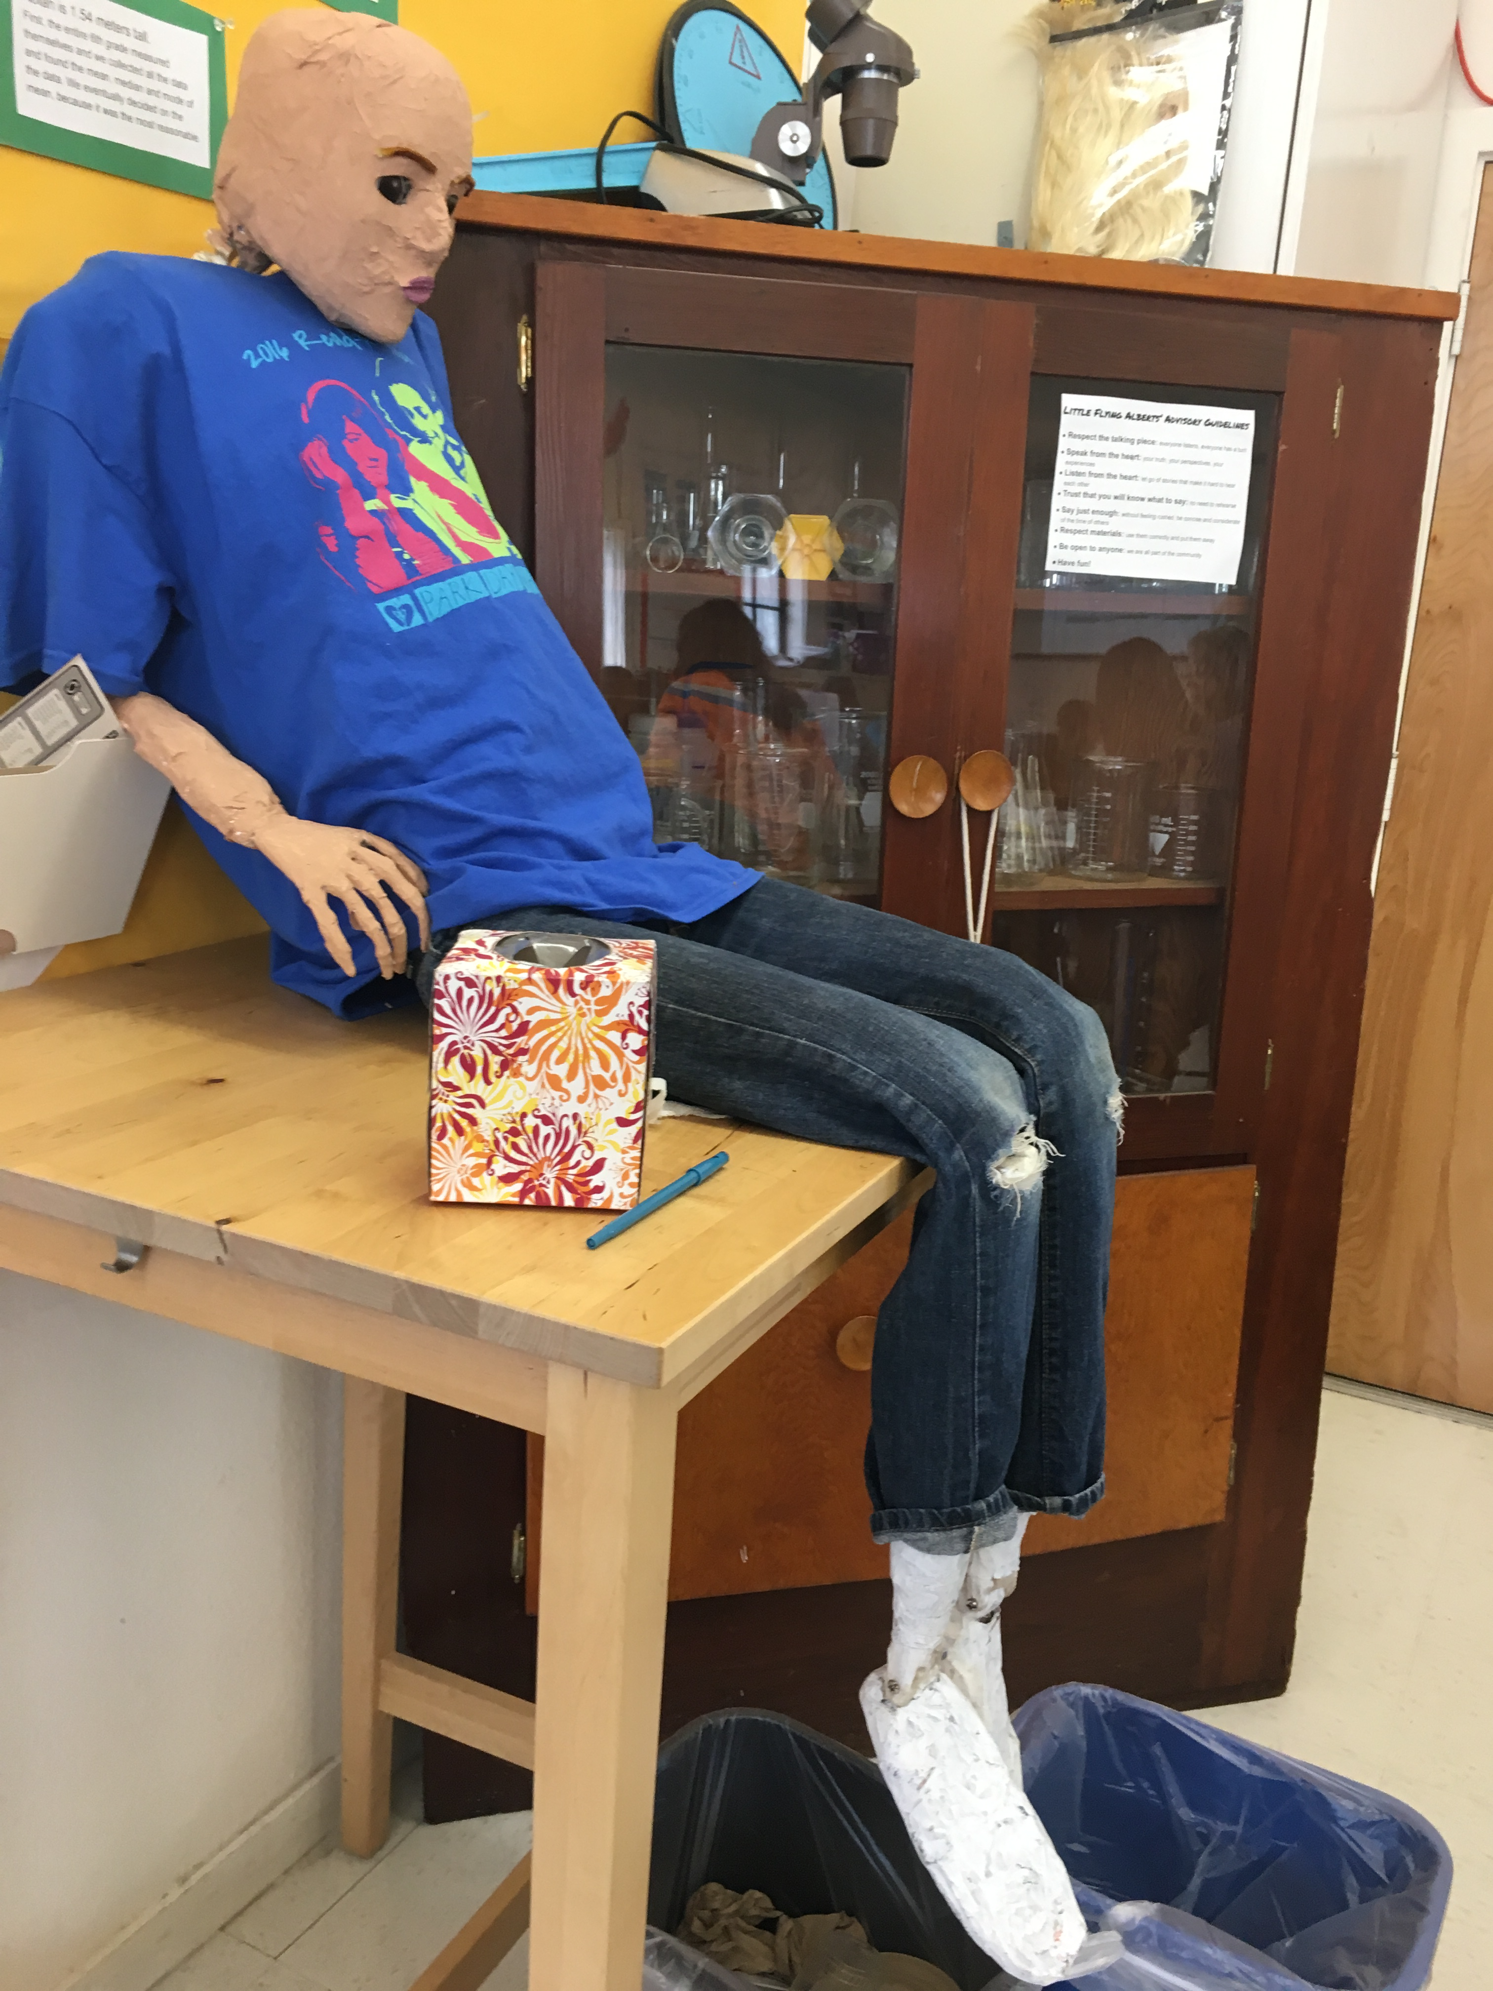
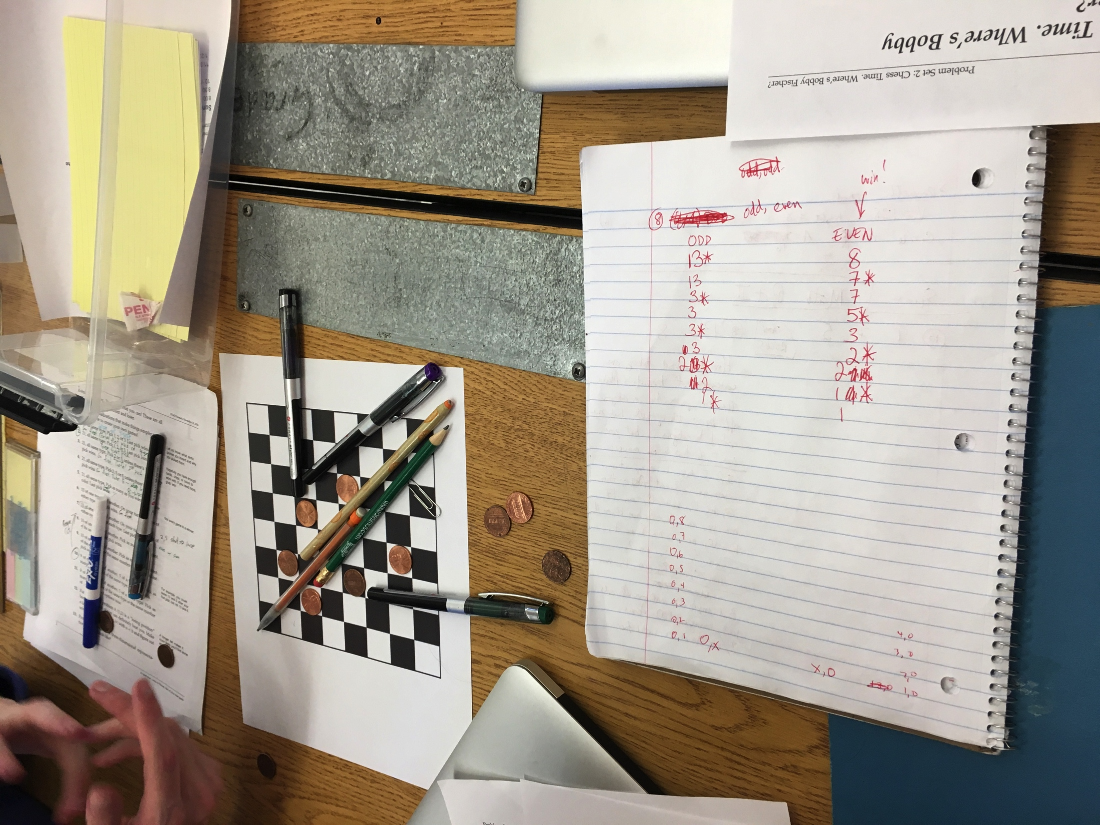
Oakland Math!

Slide 8
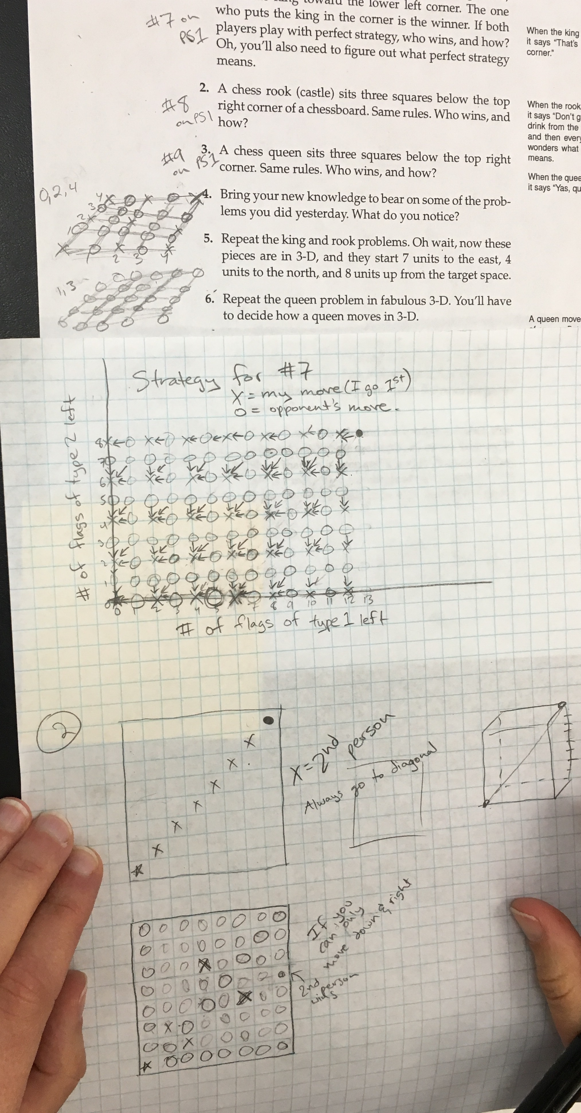
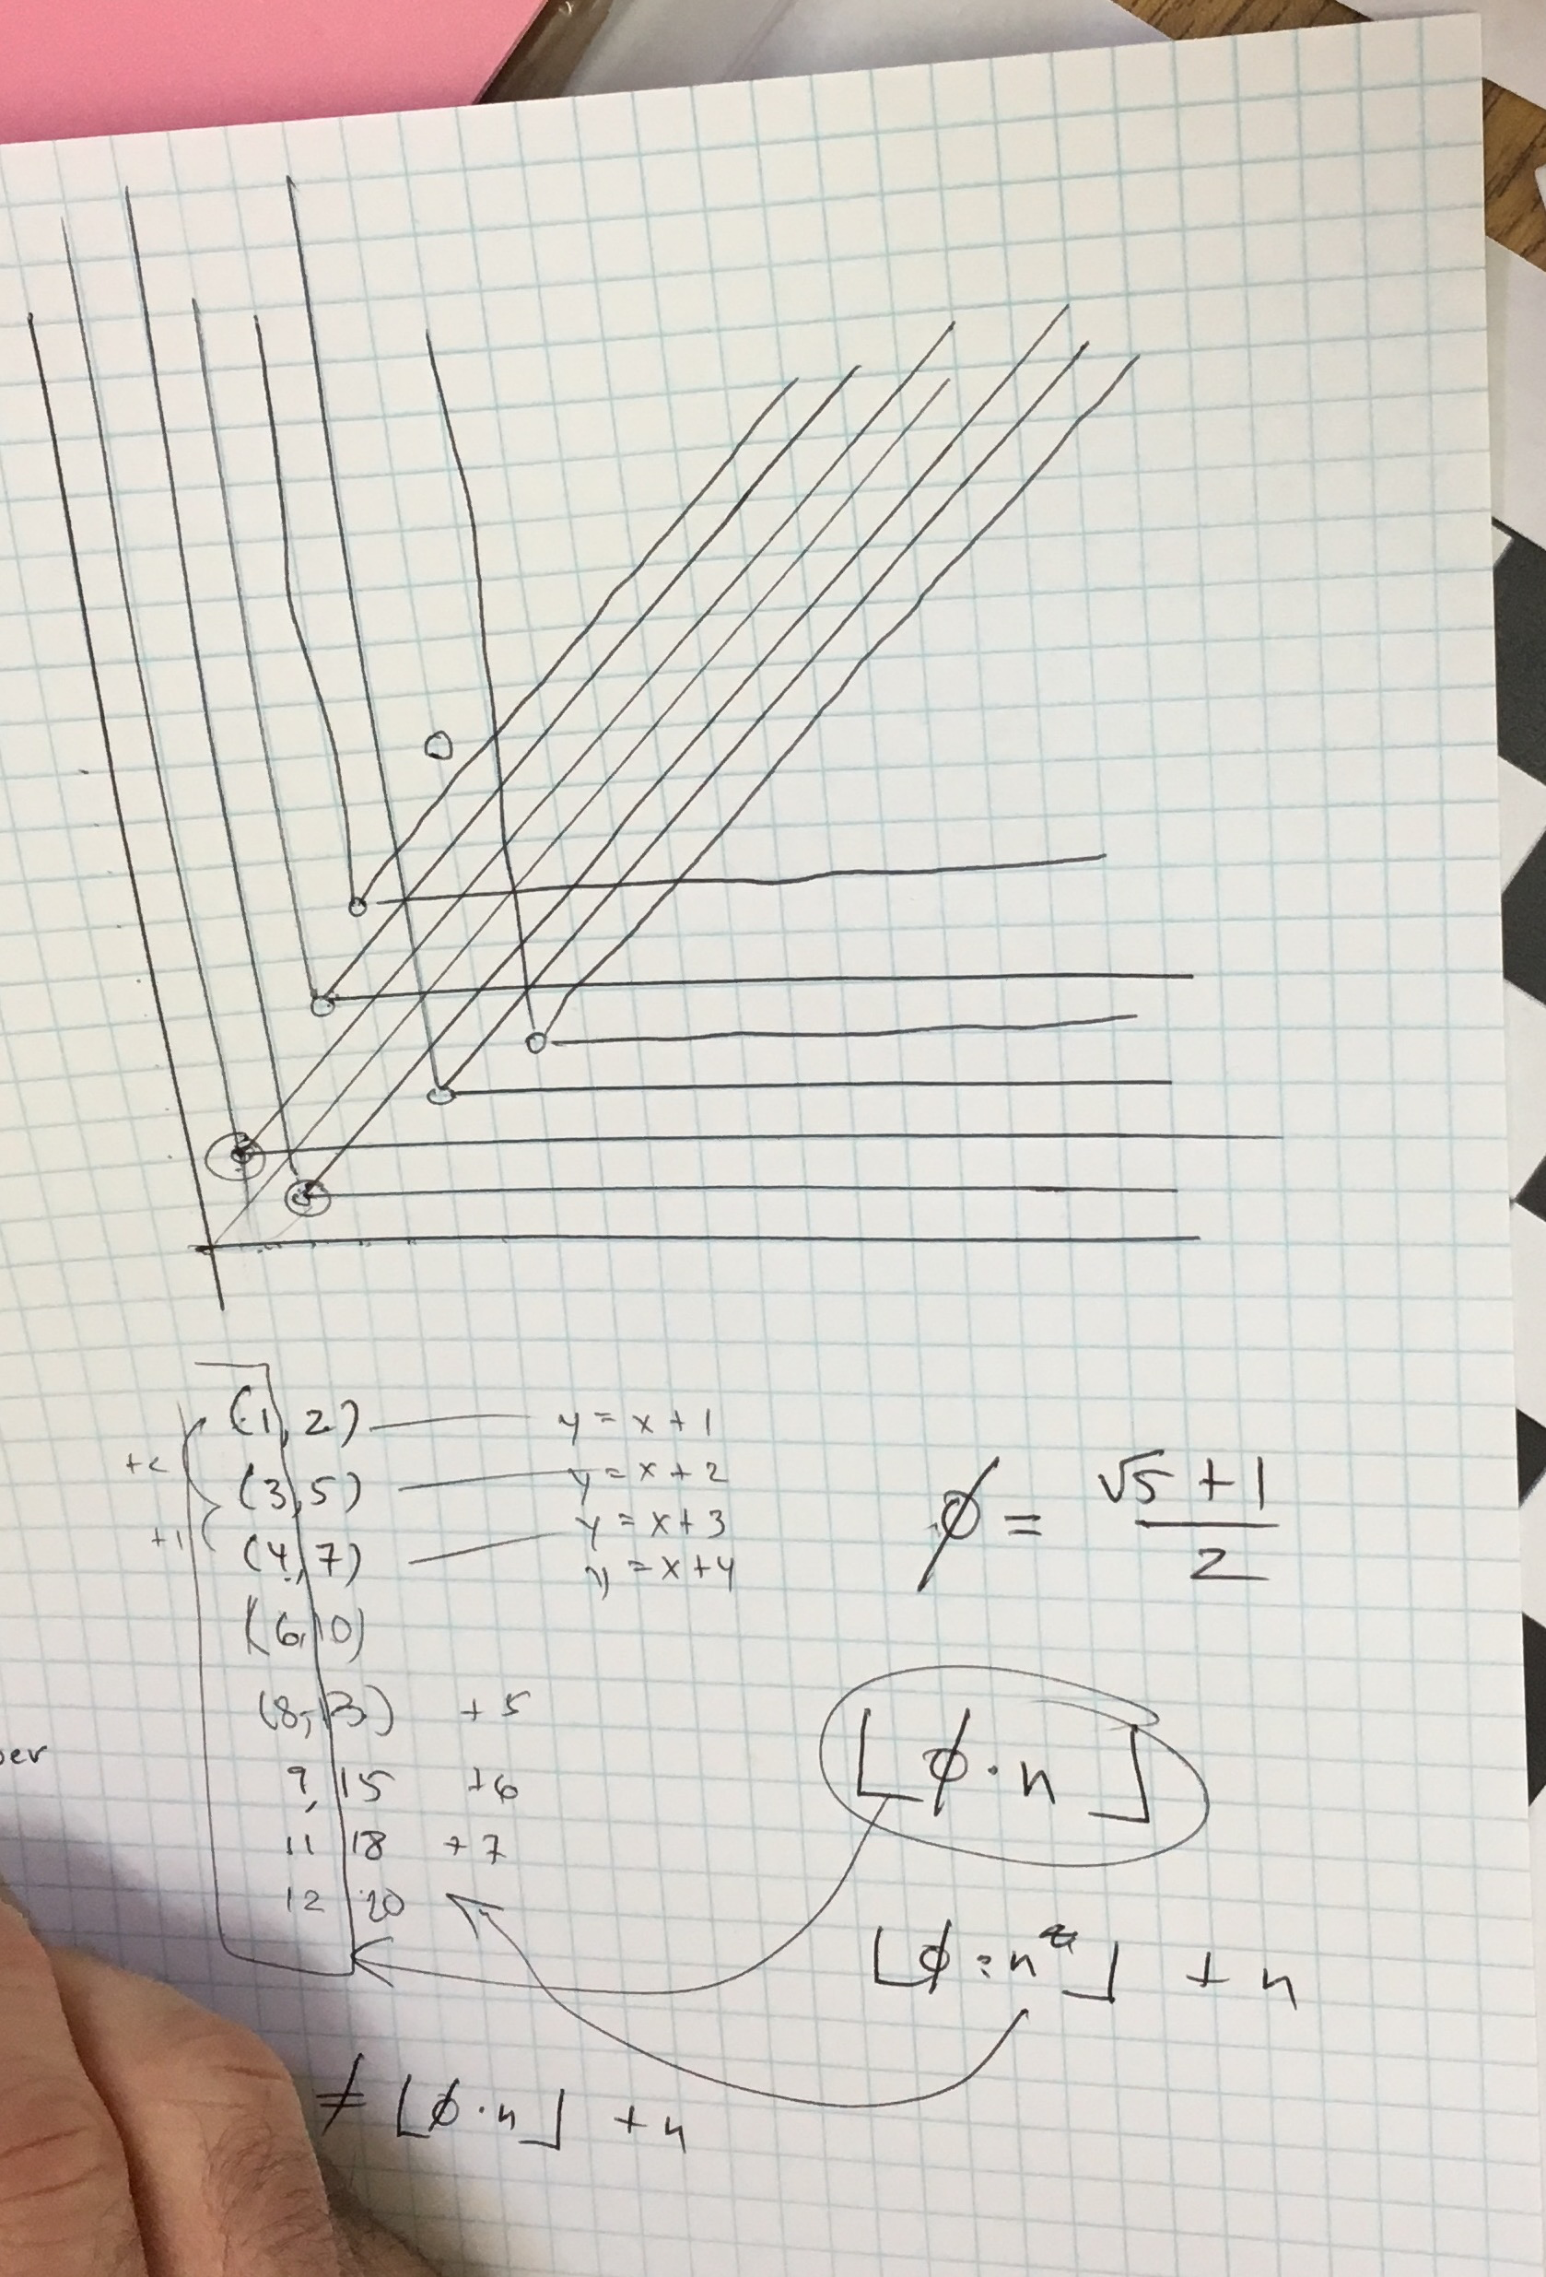
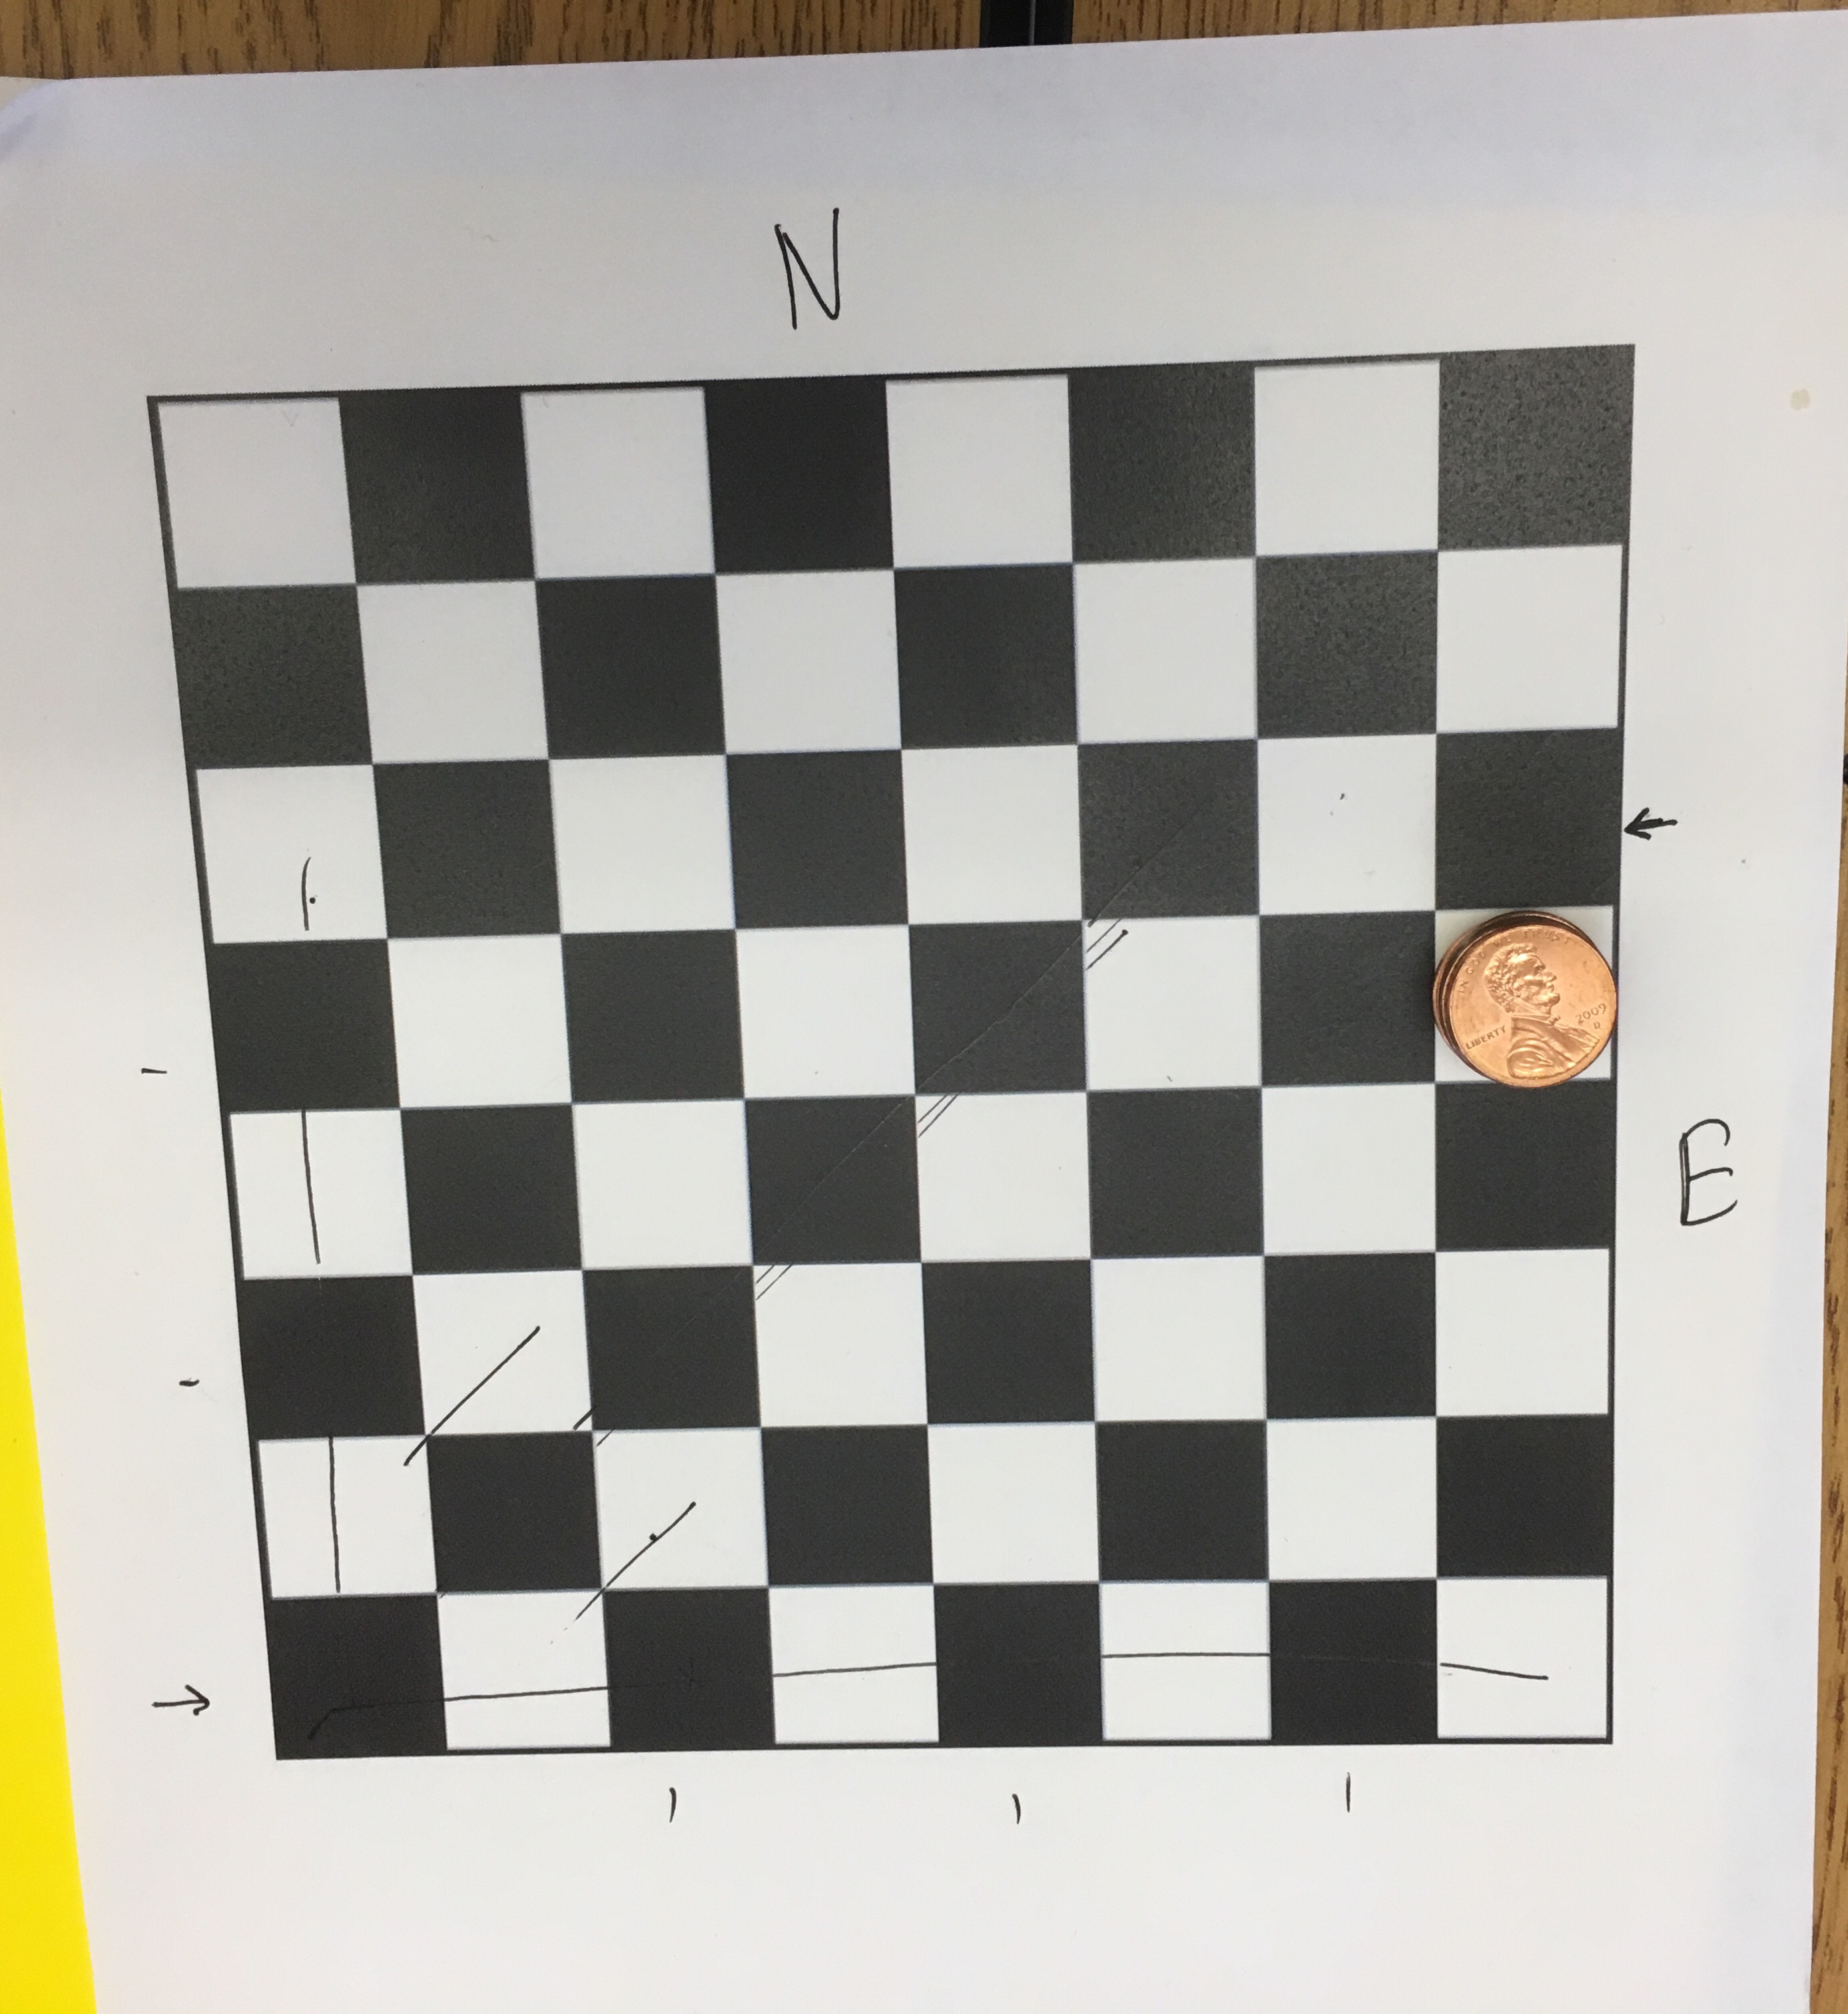
Oakland Math!

Slide 9
Chess Time
What questions do you have? Wonderings? Noticings?
It was difficult to play with an 8 by 8 by 8 chessboard, so we stacked pennies.
#7: Connected to Fibonacci. First player will always win.
Have a better understanding of how pieces move in 3D. 3D was a big challenge – but using the 3 different types of tokens helped visualize the movement along the diagonals.
How can we use the protocols for group shuffling in our own classrooms for effectiveness. Hearing about stacking the pennies from another group was cool!
How to extend 2D strategies to 3D. Low confidence in some really neat solutions. What does diagonal mean in 3D? The colors on different levels do not match for all diagonals. Controversy!
Reviewed 2D strategies. How would this sort of problem set look in our classrooms? How would students work in groups on these problems? Creating a climate where all are involved.
It was helpful to go back to the physical aspect of moving pieces in order to see relationships and lose cases. Still searching for answers! Better understand movement of pieces.

Slide 10
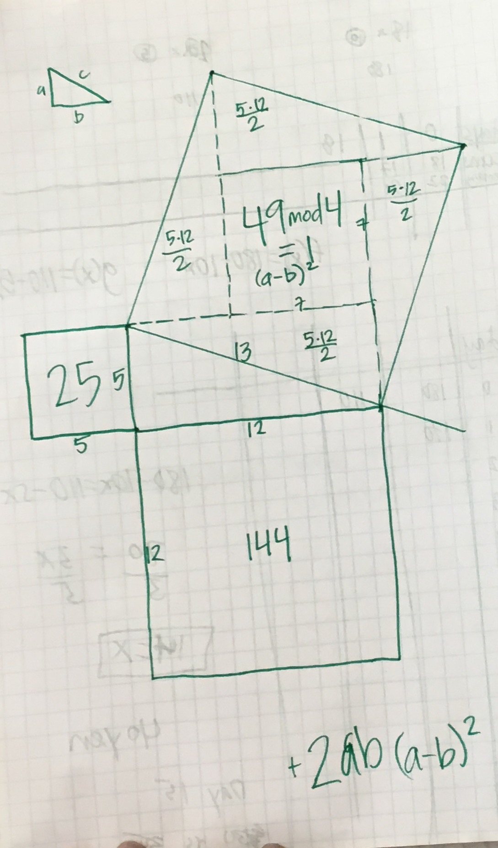
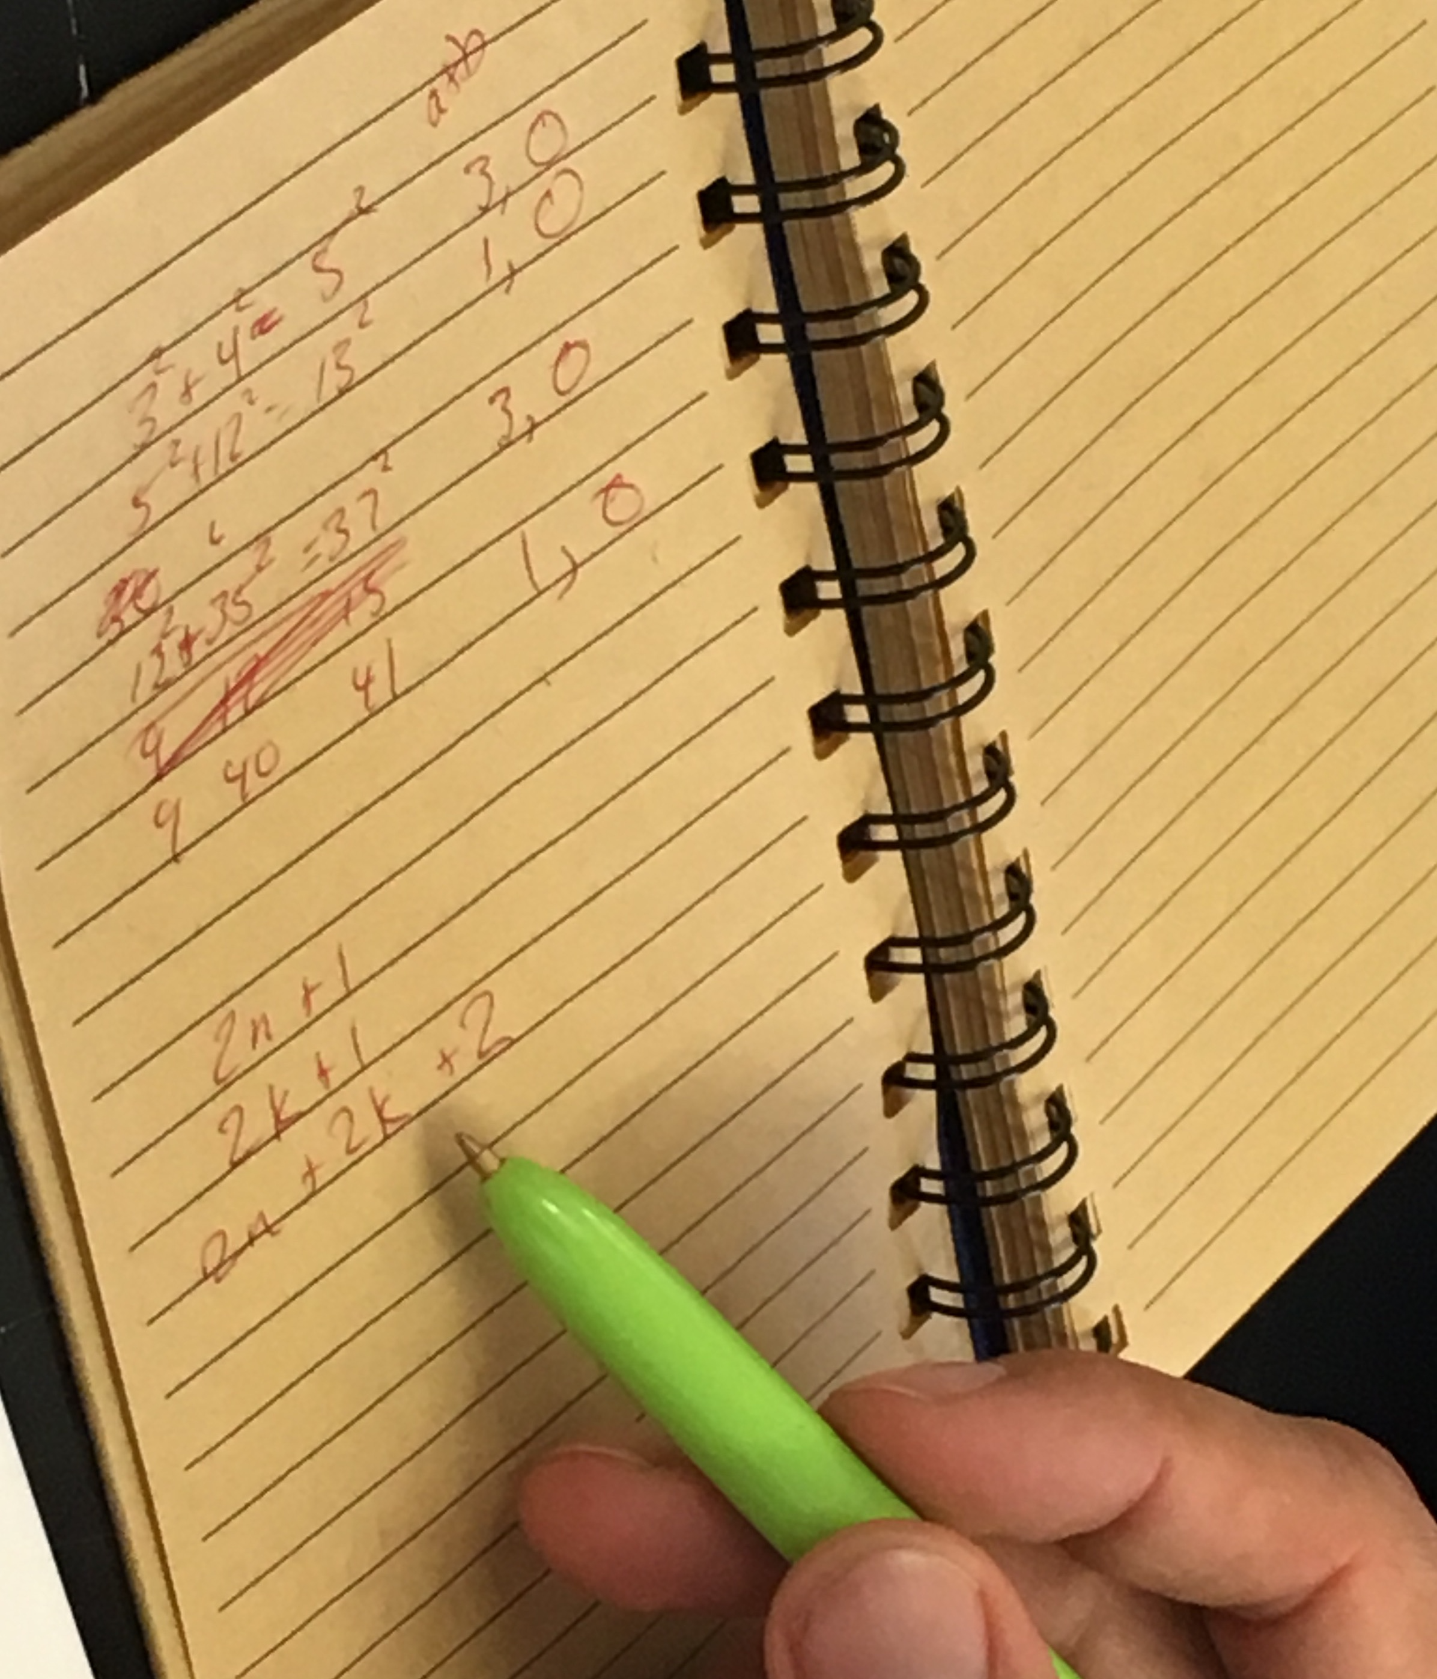
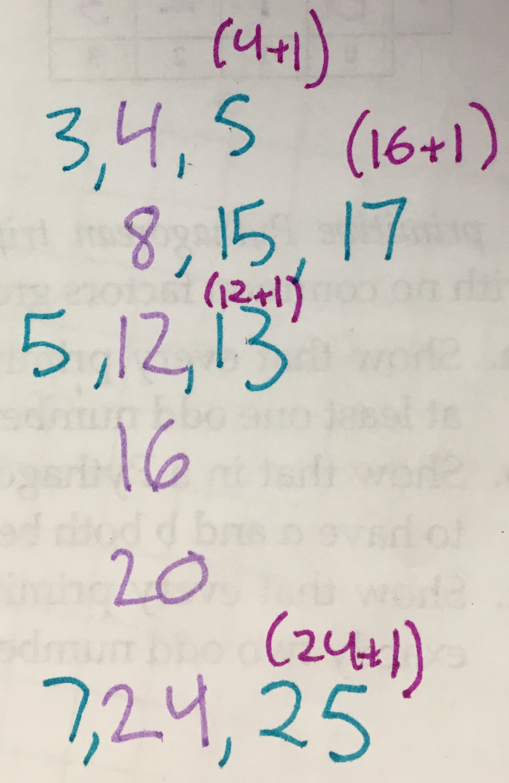
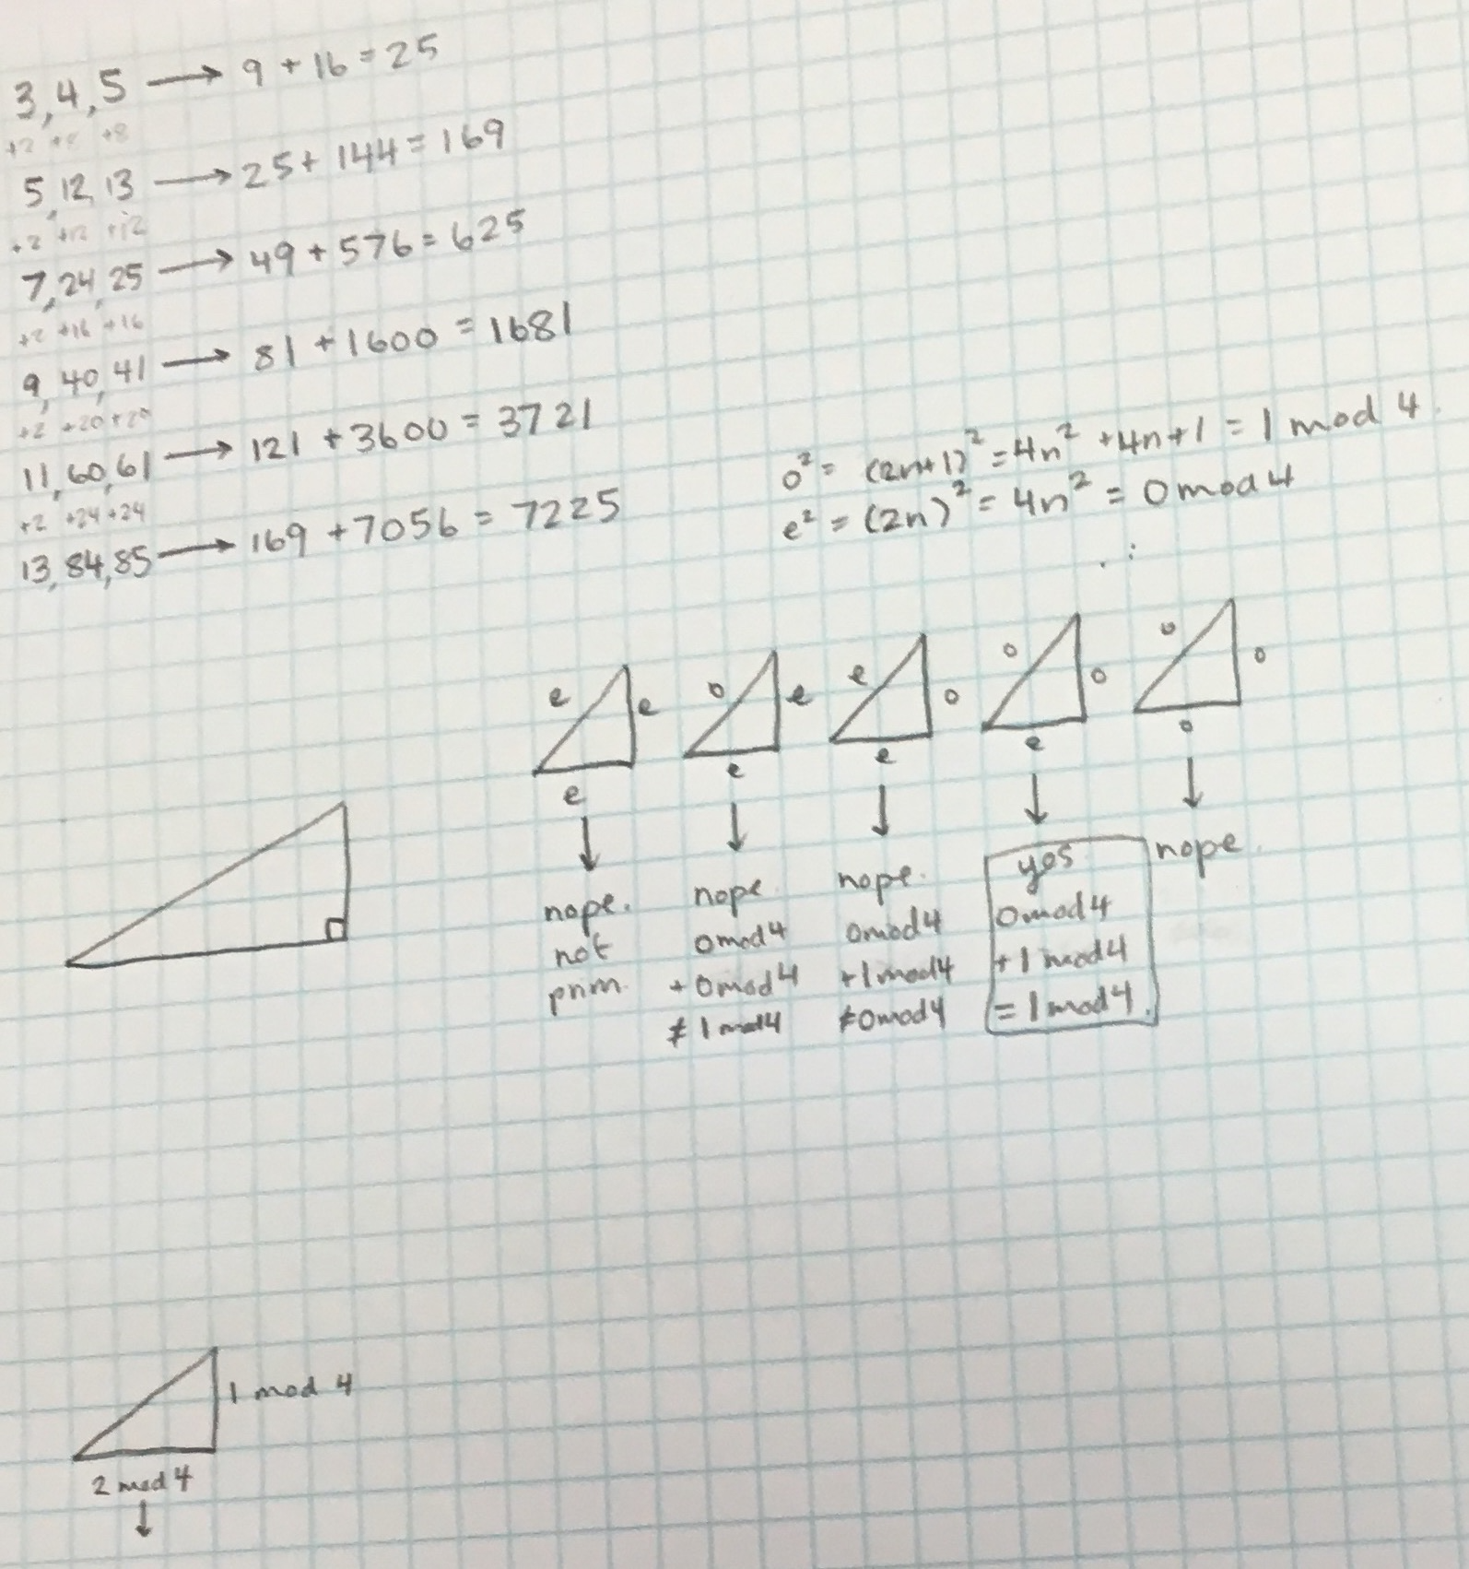
Pythagorean Triples!

Slide 11
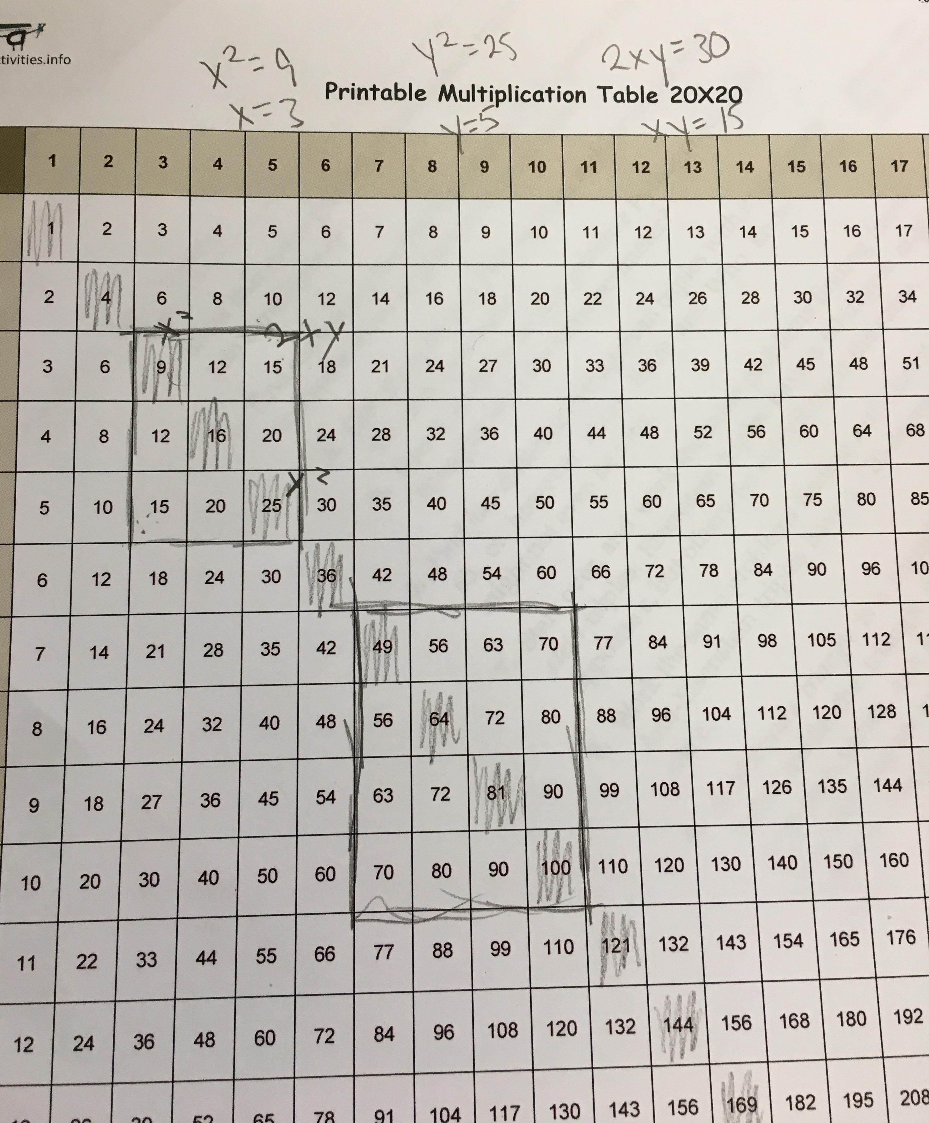
Pythagorean Triples
What questions do you have? Wonderings? Noticings?
There’s always a multiple of 4 in a Pythagorean Triple, and the hypotenuse, H, is (H)mod4=1.
The sum of a and b is always 3 or 1 mod4, and the product ab is always 0 mod4.
Classified PTs with lowest # being odd vs even. There were some sides that were 2 apart. Sides as a^2+b^2, a^2-b^2, 2ab. What happens when a and b are 1 apart, 2 apart, etc.
Tried to connect Q1 and Q2. mod 4 is mod 2^2
Q3: Every PT has to have a multiple of 2, 3, and 5. (but can be in the same number). All have 2, 3, 4, and 5? e.g. 5, 12, 13 (12 is a multiple of 2 and 3, 5 is a multiple of 5)
Challenge: proving via argument vs many examples. (3n)^2=(3n)mod4
Discussed algebraic formula and used multiplication chart to find PTs. Make visual (see pic to the right) ->

