Slide 1
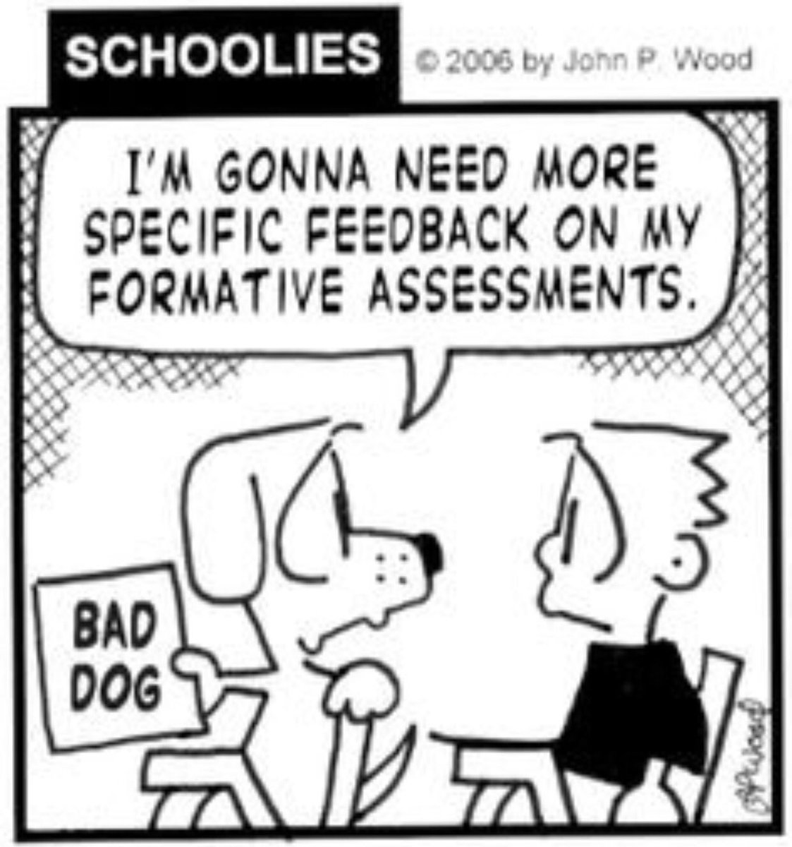
Reflecting on Practice
Portland: day two
2019
Notes:
Slide 1-2 0:00-3:00
Amy

Slide 2
Leveraging Artifacts
of Student Thinking
High quality feedback as a way to support individual students in growing as learners, doers, and lovers of mathematics.
Notes:
Intro
Today we will continue our theme of leveraging artifacts to benefit students
Yesterday we spoke about the many ways that students can display mathematical competence, and today we move to focusing on the feedback that we provide that can help students grow and see themselves as mathematicians

Slide 3
“The Secret of Effective Feedback”
Review last night’s reading with the frame of the Four A’s Protocol:
What Assumptions does the author hold?
What do you Agree with in the text?
What do you want to Argue with in the text?
What part of the text do you want to Aspire to (or Act upon)?
Select one of your “A’s” and share with an
elbow partner
Notes:
Slide 3-4 Reading Review 3:00 - 20:00
Amy
5 min review of reading with Four As lens

Slide 4
Getting Ready...
Framing our view of students, and students’ thinking in preparation for providing feedback.
why 2>4
Notes:
https://www.youtube.com/watch?v=h00Ux1qx2zw

Slide 5
Math Club Mystery
Go to: https://tinyurl.com/MathClubMystery
On your own, take a few minutes to make sense of the problem.
Then begin familiarizing yourself with the student solutions, and the feedback provided.
Notes:
Slides 6-8 EnCompass Activity 25:00 - 55:00
On your own, take a few minutes to try the problem then begin reading through the student solutions and feedback provided.
10 min- Solve problem & read through student solutions and feedback
10 min- Work in pairs to choose one piece of feedback to revise in order to more effectively invite the student to re-engage with the problem
10 min- Share at tables

Slide 6
Math Club Mystery
With a partner, or two, at your table:
Pick one piece of written feedback to revise
Describe why the modification(s) would be more helpful in inviting the student to continue engaging productively with the problem
Notes:
Slides 6-8 EnCompass Activity 25:00 - 55:00
10 min- Solve problem & read through student solutions and feedback
10 min- Work in pairs to choose one piece of feedback to revise in order to more effectively invite the student to re-engage with the problem
10 min- Share at tables

Slide 7
Refined Feedback
In order…. offering revised feedback to
Brian, Hannah, Kyle, Jacob or Daniel
Be sure to share why you feel the modification(s) would more effectively invite the student to re-engage with the problem.
Notes:
Slides 6-8 EnCompass Activity 25:00 - 55:00
10 min- Solve problem & read through student solutions and feedback
10 min- Work in pairs to choose one piece of feedback to revise in order to more effectively invite the student to re-engage with the problem
10 min- Share at tables
Full group share out of one revision for each piece of feedback (TLPLT will look for and warm call one pair for each)

Slide 8
“Feedback should be more work for the recipient than the donor.”
-Dylan Wiliam
Notes:
Slide 5- Framing for activity 20:00-25:00
Kristen
Here is another quote from Dylan Wiliam. It reminds me of a quote in the article that said “if our feedback doesn’t change a student in some way, it was probably a waste of time”
We really want to keep this framing of intent in mind with regard to feedback.
Mention that we could teach an entire 3-week course on effective feedback and our purpose for today is to think about giving feedback that will get our students to think about a problem again / get them to return to the problem and think about it again.
Along with the ideas from last night’s article, this framing for feedback comes from Suzanne and her colleagues at the Math Forum. At this sadly defunct site, solutions for Problems of the Week were submitted by students and given feedback by Max Ray-Rieck (whose 2>4 video we watched yesterday), Annie Fetter, Suzanne Alejandre and others. When they gave feedback the framework they used was to notice and wonder--telling students “I notice you did this and it was useful because…or I noticed this was helpful” then posing a question or wondering that would hopefully motivate a student to keep thinking about the problem. This would both validate their work but also invite them to return back to the work.
Related to the math forum was a group called EnCompass, which was a group focused on collaborating around student work remotely, building an online space to comment on student work both to other teachers and directly to students. The task we are about to do came from the EnCompass work and was graciously shared with us by Peg to dive into thinking about improving feedback for students.
Lastly before we start, it is important to mention that this particular activity has a focus on written feedback, which is only one type of the multitude of ways we give feedback as teachers. At the end of the session, there will be more time for reflection on various types of feedback.

Slide 9
Feedback for 140+
Feedback Buddies
Group Buddies
Random 7
Random 3
https://powteacher.blogspot.com/2019/07/feedback-for-140-repost.html
Notes:
Slides 9 - 11 Reflection on Practicalities 55:00 - 70:00
Providing high quality written feedback seems like a daunting task when you have 140 plus students.
Overwhelming
Suzanne has some great ideas on how to provide the same quality feedback but not for every single student.
Feedback buddies - if students were working in pairs, feedback is given to one student and they share it with their buddy
Group Buddies - A larger group of 4 or more, feedback is given to one of the four students
Random 7 or 3 - use a randomizer to select 7 students or 3 students
Highlight Suzanne’s ideas

Slide 10
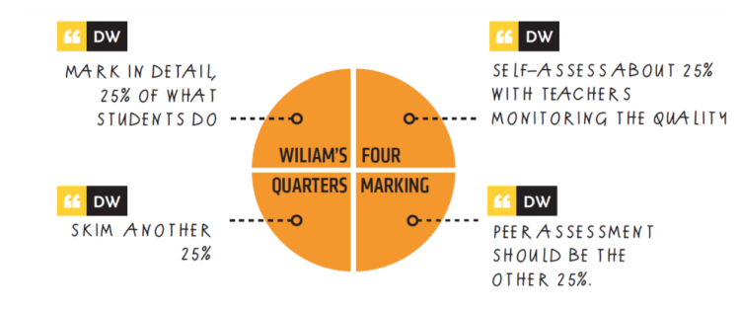
Four Quarters Marking
Notes:
Slides 9 - 12 Reflection on Practicalities 55:00 - 70:00
Introduce this idea of Four Quarters Marking for how to balance the workload of giving feedback

Slide 11
Reflection
What are the ways you give feedback that help students grow in their learning? What’s working? What might work better?
What are ways that you balance the workload of giving effective feedback for many students? What’s working? What might work better?
Notes:
Slides 9 - 12 Reflection on Practicalities 55:00 - 70:00

