Slide 1
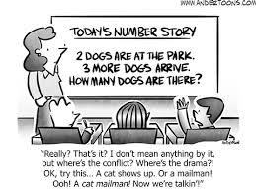
Reflecting on Practice
Portland;
day three
2019

Slide 2
Leveraging Artifacts of
Student Thinking
Our students are continually providing evidence of their thinking throughout the course of the school day and the academic year. We will be examining ways these physical records of their thinking can be viewed as a natural resource of classrooms, and better used to serve us as teachers and our students as learners.

Slide 3
Re-teach vs Re-engage
Re-teach
Re-engage
Address basic skills that are missing
Do same or similar problems over
Teach the unit again
More practice to learn procedures
Focus mostly on underachievers
Lower cognitive demand
Revisit student thinking
Address conceptual understanding
Examine the task from different perspectives
Critique approaches
Make connections
Engage entire class
Higher cognitive demand
‹#›

Slide 4
Types of Re-engagement Activities
Annotate
Critique then Improve
Scoring Using a Rubric
Fix the Mistake
What makes it a model?
Compare & Contrast
Correct previous work
Gallery Walk
‹#›

Slide 5
Example of Re-engagement
Frame for viewing the video:
How is the teacher leveraging artifacts of student thinking?
What aspects of the lesson make this re-engagement rather than re-teaching?

Slide 6
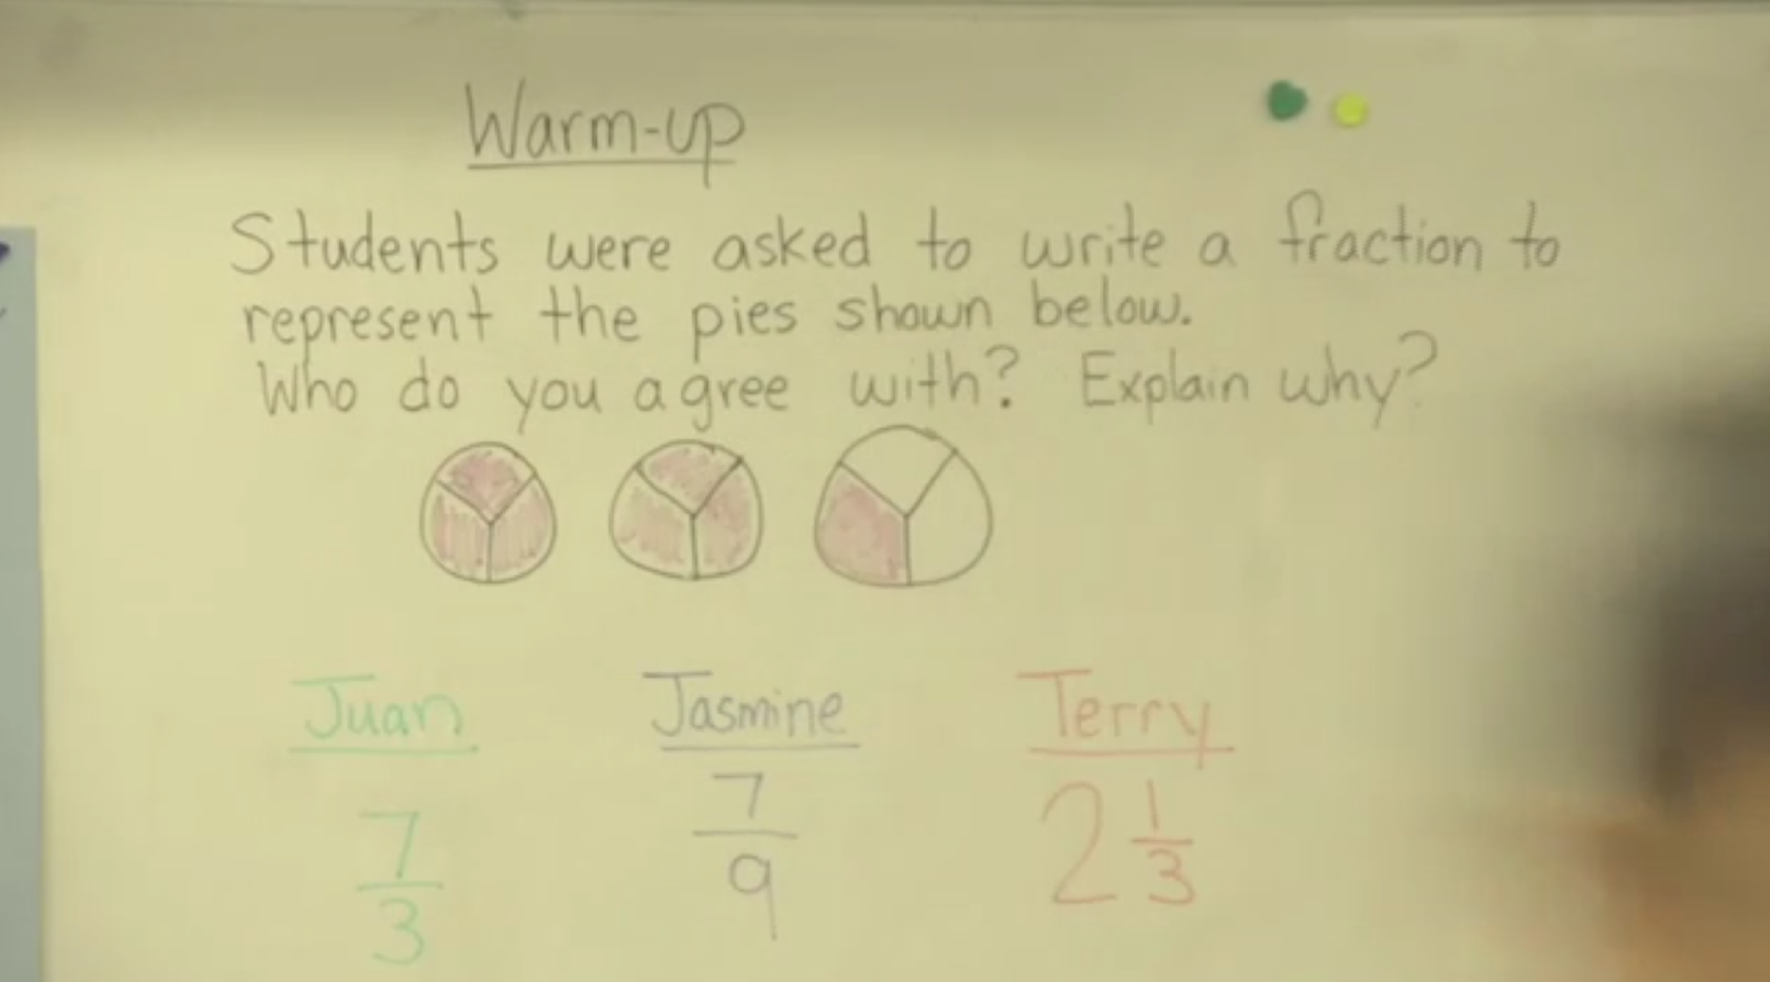
‹#›
Notes:
http://www.insidemathematics.org/classroom-videos/formative-re-engaging-lessons/5th-grade-math-interpreting-fractions/lesson-part-1
Approximately 0:00 - 4:09

Slide 7
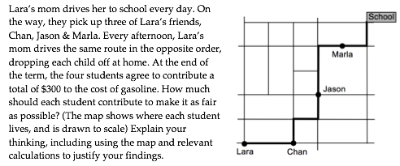
Getting Ready to Re-engage
Familiarize yourself with the carpool problem:
‹#›
Notes:
10-15 minutes

Slide 8
Re-engagement Activities
At each table define two sets (1-3 pieces) of student work that you will focus on.
Then split your table into two groups, each focusing on one of the sets.
Define a re-engagement activity based on your set of work.
https://tinyurl.com/Re-engagementLesson
‹#›
Notes:
10-15 minutes

Slide 9
Re-engagement Activities
Find a group from a different table who do not define the exact same set of student work.
Describe your group’s thinking in selecting the type of re-engagement activity.
Switch roles and listen.

Slide 10
Reflect on Re-engagement
How might re-engagement lessons/activities be used to support student learning in your classroom?
What might be some challenges that could arise in using re-engagement lessons/activities in your classroom?

Slide 11


Slide 12

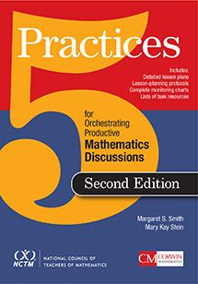
5 Practices for Orchestrating Productive Classroom Discussions
Peg Smith
Mary Kay Stein
2nd edition, 2019
Notes:
5 Practices review
(Show the book)
[Anne] 0:05 - 0:10
Last night, you each had a chance to review a little bit about the 5 Practices. Right now, discuss in your group:
How do you use the 5-Practices in your classroom, if you do?
What questions do you have about the 5 practices?

Slide 13
5 Practices
1) Anticipating
2) Monitoring
3) Selecting
4) Sequencing
5) Connecting
Notes:
[Anne]
As you read and discussed, these are the 5 practices.

Slide 14
5 Practices
0) Selecting (Choose an appropriate task)
1) Anticipating (Predict range of student work)
2) Monitoring (Identify during the lesson)
3) Selecting
4) Sequencing After student work is created
5) Connecting
}
Notes:
[Anne] 0:10 - 0:12
The first two practices take place before and during a given lesson or task. We’re going to focus on the other 3 practices today...

Slide 15
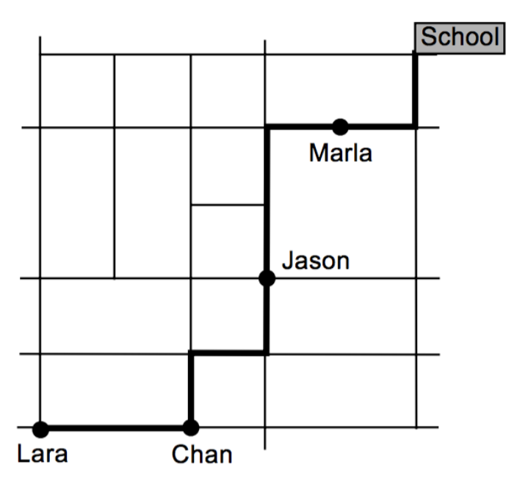
Select, Sequence, Connect
Look again at the student work from the carpool task.
With your table group:
Select 4 or 5 pieces of work
Sequence in a way that you would have it presented in your classroom
Notes:
Steps 3-5 of the 5 Practices: Select, Sequence, Connect
[Anne] 0:12 - 0:20
In your folder, you will find a collection of student work from the carpool task.
With your table group,
Select 4 or 5 of the artifacts
At your table, sequence work in a way that you would have it presented in your classroom
(We,the TLPLT will walk around and determine which 2-3 tables we want to share out (depending on time) and how we want to sequence)

Slide 16
Select, Sequence, Connect
Once you have come to an agreement of a sequence at your table:
record your sequence
explain your reasoning
what do you imagine students would take away from your sequence?
Discuss two significant take-aways
Notes:
Steps 3-5 of the 5 Practices: Select, Sequence, Connect
[Anne] 0:20 - 0:25
Once you and your table have agreed on a sequence, write down your sequence next to #1 on the handout in your folder
One more minute to have something written down.
Student work - from work that’s up in the posters. What if this was produced in your classroom?
Choose 4 or 5 of the artifacts
At your table, sequence work in a way that you would have it presented in your classroom
(After many minutes of sequencing, go to the questions on the next slide)
(We,the TLPLT will walk around and determine which 2-3 tables we want to share out (depending on time) and how we want to sequence)

Slide 17
Reflect on the 5 Practices
How might the 5 Practices be used to support student learning in your classroom?
What might be some challenges that could arise in using the 5 Practices in your classroom?

