Slide 1
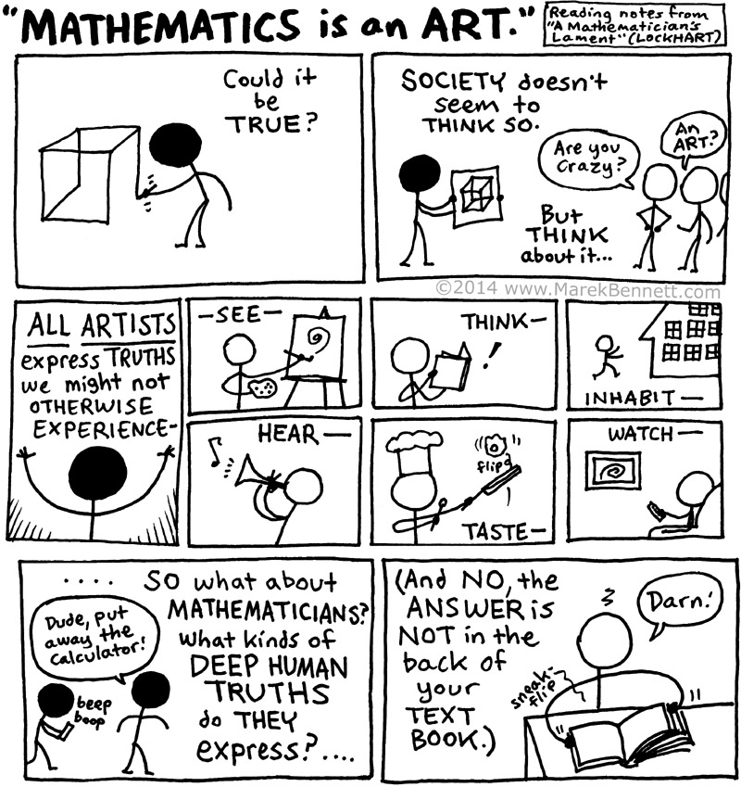
Reflecting on
Practice
Portland;
day four
2019

Slide 2


Slide 3
All on the Wall
What if you are not picking and choosing which student work to share with the whole class?
What if everyone’s work is available for everyone to look at, think about, respond to?!
Notes:
Table or whole group discussion? Individual reflection?

Slide 4
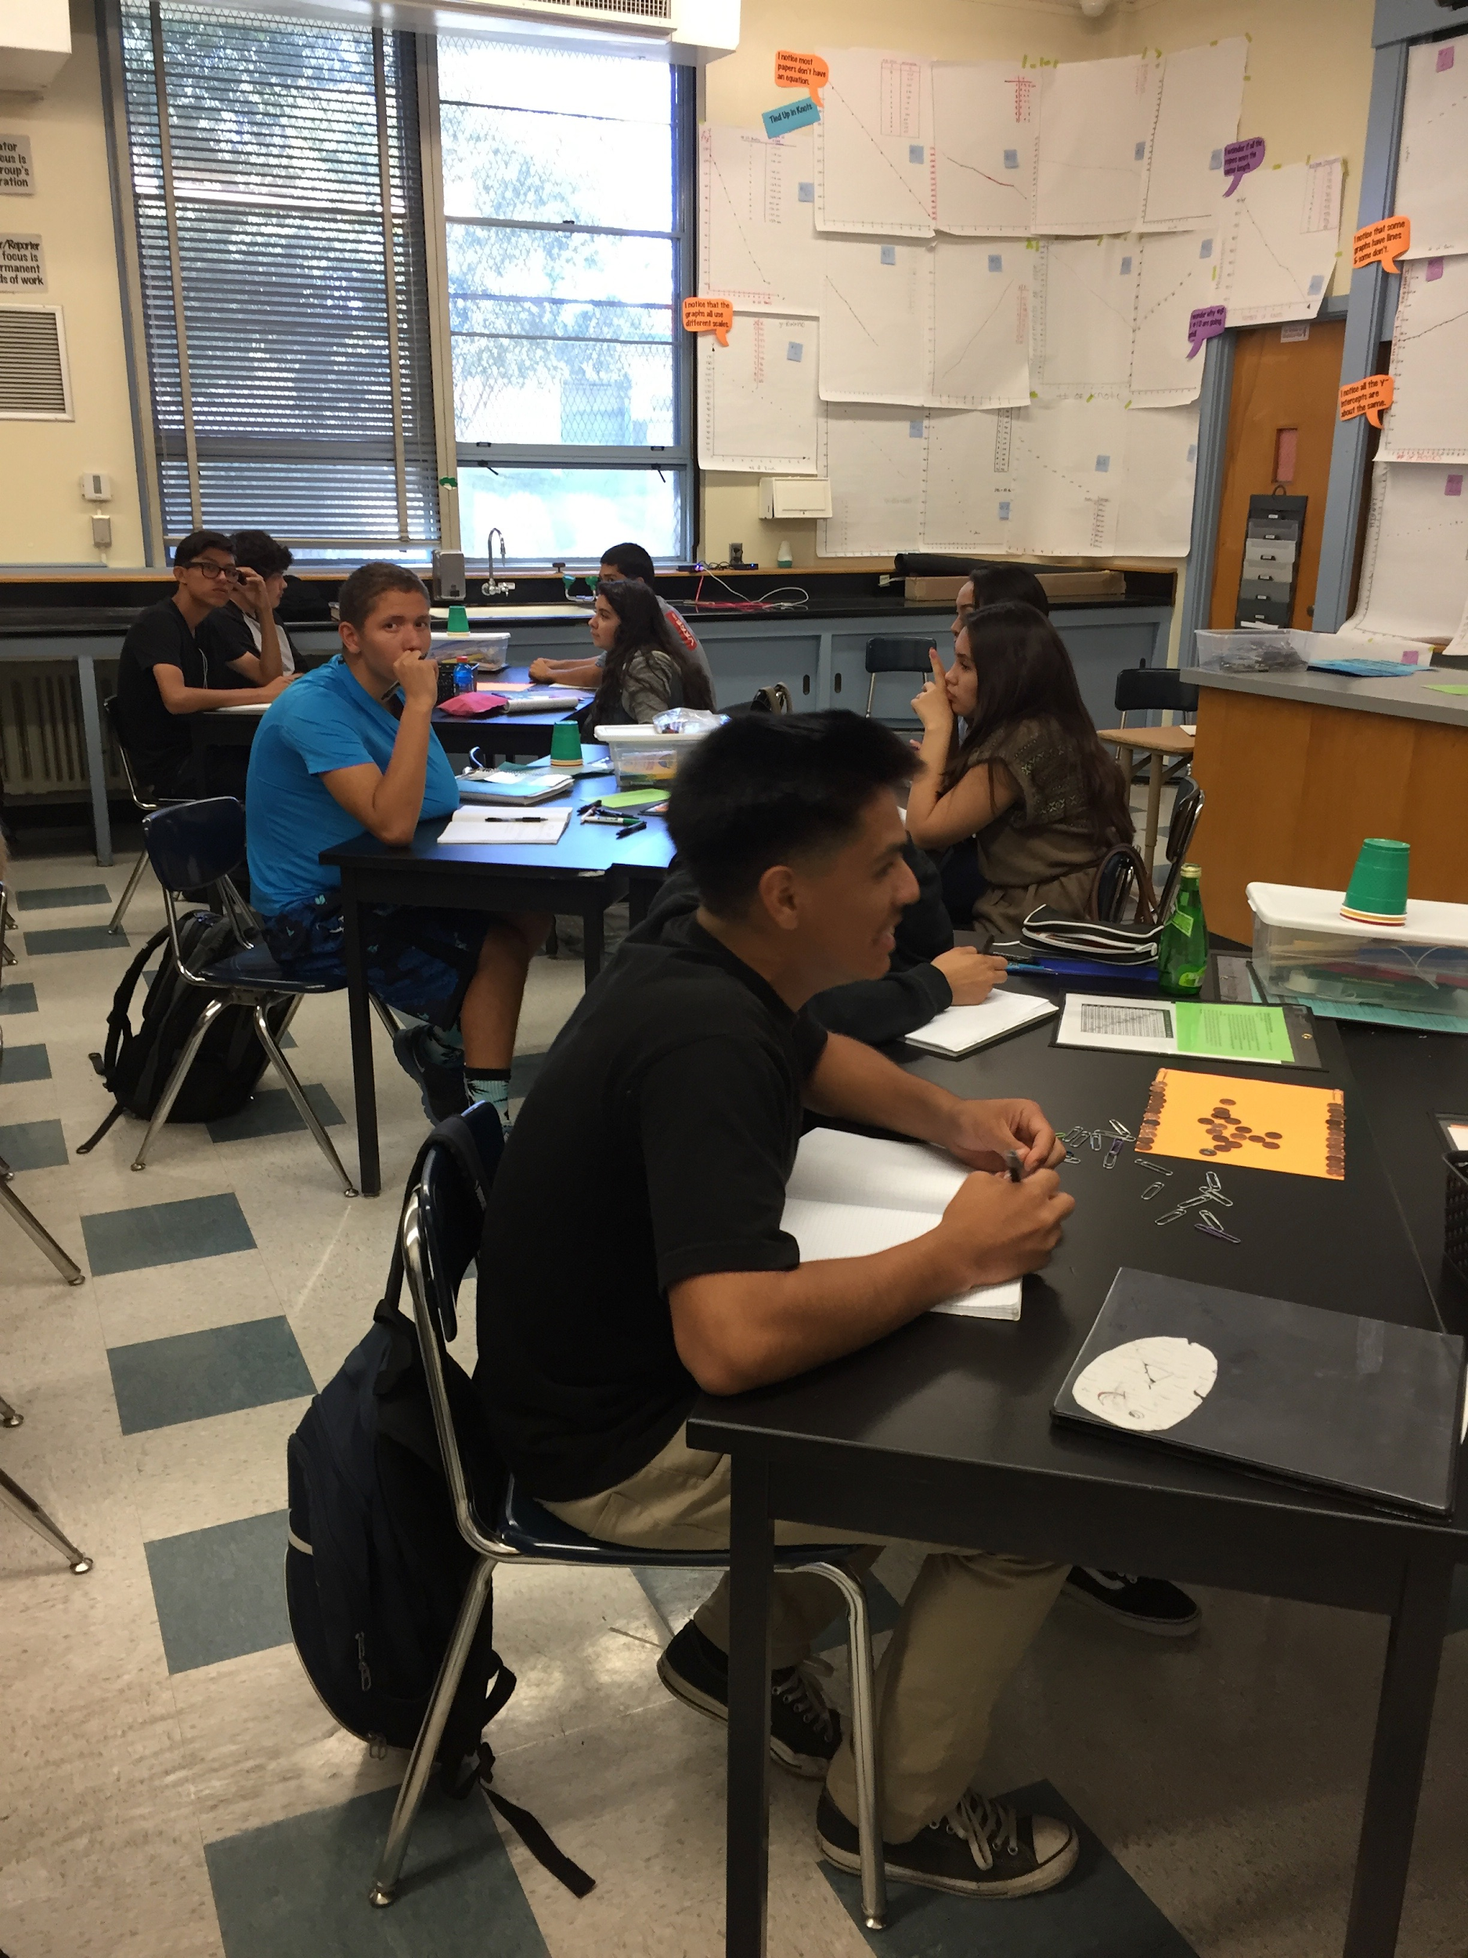

Slide 5
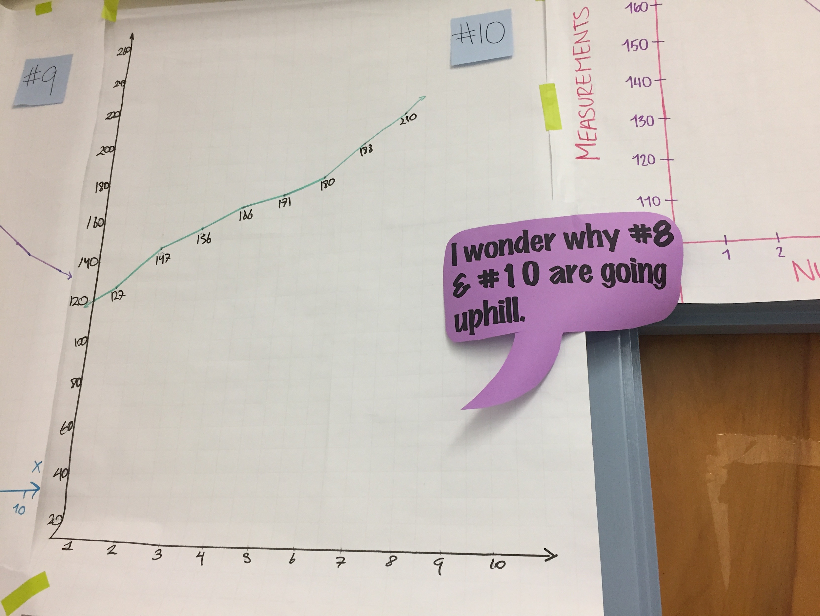

Slide 6
Compare/Contrast
ReEngage vs. 5 Practices vs. All on the Wall
What opportunities do you imagine for students to think and talk productively about the work and move their own thinking forward in each of approach?
What challenges do you imagine in supporting students to think and talk productively about the work and move their own thinking forward in each of approach?
Notes:
Let’s compare and contrast these two different approaches of what to do with students produce?
T chart Thoughts? Ideas? Anyone?

Slide 7
Compare/Contrast
 | Re-Engagement | 5 Practices | All on the Wall
Opportunity/ Support for productive student reasoning & sense-making
Challenges to productive student reasoning & sense-making
Notes:
Let’s compare and contrast these two different approaches of what to do with students produce?
T chart Thoughts? Ideas? Anyone?

Slide 8
Issues of
Academic & Social Status
What status issues do you see being addressed through the public use of genuine student work? In what ways?
What status issues do you see being exacerbated through the public use of genuine student work? In what ways?

Slide 9
Invitations & Toeholds
As professional educators, we have an ethical obligation to continually invite previously disengaged, absent, or distracted students to get back into the work at hand.
We have an equal obligation to make it possible for them to do this productively.
Reflecting on Practice
Park City Mathematics Institute
9
Notes:
You’ve seen three very different approaches to public use of student created materials and how it is being used with the whole class or classes. There’s been plenty written about the 5 practices, and re-engagement has been well documented in digital ways, so you can dig into them. If you want to know any more about Peg’s approach, you will need to talk to Peg. We all have choices. We all need to think intentionally about our goals: Why am I doing what I am doing? What about this am I using? Why am I using it?
If it isn’t about some instructional goals, then why are you doing it?

Slide 10
Revisiting the Last Three Days
How can you use artifacts...
To benefit you as the teacher?
To benefit individual students?
To benefit the classroom community?

Slide 11
Revisiting the Last Three Days
What we did….
Notice & Wonder
Lenses for looking
Stand & talk
4 A’s protocol
Feedback at scale
4 quarters marking
Eavesdropping
Round robin
.
Mingle, mingle, mingle
Silent communication
Question “game”
Groupwork
Re-engagement
5 Practices
All on the wall
Speech bubbles

Slide 12
why > how
Notes:
Peg calls dibs….

Slide 13

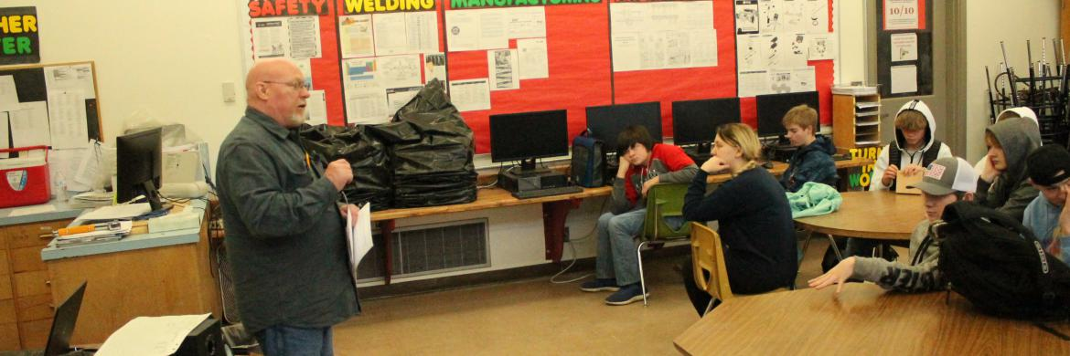

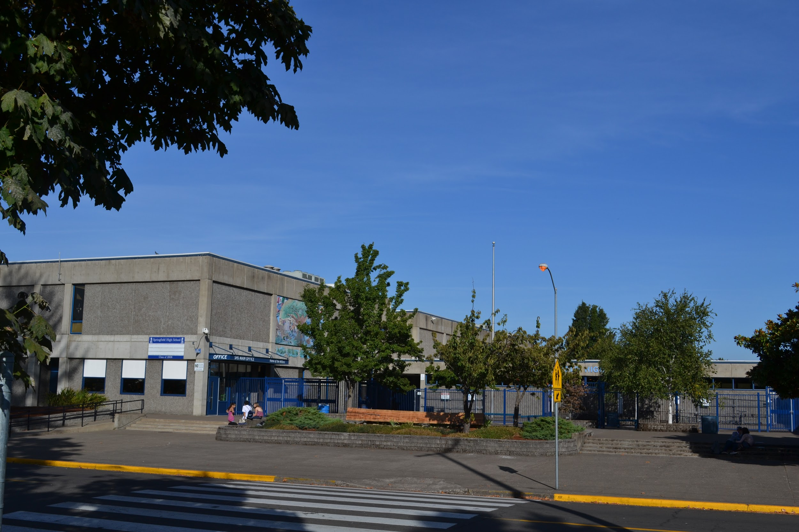
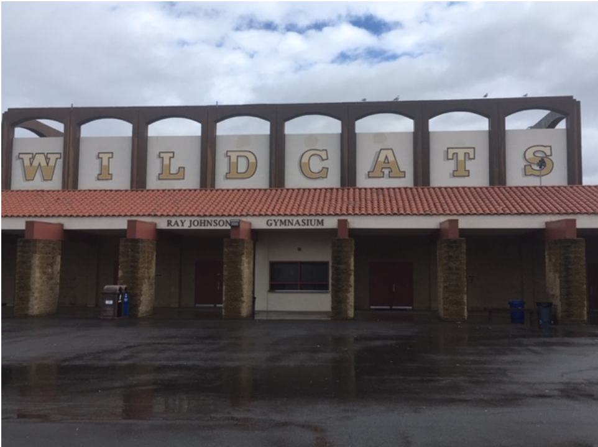

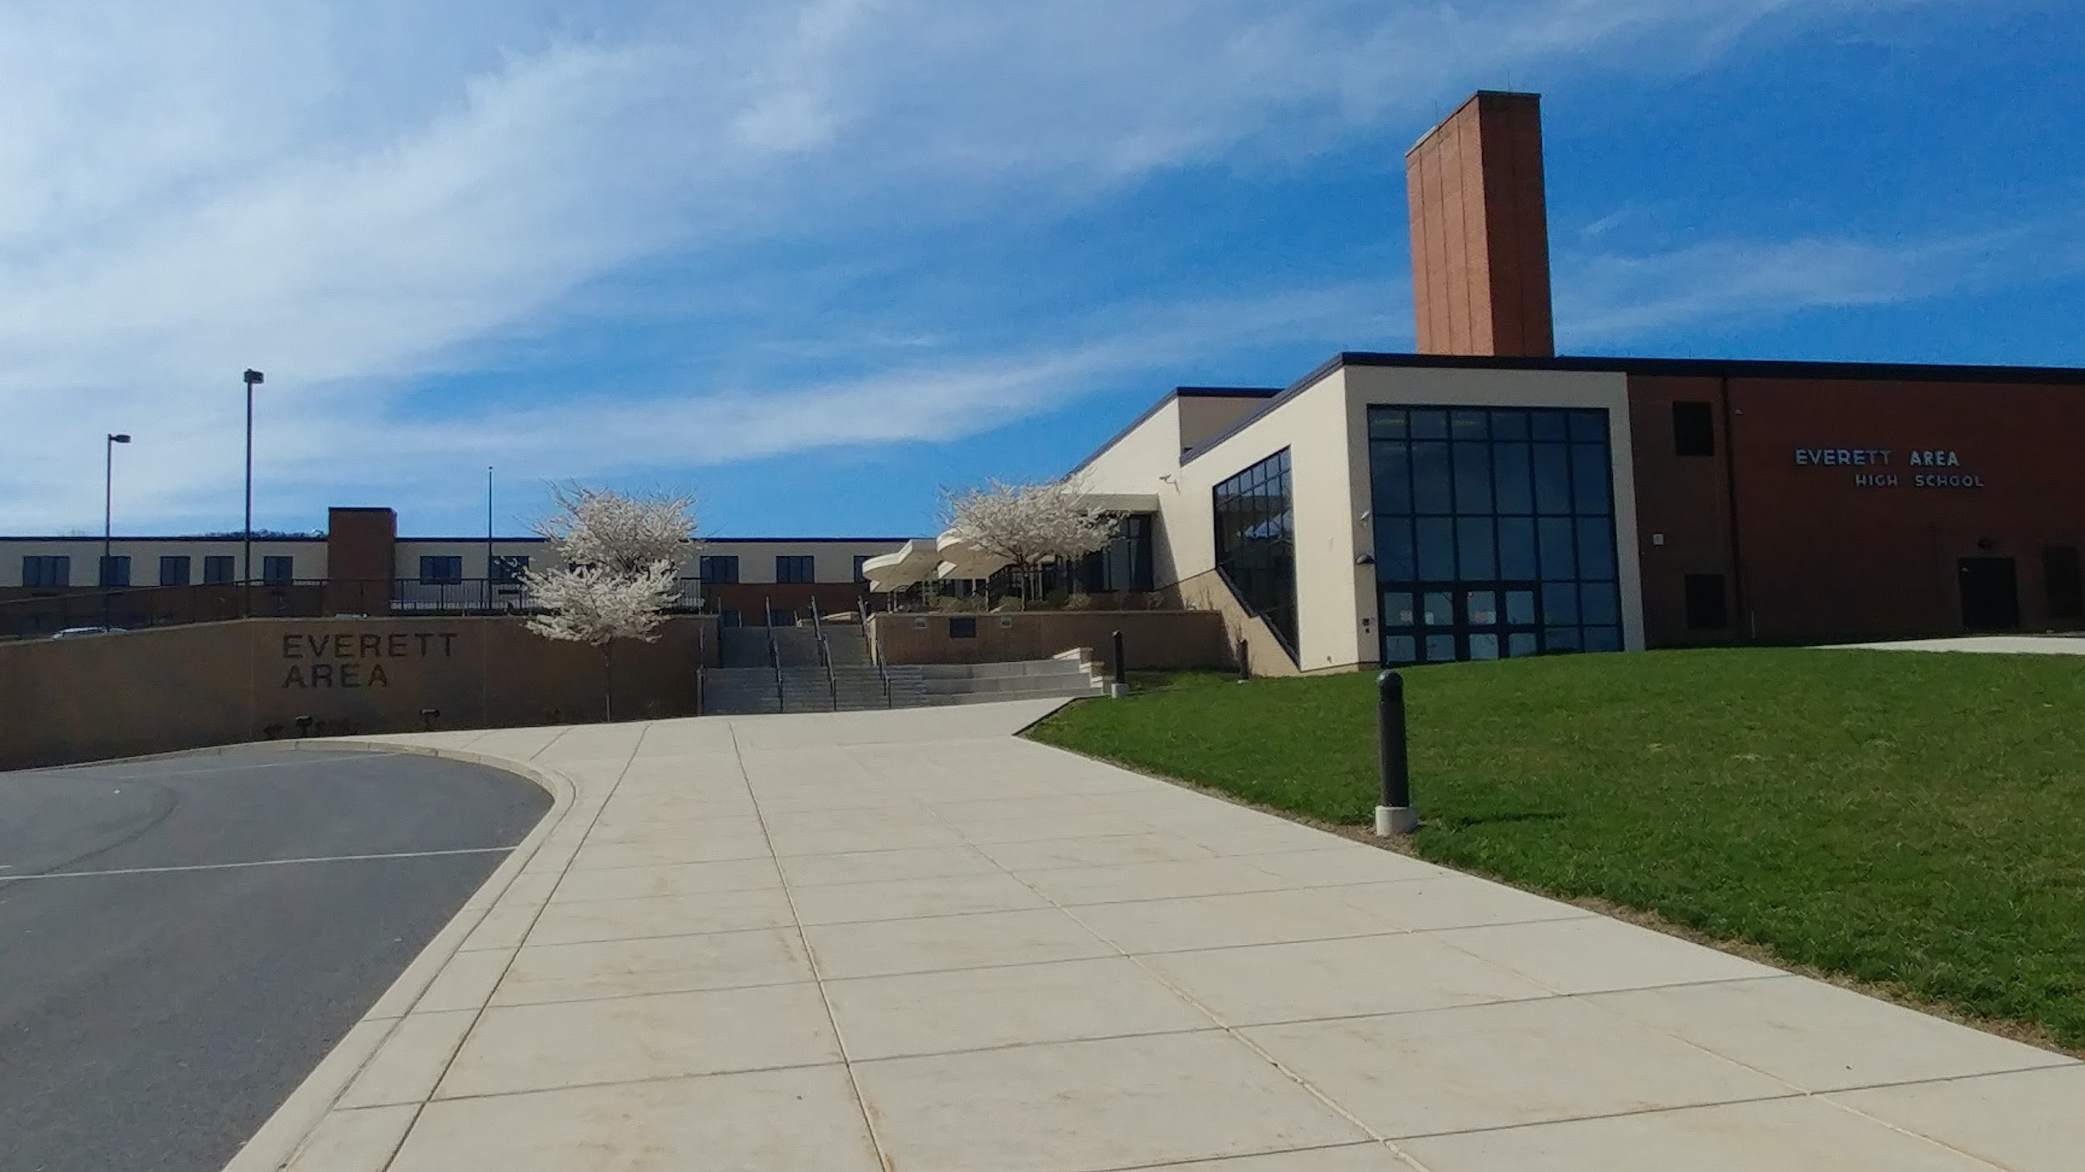


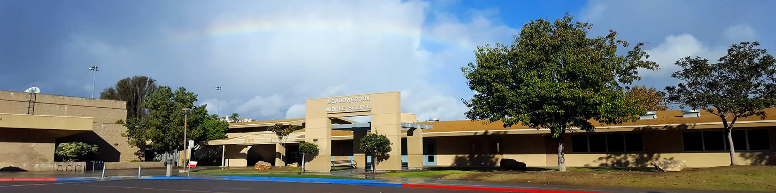

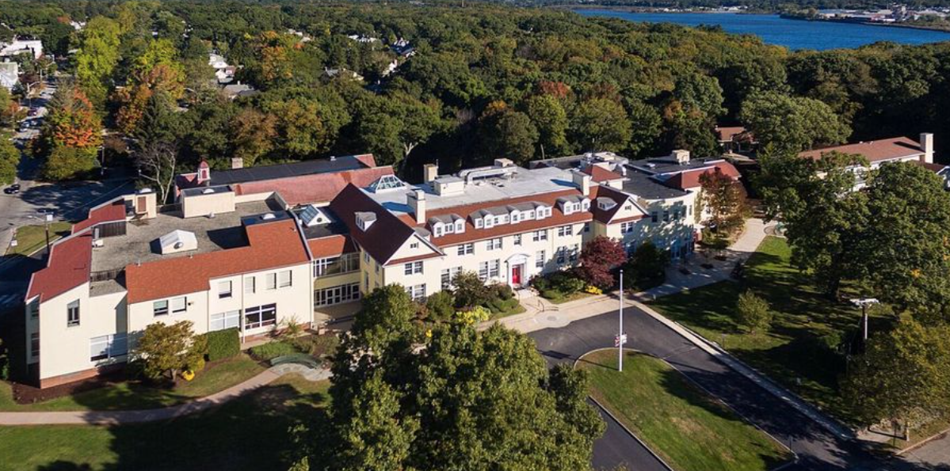
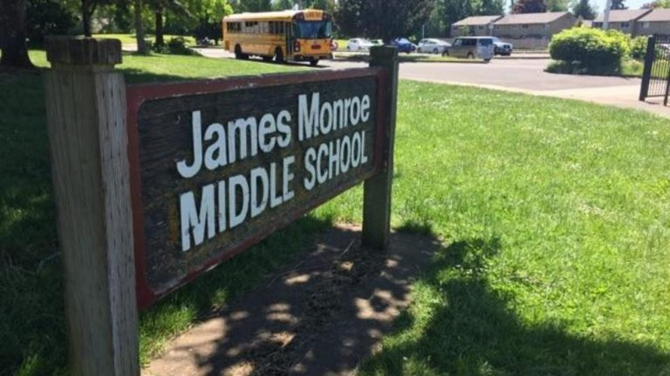
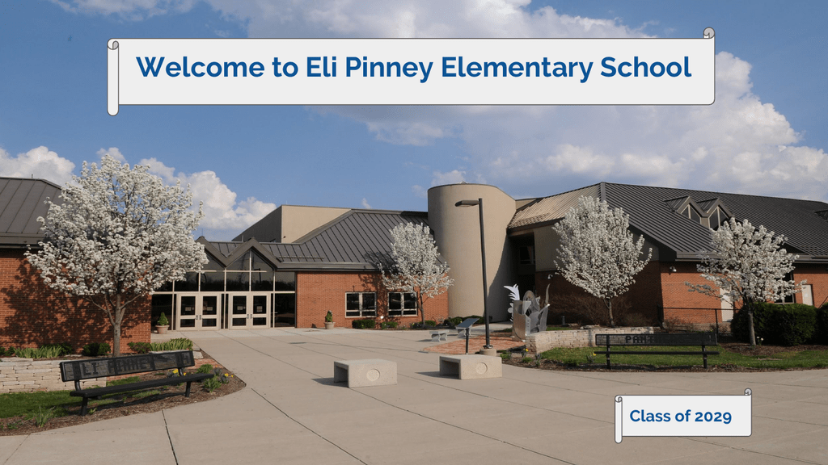
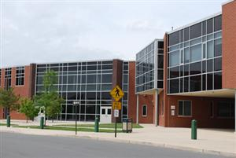
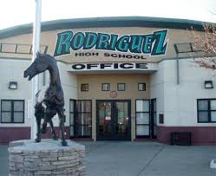
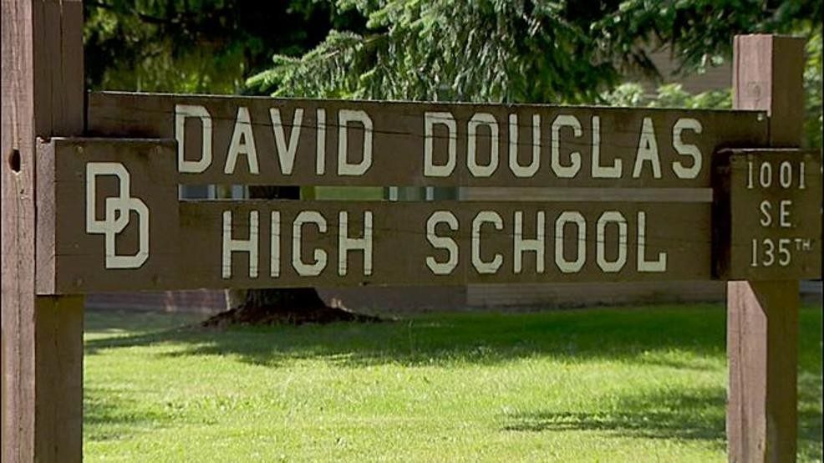
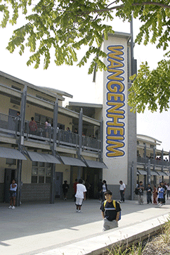
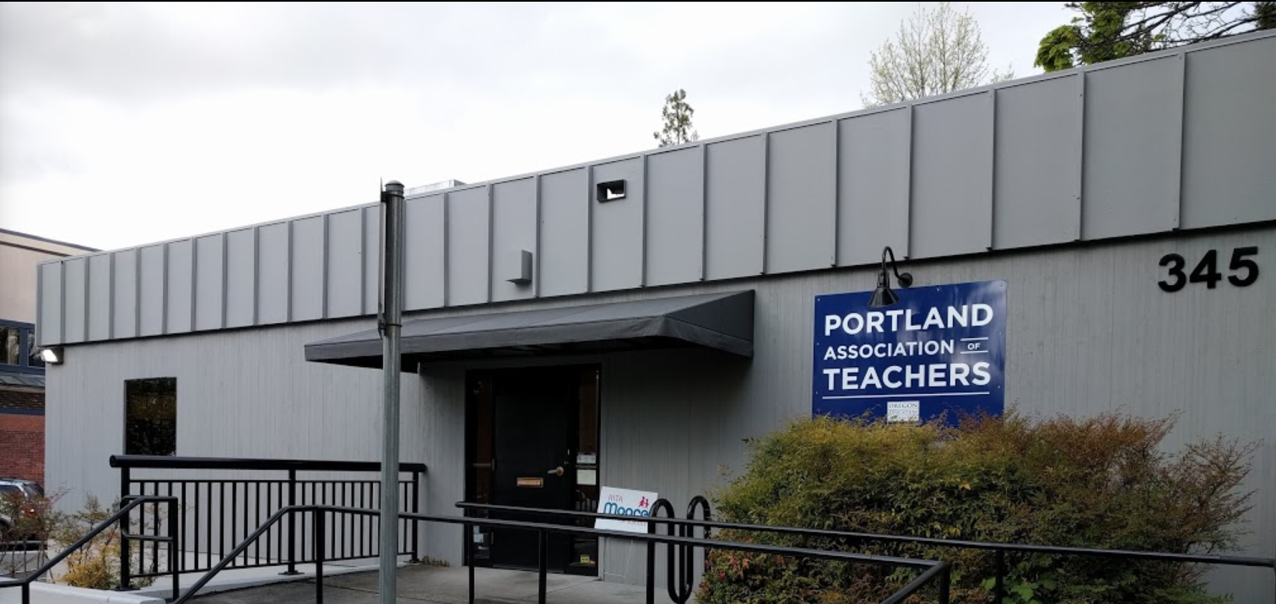
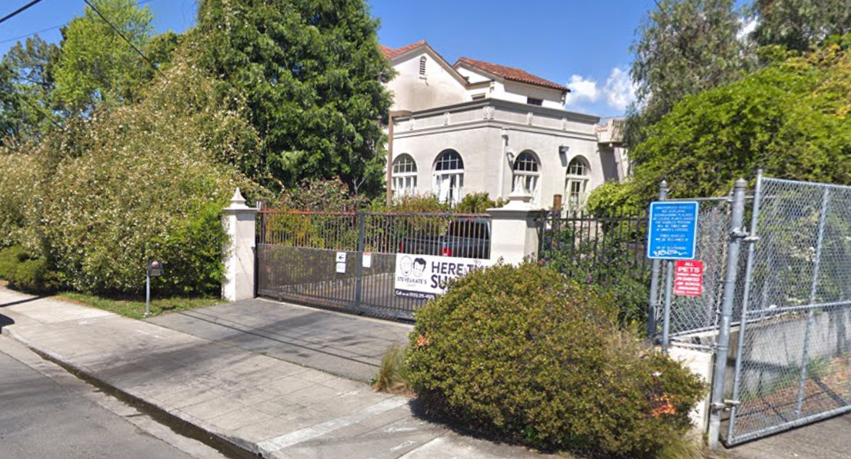
Notes:
Right now, we want you to transport yourself back to the work that you do with your students. Close your eyes if you need to.
- it’s time to re-enter that sacred space that is your classroom.

Slide 14
Goal Setting
What’s your goal(s) for returning to your school setting, your classroom, and welcoming your students to a productive year of learning mathematics?
Notes:
[Amy]

Slide 15

Notes:
Pick one goal that you want to remind yourself of later in the year….
What reminder do you want to do more of…. to do less of …. to do differently…..

Slide 16
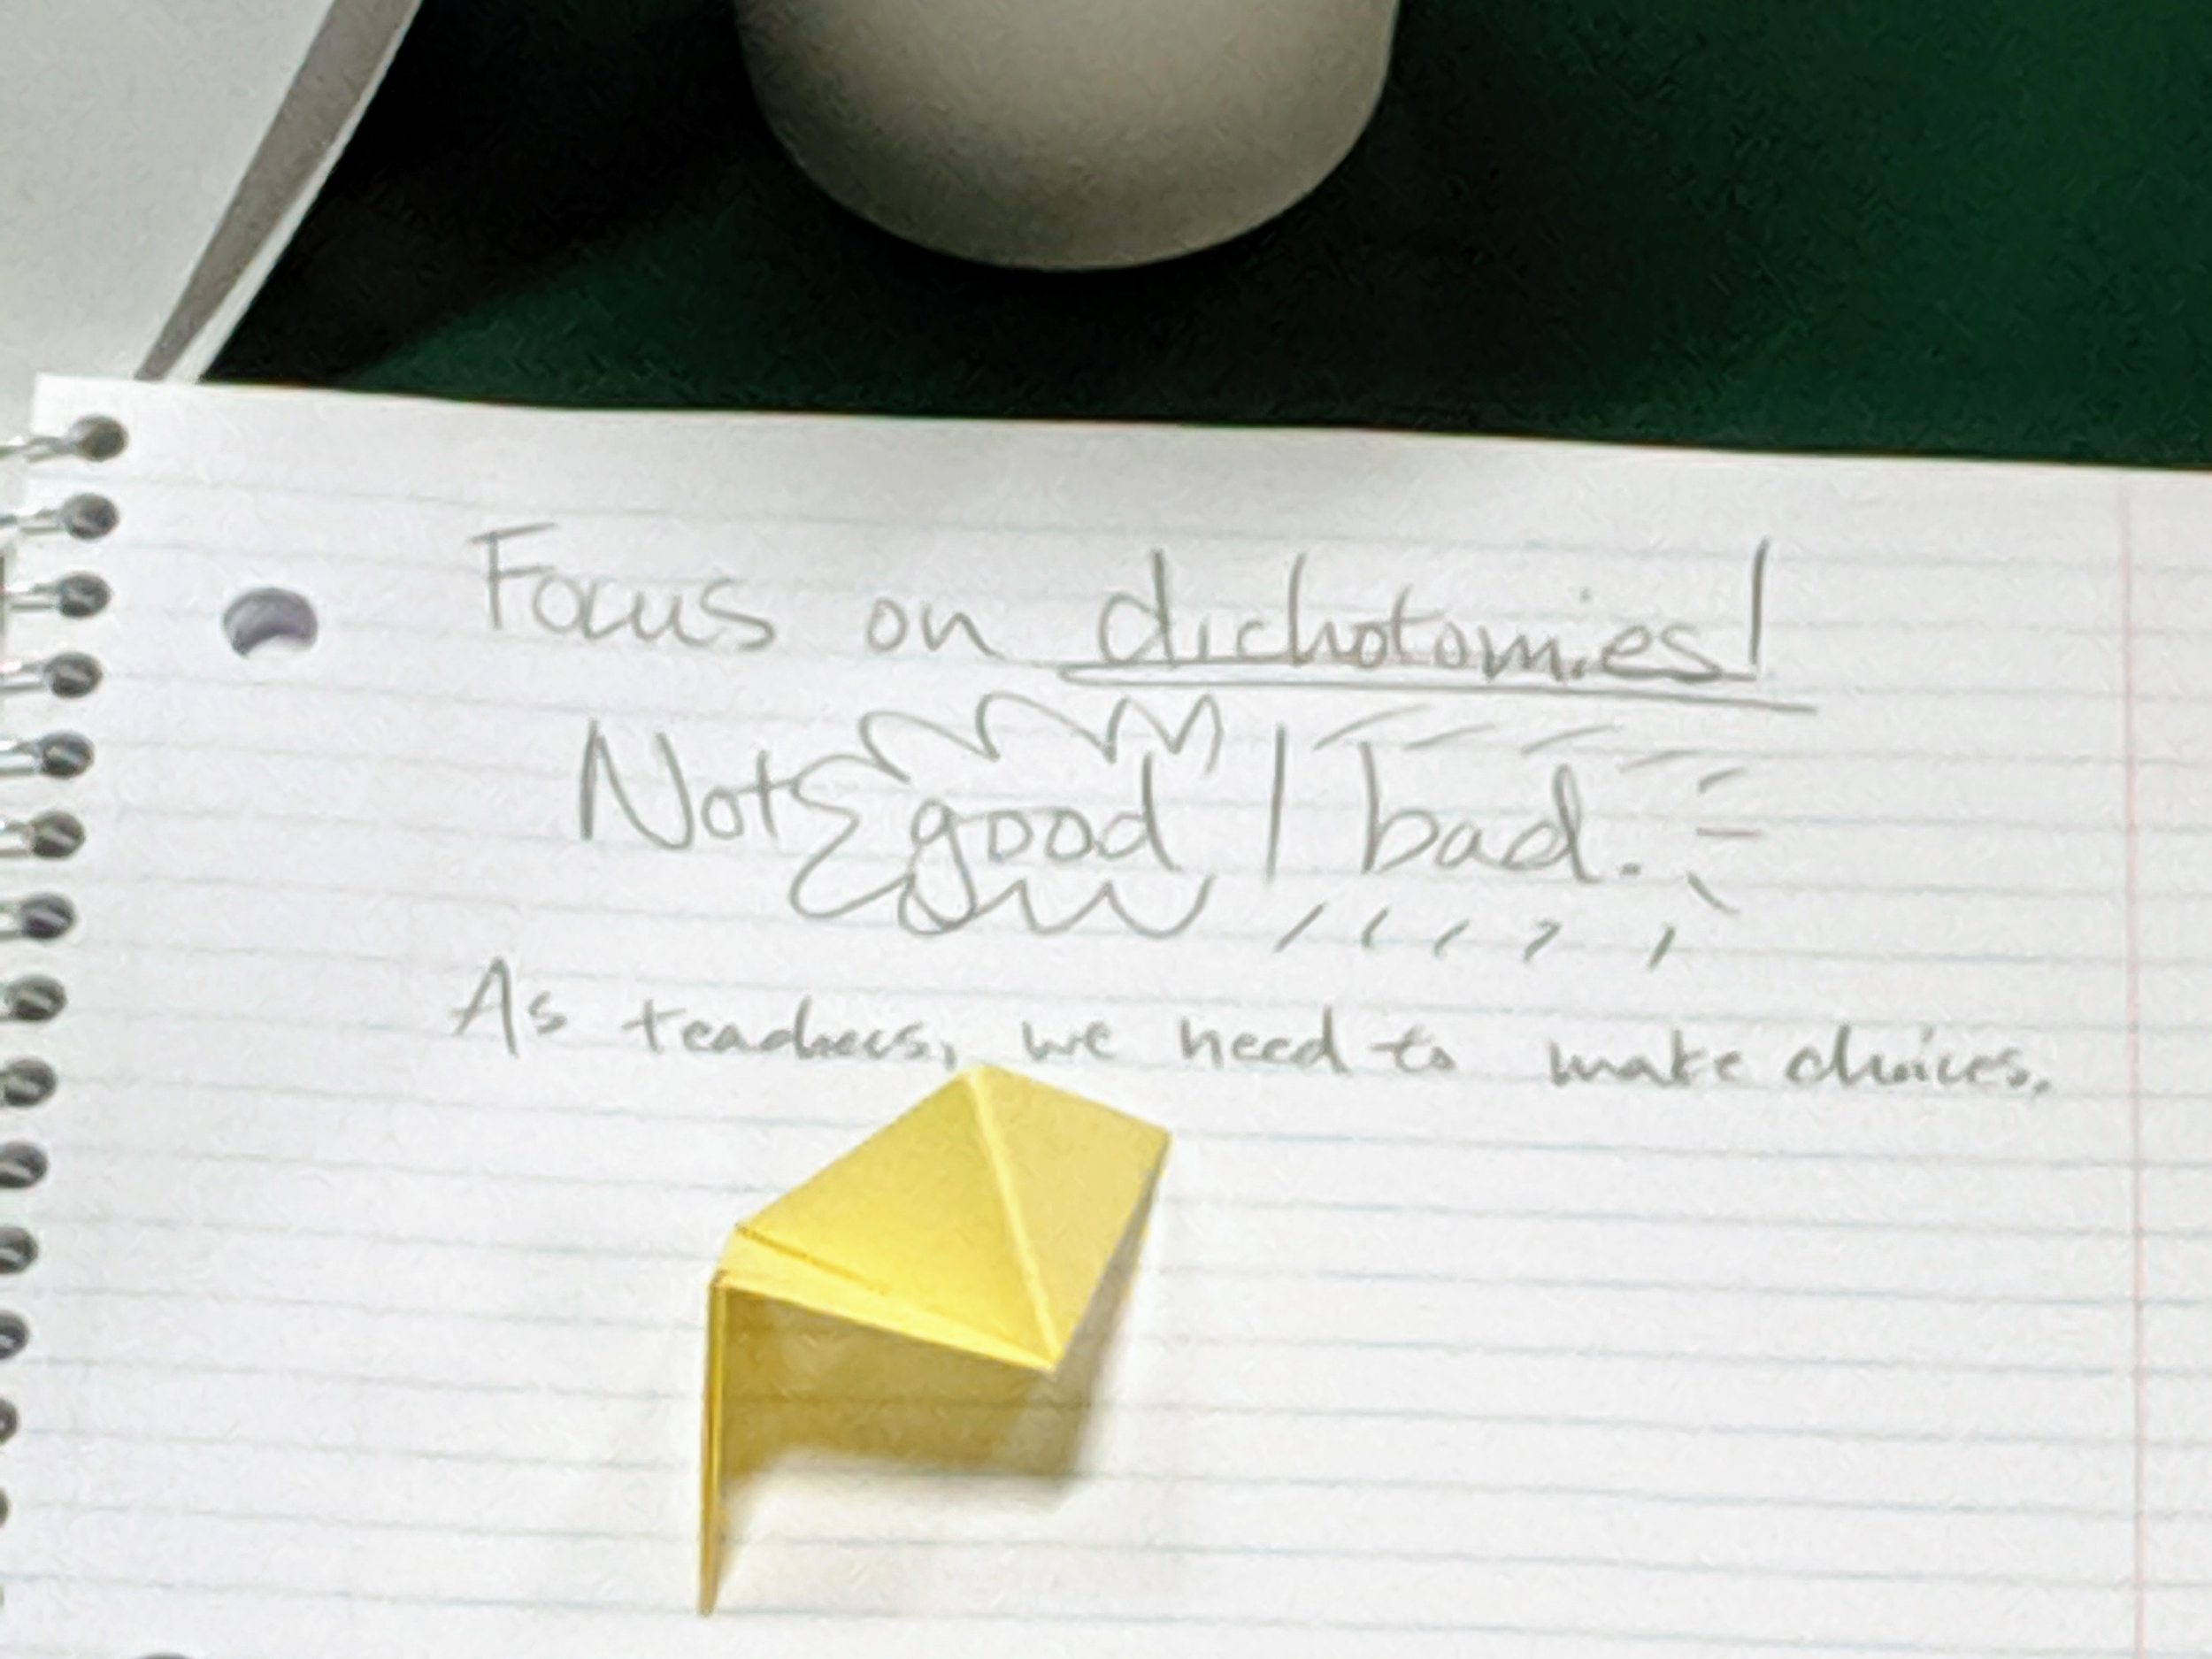
Notes:
remember to give yourself permission as you continually refine your practice to get worse in the process of getting better….
and also give yourself permission not to change practices, but to change your thinking/level of understanding & commitment of why you are engaging in those practices

