Slide 1
Reflecting on Practice: Worthwhile Tasks
Session 2:
How to can teachers adapt tasks to
make them worthwhile?

Slide 2
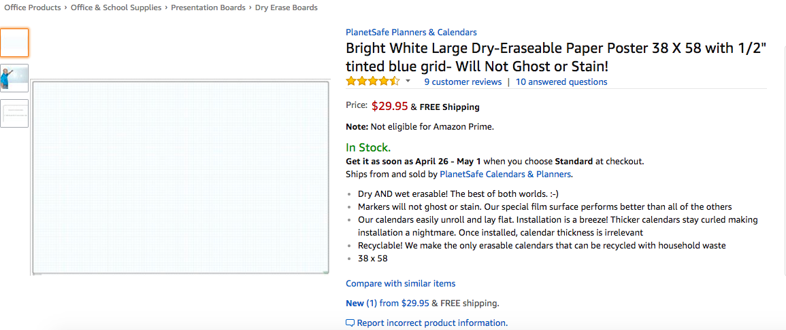
White Boards
tinyurl.com/buyvnps

Slide 3
In the figure below, what fraction of the rectangle ABCD is shaded?
A
B
1/6
1/5
1/4
1/3
e) 1/2
D
C
NCES, Grade 8, 1996

Slide 4
In the figure below, what fraction of the rectangle ABCD is shaded?
A
B
1/6 (5%)
1/5 (3%)
1/4 (24%)
1/3* (66%)
e) 1/2 (2%)
D
C
NCES, Grade 8, 1996

Slide 5
Color ¼ of the drawing.
Dekker & Querelle, 2002

Slide 6
Another approach to ¼ (Dekker & Querrelle)

Slide 7
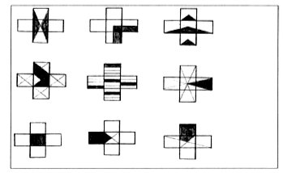
In which is ¼ of the shape shaded?
Dekker & Querelle, 2002

Slide 8
What did you like or not like about this task in terms of promoting discussion and eliciting student understanding?

Slide 9
Tasks should be chosen so that there is an opportunity for error in reasoning or thinking that opens up the ability to discuss or explain - not just an error in the next step (for example, lost a negative sign or multiplied incorrectly).

Slide 10
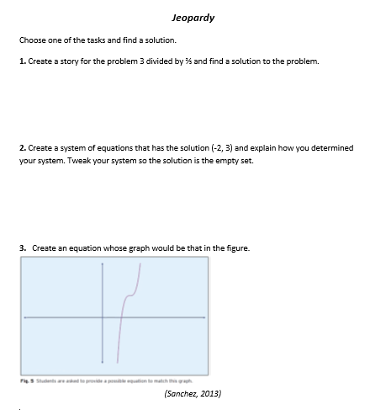

Slide 11
Pair Up
Find another partnership at a different table who did the same task and discuss your solution with them.

Slide 12
Jeopardy
We often call this approach Jeopardy … Give students the answer and ask for the question.
How did Jeopardy promote discussion and elicit student thinking and understanding?

Slide 13
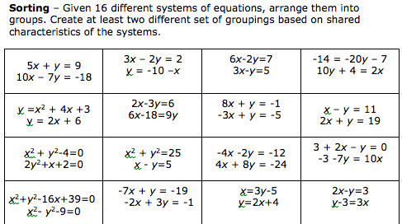

Slide 14
What mathematical ideas emerged during your discussions either with your partner or as a whole table?

Slide 15
How is this approach different from just working through a worksheet?

Slide 16
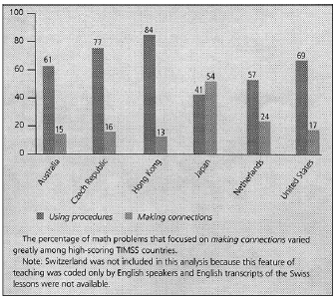
Types of math problems presented
http://bit.ly/hiebert2004
Hiebert & Stigler, 2004

Slide 17
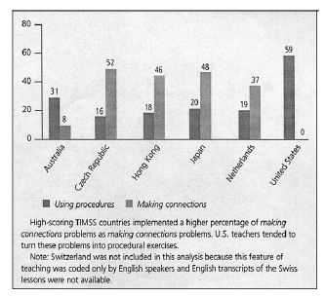
Teacher implementation of the making connections
math problems
Of the making connections problems…
http://bit.ly/hiebert2004
Hiebert & Stigler, 2004

Slide 18
Take a few minutes to reflect using the prompts in your notes:
What is one message from this session that you would want to bring back to another teacher? How would you make it meaningful and accessible for them (when they haven’t been here with you)?
On your Exit Card:
What question would you like to raise for us to think about as we move forward?

Slide 19
References
Dekker,T. & Querelle, N. (2002). Great assessment problems (and how to solve them). CATCH project www.fi.uu.nl/catch
Hiebert, J., & Stigler, J. (2004). Improving Mathematics Teaching Improving Achievement in Math and Science, 64(5), 12-17.
National Council of Teachers of Mathematics. (2014). Principles to action: Ensuring mathematical success for all students. Reston VA: The Council
Sanchez, W. (2013). Open ended questions and the process standards. 107(3). Mathematics Teacher.

