Slide 1
Reflecting on Practice: Worthwhile Tasks
Session 3
Implementing Tasks: Maintaining Fidelity

Slide 2
In this figure as the step changes, the _____________ also changes”
Step 1
Step 2
Step 3
Peterson, 2006

Slide 3
Investigate
With your partner, pick one of the attributes in our list and investigate how it changes. Make a conjecture and try to prove it. How would a graph, a table, and/or an equation support your conclusion?
(If time, explore a 2nd or 3rd property)

Slide 4
As a table, decide what your lesson goal will be
Possible goals:
Distinguish between linear and quadratic relationships
Distinguish between closed form and recursive rules for sequences
Interpret numerical, algebraic and geometric representations of a mathematical concept
Describe a geometric pattern by an algebraic expression
Recognize a quadratic relationship and be able to find a closed form rule for the relationship
Recognize and be able to describe the components of an arithmetic sequence
Explain what rate of change means in different situations

Slide 5
Select and Sequence
As a table, keeping your learning goal in mind, select a few examples of work that you would want to have your class discuss.
Sequence the work in the order in which you want the discussion to take place and be ready to defend your choice of sequence for the discussion.

Slide 6
Connections
It is important to bring ideas together for students.
What connections would you want students to discuss? How would you help them see those connections?

Slide 7
Possible mathematical connections
Which changes led to linear equations and which lead to quadratic? Is there an explanation?
What were the advantages and disadvantages of different approaches (symbolic vs. tables vs. graphs vs diagrams)?
What is the distinction between patterns and proof? Is this important? Why or why not?
Identify where it was important to “attend to precision”.

Slide 8
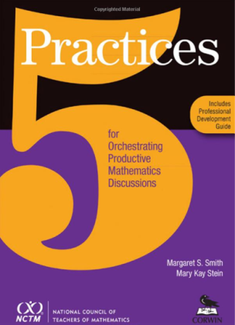
The 5 Practices
Anticipate
Monitor
Select
Sequence
Connect
Smith & Stein, 2011

Slide 9
Consider the task we just looked at and it’s implementation.
As a student, what was useful about this task? What did you like? What didn’t you like?

Slide 10
Consider the task we just looked at and it’s implementation.
As a teacher, what was useful to you? What did you like? What didn’t you like? What would you change? How would you change it?

Slide 11
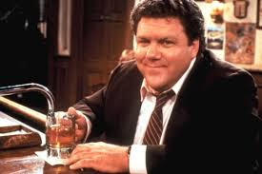
Norms!!

Slide 12
Participation quiz (PCMI, 2011)
High school algebra class working on factoring. They are being graded on how well they work together on the task not on right answers.
As you watch, what norms are being established to encourage discussion?

Slide 13
With your table group
What explicit norms does the teacher set for student discussion?
What teacher moves enforced the norms?

Slide 14
Sociomathematical Norms - Talking About The Math
Explanations consist of mathematical arguments not simply procedural summaries of the steps taken to solve the problem.
Errors offer opportunities to reconceptualize a problem and explore contradictions and alternative strategies.
Mathematical thinking involves understanding relations among multiple strategies.
Collaborative work involves individual accountability and reaching consensus through mathematical argumentation (Kazemi, 1998).
Notes:
Vicki’s Norms

Slide 15
Norms for students working together
Take turns
Listen to others ideas
Disagree with ideas not people
Be respectful
Helping is not the same as giving answers
Confusion is part of learning
Say your “becauses”
I can’t do that - YET
Notes:
Llana Horn – Strength in Numbers

Slide 16
Student Engagement
tinyurl.com/ishorn

Slide 17
Motivational Constructs
  Belongingness
  Meaningfulness
  Competence
  Accountability
  Autonomy

Slide 18
References
Horn, I. (2012). Strength in numbers: Collaborative learning in secondary mathematics. Reston VA: National Council of Teachers of Mathematics
Peterson, B. (2006). Linear and quadratic change: A problem from Japan. The Mathematics Teacher, 100(3). Reston VA: National Council of Teachers of Mathematics.
Smith, M., & Stein, M.(2011). 5 practices for orchestrating productive mathematics discussions. Reston VA: National Council of Teachers of Mathematics

