Slide 1
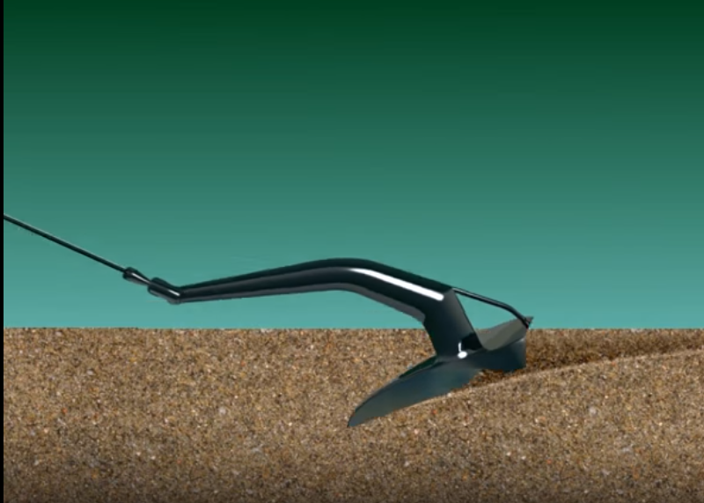
Anchor Settings: Making Math Stick
Sean Corey
Brooke Sossin
Cindy Ruhsam

Slide 2
Have you implemented or wish to implement rich mathematical tasks?

Slide 3
A month after doing the rich task, how much did the students remember the math learned from the task?

Slide 4
What has been your experience of how much the knowledge from these tasks “stuck”?
If not, why not?
If so, why did they stick?

Slide 5
Round Robin
Each table mate gives their idea and then the next (clockwise) table mate gives theirs. You can’t speak again until it comes back around to you.

Slide 6
Stick | Not Stick
Students “owned” the work, students engaged When actual math connection was made by the students students "discovered" the ... formula, idea, etc When a students had a memorable experience, maybe a story, or something that another student said, or a conversation that we had When they saw the problem more than once Students worked in team | When teacher told the students the math connection tried to memorize without understanding “Lecture” based when the teacher did all the work and thinking it didn’t stick no time to "struggle" Didn’t see it more than onece

Slide 7
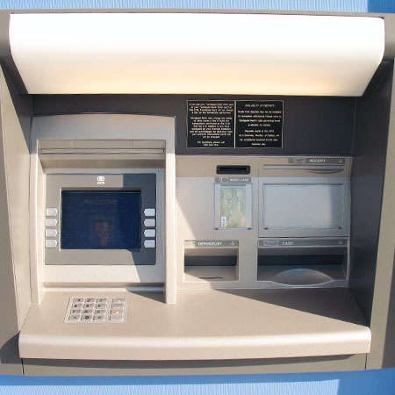
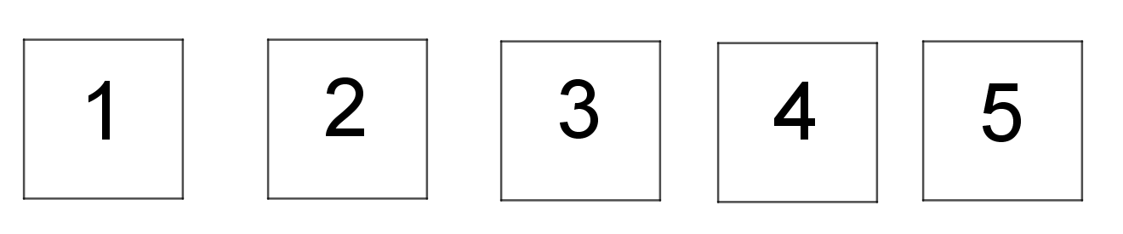
Hungry Machine
Feed me
2 cards

Slide 8
The Hungry Machine
Cards with the numbers 1,2,3,4,5 are laid out. The machine eats 2 of the cards and spits out a new card with a number on it that is the sum of the 2 cards it just ate plus the product of those two cards.
EX. If you feed it the 2 and 5 cards first then it spits out 17
Because 2+5 +(2)(5) = 17. Now you have 4 cards left {1,3,4,17}.
But the machine is still hungry, it wants more cards.
What is the first mathematical question that comes into your mind?
Notes:
Participants do the problem.
Does it matter what order the machine eats the cards in?
Does the card have to be put back in any order.?
When you get down to 1 card how large of a number will it be/ or smaller number.
How many rounds does it take to get down 1 cards?
How many things get added (how many individual terms get added)
Organization is super important.
This task is considered done when the audience has realized that are the getting same regardless of what the initial input is: i.e. its associative. (15 minutes)

Slide 9
Initial Questions
What is the highest possible card?
run out of cards
What is the lowest card?
Does the number matter- bigger or smaller is “better”?
What cards are possible to make?
Will the final card always turn out the same no matter what order you pick the cards?
find the smallest sum of all cards
How many combinations are possible?
Notes:
These are the questions audience members want to investigate from the task. We will try to answer these in the work time.

Slide 10
Math Concepts of Card Machine
Prooving/disproving our conjectures!
Function notation
associativity
Funstration
Commutativity
Binary operations
Arithmetic
Equivalent expressions.
Notes:
talk with your groups or neighbors to determine the underlying concept.
Select a key concept (associativity) to accomplish with this task this time.

Slide 11
Anchors
Definition: An anchor is a setting that learners can laminate mathematical concepts to.
By systematically revisiting a rich setting in different units throughout the year/ years, we connect content through a memorable theme.
Notes:
We don’t want to just do a good task and be done; the understanding won’t “stick.” Cindy
You probably already anchor concepts and procedures i.e. y=mx+b.

Slide 12
Anchor This Setting
Cards with the numbers 1 through 5 are laid out. The machine eats 2 of the cards and spits out a new card with a number on it that is the sum of the 2 cards it just ate plus the product of those two cards. For example, it eats 5 and 3 and spits out 23.
What are some possible extensions/ simplifications of Card Machine setting, and what math content could be laminated to this?
Notes:
(Consider their initial questions - are any of them extensions?) Cindy
Does it matter what order the machine eats the cards in?
Does the card have to be put back in any order.?
When you get down to 1 card how large of a number will it be/ or smaller number.
How many rounds does it take to get down 1 cards?
How many things get added (how many individual terms get added)
Organization is super important.

Slide 13
Using Our Task as an Anchor
Progression of math concepts with the card machine
Notes:
Problem solving strategy and affect (don’t anchor the content, but the practices)
Using negative numbers. Cindy
decimals/fractions
change the rule
Explicit example of how to anchor an open ened task.
given output, solve for input (equations)
Highest and lowest number computed
are the numbers increasing or decreasing

Slide 14
Hungry Machine Anchor Progression
K-5 “in out” machine (takes one card at a time), arithmetic operations on positive integers
6-8 “in out” machine, arithmetic operations on rationals
9-12 “binary operations”, explore associativity, commutativity, factoring, operations on matrices, algebraic reasoning, and proof
Notes:
(BS)
Teachers use an “anchor” all the time -- “Remember when we did this?” “We always say…” “Let’s revisit…”
But these don’t always pay off - students don’t remember, or care, or the connection is just not meaningful
Let’s see how another task, like the machine, can help us anchor ideas.
Solicit different interpretations of the task.
First, clarifying questions: Are there ambiguous parts? What are the possible interpretations?
Then, content questions: Hypotheses, or wonderings?
Don’t answer them yet -- for instance, allow one teacher to explore “additive increase” vs. “multiplicative increase.” These questions are ones that can be explored in the work phase.
Instruction: Do the work the way you imagine your students might, to see what math you confront.

Slide 15
double number line, area models for multiplication/factoring/probability
I use a progression of patterns to introduce students to linear equations
Area Models, area model for multiplication: natural numbers, fractions, polynomials
a pan balance for equations

Slide 16
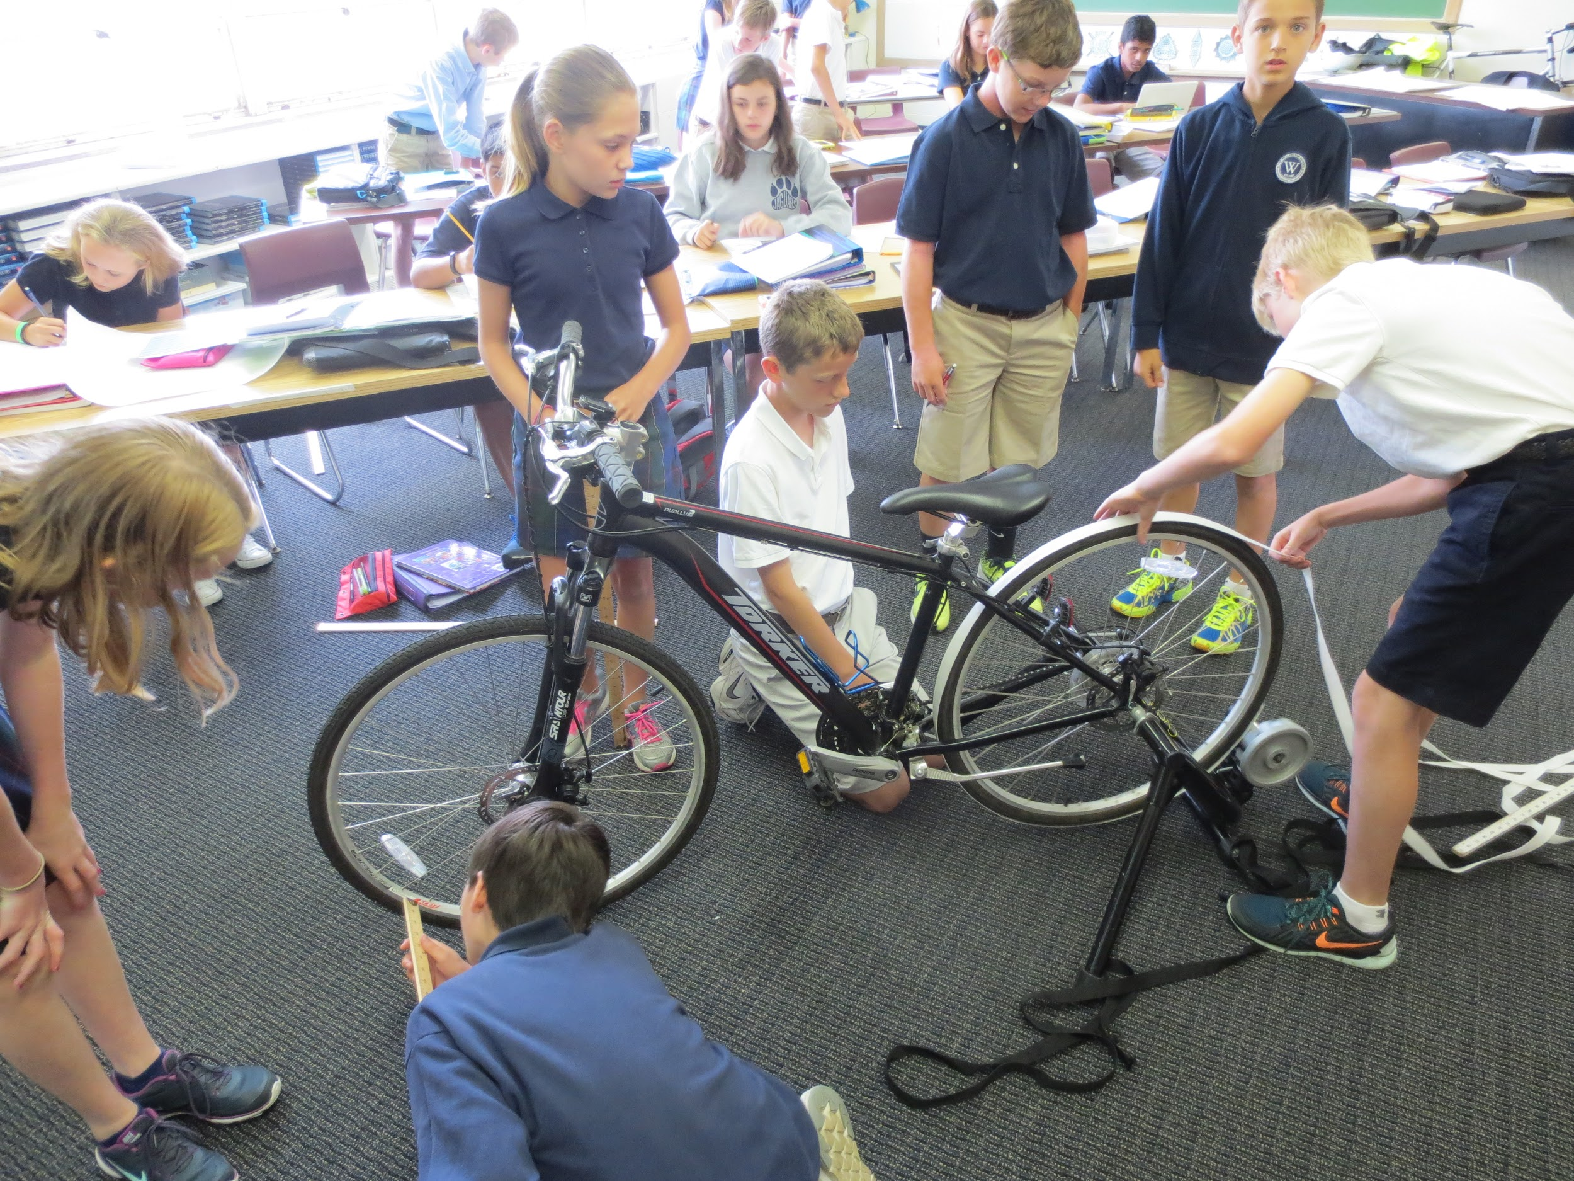
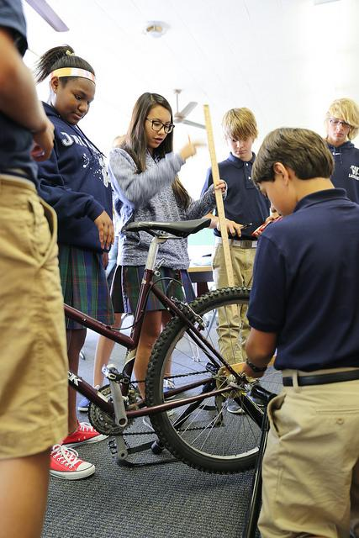
Bicycles
Notes:
(BS)
Teachers use an “anchor” all the time -- “Remember when we did this?” “We always say…” “Let’s revisit…”
But these don’t always pay off - students don’t remember, or care, or the connection is just not meaningful
Let’s see how another task, like the machine, can help us anchor ideas.
Solicit different interpretations of the task.
First, clarifying questions: Are there ambiguous parts? What are the possible interpretations?
Then, content questions: Hypotheses, or wonderings?
Don’t answer them yet -- for instance, allow one teacher to explore “additive increase” vs. “multiplicative increase.” These questions are ones that can be explored in the work phase.
Instruction: Do the work the way you imagine your students might, to see what math you confront.

Slide 17
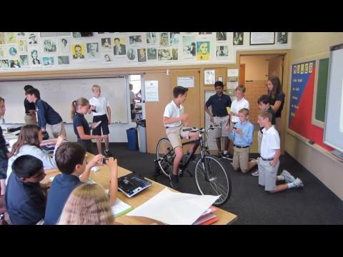

Slide 18
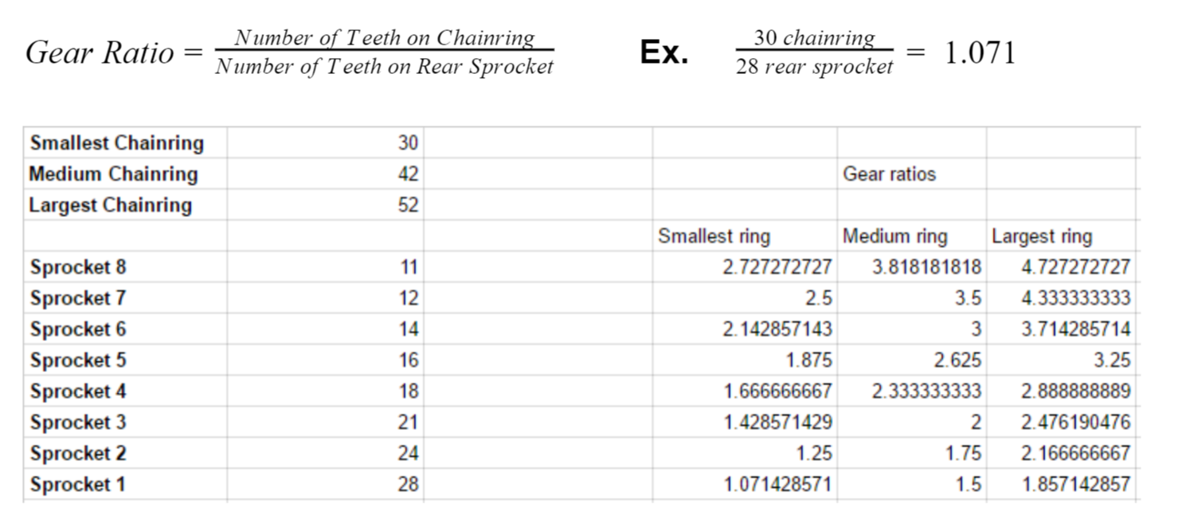

Slide 19
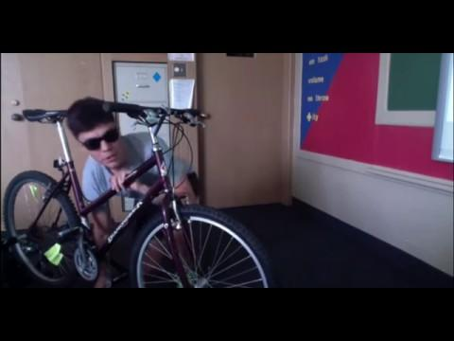

Slide 20
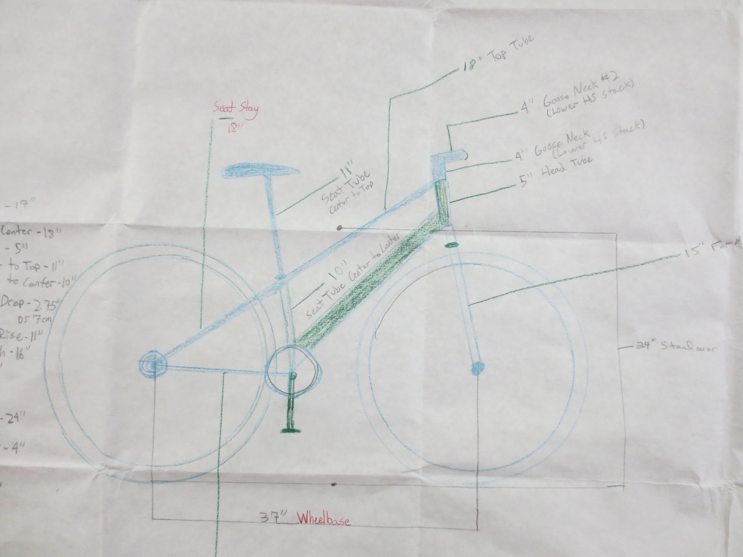

Slide 21
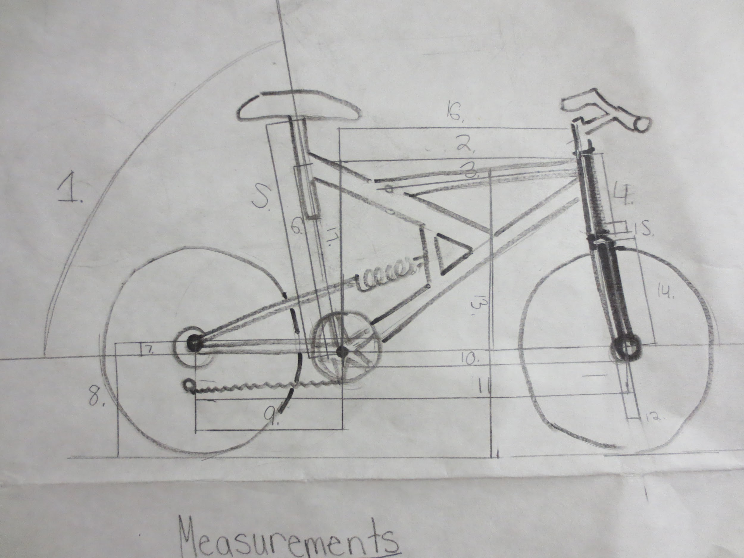

Slide 22
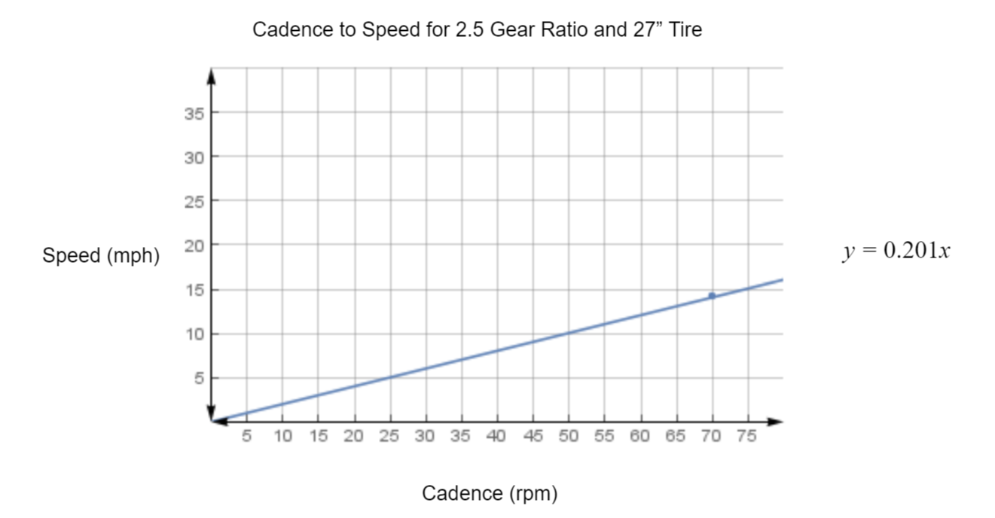

Slide 23
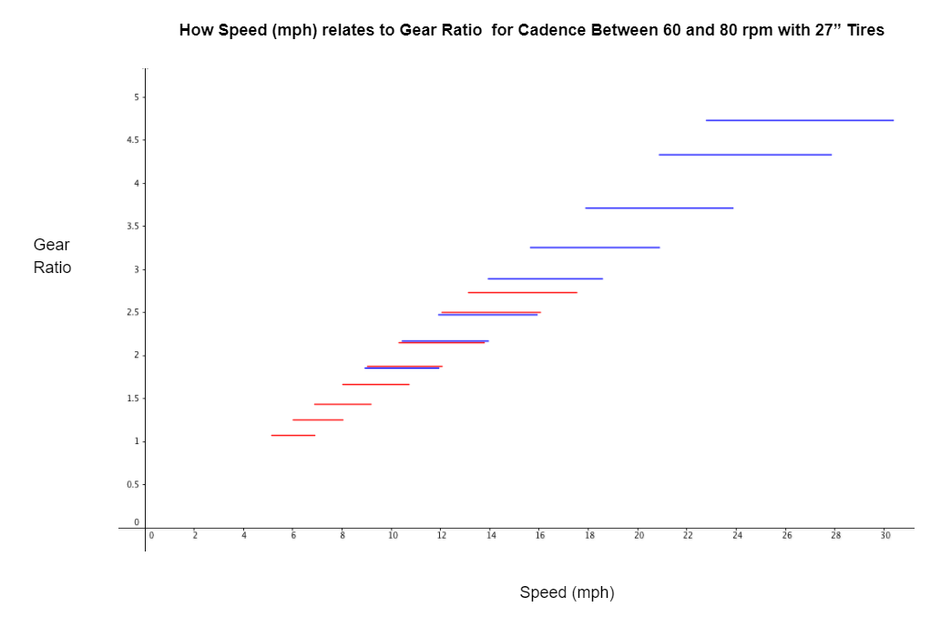

Slide 24
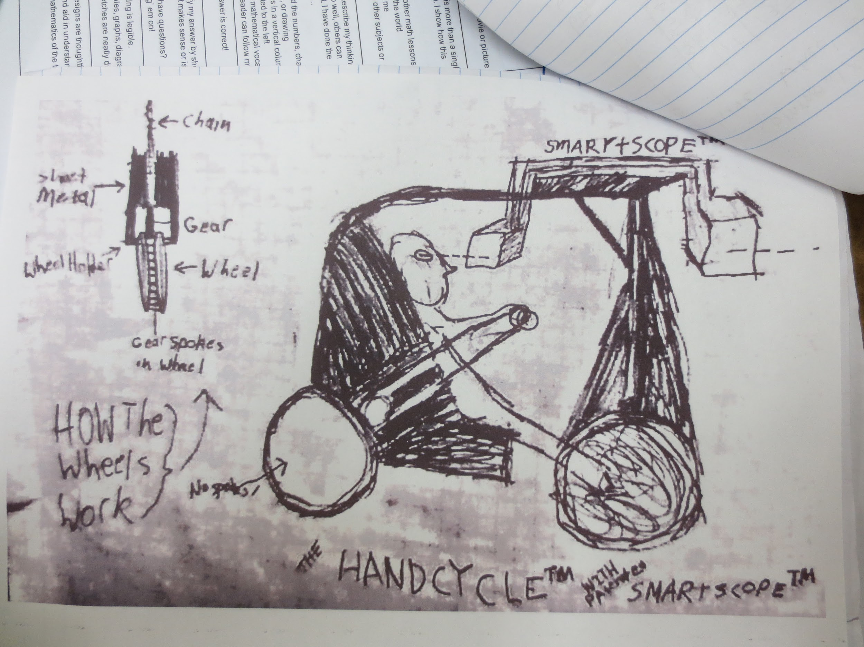

Slide 25
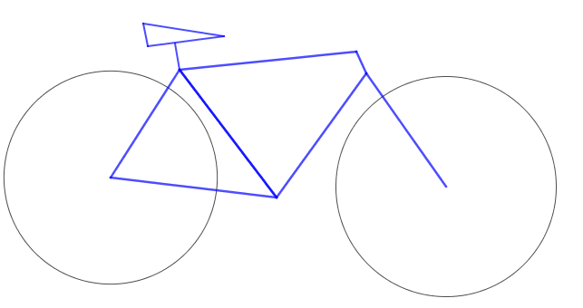
Bike Anchor: Grades K-2
What shapes are in a bike?
Design then build a bike/ trike with
twigs and Cds/ DVds.

Slide 26
Bike Anchor: Grades 3-5
Go home and measure and draw your bike
How many spokes does each wheel have?
How many spokes should half of your wheel have?
How many spokes should ¼ of your wheel have?
How many speeds is your bike?
How many front gears “chainrings” do you have? How many rear gears “sprockets”?

Slide 27
Bike Anchor: Grades 6-8
Gear ratio
Cadence
Speed
Unit conversions, 700 cc, 27 in, cm.
Circumference from tire diameter
Direct variation graphs (cadence vs speed vs ratio)

Slide 28
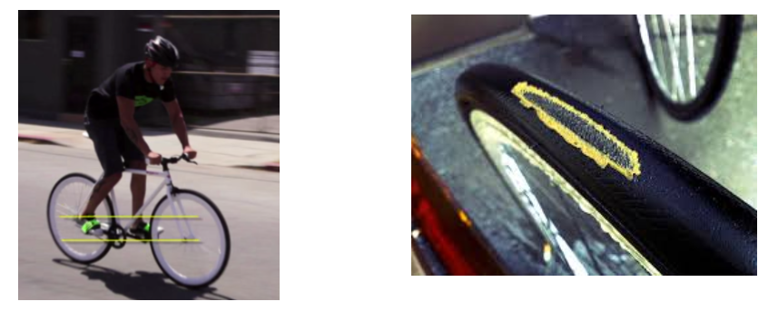
Bike Anchor: Grades 9-12
Given a set of tire tracks in the
snow/ mud. What direction were
they traveling.
Ideal gear ratio for fixed gear bike skid patch distribution
Deceleration modeling with polynomial/ exponential functions.

Slide 29
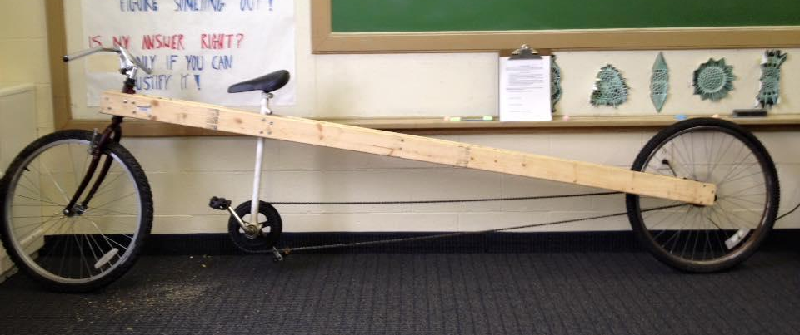
Design a Bike

Slide 30
Bicycles Anchor Progression
K-5 shapes (circles, triangles, design an oreo toothpick bike project)
6-8 Ratios, proportions (scale daring of bike with measurements) intro to linear functions and graphing
9-12 Algebra 2 (deceleration function) Calculus (telling direction from bike tracks with tangents)
Notes:
(BS)
Teachers use an “anchor” all the time -- “Remember when we did this?” “We always say…” “Let’s revisit…”
But these don’t always pay off - students don’t remember, or care, or the connection is just not meaningful
Let’s see how another task, like the machine, can help us anchor ideas.
Solicit different interpretations of the task.
First, clarifying questions: Are there ambiguous parts? What are the possible interpretations?
Then, content questions: Hypotheses, or wonderings?
Don’t answer them yet -- for instance, allow one teacher to explore “additive increase” vs. “multiplicative increase.” These questions are ones that can be explored in the work phase.
Instruction: Do the work the way you imagine your students might, to see what math you confront.

Slide 31
Farmer Jane
Farmer Jane harvested 30,000 bushels of corn over a ten-year period. She wanted to make a table showing that she was a good farmer and that her harvest had increased by the same amount each year. Create Farmer Jane’s table for the ten-year period.
What is the first question that comes to mind?
Notes:
(BS)
Teachers use an “anchor” all the time -- “Remember when we did this?” “We always say…” “Let’s revisit…”
But these don’t always pay off - students don’t remember, or care, or the connection is just not meaningful
Let’s see how another task, like the machine, can help us anchor ideas.
Solicit different interpretations of the task.
First, clarifying questions: Are there ambiguous parts? What are the possible interpretations?
Then, content questions: Hypotheses, or wonderings?
Don’t answer them yet -- for instance, allow one teacher to explore “additive increase” vs. “multiplicative increase.” These questions are ones that can be explored in the work phase.
Instruction: Do the work the way you imagine your students might, to see what math you confront.

Slide 32
Farmer Jane
Try It Yourself
Farmer Jane harvested 30,000 bushels of corn over a ten-year period. She wanted to make a table showing that she was a good farmer and that her harvest had increased by the same amount each year. Create Farmer Jane’s table for the ten-year period.
Spend 10 minutes trying it yourself.
Identify the key concept based on the grade level you teach.
Notes:
In the last minute of work, have participants write down a single key concept based on their grade level.
As a full group, come together. Record key concepts from each group. (Participants snap in agreement, and try to link one to the other.)

Slide 33
Farmer Jane
Using an Open-Ended Task as an Anchor
As a group, select one key concept to work with at the appropriate grade level. Brainstorm extensions of the task.
How could you complicate the task situation, or approach it using a different method?
What other class content could relate to this task?
Notes:
BS

Slide 34
Farmer Jane
Using an Open-Ended Task as an Anchor
Possible occasions for revisiting, new extensions & takeaways:
Notes:
Have each group share out opportunities for revisiting the task, or another extension and the corresponding takeaway.

Slide 35
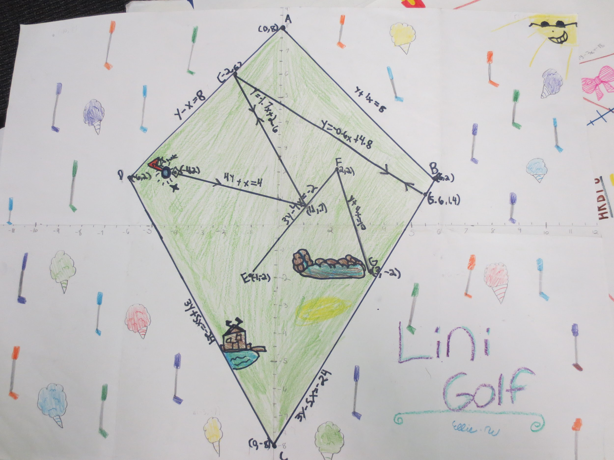
Setting #5: Lini Golf/ Lin-ball

Slide 36
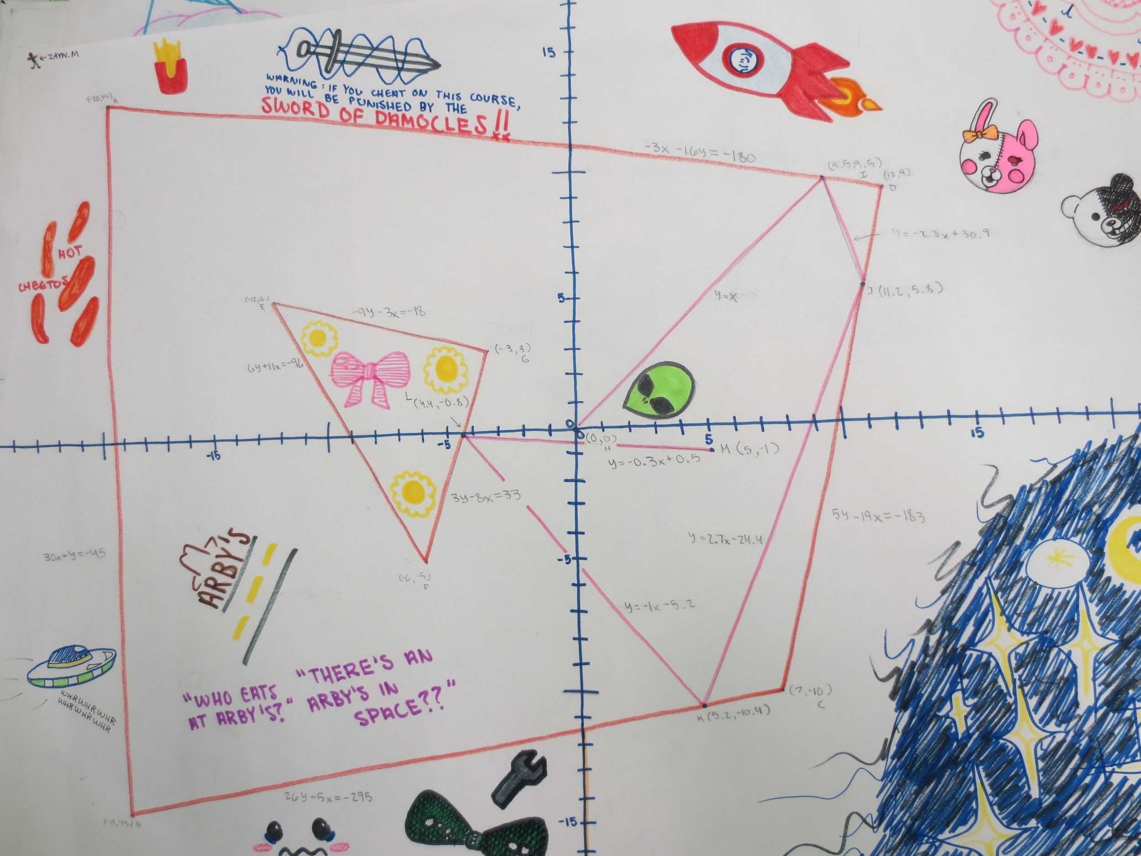

Slide 37
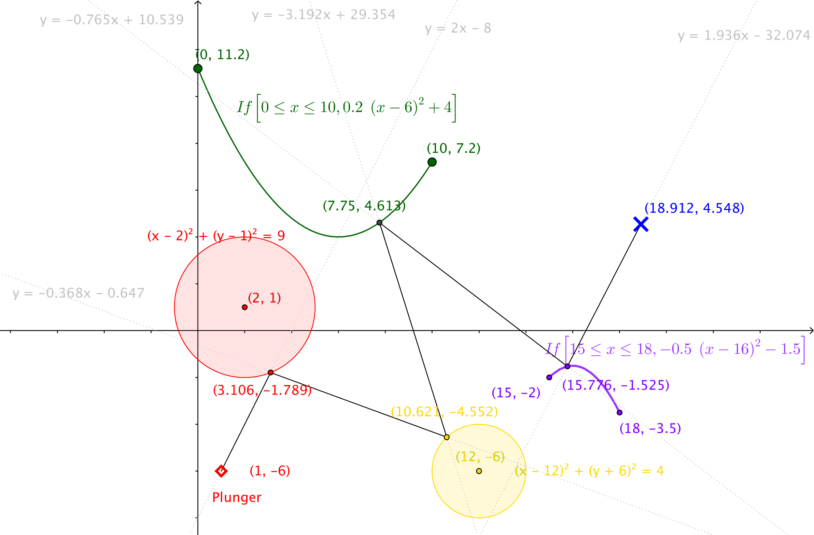
Lin Ball

Slide 38

Lini Golf progression
7th grade: Use mirra tool and protractor to reflect rebound rays off of lines.
8th grade: Use to to calculate the slope of the rebound line given slopes B of the ball line and slope W of the wall line.
Geometry: Use trig to rebound lines
Calculus: Use calculus to rebound off of conic sections, inverse functions etc. to find the tangent lines.

Slide 39
Next Steps:
Using an Anchor setting in your Course
Discuss the following in your table group:
Have you seen or used a task that could be an anchor in your course? When and how could you revisit it?
Or, are there several key concepts you would like to connect, but you don’t have the task?
Notes:
BS

Slide 40
Summary
How do students benefit from the use of anchors?
What are some challenges you anticipate when using an anchors if your class?
What are some strategies for handling these challenges?
Notes:
BS

Slide 41
Further Reading
Elements of Cognitive Demand
Smith, M.S. & Stein, M.K. (1998). Selecting and creating mathematical tasks. Mathematics Teaching in the Middle School, 3, 344-350.
Resources for Open-Ended Tasks

