Slide 1
Getting Started
Strategies to tackle problems =)
By: Ariel Kramer, Naira Harutyunyan, Johnson Nguyen
Notes:
Introductions
Explain a bit about PCMI and what our task was for this presentation

Slide 2

Goal
Participants will compile a list of problem solving strategies through math task and to show them a way to teach their students about problem solving strategies
Notes:
Have a participant read out loud to whole group
Call on people to share why they think this is important for their students
Share out why we chose to make this our goal

Slide 3

Mathematical Practice
MP1: Make sense of problems and persevere in solving them

Slide 4
Instructions
Attempt the problem with your group
Be ready to share your strategies
Notes:
Question will be presented on the board
Each table will go to the the board and read through the question
Each group attempt the problem on their own
We will discuss the strategy they use to attempt the problem
(We will compare it to our own strategies of discourse/discussion, annotating, and kwi)

Slide 5
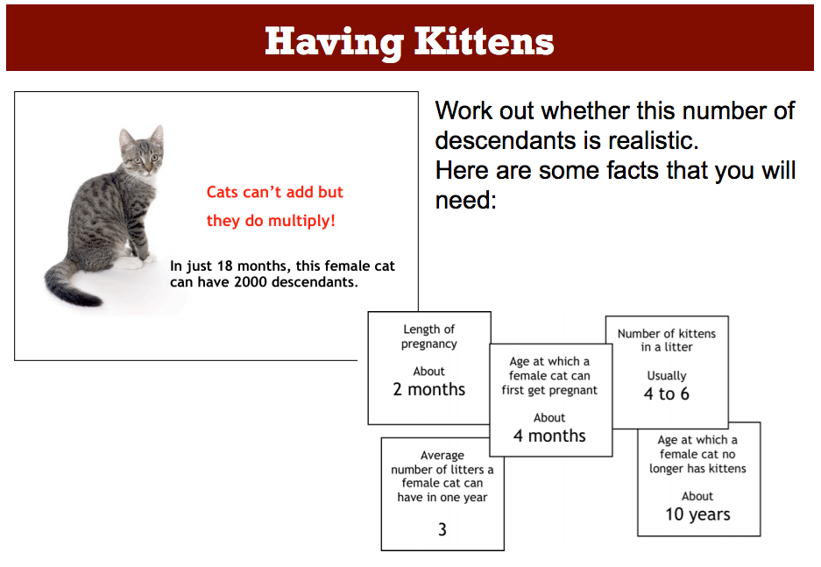

Slide 6
Strategies Used to Start the Problem
•
Notes:
Individually record strategies that you use for the cat problem.
Participants will share with their group what strategies they used and be asked/put on the board what strategies they used.
Participants will then categorized their strategies into buckets.
Are there any overarching themes? How can we create ______?

Slide 7

Buckets of Strategies
Notes:
Groups share your the bucket they came up with. - we write buckets on chart paper once finalized (leveling)
(As a class, we will find the commonly used strategies) Hopefully these will be the strategies that we came up with
Strategically guide participants to:
discourse/discussion
annotating (use common through subjects)
kwi - type strategy
productive struggle

Slide 8

Sample Work
Use sample work to discuss what kind of different strategies were used
Do these strategies compare to what
we came up with?
Notes:
Pass out copies of student work
Each table sorts the work into the buckets based on how the student approached the problem
Share out answers/groupings

Slide 9
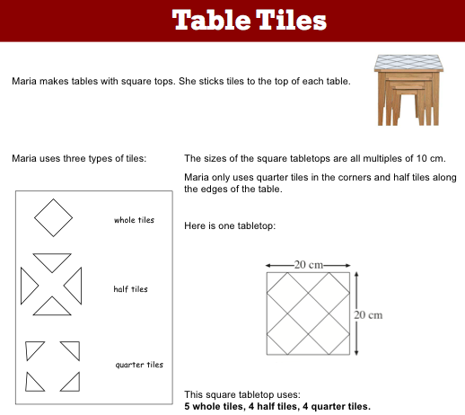
Questions
1. How many tiles of each type will she need for a 40 cm by 40 cm square?
2. Describe a method for calculating how many tiles of each type Maria needs for larger square tabletops
Notes:
Have participants count off by # of buckets agreed upon
Each group starts tile problem based on the bucket they are assigned to
Depending on timing, they can either just start, or finish, the problem.

Slide 10

Discussion Questions
How could you implement something like this into your classroom?
How can you help your students use these
strategies?
Notes:
What if they already use all the strategies
How are the strategies being used in the class?
What are you actually doing in your room?
Are they in groups or pairs?

Slide 11

Reflection
Write down:
One takeaway from today’s session
Your next step for implementation
Be ready to share out

Slide 12
References
Math Shell
Having Kittens:
http://map.mathshell.org/lessons.php?unit=9100&collection=8
Table Tiles:
http://map.mathshell.org/lessons.php?unit=9200&collection=8

Slide 13
Thank you!
Ariel Kramer
kramer.ariel@gmail.com
Naira Harutyunyan
nxh3884@lausd.net
Johnson Nguyen
johnson.n@gmail.com

