Slide 1
Finding, Altering, and Implementing Low Floor-High Ceiling Tasks in a Middle School Classroom

Slide 2
Finding, Altering, and Implementing Low Floor-High Ceiling Tasks in a Middle School Classroom
Low Floor / High Ceiling
and so much more
xxx

Slide 3
These are themes we will be talking about:
Low-Floor High-Ceiling Tasks
My personal vision as a middle school mathematics teacher
The most important thing I learned at PCMI
Classroom 360 (Vertical Non-Permanent Spaces)
Refusing to Lecture
Amazing Things on the Web
...classic bait and switch
Notes:
I’m going to really open up to you guys. And I hope that you will be really open to sharing out.

Slide 4
Introductions and discussion preparation:
Name
School location
Level(s) course(s) you teach
Something else about your school
Something about yourself

Slide 5

Important Notification!!!
PCMI has not seen what I am going to present.
They may not agree with my opinions.
So if I present something that you think or
perhaps know is incorrect please take it out on me not PCMI.

Slide 6

How to sign up for PCMI
Link to their website

Slide 7
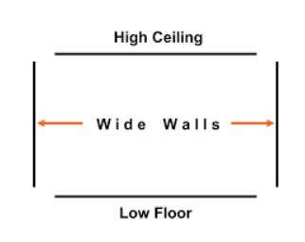
Altering Low Floor-High Ceiling Tasks

Slide 8
Warm Up
During this part of class I push the kids to their resources to find these answers.
How do you find the area of a circle?
How do you find the volume of a cylinder?
How are the two related?

Slide 9
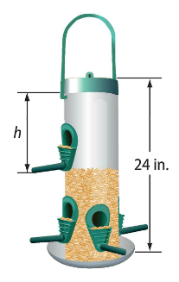
What do you notice?
Three different students live script in a rotation on the slides during the discussion.

Slide 10
What do you wonder?

Slide 11
What do you notice now?
V = 12pi(24 - h)
This piece is optional, depending on how open you want this task to be.

Slide 12
What do you notice?
Rinoa is starting a babysitting business. She spent $26 on signs for advertising. She charges an initial fee of $5 and then $3 for each hour of service.
I notice…
She spent $26 on signs & advertising.but couldve just used a piece of paper.
I notice… Rinoa is starting a baby sitter business.
She charges 3 dollars every hour.
Actual Google slide from my students.
I notice…
Rinoa is babysitting for a cheap price.she charges 5 dollars for the initial fee.

Slide 13
What do you wonder?
Rinoa is starting a babysitting business. She spent $26 on signs for advertising. She charges an initial fee of $5 and then $3 for each hour of service.
I wonder…
Why shes working for such low rate?
Is the area profitable..?
I wonder… why did she start a baby sitting business?
I wonder… why she spent 26 dollars signs for advertising.what is she blowing her money on.

Slide 14
What questions can we make?
Rinoa is starting a babysitting business. She spent $26 on signs for advertising. She charges an initial fee of $5 and then $3 for each hour of service.
How much profit would she make after 3 hours?
How many hours does she have to work to replace the money for the advertising?
3 )How much would she earn if she worked three hours for a week?
4) How much profit would she make if she worked for two weeks, three hours every day?
5) how could we use this information to make an equation?
6)how could we use this information to make an inequality?

Slide 15
How to get started:
Go to the story problems in your textbook
Use the stimulus (data/context) without the actual question
Use what do you Notice/Wonder as a whole class discussion
Use the a warm up to help students remember key information If you want to target a specific skill, guide your class with notes and or a problem set they will do before the discussion

Slide 16
Once you think your ready here’s level 2:
Know your students and have multiple “pushes” prepared
Use visual patterns and other stimuli that don’t have numbers and or variables
Open it way up (I’m not really here yet, but it can be done)

Slide 17
Why do Low Floor High Ceiling Tasks?
They are great for promoting class discourse
They are easy to differentiate
Many students are least comfortable doing any math problem that is in English (Story Problems)
You and your students will be able to see the connections between different units and topics within your subject
The Smarter Balanced tasks are very difficult, but more importantly some of the most fun math problems to work on are very difficult
Notes:
“Im tying to level the class”

Slide 18
Discussion preparation:
One example of Low Floor-High Ceiling Tasks or Open Tasks that my students do is…
One way that I alter my tasks or problems so that all my students can access the mathematics and start to explore…
I plan on trying this out with my class by…
Share something else that came to your mind during this portion of the presentation.

Slide 19
Now I’m going to really open up to you… the switch
These all tie loosely into the idea of implementing “Low Floor-High Ceiling Tasks”.
Students that feel cared for will have a higher degree of participation with lowered affective filters.
Students must have a sense of inclusion inside of your mathematics community to develop the perseverance to work on these tasks.
Getting your students up at the boards will increase engagement and help you provide feedback to them.
Finding new ways of providing your students the necessary information they need in order to make discoveries will help your students with these tasks.

Slide 20

My Personal Vision as a Middle School Mathematics Teacher
To provide unconditional love for my students while engaging them in exploring mathematics. Furthermore; to provide opportunities for my students that they would not have if I were not in their lives.

Slide 21


Culture of Care
Professor Cooper at UCLA
http://journals.sagepub.com/doi/abs/10.1177/1942775114525046
Link to the article

Slide 22
My most recent life change...
Notes:
I love this -- you can save time by skipping this slide / then only showing ONE of the examples on the following slides….
You will have to be the judge on time.

Slide 23
Discussion preparation:
My personal vision as a teacher is…
I have never thought creating a vision as a teacher. But what i think is most important as a teacher is…
I address care in my classroom by…
Share something else that came to your mind during this portion of the presentation.

Slide 24

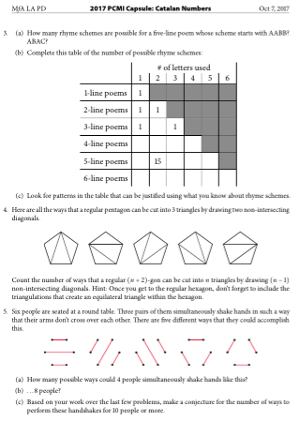
How intimidating doing something new and or difficult can be.
How this feeling is exacerbated when there are various levels of knowledge amongst the group.
Notes:
Change clip art to problem set from MfA page

Slide 25

Morning Math and Doing Problem Sets in General
The vision for Morning Math and the program in general is extremely positive and is meant to minimize the feeling of intimidation.
I value my experience that I brought from MfA Los Angeles, specifically from Math with Darryl.
If I have these feelings what do my students feel like in my room

Slide 26

Relating to My Students...

Slide 27
Side note:
About every 3-5 years in my career I have looked back just 3-5 years and have said to myself, “What was I thinking. Man I was doing that all wrong.” Not everything but one or more pieces of the most intricate machine ever created: The Master Teacher

Slide 28
Discussion preparation:
Share about a time that you felt intimidated by something, someone or a group.
Share an experience where you related to your students.
Share a practice that you previously used that you now find ineffective.
Share something else that came to your mind during this portion of the presentation.

Slide 29
Why getting your students up to the boards is so important:

Slide 30
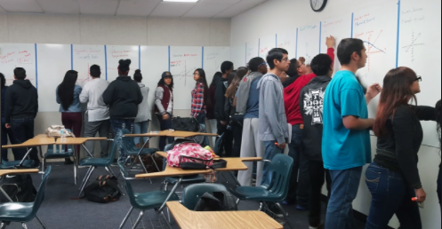
Classroom 360 or Non-Permanent Vertical Spaces

Slide 31
Students working at the boards

Slide 32
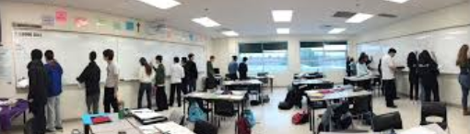
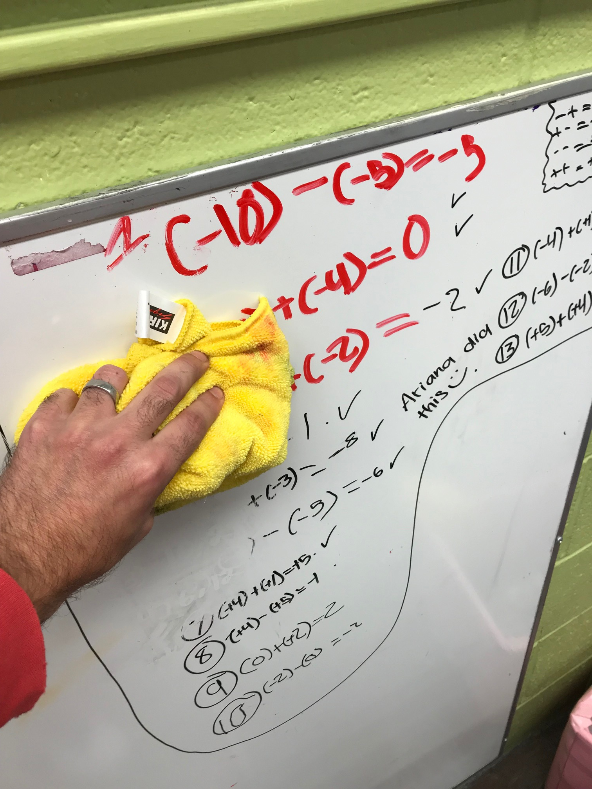
Classroom 360
At PCMI this was known as “Vertical Non-Permanent Spaces”
Tips:
Do it ASAP (link for a decent product here)
Use structures and have clear expectations
Buy a pack of inexpensive microfiber cloths
Buy a class set of erasable coordinate planes
Store the markers tip down
Ask questions but don’t wait for answers
Build capacity with patience, but make your goal very transparent
“Just start, the worst case scenario is your wrong. Someone will help”
Notes:
Explain #2
Make picture better

Slide 33
Discussion preparation:
Share how whiteboards are used in your room.
Share how you structure group work in your room.
Share a reason you would not want your kids up at the boards.
Share something else that came to your mind during this portion of the presentation.

Slide 34






Refusing to Lecture
Me
Them
Possible solutions

Slide 35
Sample of one of my lectures

Slide 36
Discussion preparation:
Share how you deliver content in your classroom.
Share another non-traditional manner to deliver content.
Share a reason you would not want your students to receive their content in this manner.
Share something else that came to your mind during this portion of the presentation.

Slide 37
Amazing Things on the Web
If you are not one-to-one with technology you need to make sure your administrator knows that the students are missing out
Games are most engaging, but most difficult to find Ratio Rumble
student.desmos.com
Arithmetic Practice (My Students Love It)
Which One Doesn’t Belong
Visual Patterns
Kahoot
*All of these are free

Slide 38

We did it!
...one last chat?

Slide 39
References and links
Link to PCMI’s website Link to their website (Slide 6)
What do you Notice/Wonder by Annie Fetter. Link to her blog. (Slides 9-14)
Link to Professor Cooper and Chickwe’s Research http://journals.sagepub.com/doi/abs/10.1177/1942775114525046 (Slide 21)
Link for non-permanent vertical spaces (Slide 33)
Link for iPad Pro and Apple Pencil (Slide 36)
Doceri (Record Videos) and EdPuzzle (Add Questions to Videos)
*Don’t forget slide 40 has more links to the websites I love

