Slide 1
Mastery Based Grading
Abigail Kirchman

Slide 2
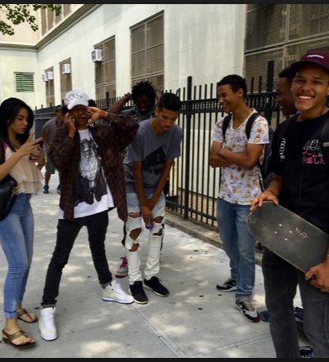
What is it?
Based on specific learning targets
Multiple opportunities/revisions
Scale of 1 - 4 rather than percentages/points

Slide 3

Why?
Reduces anxiety about grades/assessments.
Easier to understand what students know.
Easier to give feedback.

Slide 4
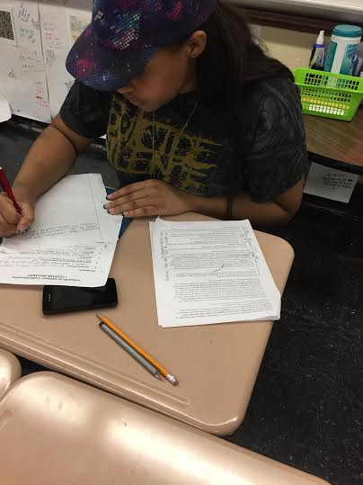
How?
Case Study Learning Target Tracker
Weekly Mastery Opportunities

Slide 5

Challenges
Easiest with discrete skills rather than complex processes.
Doesn’t always measure retention or application.
Only a sample of what students know/don’t know.

Slide 6
Questions?

