Slide 1

Implementing IB
(International Baccalaureate)
A middle school example
Cristina Jimenez
cristy.s.jimenez@gmail.com

Slide 2
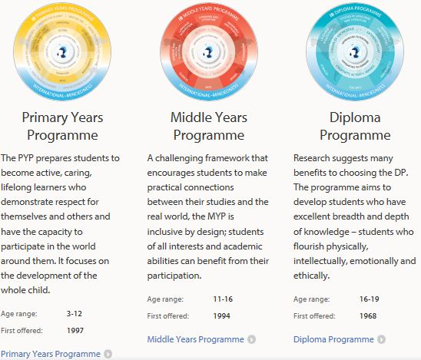
The
IB
Continuum
K-5th Grade 6th-10th Grades 11th-12th Grades
From IB website:
http://ibo.org/en/programmes/

Slide 3
The
IB
Continuum
K-5th Grade 6th-10th Grades 11th-12th Grades
From IB website:
http://ibo.org/en/programmes/
1-Inclusive & holistic (“whole child”)
2-Relevant (“connections”)
3-Rigorous (“challenging”)

Slide 4
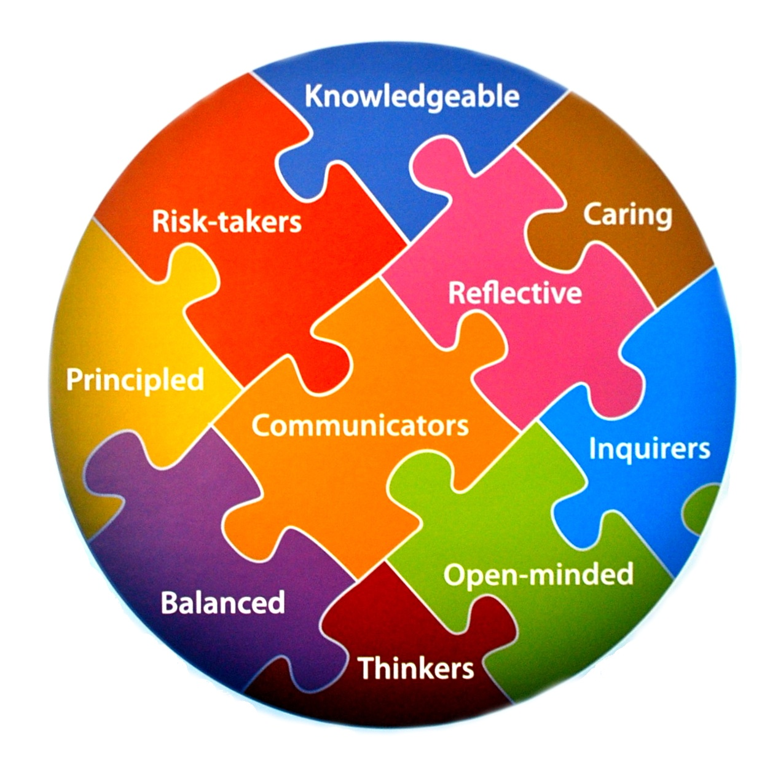
1-Inclusive &
Holistic
Our entire school is IB, not just a select few students (as often happens in high schools)
10 IB learner attribute profiles
6th Grade: Awards to students who display a given attribute each month, all students receive an award by year’s end
Attributes connected to math units
Image from: http://www.ucc.on.ca/why-ucc/the-ib-at-ucc/

Slide 5
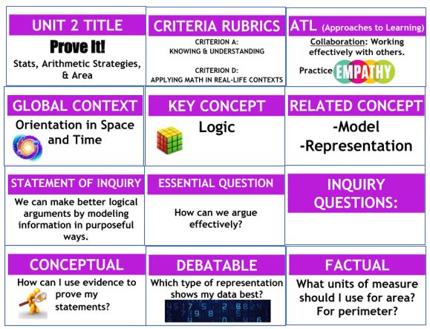
2-Relevant
“Connections between their studies and the real world”
Each unit in every content area has a unit board, which shows the broader aims and connections that each unit is based upon.
At least one interdisciplinary unit is required per grade level (example: students create solar panel models to scale, through math and science class)

Slide 6
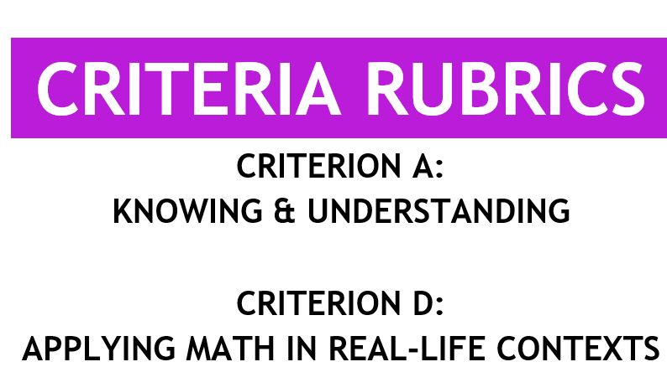
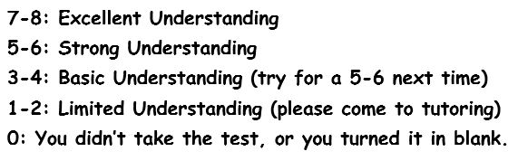
3-Rigorous
Summative assessments (tests or projects at the end of each unit) are graded with rubrics on a 0-8 point scale. 7-8 level is intended to be above grade level to provide additional challenge. All levels provide specific feedback without the stigma associated with letter grades.
4 criteria (categories):
A: Knowing & Understanding
B: Identifying Patterns
C: Communicating
D: Applying Math in Real-Life Contexts

Slide 7
Cristina Jimenez
cristy.s.jimenez@gmail.com
Questions?
More info on IB at ibo.org
Thank you!

