Slide 1
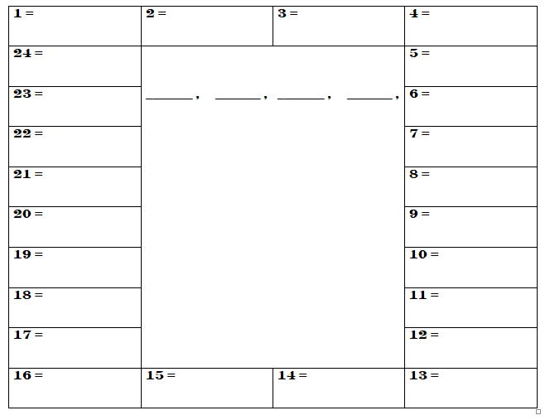

Building Fences -- a game to build teamwork and math skills Gail Englert genglert@cox.net

Slide 2
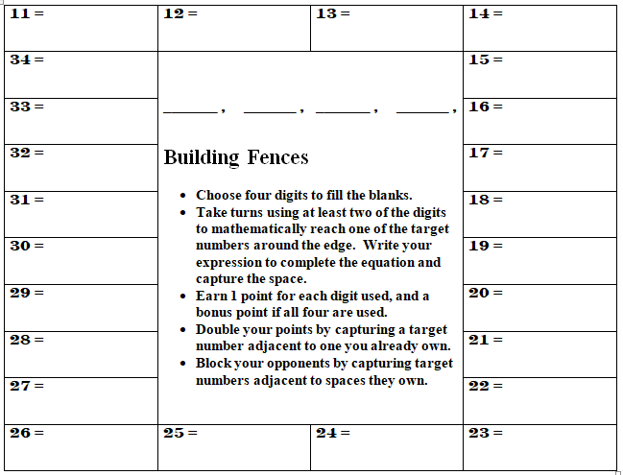
5
2
1
9

Slide 3
5
2
1
9
9 + 1 + 2 + 5

Slide 4
3
5 (2) + 1
5
2
1
9
5
9 + 1 + 2 + 5

Slide 5
3
5 (2) + 1
5
2
1
9
3
6
(9 – 5) ²
5
9 + 1 + 2 + 5

Slide 6
3
5 (2) + 1
5
2
1
9
6
(9 – 5) ²
5
9 + 1 + 2 + 5
5
[5 – (2 + 1)] 9

Slide 7
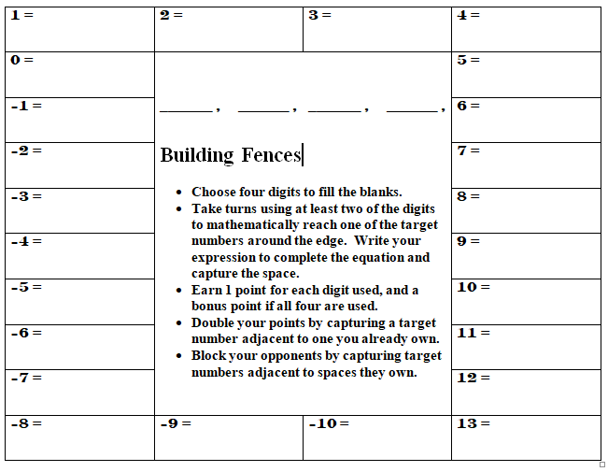
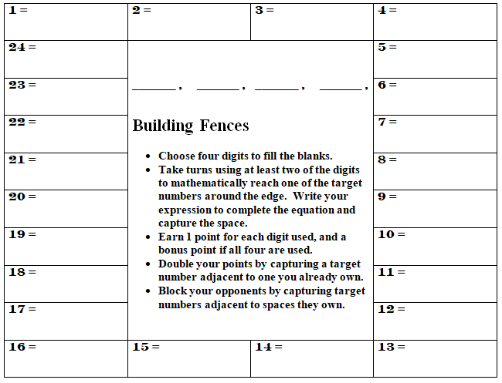
3
5 (2) + 1
5
2
1
9
3
6
(9 – 5) ²
Multiple entry points
Builds computational fluency
Provides order of operation practice
Encourages strategy
Supports teamwork
Adaptable
5
9 + 1 + 2 + 5
5
5 – (2 + 1) + 9

