Slide 1
Modeling Exponential Decay
Sunny Mall
Homer High School
amall@kpbsd.org

Slide 2
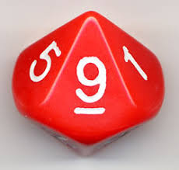
Modeling Exponential Decay
Students roll forty 10-faced dice twenty times.

Slide 3
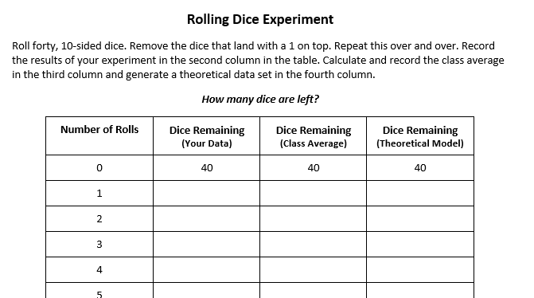

Slide 4
Modeling Exponential Decay
Analyze the basic characteristics of their graphs;
Interpret the independent and dependent variables;
Interpret the domain and range of the function;
Determine the continuity or discreteness of the function;
Consider the existence of x- and y-intercepts; and
Derive a function that best represents the relationship between the two variables.

Slide 5
But, wait, there’s more ...
Each group receives a set of forty, n-sided objects, n ≠ 10 (e.g., coins, m&m’s, dice).
Before conducting the experiment, each group must determine a theoretical model that will be consistent with the experimental data to be generated.
Students conduct the experiment using their assigned set of forty, n-sided objects, and compare and contrast the experimental data with their theoretical model.
Data for any value of n can be generated via computer simulation (for example, using Excel). Such a simulation can provide additional material for discussion of the consistency of an exponential model with experimental results.

Slide 6

Thank you!
Sunny Mall
mathnunnies@gmail.com

