Slide 1
Rosenthal Prize for Innovation and Inspiration in Math Teaching
https://momath.org/rosenthal-prize/
This presentation can be found at http://bit.ly/2I2fRta

Slide 2
Designed to recognize and promote hands-on math teaching in upper elementary and middle school classrooms, the Rosenthal Prize carries a cash award of $25,000 for the single best activity, plus up to five additional monetary awards for other innovative activities. The winning teacher(s) will have the opportunity to share their innovative activities with educators across the country.
You do not need to be a middle school teacher, but it should be a middle school lesson.

Slide 3
My first thought…. I have nothing worth $25,000!!!

Slide 4
Next thought:
Math teaching….priceless!

Slide 5
Actually next thought:
How long will it take?

Slide 6
Initial Application
What the judges are looking for:
Innovative teachers who engages students in learning mathematics.
A teacher with novel ideas and solid mathematics.
Someone willing to take risks, reevaluate, revise and try again.
Inquiry based classroom
A teacher skilled at connecting mathematics to other disciplines and real life.
Letter of Recommendation
Innovation and Engagement
Students are actively learning mathematics in the classroom.
Questioning in the Classroom
Motivation

Slide 7
What have you got to lose?
Initial application is easy.
Just a series of short response questions.
Applications likely open near the end of March and are usually due sometime in May.

Slide 8
These were my questions.
They may be modified for the coming year. Applications are not open yet.

Slide 9
Describe an innovative activity you implemented with your students in which the activity itself illustrates a relevant mathematical concept. If your activity was not implemented with 4th through 8th grade students, please also include a description of how it would be modified to work with this age group (200 words or less.) - This is 56 words….

Slide 10
2. Please write a brief essay explaining how this activity represents your teaching philosophy (200 words or less.)

Slide 11
3. Is this activity original to you? If so please comment on when and how you developed it. If this activity is one you borrowed from another source, please provide an attribution and explain how you have adapted or changed the activity.
(They will Google your activity)

Slide 12
Imagine that another teacher were trying to implement your activity in their classroom. If they had to start from scratch, what materials would they need? How much time would it take to prepare? What would be the cost of the materials?
They will try your activity.

Slide 13
When did you start using this innovative practice in your classroom?

Slide 14
Rubric -
This is fairly hidden in the information and can be useful when deciding between activities.

Slide 15
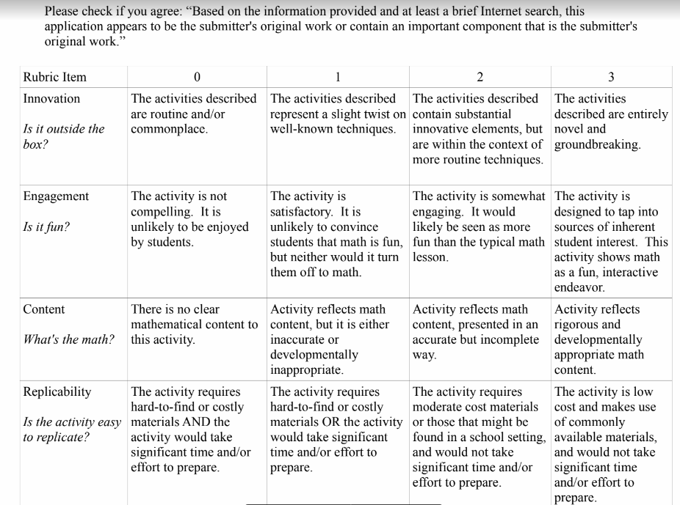
Rubic copy

Slide 17
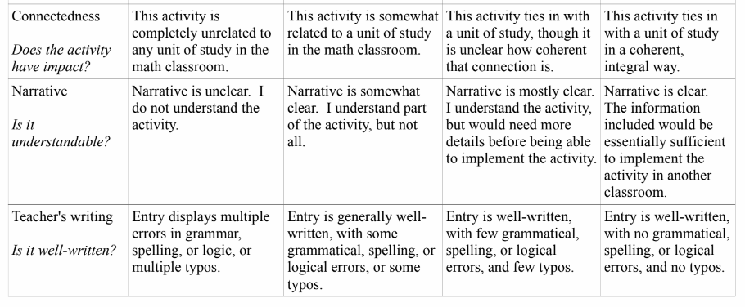

Slide 18

I found this video that gives a lot of insight as to how the process works and what the judges are looking for.

Slide 19
Next steps after initial application
Letter of recommendation
Video of your class (I videoed all 6 of my classes and chose the best one.) Get parent permission.
Short essay as to how the lesson impacted your overall class or one particular student. (This was my essay)
Detailed Lesson Plan (caution- looking at other people’s final lesson plans may be overwhelming at the beginning.)

Slide 20
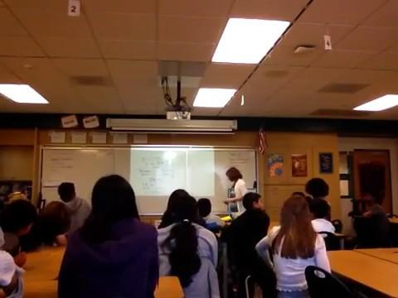

Slide 21
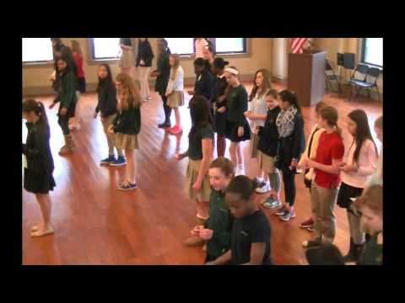
Ralph Pantozzi’s Random Walk Lesson

Slide 22
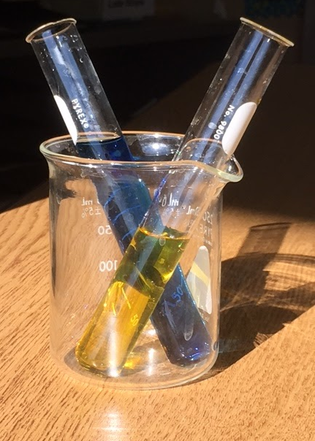
Formal Lesson Plan (1st try)
Creating Color Combos

Slide 23
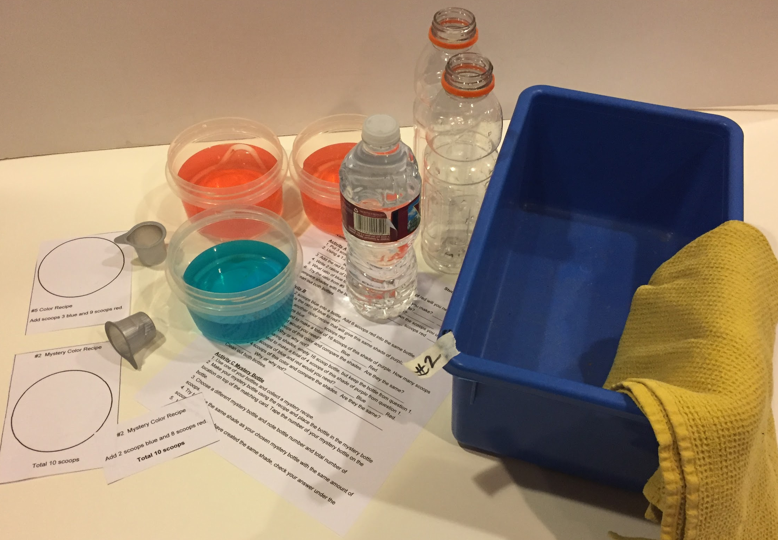
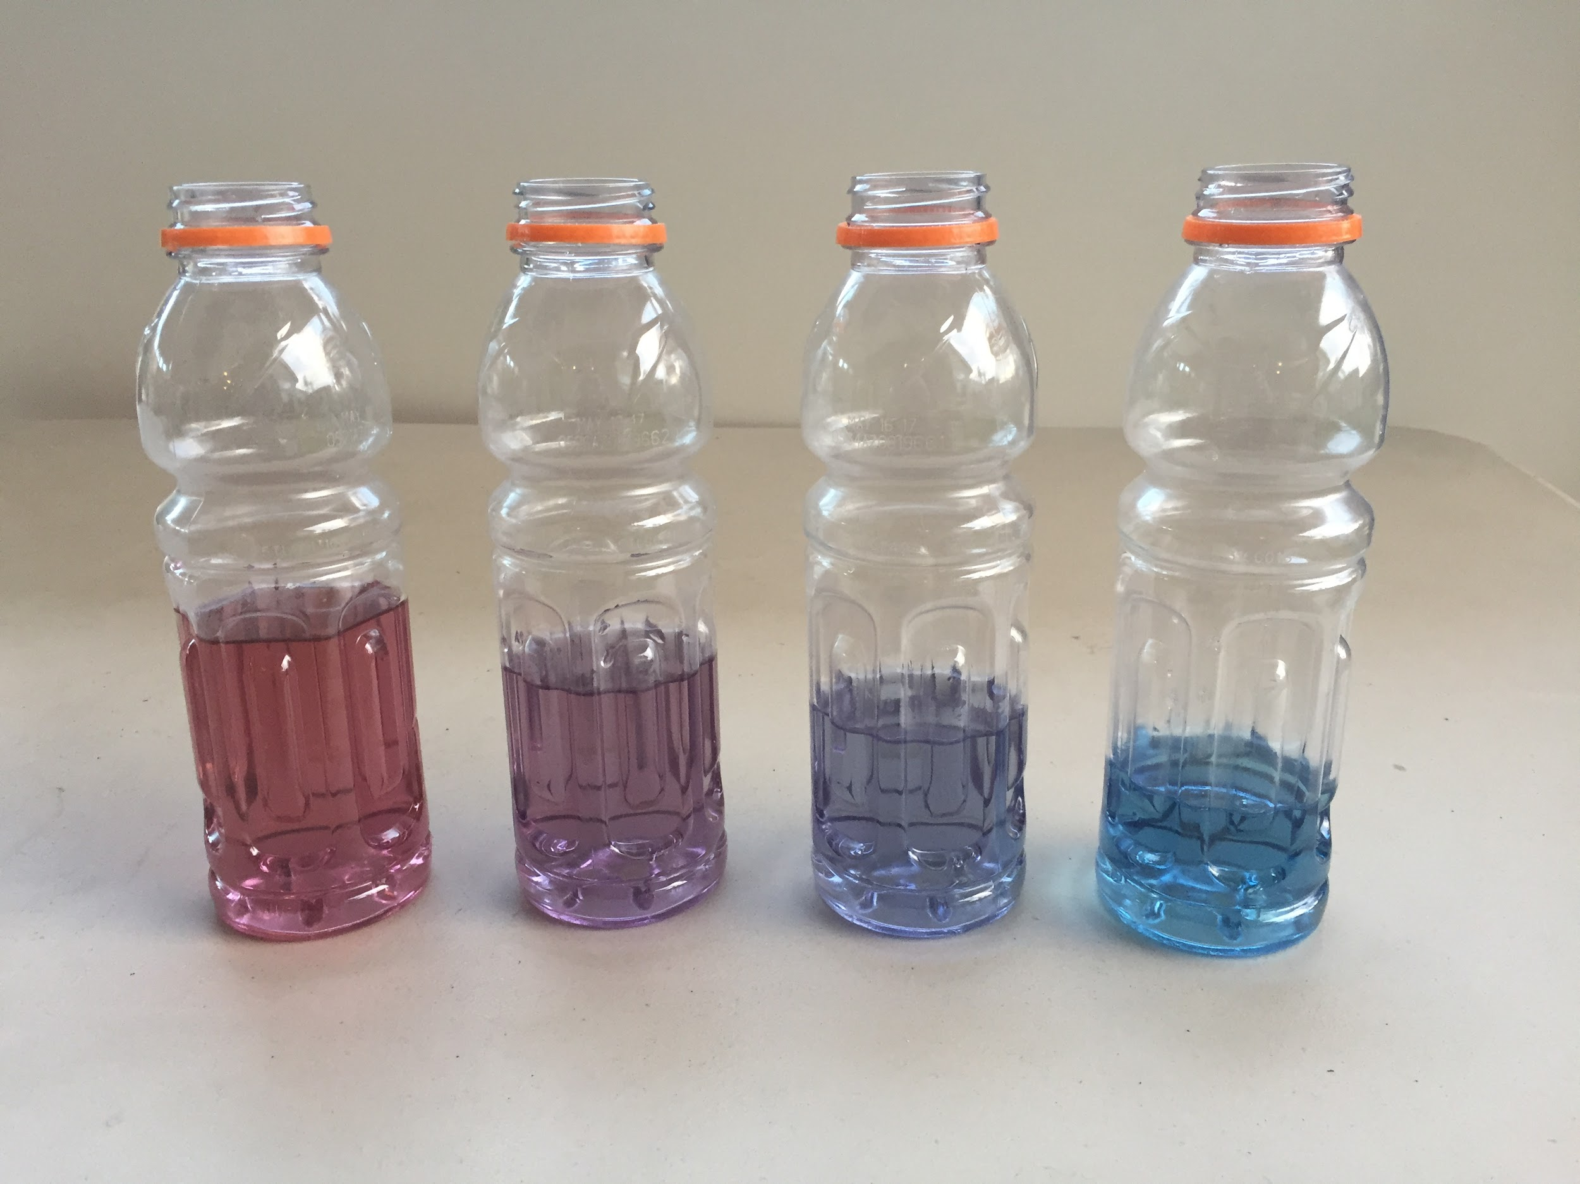
In November I was contacted to revise my lesson plan so that easier materials could be accessed.
Creating Color Combos Version 2

Slide 24
Timeline
Initial Application (March- May)
Finals notification (beginning of school year)
Revisions November
Notification December
Ceremony Jan/ Feb

