Slide 1
Reflecting on Practice: Worthwhile Tasks

Slide 2
In the figure below, what fraction of the rectangle ABCD is shaded?
A
B
1/6
1/5
1/4
1/3
e) 1/2
D
C
NCES, Grade 8, 1996

Slide 3
In the figure below, what fraction of the rectangle ABCD is shaded?
A
B
1/6 (5%)
1/5 (3%)
1/4 (24%)
1/3* (66%)
e) 1/2 (2%)
D
C
NCES, Grade 8, 1996

Slide 4
Color ¼ of the drawing.
Dekker & Querelle, 2002

Slide 5
Another approach to ¼
(Dekker & Querrelle)

Slide 6
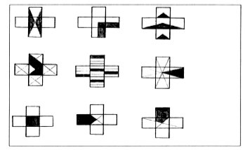
In which is ¼ of the shape shaded?
Dekker & Querelle, 2002

Slide 7
What did you like or not like about this task in terms of promoting discussion and eliciting student understanding?

Slide 8
Tasks should be chosen so that there is an opportunity for error in reasoning or thinking that opens up an opportunity to discuss or explain- not just an error in the next step (lost a negative sign or multiplied incorrectly).

Slide 9
Choose one of the problems and find a solution

Slide 10
Choose one of the problems and find a solution
Share your solution with one or two others that did the same task
Write down a few ways that the task could promote discussion and elicit evidence of student thinking and understanding

Slide 11
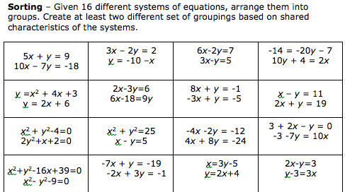

Slide 12
Tasks should be chosen so that there is an opportunity for error in reasoning or thinking that opens up an opportunity to discuss or explain- not just an error in the next step (lost a negative sign or multiplied incorrectly).

Slide 13
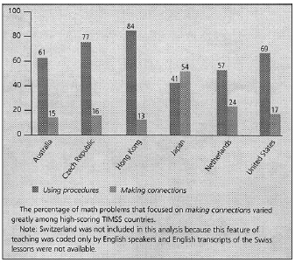
Types of math problems presented
Hiebert & Stigler, 2004

Slide 14
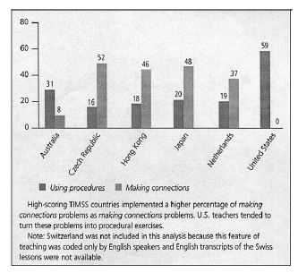
How teachers implemented making connections
math problems
Hiebert & Stigler, 2004

Slide 15
Mathematics Teaching Practices: Effective teachers
Establish mathematics goals to focus learning.
Implement tasks that promote reasoning and problem solving.
Use and connect mathematical representations.
Facilitate meaningful mathematical discourse.
Pose purposeful questions.
Build procedural fluency from conceptual understanding.
Support productive struggle in learning math.
Elicit and use evidence of student thinking.
(NCTM, 2014)

Slide 16
Mathematics Teaching Practices: Effective teachers
Establish mathematics goals to focus learning.
Implement tasks that promote reasoning and problem solving.
Use and connect mathematical representations.
Facilitate meaningful mathematical discourse
Pose purposeful questions.
Build procedural fluency from conceptual understanding.
Support productive struggle in learning math.
Elicit and use evidence of student thinking.
(NCTM, 2014)

Slide 17
Take a few minutes to reflect using the prompts:
What is one message from this session that you would want to bring back to another teacher? How would you make it meaningful and accessible for them (when they haven’t been here with you)?

Slide 18
Readings
Hiebert, J., & Stigler, J. (2004). Improving Mathematics Teaching Improving Achievement in Math and Science, 64(5), 12-17.
Sanchez, W. (2013). Open ended questions and the process standards. 107(3). Mathematics Teacher.

Slide 19
References
Dekker,T. & Querelle, N. (2002). Great assessment problems (and how to solve them). CATCH project www.fi.uu.nl/catch
Hiebert, J., & Stigler, J. (2004). Improving Mathematics Teaching Improving Achievement in Math and Science, 64(5), 12-17.
National Council of Teachers of Mathematics. (2014). Principles to actions: Ensuring mathematical success for all students. Reston VA: The Council
Sanchez, W. (2013). Open ended questions and the process standards. 107(3). Mathematics Teacher.
.

Slide 20
Question: If r=2, find the circumference of the circle
A: C=4π

Slide 21
Another question
Question: If r=2, find the circumference of the circle
A: C=4π
Is this a better question?
Will the circumference and the area of a circle ever be the same? Why or why not?

