Slide 1
The Role of Questions in Japanese Teaching
Blake E. Peterson
Brigham Young University

Slide 2
Some Definitions
Task
Question
Shitsumon
Hatsumon

Slide 3
Some Definitions
Task – “projects, questions, problems, constructions, applications, and exercises in which students engage. They provide the intellectual contexts for students' mathematical development.” (Professional Teaching Standards)
Question
Shitsumon
Hatsumon

Slide 4
Some Definitions
Task – “projects, questions, problems, constructions, applications, and exercises in which students engage. They provide the intellectual contexts for students' mathematical development.” (Professional Teaching Standards)
Question – a sentence worded or expressed so as to elicit information
Shitsumon
Hatsumon
Notes:
How is a question different from a task? What is the purpose of a question?
Talk about the question observation task for PST.

Slide 5
Some Definitions
Task – “projects, questions, problems, constructions, applications, and exercises in which students engage. They provide the intellectual contexts for students' mathematical development.” (Professional Teaching Standards)
Question – a sentence worded or expressed so as to elicit information
Shitsumon – a question, an interrogation; an inquiry; a query
Hatsumon

Slide 6
Some Definitions
Task – “projects, questions, problems, constructions, applications, and exercises in which students engage. They provide the intellectual contexts for students' mathematical development.” (Professional Teaching Standards)
Question – a sentence worded or expressed so as to elicit information
Shitsumon – a question, an interrogation; an inquiry; a query
Hatsumon - “asking a key question that provokes students’ thinking” (Shimizu, 1999, p. 109)
Notes:
Point out that we don’t have an English equivalent for Hatsumon and they don’t have an English equivalent for Classroom Management.

Slide 7
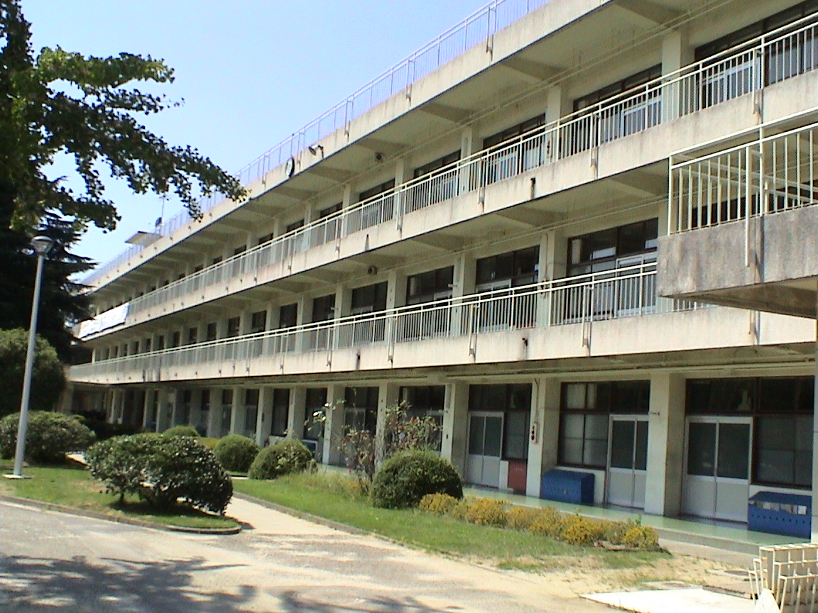
Source of Data

Slide 8
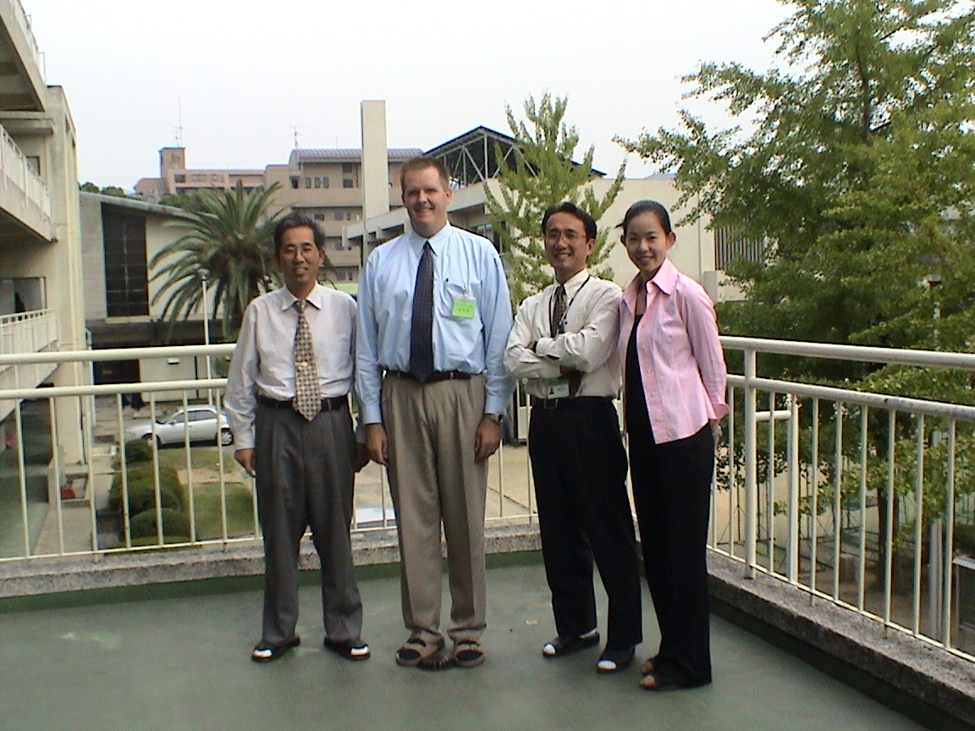
Source of Data

Slide 9
Source of Data
Three cooperating teachers and three student teachers
Each student teacher taught 3 lessons each over 4 weeks.
Each of the three lesson was taught to a different class and for a different cooperating teacher.
Each student teacher met with the cooperating teacher 2-4 times prior to the teaching of the lesson to receive feedback on the lesson plan.
These sessions were video-taped for analysis.
I searched for references to “questions”

Slide 10
Comments related to Questions
Goals
Understanding
Questions build toward
Flow
Task
Anticipate students response to
Anticipate context
Question
Purpose
Wording

Slide 11
Viewpoints Worth Considering
The points these Japanese colleagues make are somewhat different than what we might think about or consider.
We don’t have to mimic the Japanese but their approach to questioning is worth considering.
“The teacher may find many points [of his lesson] which can be improved, and most of such points are not realized by other [observers]. The capable teacher is never satisfied with his lesson, and we can say, he is a capable teacher because he is always seeking for better lesson.” Hiro Ninomiya

