Slide 1



Slide 2
Reflecting on Practice: Making Connections that Support Learning
Unit 2, Session 1
2016

Slide 3
At your tables, go around the table round robin with each person offering a thought about a key idea you found in the reading or something you found surprising.
Without discussion, continue around the table round robin until no one has new ideas to offer.
Then open the table to general thoughts.

Slide 4
What evidence did you find in the readings in support of making connections in learning? What kind of connections?
If their initial understanding is not engaged, they wl learn for test and nothing else.
Example of dart board, where students who came with the information about light refraction were able to do better than others who did not.
In classroom environment, the learning centred approach, you need to pay attention to their background
In geograpy example, connecting not just location but a deeper conceptual framework is needed.
Not just saying connecting to prior knowledge but understanding… the explanation but not just the procedure.
The implication for teaching, you have to confront prior knowledge to tease out the misconceptions… they have to realize there is a conflict in their understanding.
How experts don’t get overtaxed with complex information… they know the important parts to connect.

Slide 5
…continued
In Classroom environment, when you connect with everyday experiences, the child can retrieve and apply the information.
The connection we’re trying to develop can take several years.
Formative assessment – Have the students think visibly about themselves, and peers and teachers.
Learning with understanding… not only learner centred but also content centred instruction … building connections within the content.
Experts & Novices… have organizational structure… promotes idea that the primary job is to have structure.
One of the things in Class Environment, not sufficient to provide the models… you have to actually work with them.
In the understanding versus memorizing… you have to give them enough time to think through .. They need time to process.
The idea of transfer .. Only accessible if students learn for understanding.
In classroom environment, not only chose the right level problem, but you can’t just assume the connections are made.. They have to be explic

Slide 6
How People Learn
1.Teachers must draw out and work with the pre-existing understandings that their students bring with them.
Students come to the classroom with preconceptions about how the world works. If their initial understanding is not engaged, they may fail to grasp the new concepts and information that are taught, or they may learn them for purposes of a test but revert to their preconceptions outside the classroom.
NRC, 2001

Slide 7
How People Learn
2.Teachers must teach some subject matter in depth, providing many examples in which the same concept is at work and providing a firm foundation of factual knowledge.
To develop competence in an area of inquiry, students must: (a) have a deep foundation of factual knowledge, (b) understand facts and ideas in the context of a conceptual framework, and (c) organize knowledge in ways that facilitate retrieval and application.
NRC, 2001

Slide 8
“What is an equation?” examples
In addition to the examples provided by participants, Branca intentionally suggested the following:
2 + 3 = 5
x+ 5 = x + 5
x+ 5 = x + 6
x= y

Slide 9
Examples
“…[use] problems that are moderately similar to each other (as opposed to highly different from each other) to help students look past the surface features of the problems and instead focus on the underlying solution structure. “
(Star, Jon; Foegen, Anne; Larson, Matthew; McCallum, William; Porath, Jane; Zbiek, Rose Mary; Caronongan, Pia; Furgeson, Joshua,; Keating, Betsy; Lyskawa, Julia inTeaching Strategies for Improving Algebra Knowledge in Middle and High School Students, page 34.)

Slide 10
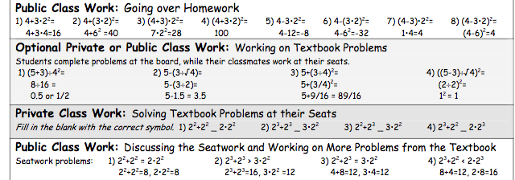
How do these examples help students “look past the surface features of the problems and focus on the underlying solution structure”?

Slide 11
Choosing Examples
Scenarios: Teaching solving linear equations in one variable to students in grade 6 or 7. The goal is to build on student conceptual understanding of arithmetic by posing questions related to missing factors and missing addends, which connects to elementary work in arithmetic.

Slide 12
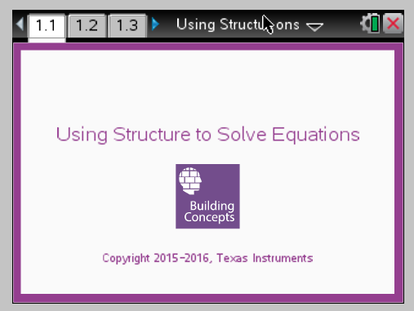
Cover-up Method

Slide 13
Choosing examples
In pairs to decide which of these you would use and or modify to use and why.
2(x+3)= 60;
2x+3 = 60;
2x+6=60;
2(x+6) = 60;
2(x+6) = 50;
2x+6=50

Slide 14
Share Out
WHY were some examples better than others?

Slide 15
Create Your Own Examples
In pairs, choose one of the following contexts and create three examples you want to use to introduce the topic that emphasize the structure of the mathematical idea.
Think about the WHYS on the board. Write your examples on a poster and be ready to explain why those examples are good.
absolute value
exponential equations
logarithms

Slide 16
Choosing examples
Questions to think about when looking at possible examples:
Can you understand the concept trying to introduce through the examples?
Do the examples obey the whys listed on the chart earlier?
Do they offer cognitive dissonance for students so they can sort out the important elements of the math?

Slide 17
Share Out
As a group, select one example you want to share out with the room.
Explain why the sequence creates attention to the structure as a way of thinking about the problem

Slide 18
The Take Away
The selection of examples should not be random but carefully thought about to help students see how to approach a similar but different problem to help them learn the ideas within a conceptual framework.

Slide 19
Readings
Cross, K. P. (1999). Learning is about making connections. The Cross Papers Number 3. League for Innovation in Community College, Educational Testing Service, page 8 cognitive connections to page 11
Hiebert, J., Carpenter, T., Fennema, E., Fuson, D., Murray, H., Olivier, A., & Piet Human. P. (2000). Making Sense: Teaching and Learning Mathematics with Understanding. Heinemann.
National Research Council. How People Learn: Brain, Mind, Experience, and School: Expanded Edition. Washington, DC: The National Academies Press, 2000
National Research Council. How Students Learn: History, Mathematics, and Science in the Classroom. "8 Teaching and Learning Functions." Washington, DC: The National Academies Press, 2005. doi:10.17226/10126

